Slide 1

Tech Society Basic Plan

Slide 2

Installation of the software’s and dependencies
Python v3.8.2
Anaconda
NodeJS
visual studio-code

Slide 3
Setup
In anaconda we select the path variable option while installation.
The program can then be launched either by opening anaconda navigator or by typing “jupyter notebook” on cmd.

Slide 4
The Schedule
The first thing we will do is basics of any programming language. So ill tell datatypes the basic procedure you should follow and more of a theoretical class.
Based on the student's adaptation we will start with python or JavaScript

Slide 5
Python
We will finally be able to sort a large amount of data into a required usable form

Slide 6
JavaScript
We will be able to create our own single page application and website on react native.

Slide 7
DEV development tools by browser
We will have a look at tools offered by the weba nd xhr and http requests

Slide 8
MongoDB and React
Will be used with JavaScript
React is a Facebooks framework for js
MongoDB is a non-SQL database
Some famous SQL databases belong to microsoft

Slide 9
Amazon Web Services Learning
The students will learn to create an IAM user account on aws and then learn buckets and amplify. (The Basics Required For Uploading The Website)
Lambda Function for making Alexa skills

Slide 10
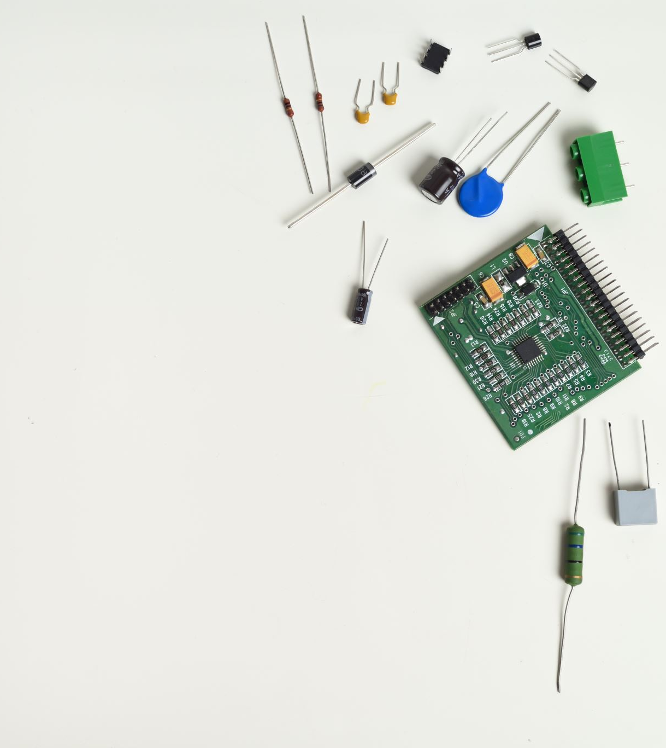
Hardware and iot portion
Can only be done in school, else students won't be able to perform it.
Includes –
Working with raspberry pi
Introduction to various sensors
Drilling will be taught to students
Finally the skill of soldering is taught.

Slide 11
Links
GitHub – here you can see all the programs that we will be doing (https://github.com/info-arnav )
Fill this form for the next classes plan (choose the topics wisely as one language takes approx. 450hours to master) - (https://forms.gle/8csouxgGtiAYRV1M6 )

Slide 12

Thank you

