Slide 1

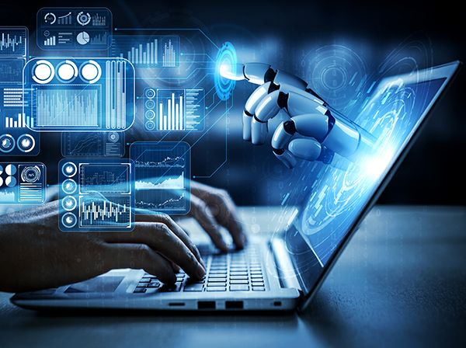
INSTIUTUTE OF TECHNOLOGY , NIRMA UNIVERSITY
HackNUthon 5.0
Track : Open Innovation
Team Ultimate –
Nisarg
Dharan
Kavya
Tapan

Slide 2
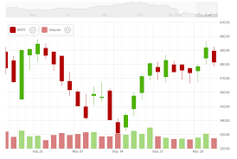
Data SELECTED
PREDICTION OF Activity Done
The Dataset Selected showcases :
1.) HAR (human activity recognition)
2.) BMI
3.) Health Data By smart watch
From KAGGLE.

Slide 3
Tech Used :
Python
Scikit learn
Tkinter GUI
Future Aspects :
Flask
API
WebDev
Sensors ( Hardware )
Deep learning
*All the files are with Github Repo.

Slide 4
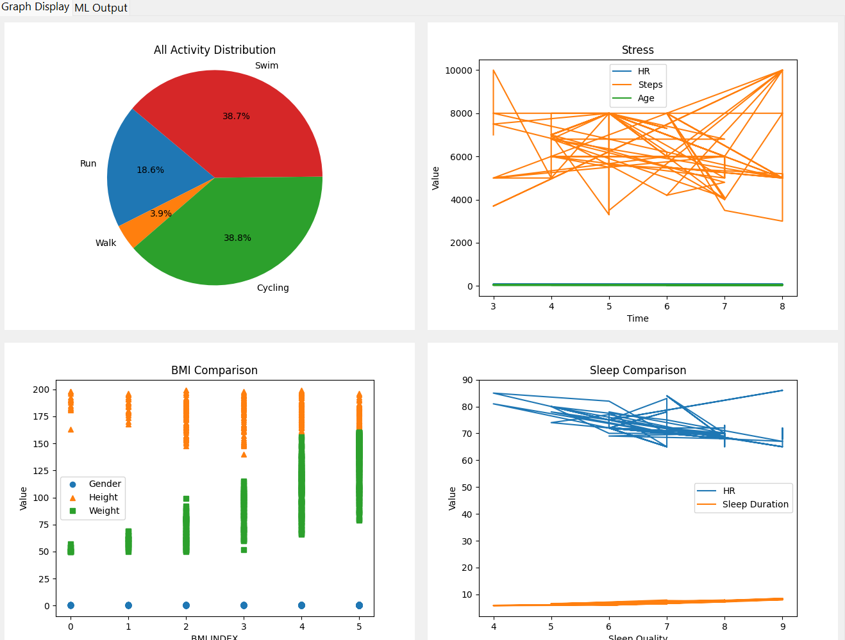
DATA VISUALISATION

Slide 5
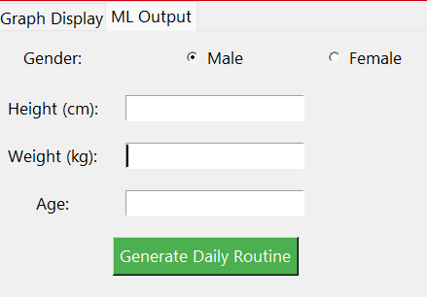
Machine Learning Model

Slide 6
BONUS PROJECT
Adani Ent. Stock Prediction

Slide 7
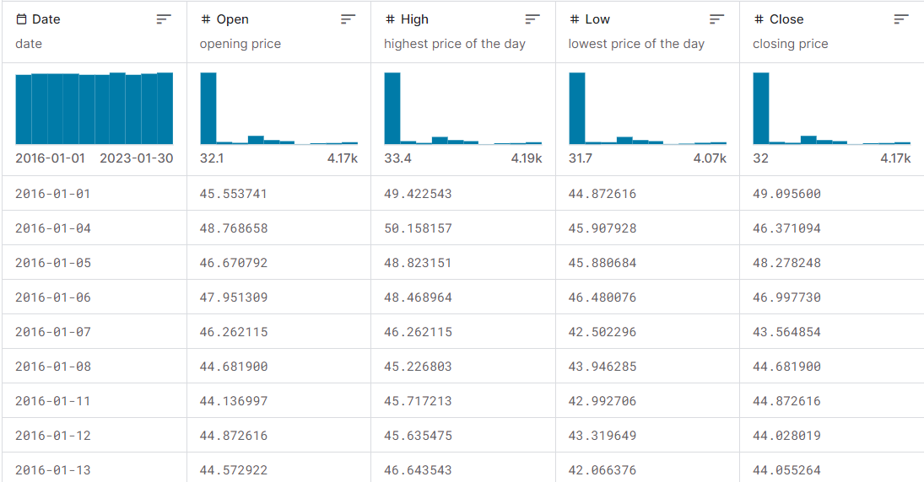
DATAset selected : Adani ENT.

Slide 8
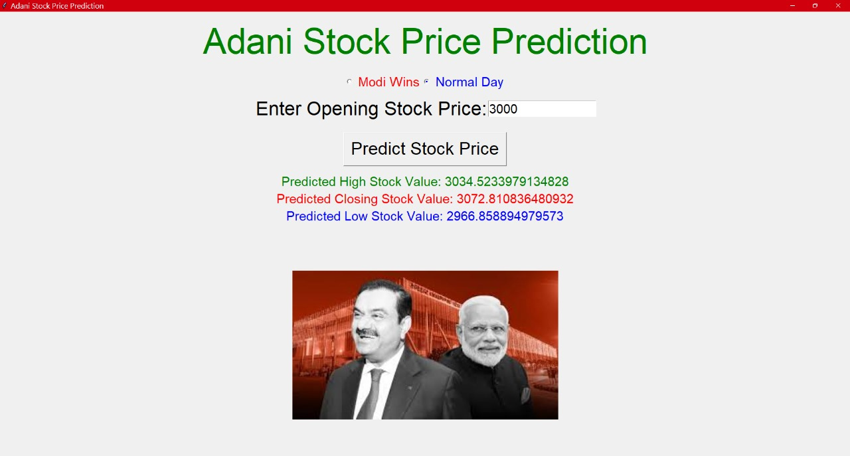
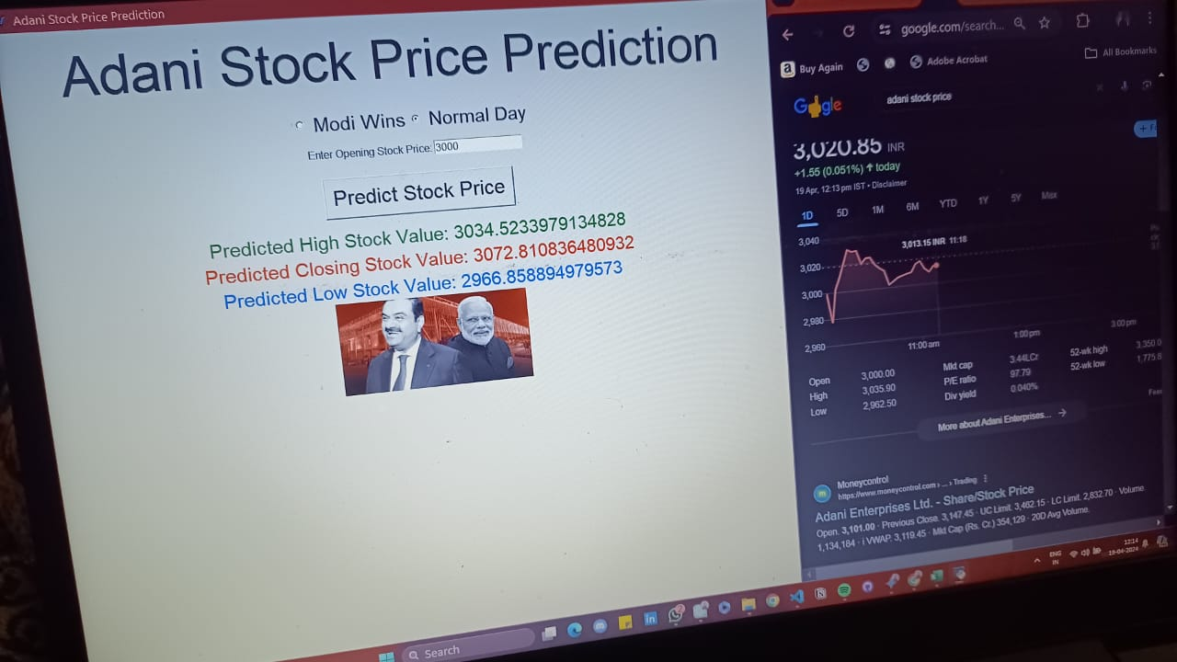
GUI : Tkinter - Python
This ML model created is pretty much accurate .

Slide 9
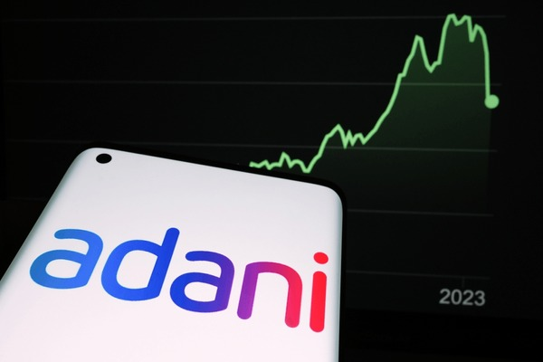
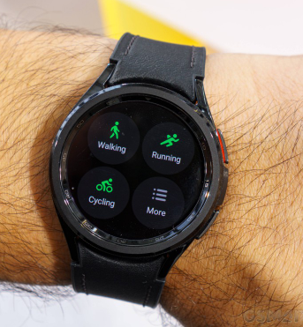
CONCLUSION
first model will predict human activity by providing required sensor data.
second model predicts the closing price adani stock by giving opening price as input with modi factor .

Slide 10
THANK YOU!!

