Slide 1
ZAS Robotics (Motion Kit)
Training

Slide 2
Kit 2 (Motion Kit) Objectives
Review the Contents in the Box
Review & Discuss the Motion Creative Board
Discuss the Health & Safety Precautions, Power Supply and Sensor Modules V/G Pins
Conduct the Following Labs on both the Bread Board and Creative Board
  DC Motor
  Stepper Motor
Conduct the Following Labs on the Creative Board
  DC Motor Encoder – Ticks
  DC Motor Encoder – PID Controller
Discuss the Bread Board of the Creative Board

Slide 3
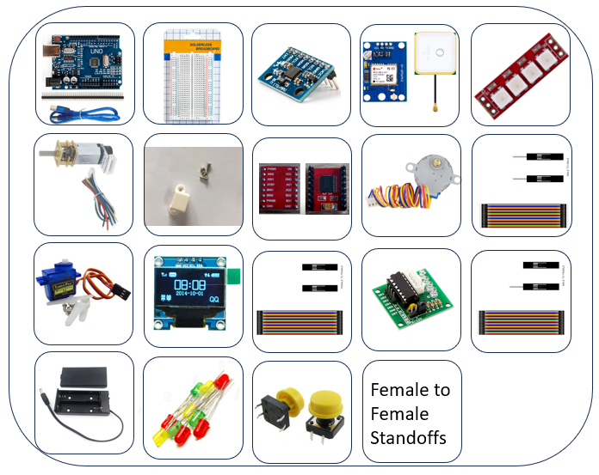
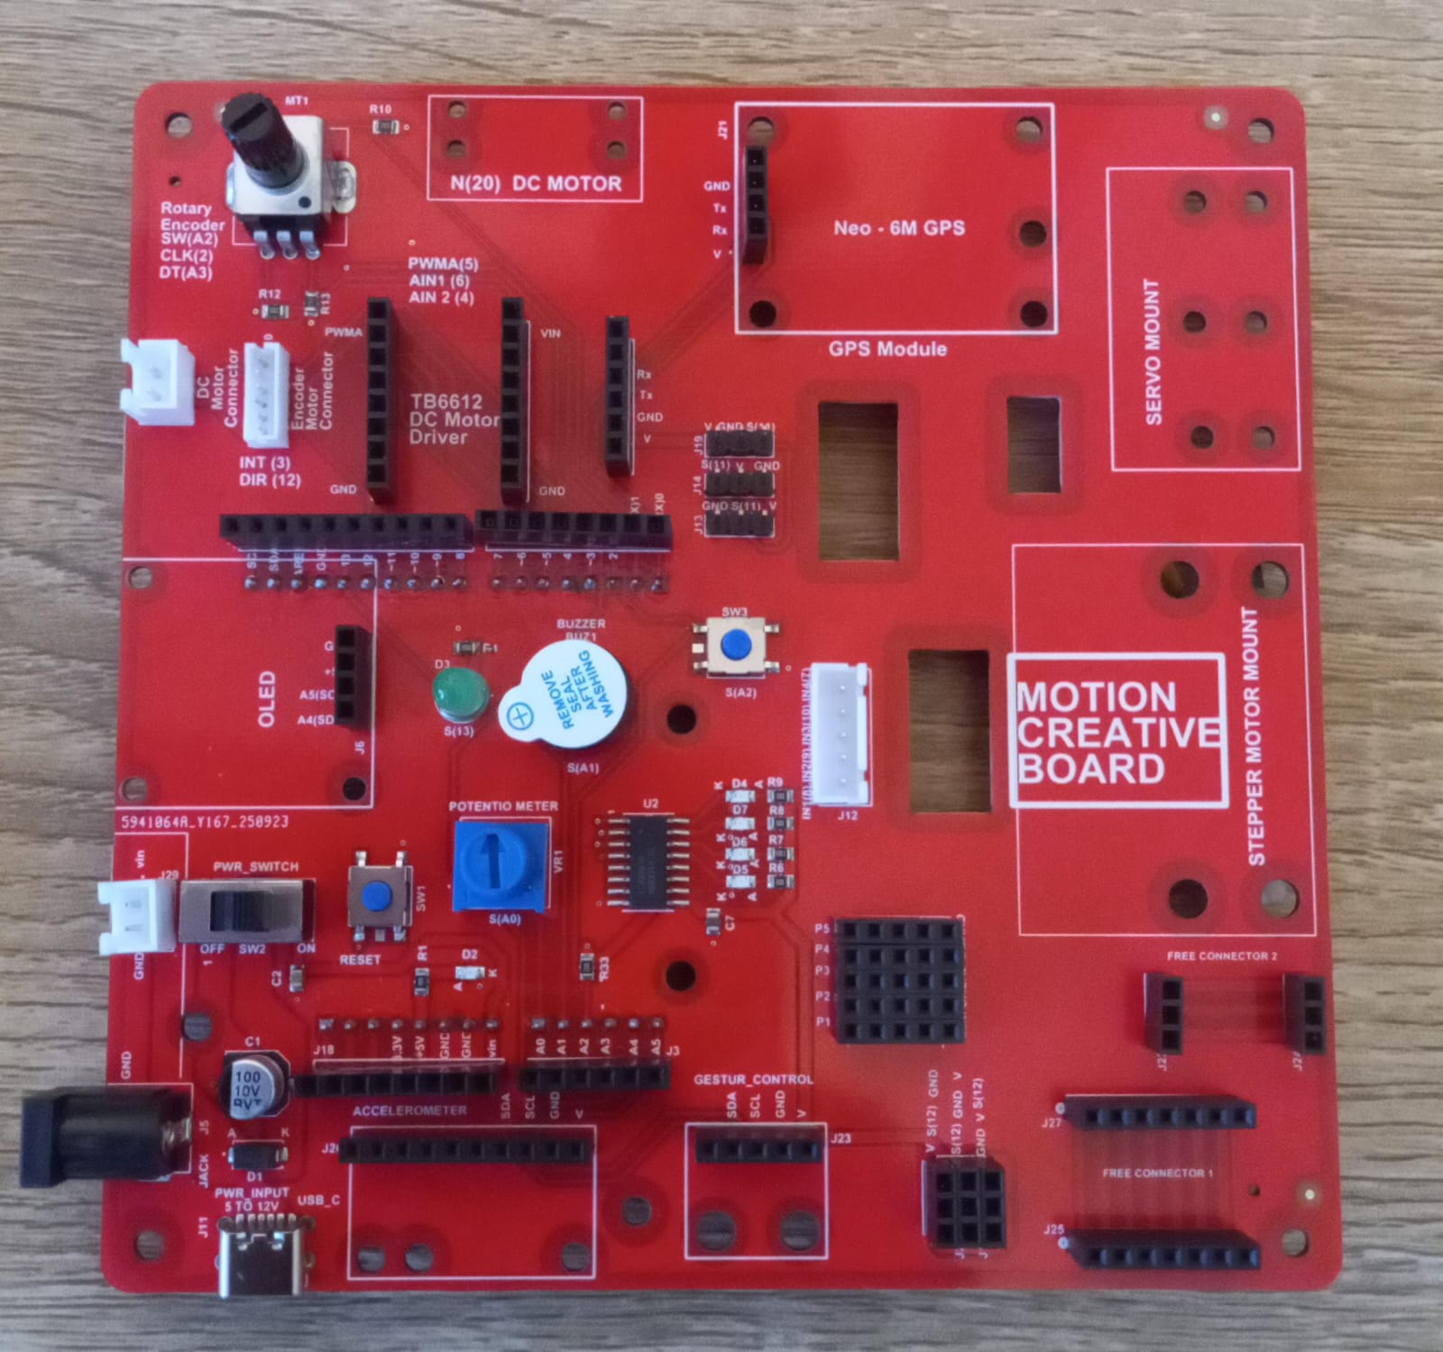
Motion Kit (Contents)
Motion Kit Components
Motion Creative Board

Slide 4
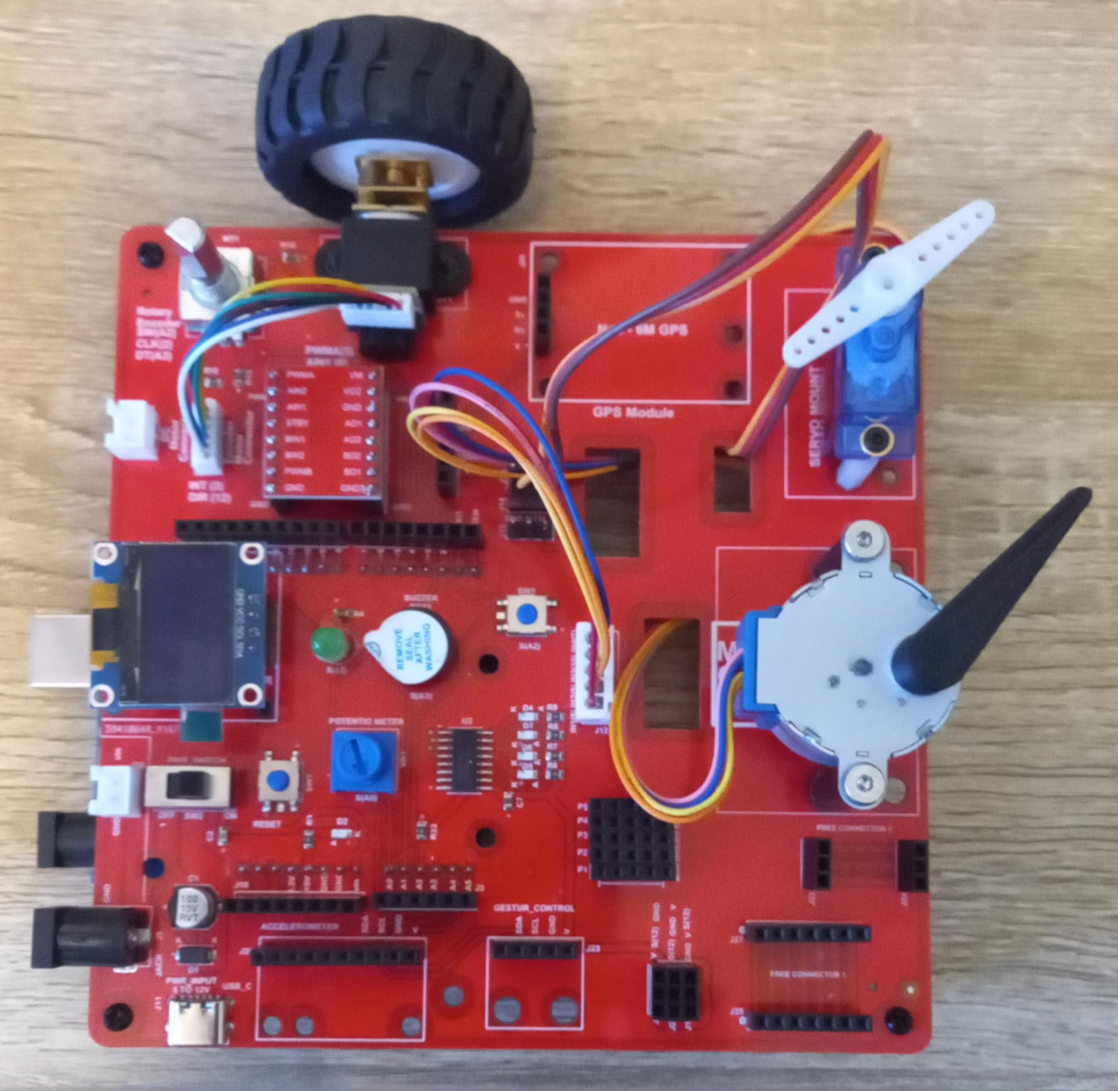
Kit 2 Motion Creative Board
Motion Creative Board – Bare Board
Motion Creative Board – Motors Mounted

Slide 5
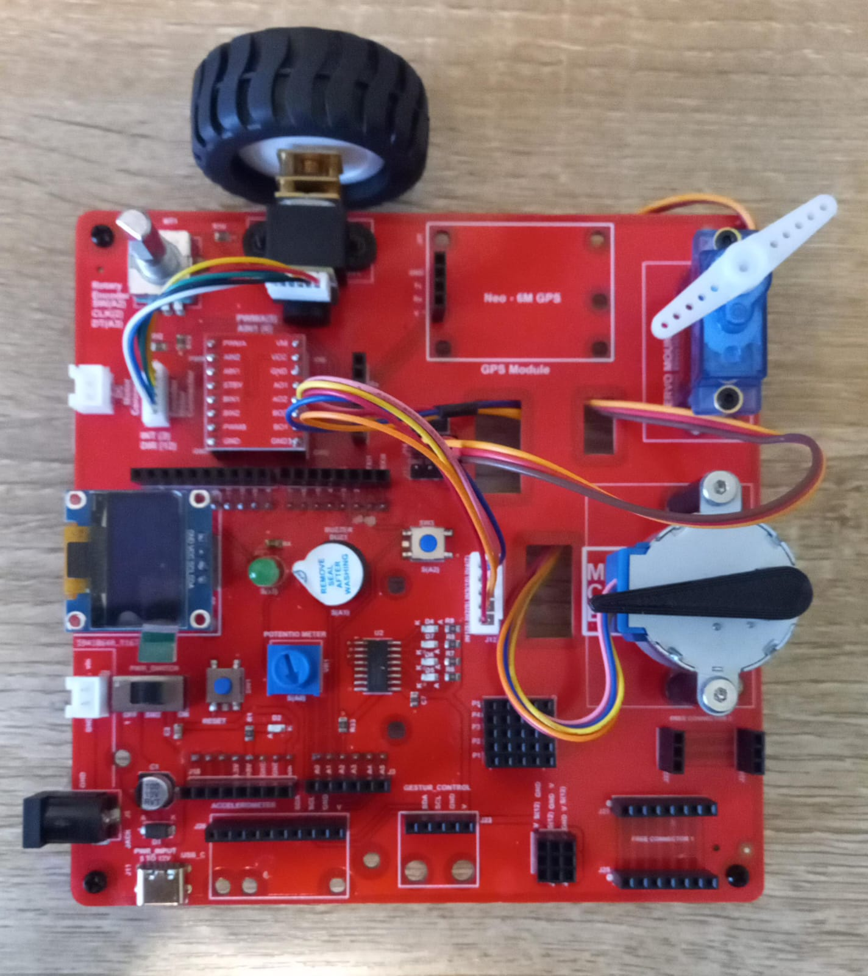























Kit 2 Motion Creative Board - Features
DC/Encoder Motor
GPS Sensor
Servo Motor
Rotary Encoder
Servo Motor Connector
Encoder/DC Motor Connector
Stepper Motor Connector
TB6612 Motor Driver (DC/Encoder Motor Driver)
Stepper Motor
OLED
Stepper Motor Driver
ON/OFF Switch
Mini Breadboard
Power Input Connectors
Free Connectors
Accelerometer
Reset Button
Gesture/I2C Connector
Connector (With Signal 12)

Slide 6
Health & Safety Precautions
Double-check all power connections
Ensure correct GND and VCC wiring for the power supply, OLED, motor drivers, GPS, sensors, and other modules.
Use the correct input voltage
Battery input should be between 5V and 12V only.
Work on a safe surface
Use the kit on an insulated table (e.g., wood) and ensure the surface is dry and clean.
Avoid leaving the kit unattended
Do not keep the system powered on without supervision.
Build and Test Incrementally
Turn on the microcontroller first, then build and test the circuit step-by-step.
Avoid wiring the entire system at once and powering it without intermediate testing.

Slide 7
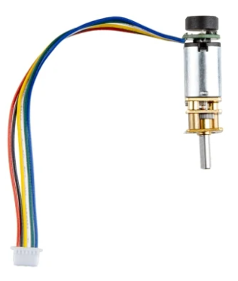
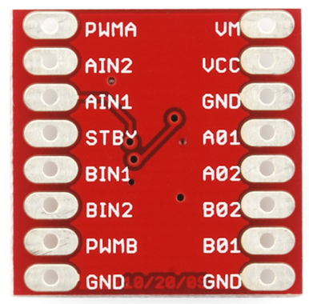
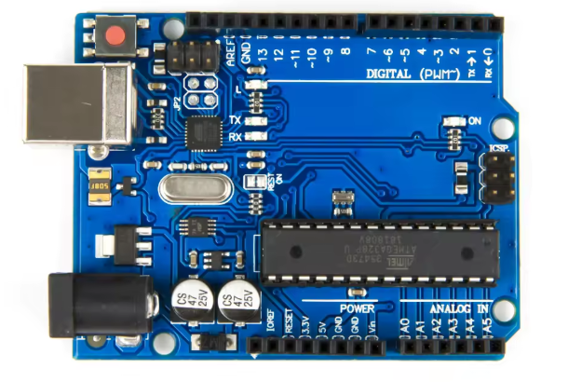
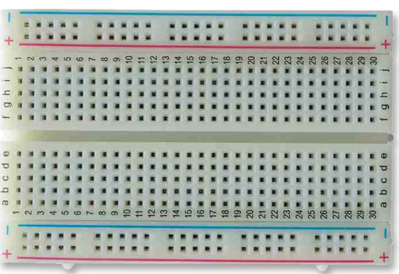
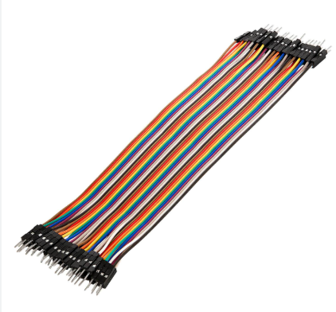
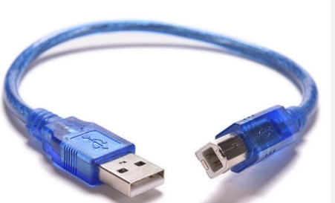
DC Motor - Direction Control - with TB6612 Motor Driver
Things Needed

Slide 8
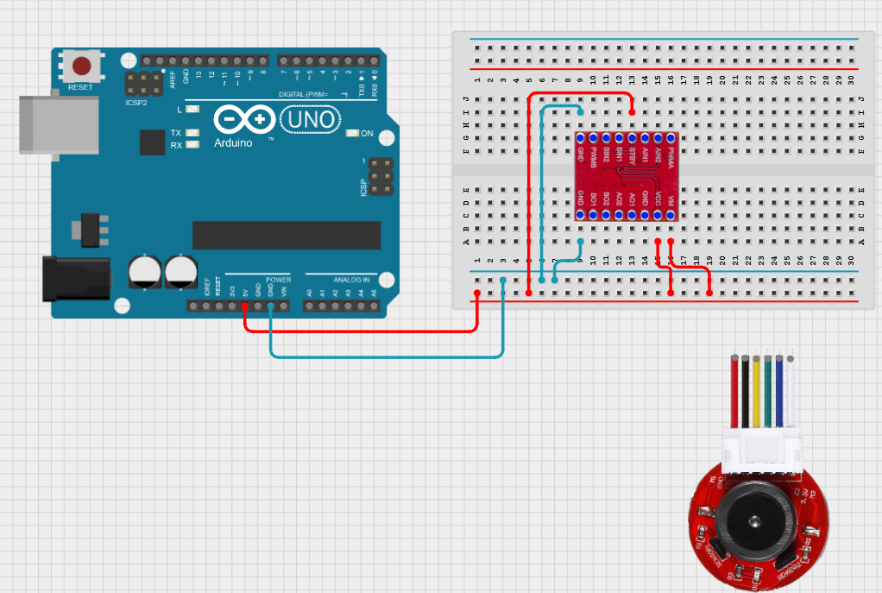

DC Motor - Direction Control - with TB6612 Motor Driver
Power and Ground connections

Slide 9
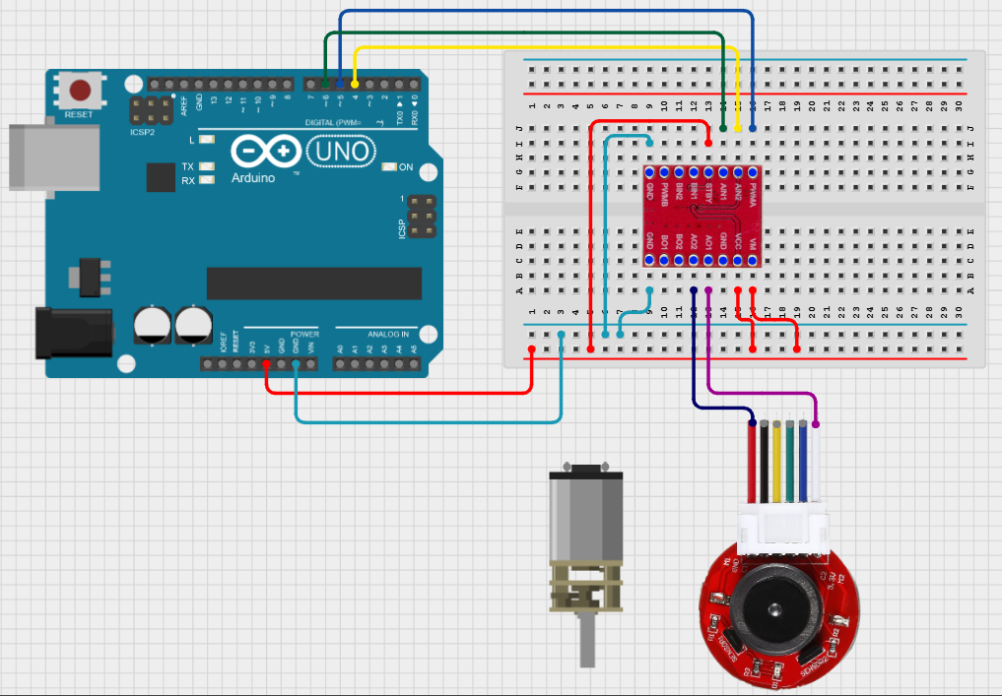
DC Motor - Direction Control - with TB6612 Motor Driver
TB6612 Pins | Arduino UNO Pins
PWMA | 5
AIN2 | 4
AIN1 | 6
TB6612 Pins | DC Motor
AO1 | DC Motor
AO2 | DC Motor

Slide 10
DC Motor - Direction Control - with TB6612 Motor Driver
Code X for the breadboard
https://github.com/info-zas/zas-robotics-motion/blob/main/04_BasicFunctionalTests/00_BasicTests/02_DC_Encoder_Motor_Basic.ino
setup()
• Set motor driver pins as OUTPUT
(PWM pin, Direction pin 1, Direction pin 2)
loop()
• Set motor speed (0–255)
• Run motor forward for 1 second
• Run motor backward for 1 second
forward()
• Set direction pins for forward motion
backward()
• Set direction pins for reverse motion

Slide 11
DC Motor - Direction Control - with TB6612 Motor Driver
Execute the same code in the motion creative board
setup()
• Set motor driver pins as OUTPUT
(PWM pin, Direction pin 1, Direction pin 2)
loop()
• Set motor speed (0–255)
• Run motor forward for 1 second
• Run motor backward for 1 second
forward()
• Set direction pins for forward motion
backward()
• Set direction pins for reverse motion
https://github.com/info-zas/zas-robotics-motion/blob/main/04_BasicFunctionalTests/00_BasicTests/02_DC_Encoder_Motor_Basic.ino

Slide 12
DC Motor - Speed Control - with TB6612 Motor Driver
void setup() {
pinMode(5, OUTPUT); // PWM speed control
pinMode(6, OUTPUT); // Direction pin 1
pinMode(4, OUTPUT); // Direction pin 2
}
void loop() {
analogWrite(5, 255); // Speed (0–255), adjust as needed
forward();
delay(1000);
backward();
delay(1000);
}
// Function to move motor forward
void forward() {
digitalWrite(6, HIGH); // Forward direction
digitalWrite(4, LOW);
}
// Function to move motor backward
void backward() {
digitalWrite(6, LOW); // Reverse direction
digitalWrite(4, HIGH);
}
Execute the code in the motion creative board
Change the value between 0 to 255 to observe the speed changes of DC motor
0,1,3,15,31,63,127,255
https://github.com/info-zas/zas-robotics-motion/blob/main/04_BasicFunctionalTests/00_BasicTests/02_DC_Encoder_Motor_Basic.ino

Slide 13
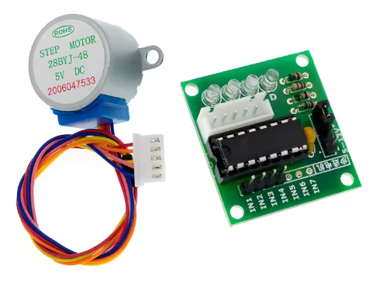
Stepper Motor- Control - with ULN2003
Stepper Motor
28BYJ-48-5V
Stepper Motor Driver Board ULN2003

Slide 14
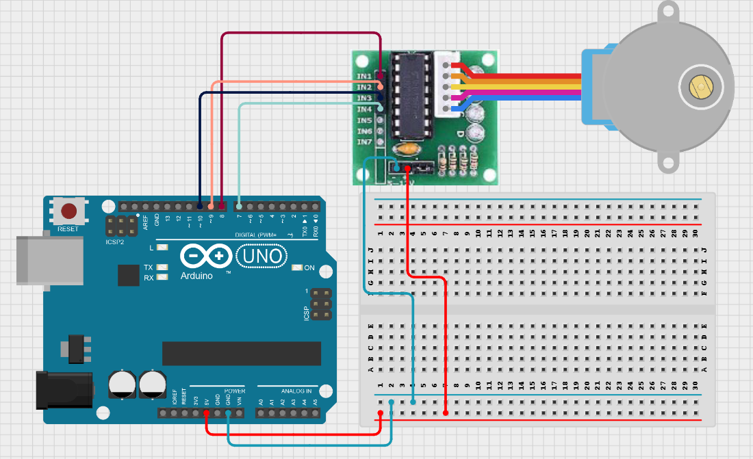
Stepper Motor- Control - with ULN2003
ULN2003 Stepper Motor Pins | Arduino UNO Pins
AIN1 | 8
AIN2 | 9
AIN3 | 10
AIN4 | 7

Slide 15
Stepper Motor- Control - with ULN2003
Code X for the breadboard
setup()
• Set stepper motor speed (RPM)
• Start serial communication
• Print "Stepper Motor Test Start" to serial monitor
loop()
• Print "Clockwise rotation"
• Rotate stepper motor one full turn clockwise
• Wait for 1 second
• Print "Counterclockwise rotation"
• Rotate stepper motor one full turn counterclockwise
• Wait for 1 second
https://github.com/info-zas/zas-robotics-motion/blob/main/04_BasicFunctionalTests/00_BasicTests/08_Stepper_Motor_Control.ino

Slide 16
Stepper Motor- Control - with ULN2003
Execute the same code in the motion creative board
https://github.com/info-zas/zas-robotics-motion/blob/main/04_BasicFunctionalTests/00_BasicTests/08_Stepper_Motor_Control.ino

Slide 17
Encoder Motor – Target Ticks – Manual Control
setup()
• Set ENCA pin as INPUT
• Set DIR pin as INPUT
• Attach interrupt to ENCA on RISING edge to call readEncoder()
• Initialize OLED display at I2C address 0x3C
• Display "Ready..." message on OLED
loop()
• Safely copy encoder tick count and direction using noInterrupts()
• Clear OLED display
• Show "Ticks" and tick count
• Show "Dir" and direction (CW or CCW)
• Refresh OLED and wait 200 ms
readEncoder()
• Read DIR pin
• If HIGH, increment encoderTicks and set lastDirection = 1 (CW)
• If LOW, decrement encoderTicks and set lastDirection = -1 (CCW)
https://github.com/info-zas/zas-robotics-motion/blob/main/04_BasicFunctionalTests/00_BasicTests/06_EncoderTicksByHand.ino

Slide 18
Encoder Motor – Target Ticks – PID Controller
setup()
• Set motor driver pins (PWM, AIN1, AIN2) as OUTPUT
• Set ENCA pin as INPUT_PULLUP
• Attach interrupt to ENCA (RISING) to track encoder ticks
• Initialize OLED display at address 0x3C
• Display "PID Start" message on OLED
loop()
• Safely copy encoderTicks using noInterrupts()
• Calculate error = targetTicks – ticks
• If error is within tolerance:
- Stop motor (PWM = 0, AIN1 & AIN2 LOW)
• Else:
- Compute PID terms: proportional, integral, derivative
- Calculate output speed (PWM), constrain between minPWM and maxPWM
- Set direction (CW), apply PWM to motor
- Update previousError and lastTime
• Clear OLED
• Display ticks and error value
• Wait 100 ms
readEncoder()
• Increment encoderTicks every time ENCA rises
https://github.com/info-zas/zas-robotics-motion/blob/main/04_BasicFunctionalTests/00_BasicTests/07_EncoderMotor_Target_Ticks_PID_Controller.ino

Slide 19
Summary
Previously:
We explored the Sensor Kit, the first kit in the ZAS Robotics Foundational Series.
Present Session:
We covered the second kit in the series — the Motion Kit, focusing on how robots move and navigate.
Key Topics Covered / Demoed:
Controlling DC Motors using the TB6612 motor driver
Controlling Stepper Motors using the ULN2003 driver
Working with Encoder Motors with PID Control
Next Session:
We will explore the final kit in the ZAS Robotics Foundational Series — the Communication Kit.

Slide 20
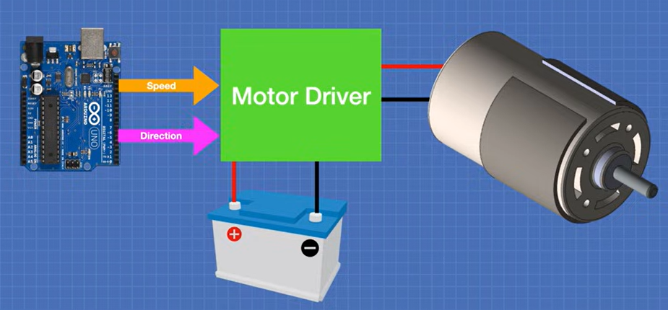
DC Motor - Direction Control - with TB6612 Motor Driver
DC Motor Control using TB6612FNG – Understanding the Role of a Motor Driver
Why a Microcontroller Alone Can’t Drive a Motor?
Microcontrollers (like Arduino) can only source or sink limited current (≈20–40 mA per I/O pin).
DC motors, however, require significantly higher current (hundreds of mA to several Amps) and often operate at voltages different from logic levels (3.3V / 5V).
Connecting a motor directly to the microcontroller would result in voltage drops, pin damage, or MCU failure.
Solution — Motor Driver (TB6612FNG):
Acts as a power interface between the low-power control circuit and high-power actuator.
Uses H-Bridge configuration to allow bidirectional control (CW / CCW).
Supports PWM-based speed control.
Provides current amplification and electrical isolation between logic and load.

