Slide 1

Navigational Robotics Series
Robot Car-2 (Communications)
Training Slides

Slide 2

Navigational Robot Car-2 (Communications)
Review the Contents in the Box
Review & Discuss the Motor Controller Board, Assembly, Power Supply etc.
Discuss the Health & Safety Precautions
Practice the Following Lab
  Initial Setup - Car Basic Movements
  Explore the Remote Control Device: Joystick, Accelerometer & Buttons etc.
Review the Features:
  Gesture Sensor, Bluetooth and IR
  Free Connectors & Breadboard

Slide 3
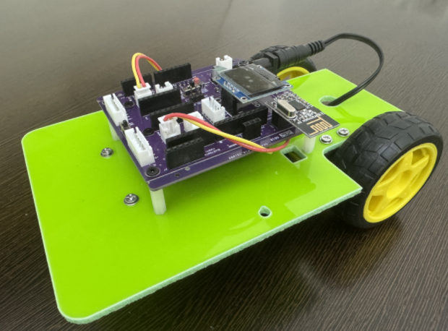
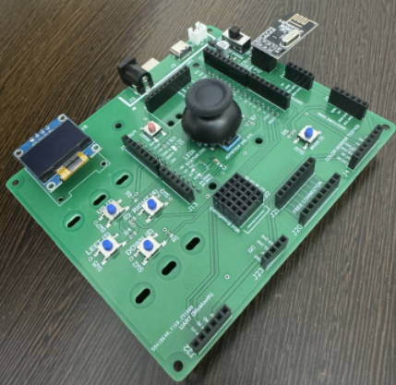
Navigational Robot Car-2 (Communications)
Parts & Components
Arduino Uno
TT DC Motors
TB6612 Motor Driver
OLED
NRF24L01 (Trans/Receiver)
Bluetooth
IR Remote Receiver
Battery Case
Batteries
Battery Charger

Slide 4
Navigational Robot Car-2 (Communications)
Where CAR-2 Fits in Your Learning Path
CAR-1 (Autonomous Robot – Sensors)
  Thinks and drives by itself
  Uses IR, Ultrasonic, Line, Pit sensors
  Has many intelligence modes
  Focus: Autonomous navigation + sensor logic
CAR-2 (Wireless Communications)
  Works like an RC car
  Controlled remotely (up/down/left/right)
  Uses NRF24L01 wireless module
  Also Bluetooth, IR Remote Receiver
  Shows status on OLED screen
  Focus: Communication systems + control architecture
  Applications: SLAM/Manual Remote Control during Initial Stages of RL
Why You Need Both
  CAR-1 teaches Robot Intelligence
  CAR-2 teaches Wireless Control & Real-Time Feedback

Slide 5
Health & Safety

Slide 6
Health & Safety
Double-check all power connections.
Ensure correct GND and VCC wiring for the power supply, OLED, motor drivers, GPS, sensors, and other modules.
Use the correct input voltage
Battery input should be between 5V and 12V only.
Work on a safe surface
Use the kit on an insulated table (e.g., wood) and ensure the surface is dry and clean.
Avoid leaving the kit unattended
Do not keep the system powered on without supervision.
Build and Test Incrementally
Turn on the microcontroller first, then build and test the circuit step-by-step.
Avoid wiring the entire system at once and powering it without intermediate testing.
Don’t leave Batteries charging unattended
Robotic car is for in-door use only
Always follow 4-eyes principle when it comes to checking VCC & GND

Slide 7
Motor Driver

Slide 8
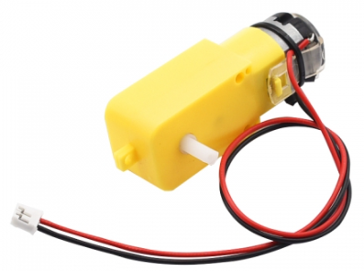
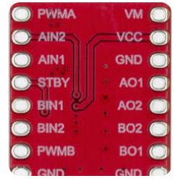
Navigational Robot Car-2 (Communications)
TT Motor Driver
TB 6612 Motor Driver
Series: TT DC
Speed: 130 RPM
Voltage: 6V

Slide 9
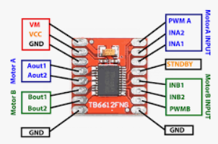
Navigational Robot Car-3
PIN Details - TB6612 Motor Driver and TT Motor
Left Motor
A-IN1 – Arduino Nano 3
A-IN2 – Arduino Nano 4
PWMA – Arduino Nano 5
Right Motor
B-IN1 – Arduino Nano 8
B-IN2 – Arduino Nano 7
PWMB – Arduino Nano 6

Slide 10
Test Basic Movement

Slide 11
Initial Setup - Test Basic Movements
The purpose of this exercise is to test basic movements of the robot car
Also to ensure, your program is using the correct allocated PINs for Motor Inputs (IN1/IN2)
The Program has the following 3 major functional blocks
Pins declaration
  Ensure correct pins are defined (see sample program)
B. Setup:
input/outputs
C. Loop:
In the loop the car drives forward/left/right

Slide 12
Initial Setup - Test Basic Movements
// ============== Pin Definitions ==========
// Left Motor
#define IN2_L 3
#define IN1_L 4
// Right Motor
#define IN2_R 7
#define IN1_R 8
Please test each direction in isolation
  Forward
  Backward
  Left
  Right
If incorrect direction, then swap IN1/IN2 pins of the corresponding motor
Expected Output: The car moves in the desired direction

Slide 13
Remote Setup for: Joystick, Accelerometer and Buttons

Slide 14
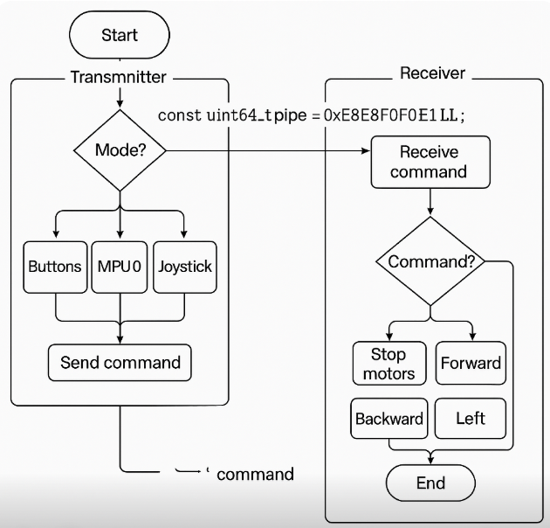
Navigational Robot Car-2 (Communications)
Receiver (Car)
Listens for wireless commands using NRF24L01 on a matching pipe address.
Converts received strings into motor actions (forward, reverse, left, right).
Defaults to stop if command is unknown or no signal is received.
Transmitter (Handheld Controller)
Switches between 3 control modes: Button, MPU tilt, and Joystick.
Reads input and sends: directional commands ("up", "down", "left", "right") via NRF24L01.
Displays current mode and action on the OLED screen.
Note:
Ensure both the receiver/transmitter have the identical Device Address

Slide 15
Navigational Robot Car-2 (Communications)
Application Opportunities
The remote control logic learned here is useful to generate Global MAP for SLAM algorithms
The remote control of robots during initial stages of Reinforcement Learning
To generate the test data for Imitation Learning
To perform a tangle-free calibration of the IMU sensors.
IOT/Remote Control/Monitoring/Inspection

Slide 16
Discuss the Free Connectors, Gesture Sensor for Enhancements

Slide 17
Navigational Robot Car-2 (Communications)
Other Features Discussion
Gesture Control Sensor
Bluetooth
IR Receiver
Free Connectors & Its Uses
Breadboard Extension

