Slide 1



ZAS Robotic Products
Familiarisation Training to Faculty
Training Schedule
(5th and 6th Dec 2025)

Slide 2
Faculty Training Agenda
Day-1
9 AM
10 AM
12 AM
1 PM
3 PM
5 PM
Introductions
Brief Talk
Sensors
Lunch
Motion
Communications
Day-2
9 AM
9.30 AM
12 AM
1 PM
3 PM
5 PM
Re-cap
Robotic Car-1
(Sensors)
Lunch
Robotic Car-2
(Comms.)
Robotic Car-3
(Encoders/IMU/GPS)

Slide 3
Design Philosophy
(Day-1: 9 AM to 10 AM)

Slide 4
Design Philosophy
In Robotics, true understanding is achieved not through theory, but through practical application

Slide 5
Doing Robotics - Challenges
Common Issues:
  Finding & Sourcing Challenges;
  Incomplete & Unreliable
  Incompatible Issues as Complexity Increases
  Advanced Robotics – Import Tariffs
  Black Box Products
  Unstructured
  Documentation & Support Almost Non-Existent
Consequences of the Above Issues:
  Learning Remains Shallow
  Giving-up
  Challenging Projects are Not Executed
  Missed Career Opportunities

Slide 6
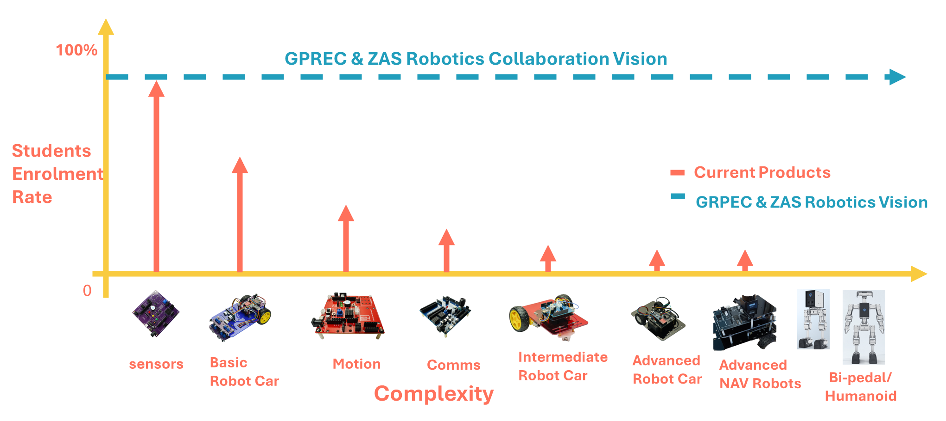
Doing Robotics - Challenges

Slide 7
Design Philosophy: Building for Mastery
Removed all Obstacles: Addressed all electrical, mechanical & power supply issues
Prioritize Deep Understanding: Deconstruct systems rather than relying on 'Black Box' or pre-packaged solutions.
Maximize Resource Efficiency: Develop projects using reusable and adaptable components across different prototypes.
Master Modular Design: Learn system configuration by actively adding, replacing, and integrating individual components.
Bridge Theory to Application: Solidify foundational concepts by rapidly moving from theory to practical implementation.
Ensure Accessible Innovation: Maintain low-cost, high-impact projects to make learning widely accessible.

Slide 8
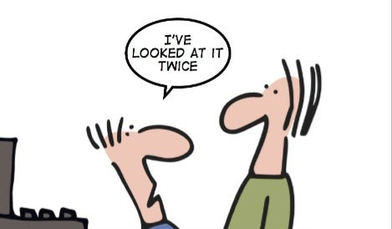
Design Philosophy
Mandatory Lab Protocol
Strict Adherence to Safety: Uphold all health and safety procedures, regardless of the perceived low voltage or current of the equipment.
Implement the 'Four-Eyes Principle': Before engaging battery power, ensure critical system checks are independently verified by a second person.
Always follow 4-eyes principle when it comes to checking VCC & GND
Otherwise, you risk of damaging components

Slide 9
Design Philosophy
Products Series
Foundational Products
Sensors
Motion
Communications
Navigational Robots
Robot Car-1
(Sensors)
Robot Car-2
(Comms.)
Robot Car-3
(Encoders/GPS/IMU)

Slide 10
Design Philosophy
Each Product
Foundational
(15 Lessons/Labs)
Take Home
Projects
Capstone
Projects
Staff Responsibility
Students Initiative/Responsibility
Foundational Lessons/Labs
Staff would introduce the lab lesson, give a demo
Students follow the instructions and conduct the experiment under the supervision of staff

Slide 11
Design Philosophy
Avoid Blackbox Approach to Lay Firm Foundations
Sensors
Conduct all 15 lessons/labs on both the Bread Board and Creative Board
Motion
Conduct DC Motor & Stepper Motor labs on a Bread Board and Creative Board
Remaining Lessons/Labs on the Creative Board
Communications
Conduct NRF & LoRa labs on a Bread Board and Creative Board
Remaining Lessons/Labs on the Creative Board

Slide 12
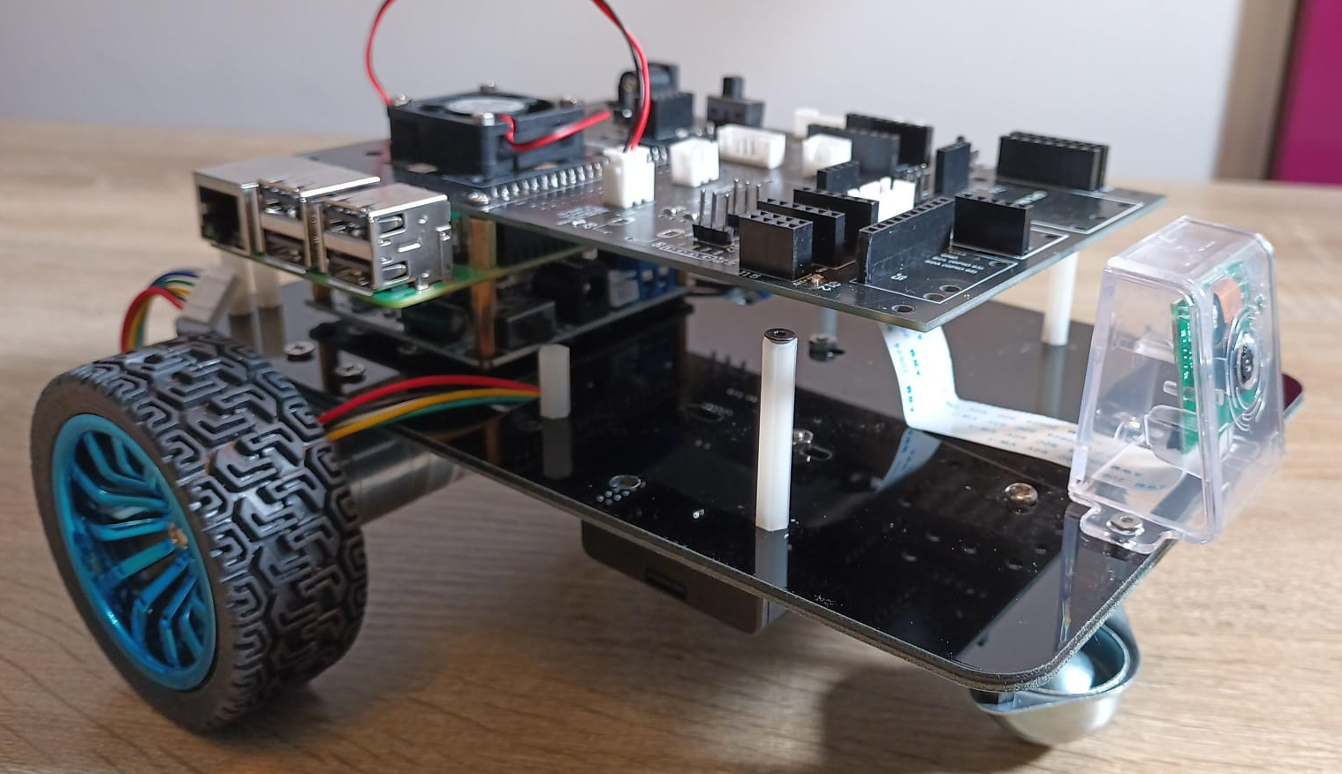
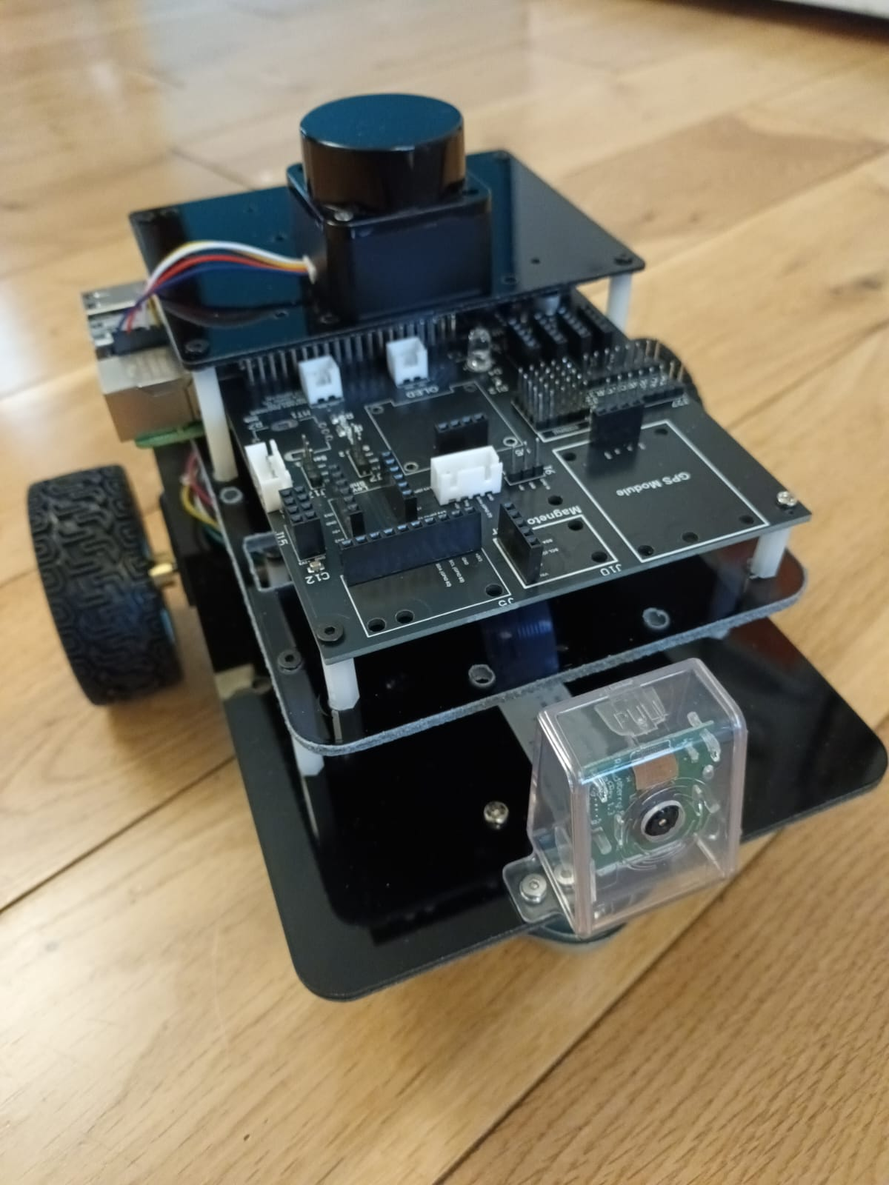
Upcoming Products
Car-5: Raspberry PI/Camera/LIDAR
with ROS2 Interface
Car-4: Raspberry PI/Camera/LIDAR
Raspberry PI
LIDAR
Camera
ROS2 Interface Board
Deep Learning & Reinforcement Learning
DC 371 Series Precision Encoder Motors
Dedicated Power Supply for PI & Motors
Timeline – Q1 2026

Slide 13
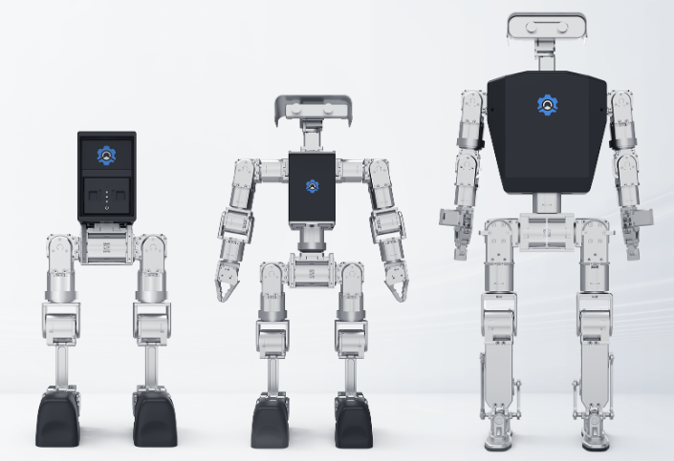
Upcoming Products
Timeline – 2026-27
Import makes the product twice the price

Slide 14
Upcoming Workshops
Sensor Fusion – December 2025
Phase-1: Reinforcement Learning – Q1/2026
Advanced PID Controllers – Q1/2026
SLAM – Q2/2026
Phase-2: Reinforcement Learning – Q3/2026

Slide 15
Tools Recommended
Name (Tool/Hardware) | Specifications | Description
Screws | M2/M2.5/M3 | Length: 6mm, 8mm and 10mm
Washers & Nuts | M2/M2.5/M3 | Nylon and/or metal
Standoffs | M2/M2.5/M3 | Length: 10mm, 12mm, 20mm, 25mm, and 30mm
Screw Drivers | M2/M2.5/M3 | Hex, Philips, Flat Head
Jumper Cables | Dupont, JST | Stock of cables
Multimeter | Digital
Soldering Station | - | Weller or Hacko brand
Plastic Containers | - | For organising the components, PCB Boards etc.
Inventory List | - | Due to small components highly recommended to keep a strict registry of components
Magnifying Lens | - | To read small prints on PCBs & Components
Batteries & Battery Charger | - | Large storage and large capacity chargers
Cutting pliers, scissors, etc. | -

Slide 16
Routine Restock
Look out for new types of sensors & purchase them to extend the AI & Robotics lab capabilities
Replace/restock damaged sensors at regular intervals

Slide 17
Sensors
(Day-1: 10 AM to 12 PM)

Slide 18
Sensors
Review the Contents in the Box
Review & Discuss the Sensors Creative Board
Discuss the Health & Safety Precautions, Power Supply and Sensor Modules V/G Pins
Conduct the Following Labs on both the Bread Board and Creative Board
  OLED
  Ultrasonic Sensor
Discuss the Bread Board feature of the Creative Board
Discuss the Free Connector Concept of Creative Board
Conduct the Following Lab on the Bread Board feature of the Creative Board
  Gas Sensor
  OLED

Slide 19
Motion
(Day-1: 1 PM to 3 PM)

Slide 20
Motion
Review the Contents in the Box
Review & Discuss the Motion Creative Board
Discuss the Health & Safety Precautions, Power Supply and Sensor Modules V/G Pins
Conduct the Following Labs on both the Bread Board and Creative Board
  DC Motor
Conduct the Following Labs on the Creative Board
  DC Motor Encoder – Ticks
  DC Motor Encoder – PID Controller
Discuss the Bread Board feature of the Creative Board & Free Connector

Slide 21
Communications
(Day-1: 3 PM to 5 PM)

Slide 22
Communications
Review the Contents in the Box
Review & Discuss the Communication Creative Board
Discuss the Health & Safety Precautions
Conduct the Following Labs on both the Bread Board and Creative Board
  RFID
Conduct the Following Labs on the Creative Board
  NRF24L01
Discuss the SD Card module and practice memory card insertion/removal/formatting
Discuss the Bread Board of the Creative Board

Slide 23
Robot Car-1
(Day-2: 9.30 AM to 12 PM)

Slide 24
Navigational Robot Car-1
Review the Contents in the Box
Review & Discuss the Motor Controller Board, Assembly, Power Supply etc.
Discuss the Health & Safety Precautions
Practice the Following Lab
  Car Basic Movements; how to correct directions (by swapping the pins)
Practice the IR Sensor Calibration
Practice the Edge or IR Obstacle Mode

Slide 25
Robot Car-2
(Day-2: 1 PM to 3 PM)

Slide 26
Navigational Robot Car-2
Review the Contents in the Box
Review & Discuss the Motor Controller Board, Assembly, Power Supply etc.
Discuss the Health & Safety Precautions
Practice the Following Lab
  Car Basic Movements; how to correct directions (by swapping the pins)
Practice the Remote Setup for: Joystick, Accelerometer and Buttons
Discuss the Free Connectors, Gesture Sensor for Enhancements

Slide 27
Robot Car-3
(Day-2: 3 PM to 5 PM)

Slide 28
Navigational Robot Car-3
Review the Contents in the Box
Review & Discuss the Motor Controller Board, Assembly, Power Supply etc.
Discuss the Health & Safety Precautions
Practice the Following Lab
  Car Basic Movements; how to correct directions (by swapping the pins)
  Constant Speed via PID Controller
  Read & Display – GPS (Discuss the importance of removing GPS module while uploading)
  Read & Display – Digital Compass Bearing

Slide 29
Q&A

