Slide 1
ZAS Robotics (Communication Kit)
Training

Slide 2
Communications
Review the Contents in the Box
Review & Discuss the Communication Creative Board
Discuss the Health & Safety Precautions
Conduct the Following Labs on Creative Board
  Lab C1 - RFID
Conduct the Following Labs on the Creative Board
  Lab C2 – Wireless Communication between Tx and Rx Using NRF24L01
Discuss the Lab C3 - SD Card module and practice memory card insertion/removal/formatting
Discuss the Bread Board of the Creative Board

Slide 3


Communication Kit (Contents)
Communication Kit Components
Communication Creative Board

Slide 4
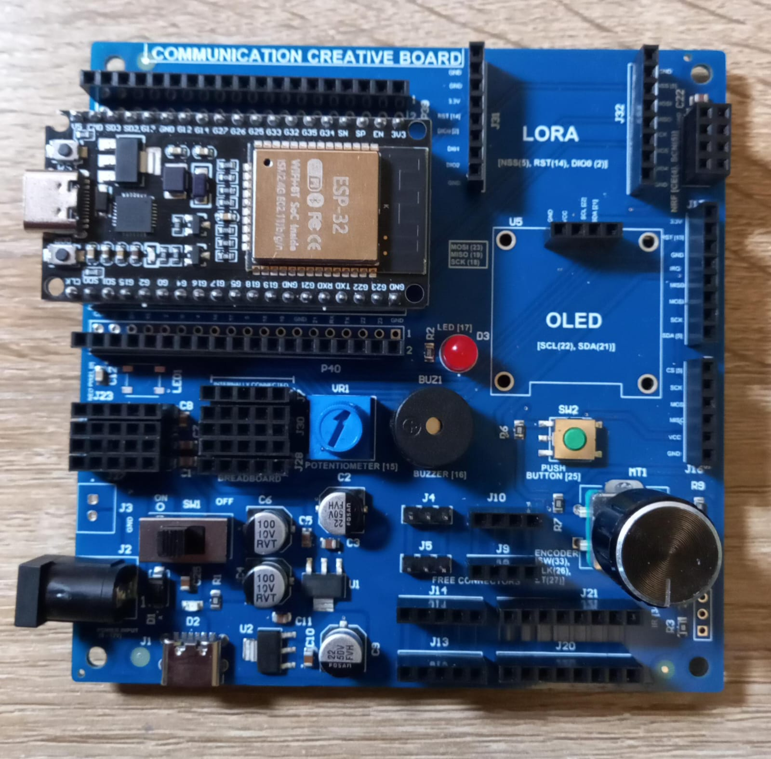
Communication Creative Board
Communication Creative Board – Bare Board
Communication Creative Board – ESP32 Mounted

Slide 5
Kit 3 Communication Creative Board - Features

Slide 6
Health & Safety Precautions
Double-check all power connections
Ensure correct GND and VCC wiring for the power supply, OLED, motor drivers, GPS, sensors, and other modules.
Use the correct input voltage
Battery input should be between 5V and 12V only.
Work on a safe surface
Use the kit on an insulated table (e.g., wood) and ensure the surface is dry and clean.
Avoid leaving the kit unattended
Do not keep the system powered on without supervision.
Build and Test Incrementally
Turn on the microcontroller first, then build and test the circuit step-by-step.
Avoid wiring the entire system at once and powering it without intermediate testing.

Slide 7
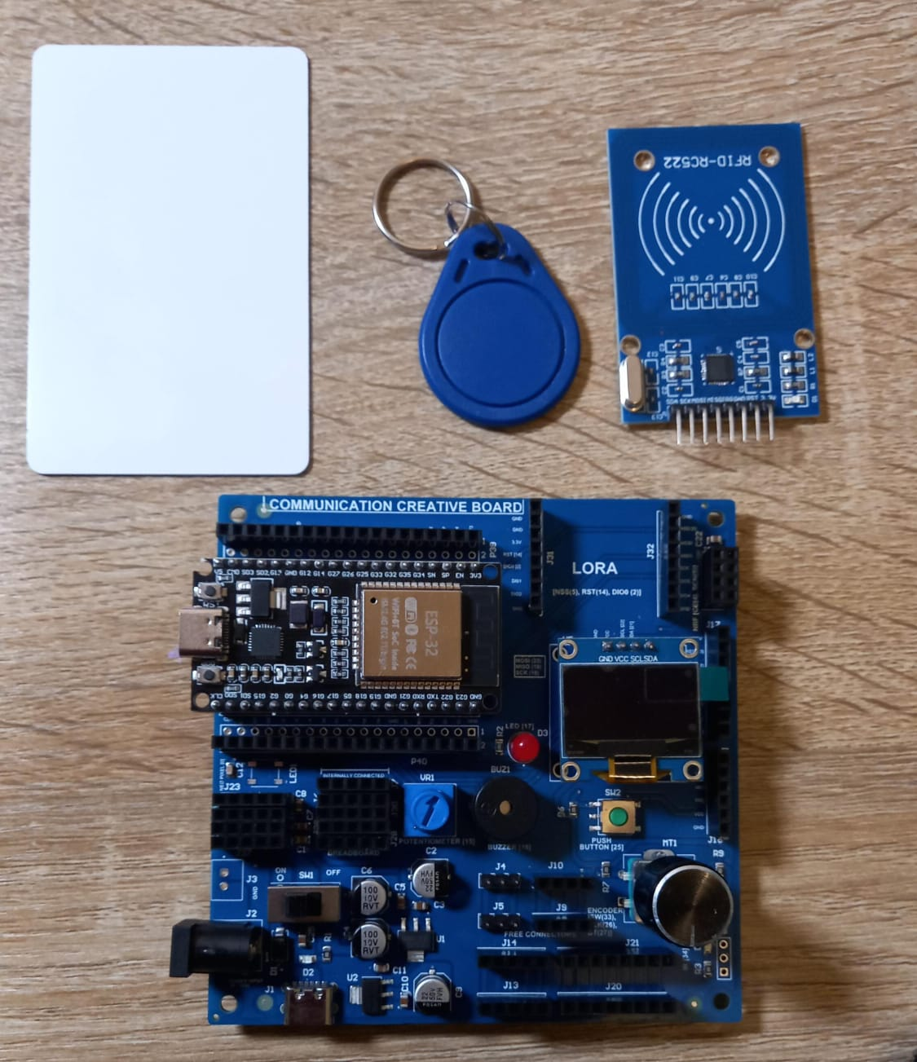
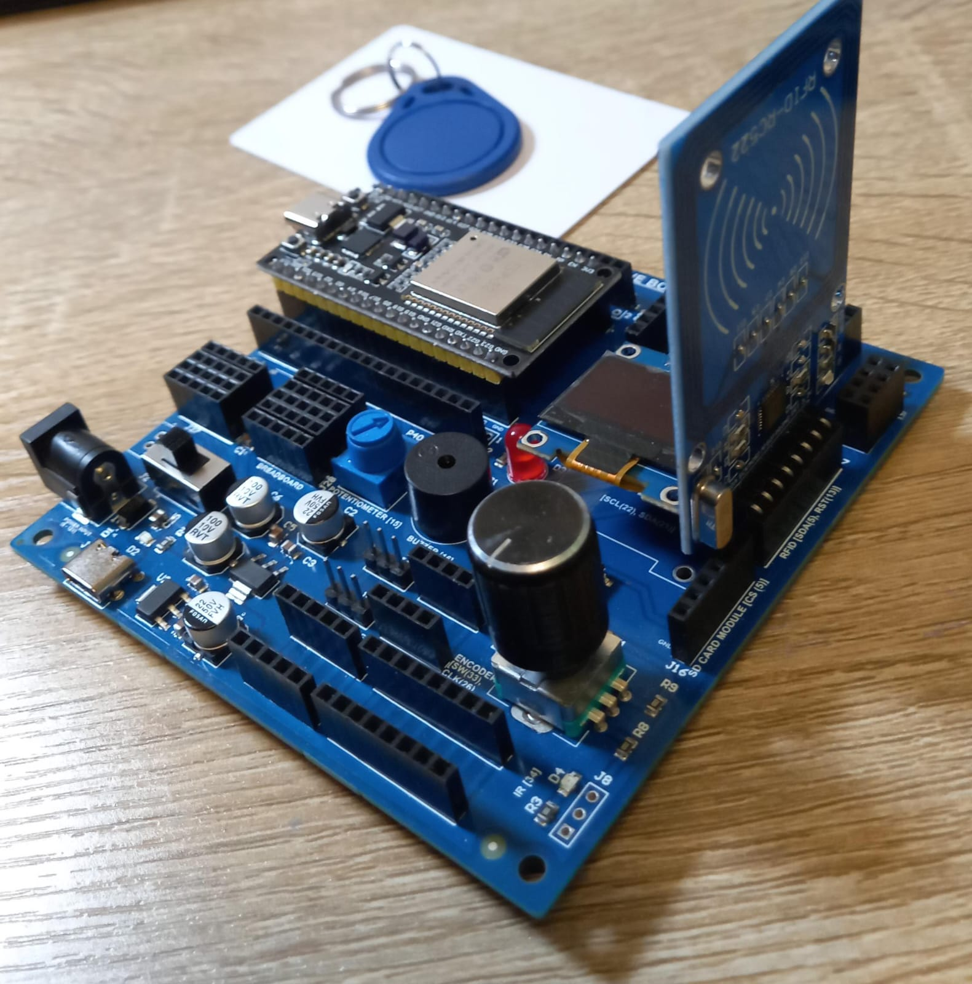
Lab C1 - RFID Reading & Access Control System (MFRC522 + OLED)

Slide 8
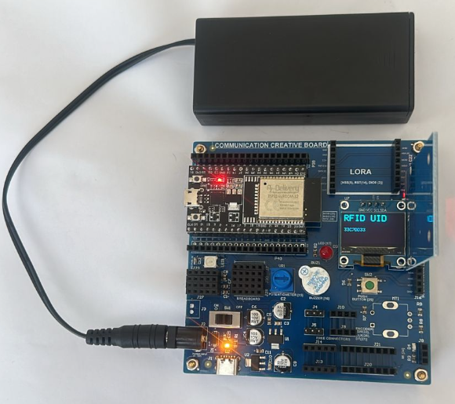
Lab C1 - RFID Reading & Access Control System (MFRC522 + OLED)
Program 1: RFID / NFC UID Reader
✅ Recommended Heading
RFID/NFC – UID Reading & Identification Display (MFRC522 + OLED)
Alternative headings:
RFID – Card UID Scanner with OLED Feedback
RFID Reader – UID Detection & Display System
RFID/NFC – Simple Card Scanning & UID Output
⭐ Simple Code Explanation (RFID UID Reader)
setup()
Start Serial monitor
Initialize OLED, show “RFID Ready”
Initialize RFID reader (MFRC522)
Display “Scan card…” message in Serial
loop()
Check if a new card is present
Read card’s UID bytes
Convert UID to HEX string
Print UID in Serial
Display UID on OLED
Title: “RFID UID”
UID printed below
Small delay before next scan
Github Link:
(1). https://github.com/info-zas/Training/tree/main/GPREC/03_Communications/01_Code/01_Comm_Kit_RFIDCardInfo
(2). https://github.com/info-zas/Training/tree/main/GPREC/03_Communications/01_Code/02_Comm_Kit_RFIDCardReaderAccess

Slide 9
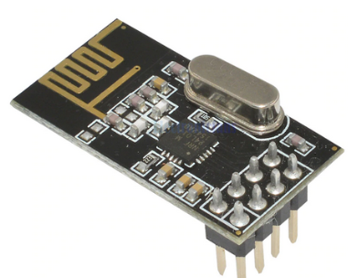
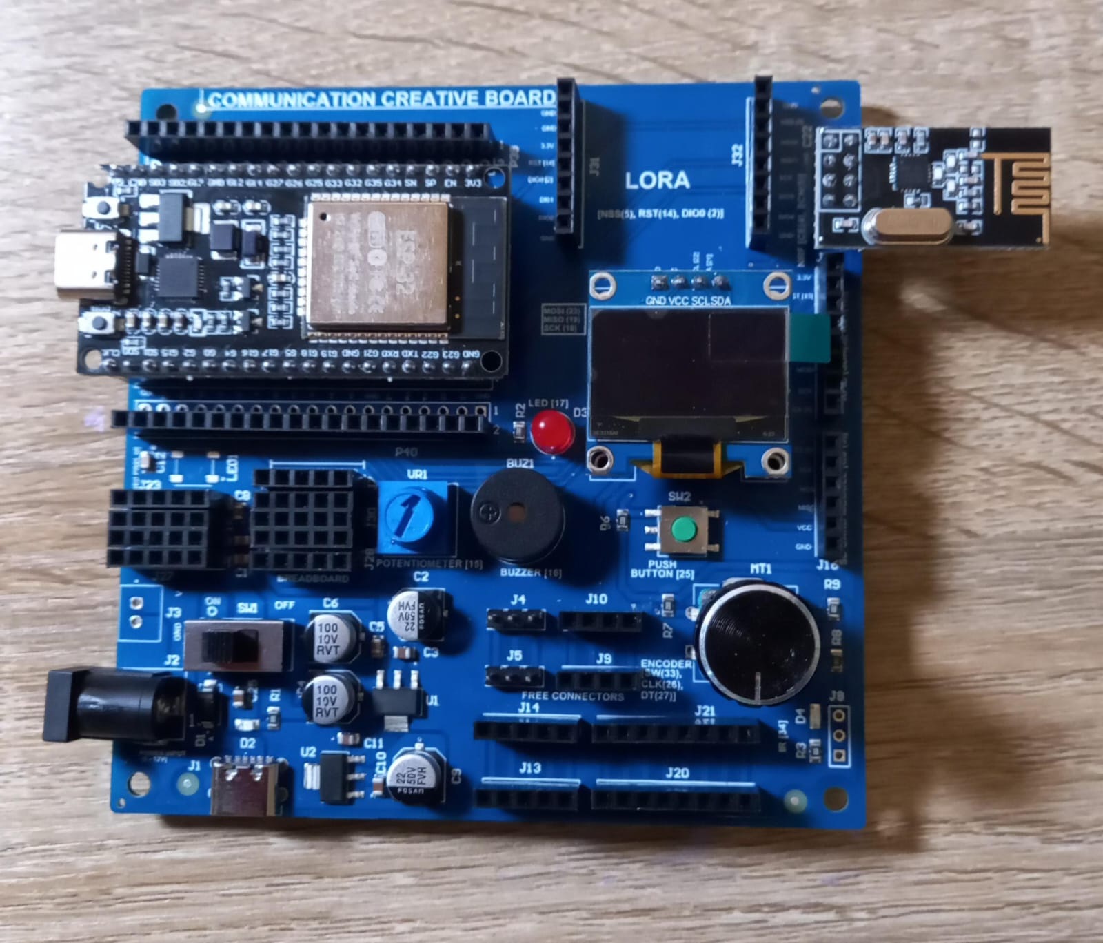
  Lab C2 – Wireless Communication between Tx and Rx Using NRF24L01
Things Needed

Slide 10
  Lab C2 – Wireless Communication between Tx and Rx Using NRF24L01
NRF Transmitter
NRF Receiver

Slide 11
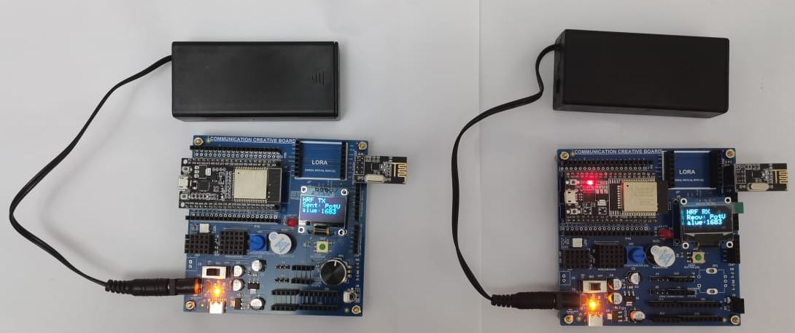
  Lab C2 – Wireless Communication between Tx and Rx Using NRF24L01
NRF24L01 – Transmitter & Receiver Workflow
1. Setup Transmitter & Receiver
Configure ESP32 + NRF24L01 on SPI pins
Connect OLED display for feedback
Set matching radio address for TX/RX
2. NRF24 Communication Workflow
🔵 Transmitter Side (TX)
ESP32 reads potentiometer value
Formats message as: "PotValue:XXXX"
Sends packet using NRF24L01 @ 2.4 GHz (32-byte payload)
OLED shows: “Sent: XXXX”
Uses SPI pins (CE, CSN, SCK, MOSI, MISO)
NRF24 Wireless Link
Short-range, high-speed 2.4 GHz radio link
Ideal for robot-to-robot, remote sensors, wireless controllers
Low power, reliable packet system with auto-acknowledge
Supports multiple nodes via unique radio addresses
Receiver Side (RX)
ESP32 detects packets using radio.available()
Reads data with radio.read()
Extracts potentiometer value from received message
OLED displays: “Recv: XXXX”
Github Link:
(1). https://github.com/info-zas/Training/tree/main/GPREC/03_Communications/01_Code/03_Comm_Kit_NRF24L01_Transmitter_Encoder_Value
(2). https://github.com/info-zas/Training/tree/main/GPREC/03_Communications/01_Code/04_Comm_Kit_NRF24L01_Receiver_Encoder_Value

Slide 12
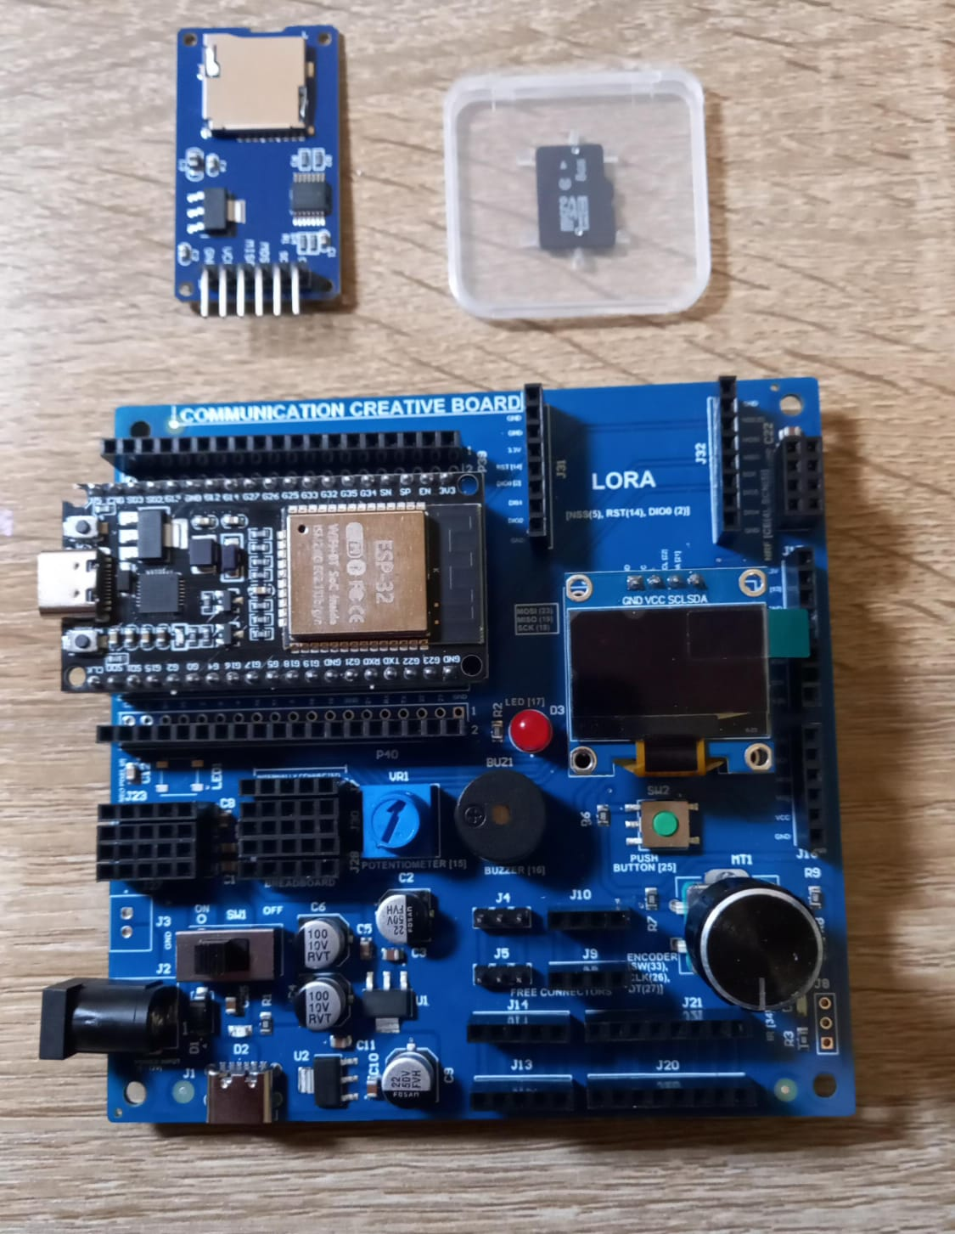
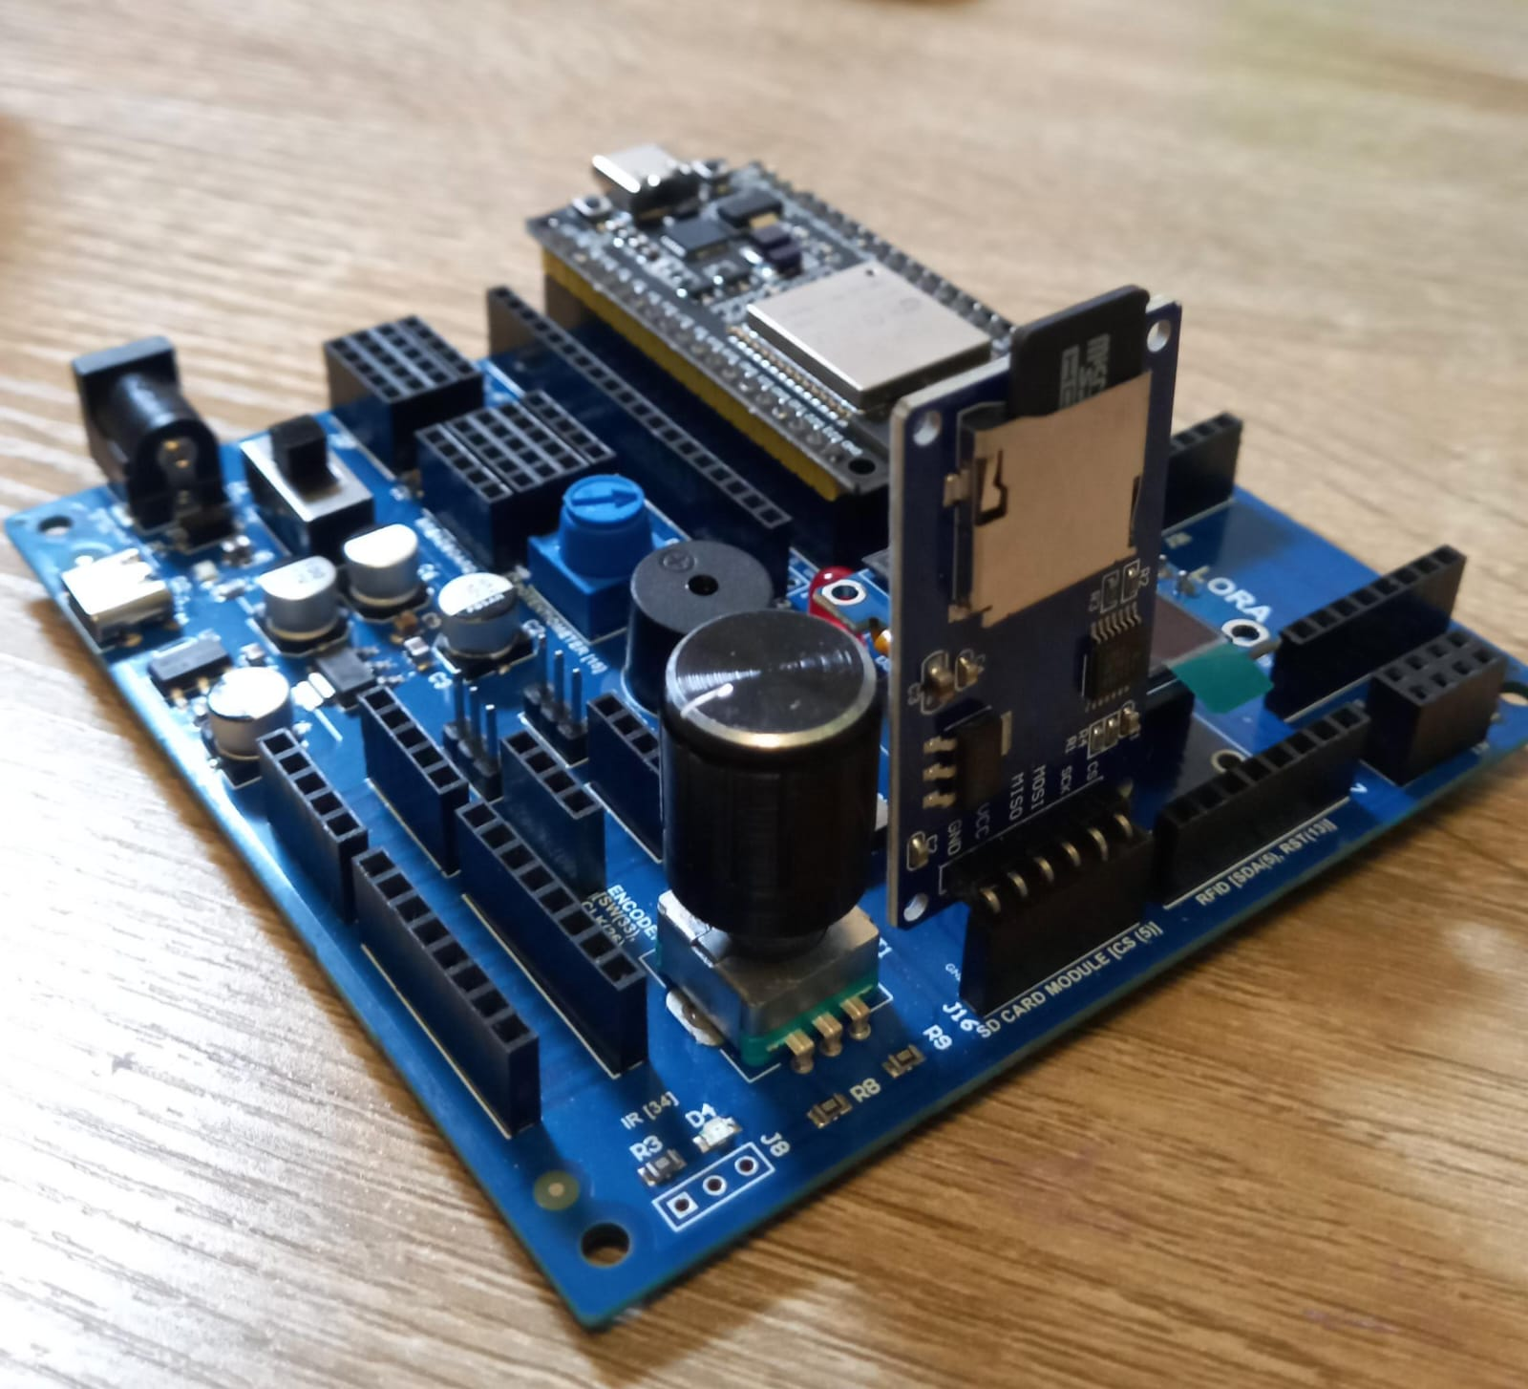
Lab C3 – SD Card Module

Slide 13
Lab C3 – SD Card Module
Discuss the SD Card Module –
The SD Card Pin Layout
SD Card formatting requirements
Practice the SD Card orientation for insertion & removal
Github Link:

Slide 14
Summary
We explored the Communication Kit, the final kit in the ZAS Robotics Foundational Series.
We focused on using various communication technologies such as RFID, NRF, LoRa, IT, Bluetooth.
Labs Covered:
  Lab C1 – RFID
  Lab C2 – Wireless Communication between Tx and Rx Using NRF24L01
  Lab C3 – SD Card Module
Next Sessions:
We will explore the ZAS Robotics Navigational Series (Car 1, Car 2, Car 3).

