Slide 1



ZAS Robotic Products
Familiarisation Training to Faculty
Training Schedule
(5th and 6th Dec 2025)

Slide 2
Faculty Training Agenda
Day-1
9 AM
10 AM
12 AM
1 PM
3 PM
5 PM
Introductions
Brief Talk
Sensors
Lunch
Motion
Communications
Day-2
9 AM
9.30 AM
12 AM
1 PM
3 PM
5 PM
Re-cap
Robotic Car-1
(Sensors)
Lunch
Robotic Car-2
(Comms.)
Robotic Car-3
(Encoders/IMU/GPS)

Slide 3
Design Philosophy
(Day-1: 9 AM to 10 AM)

Slide 4
Design Philosophy
In Robotics, true understanding is achieved not through theory, but through practical application

Slide 5
Doing Robotics - Challenges
Common Issues:
  Finding & Sourcing Challenges;
  Incomplete & Unreliable
  Incompatible Issues as Complexity Increases
  Advanced Robotics – Import Tariffs
  Black Box Products
  Unstructured
  Documentation & Support Almost Non-Existent
Consequences of the Above Issues:
  Learning Remains Shallow
  Giving-up
  Challenging Projects are Not Executed
  Missed Career Opportunities

Slide 6
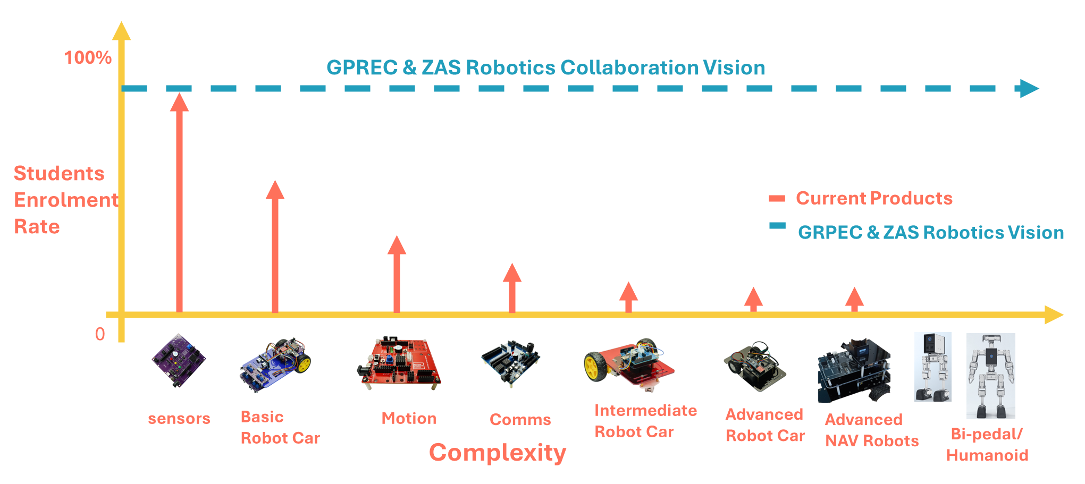
Doing Robotics - Challenges

Slide 7
Design Philosophy
Core Philosophy: Building for Mastery
Prioritize Deep Understanding: Deconstruct systems rather than relying on 'Black Box' or pre-packaged solutions.
Bridge Theory to Application: Solidify foundational concepts by rapidly moving from theory to practical implementation.
Master Modular Design: Learn system configuration by actively adding, replacing, and integrating individual components.
Maximize Resource Efficiency: Develop projects using reusable and adaptable components across different prototypes.
Ensure Accessible Innovation: Maintain low-cost, high-impact projects to make learning widely accessible.

Slide 8
Design Philosophy
Mandatory Lab Protocol
Strict Adherence to Safety: Uphold all health and safety procedures, regardless of the perceived low voltage or current of the equipment.
Implement the 'Four-Eyes Principle': Before engaging battery power, ensure critical system checks are independently verified by a second person.

Slide 9
Design Philosophy
Each Product
Foundational
(15 Lessons/Labs)
Take Home
Projects
Capstone
Projects
Staff Responsibility
Students Initiative/Responsibility
Foundational Lessons/Labs
Staff would introduce the lab lesson, give a demo
Students follow the instructions and conduct the experiment under the supervision of staff

Slide 10
Design Philosophy
Products Series
Foundational Products
Sensors
Motion
Communications
Navigational Robots
Robot Car-1
(Sensors)
Robot Car-2
(Comms.)
Robot Car-3
(Encoders/GPS/IMU)

Slide 11
Design Philosophy
Avoid Blackbox Approach to Lay Firm Foundations
Sensors
Conduct all 15 lessons/labs on both the Bread Board and Creative Board
Motion
Conduct DC Motor & Stepper Motor labs on a Bread Board and Creative Board
Remaining Lessons/Labs on the Creative Board
Communications
Conduct NRF & LoRa labs on a Bread Board and Creative Board
Remaining Lessons/Labs on the Creative Board

Slide 12
Sensors
(Day-1: 10 AM to 12 PM)

Slide 13
Sensors
Review the Contents in the Box
Review & Discuss the Sensors Creative Board
Discuss the Health & Safety Precautions, Power Supply and Sensor Modules V/G Pins
Conduct the Following Labs on both the Bread Board and Creative Board
  OLED
  Ultrasonic Sensor
Discuss the Bread Board feature of the Creative Board
Discuss the Free Connector Concept of Creative Board
Conduct the Following Lab on the Bread Board feature of the Creative Board
  Gas Sensor
  OLED

Slide 14
Motion
(Day-1: 1 PM to 3 PM)

Slide 15
Motion
Review the Contents in the Box
Review & Discuss the Motion Creative Board
Discuss the Health & Safety Precautions, Power Supply and Sensor Modules V/G Pins
Conduct the Following Labs on both the Bread Board and Creative Board
  DC Motor
Conduct the Following Labs on the Creative Board
  DC Motor Encoder – Ticks
  DC Motor Encoder – PID Controller
Discuss the Bread Board feature of the Creative Board & Free Connector

Slide 16
Communications
(Day-1: 3 PM to 5 PM)

Slide 17
Communications
Review the Contents in the Box
Review & Discuss the Communication Creative Board
Discuss the Health & Safety Precautions
Conduct the Following Labs on both the Bread Board and Creative Board
  RFID
Conduct the Following Labs on the Creative Board
  NRF24L01
Discuss the SD Card module and practice memory card insertion/removal/formatting
Discuss the Bread Board of the Creative Board

Slide 18
Robot Car-1
(Day-2: 9.30 AM to 12 PM)

Slide 19
Navigational Robot Car-1
Review the Contents in the Box
Review & Discuss the Motor Controller Board, Assembly, Power Supply etc.
Discuss the Health & Safety Precautions
Practice the Following Lab
  Car Basic Movements; how to correct directions (by swapping the pins)
Practice the IR Sensor Calibration
Practice the Edge or IR Obstacle Mode

Slide 20
Robot Car-2
(Day-2: 1 PM to 3 PM)

Slide 21
Navigational Robot Car-2
Review the Contents in the Box
Review & Discuss the Motor Controller Board, Assembly, Power Supply etc.
Discuss the Health & Safety Precautions
Practice the Following Lab
  Car Basic Movements; how to correct directions (by swapping the pins)
Practice the Remote Setup for: Joystick, Accelerometer and Buttons
Discuss the Free Connectors, Gesture Sensor for Enhancements

Slide 22
Robot Car-3
(Day-2: 3 PM to 5 PM)

Slide 23
Navigational Robot Car-3
Review the Contents in the Box
Review & Discuss the Motor Controller Board, Assembly, Power Supply etc.
Discuss the Health & Safety Precautions
Practice the Following Lab
  Car Basic Movements; how to correct directions (by swapping the pins)
  Constant Speed via PID Controller
  Read & Display – GPS (Discuss the importance of removing GPS module while uploading)
  Read & Display – Digital Compass Bearing

Slide 24
Q&A

