Slide 1

Navigational Robotics Series
Robot Car-1 (Sensors)
Training Slides

Slide 2

Navigational Robot Car-1 (Sensors)
Review the Contents in the Box
Review & Discuss the Motor Controller Board, Assembly, Power Supply etc.
Discuss the Health & Safety Precautions
Practice the Following Lab
  Initial Setup - Car Basic Movements
  Calibration of IR Sensors
  IR Obstruction or Edge Following
Discuss the Features:
  List of other possible Modes
  Wooden fence test zig to test the modes

Slide 3

Navigational Robot Car-1 (Sensors)
List of Components/Interfaces
Component / Device | Purpose / Role
Arduino Board | Core microcontroller – handles sensor inputs and motor control
TB6612 Motor Driver | Controls DC motors using PWM and direction signals
2× DC Gear Motors | Drives the left and right wheels
Ultrasonic Sensor (HC-SR04) | Measures distance to obstacles using trigger & echo
IR Sensor Array (4 sensors) | Used for edge/pit detection and obstacle avoidance via analog/digital pins
Servo Motor | Rotates ultrasonic sensor for scanning left/right/middle directions
OLED Display | Outputs mode, UID info (if extended), or diagnostic status
Optional: IR Receiver/Bluetooth | For remote control or line-following edge detection logic

Slide 4
Navigational Robot Car-1 (Sensors)
Learning Outcomes
  Program Arduino to control motors, sensors, and logic
  Use TB6612 to drive DC motors with direction & speed (PWM)
  Interface Sensors: Ultrasonic (distance), IR (pit/line)
  Servo-based Scanning for obstacle direction (Ultrasonic)
  Write Navigation Logic: forward, stop, turn, avoid edges/pits
  Display Data on OLED using I2C communication
  Debug via Serial Monitor & sensor feedback
  Integrate Hardware & Code (motors, sensors, logic flow)
  Foundation for Reactive Robots & Path Decision Making

Slide 5
Navigational Robot Car-1 (Sensors)
Modes/Algorithms
Hands-on Training for Car-1
Modes:
  Infrared Obstacle Avoidance
  Ultrasound Obstacle Avoidance
  Line Following
  Pit Avoidance
  Wall Following
    External Wall Following - Left,
    External Wall Following - Right,
    Internal Wall Following - Right,
    Internal Wall Following - Left
  IR Remote.
  Bluetooth.

Slide 6
Health & Safety

Slide 7
Health & Safety
Double-check all power connections.
Ensure correct GND and VCC wiring for the power supply, OLED, motor drivers, GPS, sensors, and other modules.
Use the correct input voltage
Battery input should be between 5V and 12V only.
Work on a safe surface
Use the kit on an insulated table (e.g., wood) and ensure the surface is dry and clean.
Avoid leaving the kit unattended
Do not keep the system powered on without supervision.
Build and Test Incrementally
Turn on the microcontroller first, then build and test the circuit step-by-step.
Avoid wiring the entire system at once and powering it without intermediate testing.
Don’t leave Batteries charging unattended
Robotic car is for in-door use only
Always follow 4-eyes principle when it comes to checking VCC & GND

Slide 8
Motor Driver

Slide 9
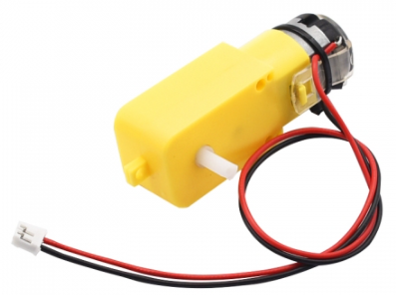
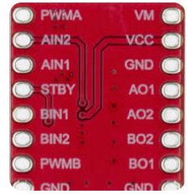
Navigational Robot Car-1 (Sensors)
TT Motor Driver
TB 6612 Motor Driver
Series: TT DC
Speed: 130 RPM
Voltage: 6V

Slide 10
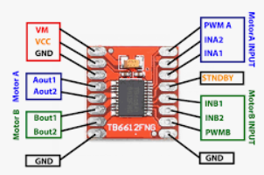
Navigational Robot Car-3
PIN Details - TB6612 Motor Driver and TT Motor
Left Motor
A-IN1 – Arduino Nano 3
A-IN2 – Arduino Nano 4
PWMA – Arduino Nano 5
Right Motor
B-IN1 – Arduino Nano 8
B-IN2 – Arduino Nano 7
PWMB – Arduino Nano 6

Slide 11
Test Basic Movement

Slide 12
Initial Setup - Test Basic Movements
The purpose of this exercise is to test basic movements of the robot car
Also to ensure, your program is using the correct allocated PINs for Motor Inputs (IN1/IN2)
The Program has the following 3 major functional blocks
Pins declaration
  Ensure correct pins are defined (see sample program)
B. Setup:
input/outputs
C. Loop:
In the loop the car drives forward/left/right

Slide 13
Initial Setup - Test Basic Movements
// ============== Pin Definitions ==========
// Left Motor
#define IN2_L 3
#define IN1_L 4
// Right Motor
#define IN2_R 7
#define IN1_R 8
Please test each direction in isolation
  Forward
  Backward
  Left
  Right
If incorrect direction, then swap IN1/IN2 pins of the corresponding motor
Expected Output: The car moves in the desired direction

Slide 14
Navigational Robot Car-1
Basic Movement
// Define Motor Pins Left1 = Digital Pin 3 Left2 = Digital Pin 4 Left_Speed = PWM Pin 5 Right1 = Digital Pin 7 Right2 = Digital Pin 8 Right_Speed = PWM Pin 6 setup(): Set all motor control pins as OUTPUT loop(): Set motor speed to medium (127) forward() // 2 sec backward() // 2 sec turnRight() // 0.5 sec turnLeft() // 0.5 sec Stop() // 1.5 sec | forward(): Left1=HIGH, Left2=LOW Right1=HIGH, Right2=LOW backward(): Left1=LOW, Left2=HIGH Right1=LOW, Right2=HIGH turnRight(): Left1=HIGH, Left2=LOW Right1=LOW, Right2=HIGH turnLeft(): Left1=LOW, Left2=HIGH Right1=HIGH, Right2=LOW Stop(): All pins LOW

Slide 15
IR Sensor Calibration

Slide 16
Navigational Robot Car-1 (Sensors)
IR Sensor Calibration
Physical demo & practice session

Slide 17
IR Obstacle Mode

Slide 18
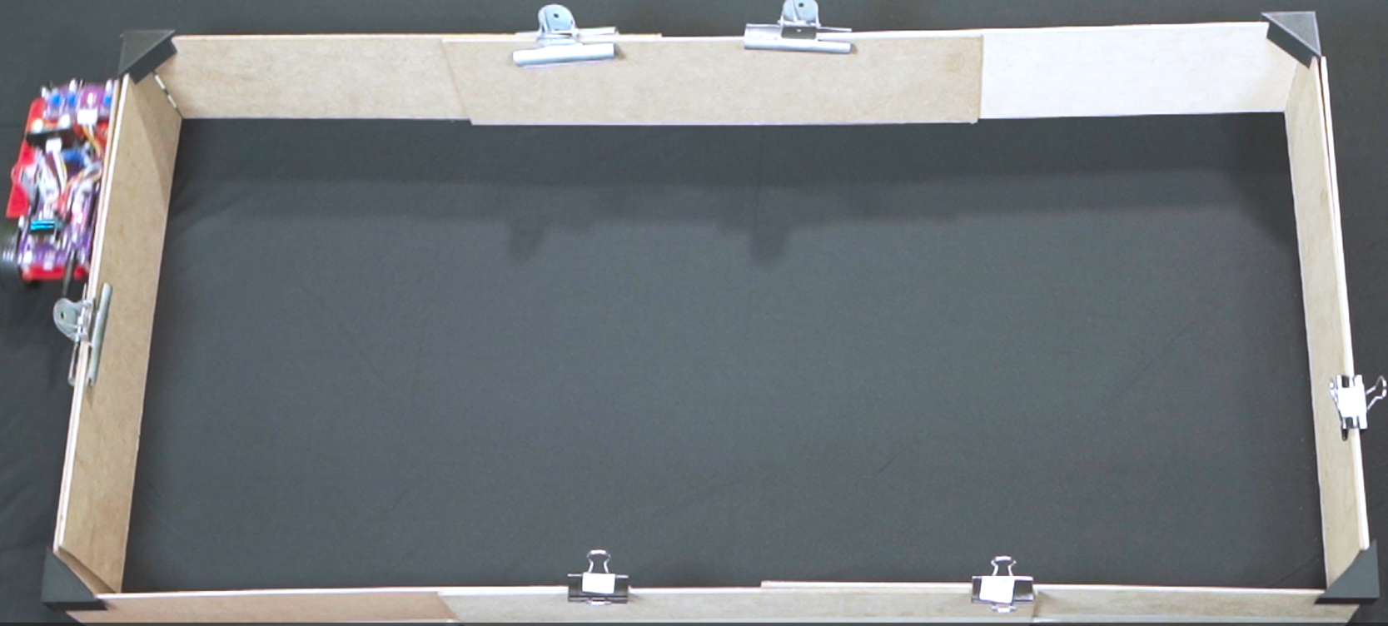
Navigational Robot Car-1 (Sensors)
The purpose of this exercise is to test IR sensor calibration for Obstacle Avoidance or Edge Following
Also to get familiarity with the usage of the test zig (boundary wall fence)

Slide 19
Edge Following or IR Obstruction
The purpose of this exercise is to test IR sensor calibration for Obstacle Avoidance or Edge Following
Also to get familiarity with the test zig (boundary wall fence)
Expected Output
Just using the IR sensor in the front, the robot car should be able to avoid the obstructions or following an edge.
During this hands-on exercise one will realise the sensor sensitiveness to the direct/indirect infrared light from the Sun.
IR Sensor is Very Sensitive to Infrared Light from the Sun so Avoid Direct/Indirect Sun Light if Possible

Slide 20
Q&A

