Slide 1

ZAS Robotic Products
Navigational Robotic Series
Robot Car-1 Sensor
Lab Session 1 – Car Basic Movements

Slide 2
Lab Session 1 – Car Basic Movements
LEARNING OBJECTIVES & AGENDA
DC Motor Control Fundamentals
  Understand motor control using H-Bridge (TB6612 driver)
  Learn how to control direction, speed, and braking
  Understand current flow and motor polarity reversal
  Master the principles of dual H-Bridge motor driver architecture
Real-world application: Same technology used in electric vehicles and industrial robots
2️ PWM Signals: The Language of Speed Control
  Control motor direction and speed with Pulse Width Modulation
  Decode PWM: Frequency, duty cycle, and their effects on motor performance
  Learn how to translate digital signals into analog motor control
  Optimize speed control for smooth, precise movements
Key insight: PWM is the backbone of modern motor control systems worldwide,especially for motor speed control

Slide 3
Lab Session 1 – Car Basic Movements
LEARNING OBJECTIVES & AGENDA
Real-Time Monitoring & Feedback
Integrate OLED display for status feedback
  Display live motor status, speed values, and system state
  Implement visual debugging for rapid development
  Create user-friendly interfaces for robot control
Professional skill: Real-time monitoring is essential in production robotics
Key Outcomes: “By the end of this lab, students will be able to:”
  Hands-on Arduino programming for robotics
  Control DC motors using PWM
  Understand differential drive motion
  Display real-time robot state on OLED

Slide 4


Lab Session 1 – Car Basic Movements
Robot Car-1 - Assembled view and Creative Board component layout

Slide 5
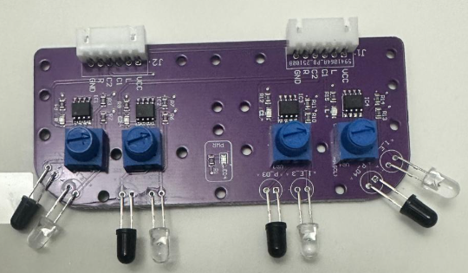
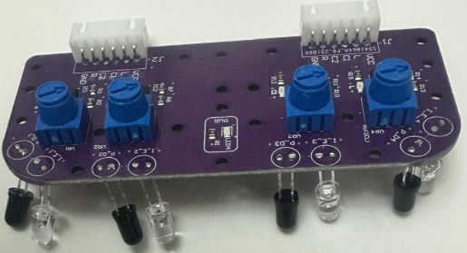
Lab Session 1 – Car Basic Movements
Robot Car-1 – Forward & downward-facing IR sensors
IR Sensor Type | Mounting Position | What It Detects | Working Principle | Main Purpose / Benefit
Downward-Facing IR Sensors | Mounted underneath the robot | Edges, pits, stairs, floor color changes | Light surface → high reflection → sensor ONDark surface / no floor → low or no reflection → sensor OFF | Prevents falling and unsafe movement; ensures floor safety
Forward-Facing IR Sensors | Mounted facing forward | Nearby obstacles, walls, objects | Object close → strong IR reflection → sensor ONObject far → weak or no reflection → sensor OFF | Quick detection of obstacles for collision avoidance
Note: Always keep the “Motor Driver Standby/ON switch(12)” in Standby mode during programming and IR sensor calibration. IR sensors are sensitive and require careful calibration to accurately understand the environment.

Slide 6
Lab Session 1 – Car Basic Movements
What do L, LC(C1), RC(C2), R mean?
Sensor Meanings
L – Left Sensor Positioned on the far left Detects: Left wall Left edge of line Obstacle on left side Used for: Wall following Line correction from left | LC(C1) – Left-Center Sensor Positioned slightly left of center Detects: Objects slightly ahead on the left Used for: Fine correction when robot drifts left/right
R – Right Sensor Positioned on the far right Detects: Right wall Right edge Obstacle on right side Used for: Avoiding right-side collisions | RC(C2) – Right-Center Sensor Positioned slightly right of center Detects: Objects slightly ahead on the right Used for: Fine correction from the right side
Signal | Meaning
HIGH (1) | No obstacle / clear
LOW (0) | Obstacle detected
Note: IR sensors must be calibrated before each experiment due to surface and lighting variations

Slide 7
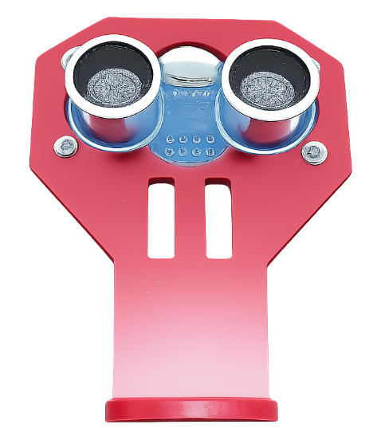
Lab Session 1 – Car Basic Movements
Robot Car-1 (Sensors edition) - Ultrasonic Sensor & Servo Mechanism
Ultrasonic sensor mounted on a servo motor for dynamic environment scanning
Servo enables angular rotation, expanding the sensor’s field of view
Provides real-time distance measurements to detect obstacles
Enhances decision-making for obstacle avoidance
Enables intelligent and responsive navigation
Note: Keep the ultrasonic sensor permanently mounted. Repeated dismantling and re-fixing may cause damage; once mounted, avoid unnecessary handling.

Slide 8
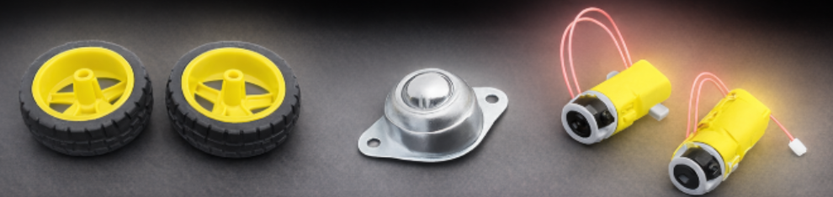
Lab Session 1 – Car Basic Movements
Robot Car-1 (Sensors edition) - Ultrasonic Sensor & Servo Mechanism
Component | Description | Function / Role
Two Rear Wheels (Drive Wheels) | Wheels connected to DC gear motors | Provide movement and enable turning using differential drive
Dual DC Gear Motors | TT DC motors (~130 RPM) | Control forward, reverse, left/right turns, and rotation
Front Caster Wheel | Free-rolling metal ball caster | Supports front weight and allows smooth, friction-free movement
Note: Most of the components come pre-assembled. Avoid dismantling and unnecessary handling.

Slide 9
Lab Session 1 – Car Basic Movements
Arduino Component–Pin Mapping Table
Component | Arduino Pin(s) | Function
IR Sensors (Left / LC / RC / Right) | A0, A1, A2, A3 | Obstacle detection
Motor Driver (IN1–IN4) | 8, 7, 4, 3 | Direction control
Motor Driver (ENA, ENB) | 6, 5 | Speed control (PWM)
OLED Display (SDA, SCL) | A4 (SDA), A5 (SCL) | Display interface
Motor Driver Pin Configuration
Note:
Downward IR sensors detect lines, floor edges, and pits.
while forward IR sensors detect walls and nearby obstacles.
Use the “Line/Wall Following Switch(2)” to select the mode.
Motor | IN1 | IN2 | PWM (Speed Control)
Left Motor | 7 | 8 | 6
Right Motor | 3 | 4 | 5
IR Sensors Pin Configuration
Sensor | Arduino Pin | Purpose
Left (L) | A0 | Left edge detection
Left-Center (LC) | A1 | Left-center path detection
Right-Center (RC) | A2 | Right-center path detection
Right (R) | A3 | Right edge detection

Slide 10
Lab Session 1 – Car Basic Movements
Schematics :
Motor Driver Pin Configuration
  Left Motor: IN1=7, IN2=8, PWM=6
  Right Motor: IN1=3, IN2=4, PWM=5
  VM → Battery, GND shared, VCC→5V
Purpose:
  IN1: This pin is used to control one direction of the motor (typically forward).
  IN2: This pin is used to control the opposite direction of the same motor (typically backward).
Control Logic:
  For the motor to move forward, IN1 is set to HIGH and IN2 is set to LOW.
  For the motor to move backward, IN1 is set to LOW and IN2 is set to HIGH.

Slide 11
Lab Session 1 – Car Basic Movements
Schematics
Additional Components
  OLED Display: I2C (SDA, SCL) → A4, A5
  Servo Motor: Signal → Pin 9
  Ultrasonic Sensor: Trig → Pin 10, Echo → Pin 11
  Visual: Include the schematic diagram you provided

Slide 12
Lab Session 1 – Car Basic Movements
Critical Programming Setup
MANDATORY Switch Settings Before Uploading Code
Before connecting USB and uploading program:
  Motor Driver Standby/On Switch
    ⚠️ MUST BE SET TO: STANDBY
  Why?
    Prevents motors from running during code upload
    Avoids car moving unexpectedly on desk
    Protects USB connection from power surges
Safety first during programming!
  Line/Wall Following Switch
    ⚠️ MUST BE SET TO: WALL FOLLOWING MODE
  Why?
  Pit avoidance uses the same sensor array as line following
  Switch must be in "Line Following" position for downward sensors to work
  Wrong position = sensors won't be read correctly

Slide 13
Lab Session 1 – Car Basic Movements
During Programming (Code Upload):
  Step 1: Connect USB cable to computer
  Step 2: Set Switch “Motor Driver Standby/On Switch” → STANDBY
  Step 3: Set Switch “Line/Wall Following Switch” LINE FOLLOWING
  Step 4: Set Switch “ON/OFF Switch” → OFF ->for batter power
  Step 5: Upload your pit avoidance program
  Step 6: Wait for "Upload Complete" message
  Step 7: Disconnect USB cable
Before Testing (Running the Robot):
  Step 1: Place robot on the ground. No obstacle as this test for basic movements
  Step 2: Verify Switch “Line/Wall Following Switch” -> WALL FOLLOWING
  Step 3: Set Switch “Motor Driver Standby/On Switch” ->activate ( motor driver ON)
  Step 4: Set Switch “ON/OFF Switch” → ON ->for batter power
  Step 5: Press RESET button
  Step 6: Robot car-1 starts pit avoidance program

Slide 14
Lab Session 1 – Car Basic Movements
Algorithm - Movement Control Logic
Movement Command | Left Motor (IN1 / IN2) | Right Motor (IN3 / IN4) | Speed (ENA / ENB) | Description
FORWARD | IN1 = HIGH IN2 = LOW | IN3 = HIGH IN4 = LOW | PWM (0–255) | Both motors rotate forward at the same speed
BACKWARD | IN1 = LOW IN2 = HIGH | IN3 = LOW IN4 = HIGH | PWM (0–255) | Both motors rotate backward at the same speed
TURN LEFT | IN1 = LOW IN2 = HIGH | IN3 = HIGH IN4 = LOW | PWM (0–255) | Left motor backward, right motor forward (pivot turn)
TURN RIGHT | IN1 = HIGH IN2 = LOW | IN3 = LOW IN4 = HIGH | PWM (0–255) | Left motor forward, right motor backward (pivot turn)
STOP | IN1 = LOW IN2 = LOW | IN3 = LOW IN4 = LOW | 0 | Both motors disabled, no movement
• H-Bridge Motor Control Principle:
IN1 | IN2 | Motor A Direction | IN3 | IN4 | Motor B Direction
HIGH | LOW | Forward → | HIGH | LOW | Forward →
LOW | HIGH | Backward ← | LOW | HIGH | Backward ←
LOW | LOW | Stop ⛔ | LOW | LOW | Stop ⛔
HIGH | HIGH | Brake ⚠️ | HIGH | HIGH | Brake ⚠️

Slide 15
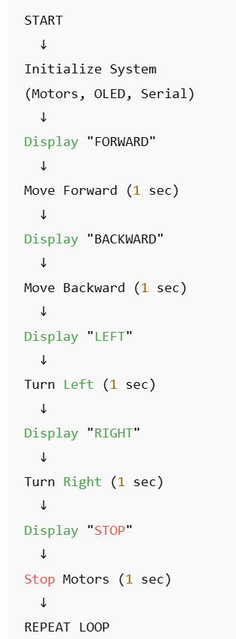
Lab Session 1 – Car Basic Movements
Flowchart -

Slide 16
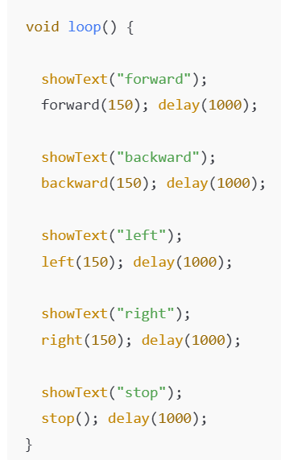
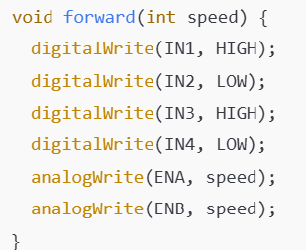
Lab Session 1 – Car Basic Movements
Code Highlight – Mail loop Motor Direction Control (Example)

Slide 17
Lab Session 1 – Car Basic Movements
Common Troubleshooting
Problem: Robot moves in circles
  Check motor polarity (swap IN1/IN2 if needed)
  Calibrate motor speeds (add trim values)
Problem: Motors don't move
  Verify power supply (VM to battery)
  Check motor driver connections
  Test with higher PWM values
Problem: OLED display blank
  Confirm I2C address (0x3C or 0x3D)
  Check SDA/SCL connections

Slide 18
Lab Session 1 – Car Basic Movements
Applications
Line Following Robot
  Uses IR sensors + basic movements
  Adjusts left/right to stay on the line
Obstacle Avoidance Robot
  Ultrasonic sensor detects obstacles
  Moves backward + turns to navigate around
Pit Avoidance Robot
  IR sensor detects edges or pits
  Uses simple avoidance or wall-following style logic
Wall-Following Car
  Follows a wall or boundary using distance sensors
  Continuously corrects path in real time
Autonomous Delivery Robot
  Uses basic movements + higher-level navigation
  Suitable for warehouse or hospital delivery tasks

Slide 19
Q&A
Invite Questions: Encourage the audience to ask questions for further clarification or discussion.

