Slide 1

ZAS Robotic Products
Navigational Robotic Series
Robot Car-1 Sensor
Lab Session 3 – IR SENSOR OBSTACLE AVOIDANCE

Slide 2
Lab Session 3 – IR SENSOR OBSTACLE AVOIDANCE
LEARNING OBJECTIVES & AGENDA
Understand IR sensor working principle (forward-facing obstacle detection)
Program 4-sensor IR array for collision avoidance
Implement intelligent decision-making algorithms
Test autonomous navigation in obstacle course

Slide 3


Lab Session 3 – IR SENSOR OBSTACLE AVOIDANCE
Robot Car-1 - Assembled view and Creative Board component layout

Slide 4
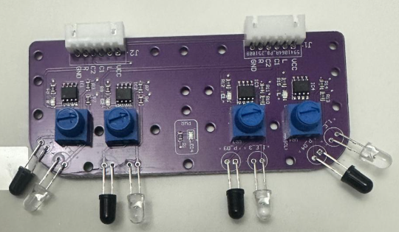
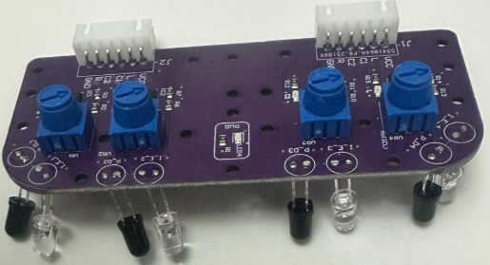
Lab Session 3 – IR SENSOR OBSTACLE AVOIDANCE
Robot Car-1 – Forward & downward-facing IR sensors
IR Sensor Type | Mounting Position | What It Detects | Working Principle | Main Purpose / Benefit
Downward-Facing IR Sensors | Mounted underneath the robot | Edges, pits, stairs, floor color changes | Light surface → high reflection → sensor ONDark surface / no floor → low or no reflection → sensor OFF | Prevents falling and unsafe movement; ensures floor safety
Forward-Facing IR Sensors | Mounted facing forward | Nearby obstacles, walls, objects | Object close → strong IR reflection → sensor ONObject far → weak or no reflection → sensor OFF | Quick detection of obstacles for collision avoidance
Note: Always keep the “Motor Driver Standby/ON switch” in Standby mode during programming and IR sensor calibration. IR sensors are sensitive and require careful calibration to accurately understand the environment.

Slide 5
Lab Session 3 – IR SENSOR OBSTACLE AVOIDANCE
What do L, LC(C1), RC(C2), R mean?
Sensor Meanings
L – Left Sensor Positioned on the far left Detects: Left wall Left edge of line Obstacle on left side Used for: Wall following Line correction from left | LC(C1) – Left-Center Sensor Positioned slightly left of center Detects: Objects slightly ahead on the left Used for: Fine correction when robot drifts left/right
R – Right Sensor Positioned on the far right Detects: Right wall Right edge Obstacle on right side Used for: Avoiding right-side collisions | RC(C2) – Right-Center Sensor Positioned slightly right of center Detects: Objects slightly ahead on the right Used for: Fine correction from the right side
Signal | Meaning
HIGH (1) | No obstacle / clear
LOW (0) | Obstacle detected
Note: IR sensors must be calibrated before each experiment due to surface and lighting variations

Slide 6
Lab Session 3 – IR SENSOR OBSTACLE AVOIDANCE
Arduino Component–Pin Mapping Table
Component | Arduino Pin(s) | Function
IR Sensors (Left / LC / RC / Right) | A0, A1, A2, A3 | Obstacle detection
Motor Driver (IN1–IN4) | 8, 7, 4, 3 | Direction control
Motor Driver (ENA, ENB) | 6, 5 | Speed control (PWM)
OLED Display (SDA, SCL) | A4 (SDA), A5 (SCL) | Display interface
Motor Driver Pin Configuration
Note:
Downward IR sensors detect lines, floor edges, and pits.
while forward IR sensors detect walls and nearby obstacles.
Use the “Line/Wall Following Switch(2)” to select the mode.
Motor | IN1 | IN2 | PWM (Speed Control)
Left Motor | 7 | 8 | 6
Right Motor | 3 | 4 | 5
IR Sensors Pin Configuration
Sensor | Arduino Pin | Purpose
Left (L) | A0 | Left edge detection
Left-Center (LC) | A1 | Left-center path detection
Right-Center (RC) | A2 | Right-center path detection
Right (R) | A3 | Right edge detection

Slide 7
Lab Session 3 – IR SENSOR OBSTACLE AVOIDANCE
Schematics
IR Sensor Modules (4x Forward-Facing)
Function: Detects obstacles by emitting infrared light and measuring reflection
  Range: 5 cm to 30 cm (adjustable via potentiometer)
  Output: Digital signal (HIGH = clear, LOW = obstacle detected)
  Response Time: <10 ms (instant detection)
DC Gear Motors (2x)
Function: Controls movement direction and speed
  Voltage: 6V - 9V DC
  Capabilities: Forward, backward, left turn, right turn movements
  Speed Control: PWM (0-255) for smooth navigation

Slide 8
Lab Session 3 – IR SENSOR OBSTACLE AVOIDANCE
Schematics
TB6612 Motor Driver
Function: Interfaces Arduino with DC motors for dual motor control
  Features: PWM speed control, direction control, thermal protection
Arduino Nano/Uno Microcontroller
Function: Acts as the brain of the robot, processing sensor inputs and controlling motor outputs
  Reads: 4 IR sensors (pins A0-A3)
  Executes: Obstacle avoidance algorithm
  Controls: Motor driver (pins 3-8) with PWM signals
OLED Display (128x64, I2C)
Function: Real-time visual feedback of sensor status and robot actions
  Connection: SDA (A4), SCL (A5)

Slide 9
Distance Measurement Functionality
How IR Sensors Work
Working Principle:
[IR LED] → Emits Infrared Light → [Obstacle] → Reflects Back → [IR Receiver]
Digital Output:
Robot Car-1 Setup:
  4 Forward-Facing IR Sensors
  Detection Range: 5-30 cm (adjustable)
  Fast Response: <10ms
Key Advantage:
Simple digital interface, no distance calculation needed
Condition | Output | Robot Action
Object Detected | 0 (LOW) | STOP / TURN
Path Clear | 1 (HIGH) | FORWARD

Slide 10
Lab Session 3 – IR SENSOR OBSTACLE AVOIDANCE
ALGORITHM – IR OBSTACLE AVOIDANCE
Priority | Condition | L | LC | RC | R | Situation | Robot Action
1 | All Clear | ✓ | ✓ | ✓ | ✓ | Safe path | FORWARD (slow, 100 PWM)
2 | Left Side Blocked | X/✓ | X | ✓ | ✓ | Obstacle on left | STOP → BACKUP → TURN RIGHT → VERIFY
3 | Right Side Blocked | ✓ | ✓ | X | X/✓ | Obstacle on right | STOP → BACKUP → TURN LEFT → VERIFY
4 | Both Sides Blocked | X | X/✓ | X/✓ | X | No safe side | STOP → LONG BACKUP → 180° TURN → VERIFY
5 | Center Clear (fallback) | X/✓ | ✓ | ✓ | X/✓ | Only center open | FORWARD (slow)
Default | Uncertain | ? | ? | ? | ? | Reassess | STOP → RECHECK

Slide 11
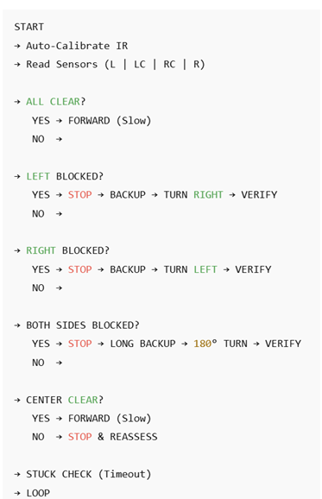
Lab Session 3 – IR SENSOR OBSTACLE AVOIDANCE
Flowchart

Slide 12
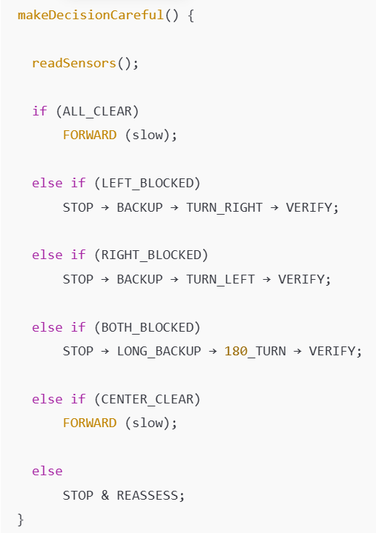
Lab Session 3 – IR SENSOR OBSTACLE AVOIDANCE
Main Decision Function

Slide 13
Obstacle Detection Logic
Decision Logic:
IF all sensors are CLEAR THEN
  Action: Move FORWARD
ELSE IF Left side blocked AND Right-Center clear THEN
  Action: Turn RIGHT
ELSE IF Right side blocked AND Left-Center clear THEN
  Action: Turn LEFT
ELSE
  Action: Move BACKWARD (then turn)Main Loop Explanation:

Slide 14
Movement Control Functions
Function Descriptions:
  forward(): Set pins to move forward.
  backward(): Set pins to move backward.
  turnLeft() / turnRight(): Define how the wheels are activated to turn.
  Stop(): Explain how all motors are disabled.
Execute Motor Commands
  FORWARD: Both motors move forward at set speed
  TURN RIGHT: Left motor forward + Right motor backward
  TURN LEFT: Right motor forward + Left motor backward
  BACKWARD: Both motors reverse + random turn

Slide 15
Repeat Loop
REPEAT continuously:
  Read sensors
  Make decision
  Execute action
  Wait 15ms
L | LC | RC | R | Action
✓ | ✓ | ✓ | ✓ | FORWARD
✗ | ✗ | ✓ | ✓ | TURN RIGHT
✓ | ✓ | ✗ | ✗ | TURN LEFT
✗ | ✗ | ✗ | ✗ | BACKWARD

Slide 16
Safety Guidelines
Troubleshooting Guide — Common Issues & Quick Fixes
Emergency
  Press the reset button or disconnect the battery immediately.
Problem | Cause | Solution
Sensors always show blocked | Sensitivity too high | Turn potentiometer clockwise
Robot ignores obstacles | Sensitivity too low | Turn potentiometer counter-clockwise
Motors don’t move | Battery low | Charge/replace battery (6–9V)
Robot turns randomly | Sensor noise | Add if (confidence >= 2) filtering logic
Gets stuck in corners | No backup logic | Implement backward movement routine
Erratic Serial Monitor | Wrong baud rate | Set to 115200 baud

Slide 17
Common Troubleshooting
Problem: Robot moves in circles
  Check motor polarity (swap IN1/IN2 if needed)
  Calibrate motor speeds (add trim values)
Problem: Motors don't move
  Verify power supply (VM to battery)
  Check motor driver connections
  Test with higher PWM values
Problem: OLED display blank
  Confirm I2C address (0x3C or 0x3D)
  Check SDA/SCL connections

Slide 18
Applications
Industrial Robotics:
  Warehouse AGVs (Automated Guided Vehicles)
  Assembly line robots
  Material handling systems
Consumer Products:
  Robotic vacuum cleaners
  Lawn mowing robots
  Floor cleaning machines
Education & Research:
  STEM learning platforms
  Robotics competitions (line following, maze solving)
  AI/ML training datasets

Slide 19
Q&A
Questions & Discussion
Common Questions:
  "Why does my robot turn when no obstacle is present?" → Check sensor sensitivity and add confidence threshold, Calibrate
  "Can IR sensors work in sunlight?" → Yes, but may need sensitivity adjustment
  "How to make robot faster while staying safe?" → Use adaptive speed based on obstacle distance
  "What if both left and right sensors detect obstacles?" → Implement backup + 180° turn logic

