Slide 1

ZAS Robotic Products
Navigational Robotic Series
Robot Car-1 Sensor
Multi-Sensor Fusion for Autonomous Obstacle Avoidance
(Integration of Infrared and Ultrasonic Sensing Systems)

Slide 2

Multi-Sensor Fusion for Autonomous Obstacle Avoidance
Problem Statement & Technical Justification
Limitations of IR-Only Systems
Physical Detection Range Constraints
  Effective Range: 2-30 cm (inverse square law limitation)
  Signal Intensity: ​​ → exponential decay beyond 30 cm
  Critical Issue: Only 0.25-0.5 seconds reaction time at 20 cm/s robot speed
  Result: Emergency braking distance > detection range = guaranteed collisions2
Environmental Sensitivity
Environment | False Positive Rate | Detection Success
Indoor (controlled) | 2–5% | 95% ✅
Near windows | 25–40% | 60% ⚠️
Outdoor / sunlight | 55–70% | 30% ❌

Slide 3
Multi-Sensor Fusion for Autonomous Obstacle Avoidance
Limitations of IR-Only Systems
Material-Dependent Detection Failures
  Black/Dark surfaces: Low reflectivity (5-15%) → detection fails at >10 cm
  Glossy/Mirrors: Specular reflection → beam reflects away
  Transparent objects: Glass, acrylic → invisible to IR (0 cm detection)
Binary Output = No Distance Information
  Output: Digital HIGH/LOW only
  Cannot answer: "Is obstacle 5 cm or 25 cm away?"
  All obstacles treated as immediate threats → excessive stopping

Slide 4

Multi-Sensor Fusion for Autonomous Obstacle Avoidance
Limitations of Ultrasonic-Only Systems
Spectacular Reflection Problem
Physics: Sound reflects at angle of incidence
Narrow Beam Angle = Tunnel Vision
Typical beam: 15-30° cone
Single sensor coverage = 15° of 360° environment
Blind area: 345° (95.8% of surroundings)
Surface Angle | Detection Success | Effective Range
0° (perpendicular) | 95% | 2-400 cm ✅
30° angle | 65% | 2-150 cm ⚠️
60° angle | 25% | 2-50 cm ❌
90° (parallel) | <5% | Undetectable ❌

Slide 5

Multi-Sensor Fusion for Autonomous Obstacle Avoidance
Limitations of Ultrasonic-Only Systems
Specular Reflection Problem
Time-of-Flight Delay:
Comparison: IR response = 1-2 ms vs US = 10-30 ms → IR is 10-15× faster
Narrow Beam Angle = Tunnel Vision
  Transducer vibration settling time: ~1 ms
  Blind zone: 0-5 cm cannot be detected
  Thin obstacles (poles, chair legs) at 3 cm = "No obstacle detected" → COLLISION ❌
Close-Range Accuracy Issues
  At <10 cm: receiver saturation
  Measurement error: ±3-5 cm (vs ±1 cm at optimal range)
Distance | Time Required | Robot Movement @ 20 cm/s
10 cm | 0.6 ms | 0.012 cm ✅
50 cm | 2.9 ms | 0.058 cm ✅
200 cm | 11.7 ms | 0.23 cm ⚠️

Slide 6
Multi-Sensor Fusion for Autonomous Obstacle Avoidance
Ultrasonic (US) vs Infrared (IR) – Complementary Strengths
Aspect | Ultrasonic (US) Strengths | Infrared (IR) Strengths
Range | Long range (up to 400 cm) | Short but precise (2–30 cm)
Surface Color/Material | Works on dark, black, transparent surfaces | Works best on light-colored, diffuse surfaces
Transparency | Detects glass, clear plastic | Fails on transparent surfaces (no reflection)
Angle Sensitivity | Poor on steep angles (specular reflection) | Best at perpendicular, drops sharply with angle
Close Range | Blind zone <5 cm | Excellent from 2 cm
Lighting Conditions | Unaffected by ambient light or sunlight | Interfered by bright light/sunlight
Soft Materials | Weak/absorbed echo on fabric, foam | Good detection on most solid surfaces
Speed/Response | Slower (~30 ms ping cycle) | Very fast response

Slide 7


Multi-Sensor Fusion for Autonomous Obstacle Avoidance
Robot Car-1 - Assembled view and Creative Board component layout

Slide 8
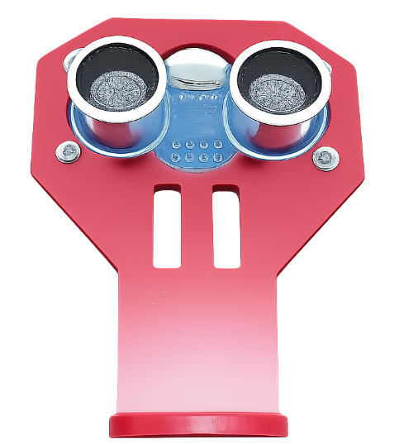
Multi-Sensor Fusion for Autonomous Obstacle Avoidance
Robot Car-1 (Sensors edition) - Ultrasonic Sensor & Servo Mechanism
Ultrasonic sensor mounted on a servo motor for dynamic environment scanning
Servo enables angular rotation, expanding the sensor’s field of view
Provides real-time distance measurements to detect obstacles
Enhances decision-making for obstacle avoidance
Enables intelligent and responsive navigation
Note: Keep the ultrasonic sensor permanently mounted. Repeated dismantling and re-fixing may cause damage; once mounted, avoid unnecessary handling.

Slide 9
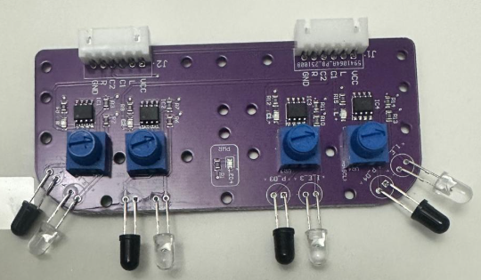
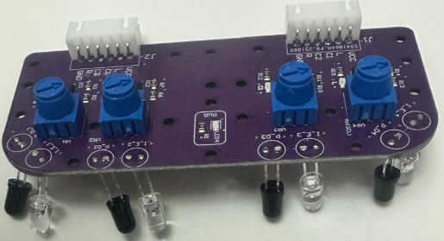
Multi-Sensor Fusion for Autonomous Obstacle Avoidance
Robot Car-1 – Forward & downward-facing IR sensors
IR Sensor Type | Mounting Position | What It Detects | Working Principle | Main Purpose / Benefit
Downward-Facing IR Sensors | Mounted underneath the robot | Edges, pits, stairs, floor color changes | Light surface → high reflection → sensor ON Dark surface / no floor → low or no reflection → sensor OFF | Prevents falling and unsafe movement; ensures floor safety
Forward-Facing IR Sensors | Mounted facing forward | Nearby obstacles, walls, objects | Object close → strong IR reflection → sensor ONObject far → weak or no reflection → sensor OFF | Quick detection of obstacles for collision avoidance
Note: Always keep the “Motor Driver Standby/ON switch” in Standby mode during programming and IR sensor calibration. IR sensors are sensitive and require careful calibration to accurately understand the environment.

Slide 10
Multi-Sensor Fusion for Autonomous Obstacle Avoidance
Fusion Obstacle Avoidance Algorithm
Sensors Used:
  IR Sensors → Very close obstacles, fast reaction
  Ultrasonic Sensor → Far obstacles, planning ahead
Main Idea: IR reacts first, Ultrasonic plans ahead
Why Fusion?
  IR: Fast & accurate close range
  Ultrasonic: Long range planning
Together: Safer & smarter navigation
Priority | Sensor & Range | Action
1 | IR (0–20 cm) | Immediate stop, backup & turn
2 | Ultrasonic Danger (≤20 cm) | Stop & scan left/right
3 | Ultrasonic Warning (20–40 cm) | Slow down
4 | Ultrasonic Scan (40–60 cm) | Scan & choose clearer path
5 | All Clear | Move forward normally

Slide 11
Ultrasonic Obstacle Avoidance
Critical Programming Setup
MANDATORY Switch Settings Before Uploading Code
Before connecting USB and uploading program:
  Motor Driver Standby/On Switch
    ⚠️ MUST BE SET TO: STANDBY
  Why?
    Prevents motors from running during code upload
    Avoids car moving unexpectedly on desk
    Protects USB connection from power surges
Safety first during programming!
  Line/Wall Following Switch
    ⚠️ MUST BE SET TO: WALL FOLLOWING MODE
  Why?
  Pit avoidance uses the same sensor array as line following
  Switch must be in "Line Following" position for downward sensors to work
  Wrong position = sensors won't be read correctly

Slide 12
Ultrasonic Obstacle Avoidance
During Programming (Code Upload):
  Step 1: Connect USB cable to computer
  Step 2: Set Switch “Motor Driver Standby/On Switch” → STANDBY
  Step 3: Set Switch “Line/Wall Following Switch” WALL FOLLOWING
  Step 4: Set Switch “ON/OFF Switch” → OFF ->for batter power
  Step 5: Upload the respective program
  Step 6: Wait for "Upload Complete" message
  Step 7: Disconnect USB cable
Before Testing (Running the Robot):
  Step 1: Place robot on the ground. No obstacle as this test for basic movements
  Step 2: Verify Switch “Line/Wall Following Switch” -> WALL FOLLOWING
  Step 3: Set Switch “Motor Driver Standby/On Switch” ->activate ( motor driver ON)
  Step 4: Set Switch “ON/OFF Switch” → ON ->for batter power
  Step 5: Press RESET button
  Step 6: Robot car-1 starts pit avoidance program

Slide 13
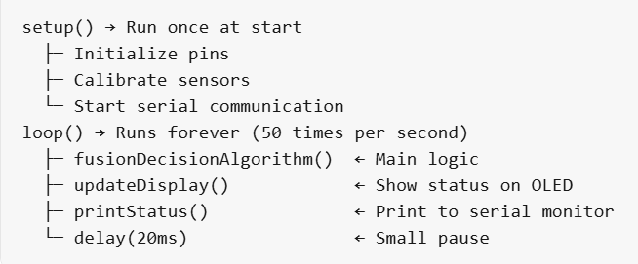
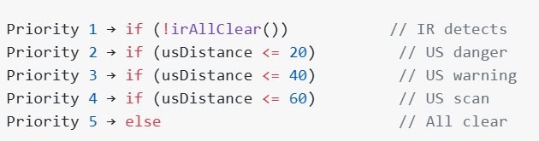
Multi-Sensor Fusion for Autonomous Obstacle Avoidance
Code Highlights (Only Important Parts)
Code Structure:
Priority System:

Slide 14
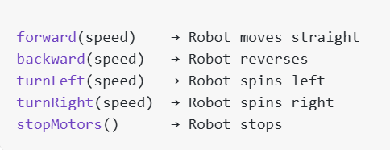
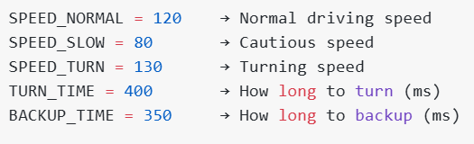
Multi-Sensor Fusion for Autonomous Obstacle Avoidance
Code Highlights (Only Important Parts)
Motor Commands:
Priority System:

Slide 15
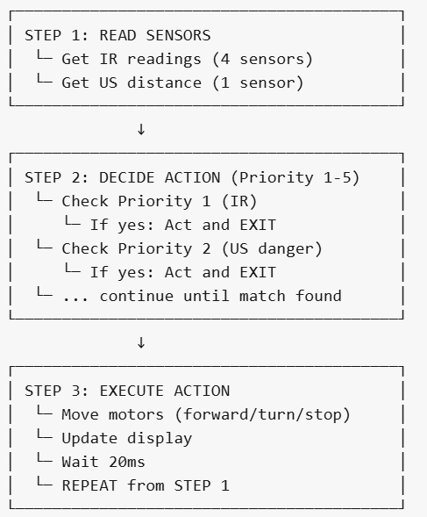
Multi-Sensor Fusion for Autonomous Obstacle Avoidance
Code Highlights (Only Important Parts)
Summary: How Code Works in 3 Steps
Note: The code repeats these 3 steps
50 times every second to continuously
avoid obstacles.

Slide 16
Q&A
Questions & Discussion

