Slide 1

ZAS Robotic Products
Navigational Robotic Series
Robot Car-1 Sensor
Ultrasonic Obstacle Avoidance

Slide 2
Ultrasonic Obstacle Avoidance
LEARNING OBJECTIVES & AGENDA
Learning Objectives
  Ultrasonic Sensor : Measure distance and detect obstacles.
  Arduino Programming: Control motors and process sensor data for autonomous navigation.
  Obstacle Avoidance: Develop program/algorithms to detect and avoid obstacles dynamically.
Key Outcomes
  Hands-on programming with Arduino
  Practical robotics: sensor integration and motor control
  Algorithmic problem-solving for autonomous navigation

Slide 3


Ultrasonic Obstacle Avoidance
Robot Car-1 - Assembled view and Creative Board component layout

Slide 4
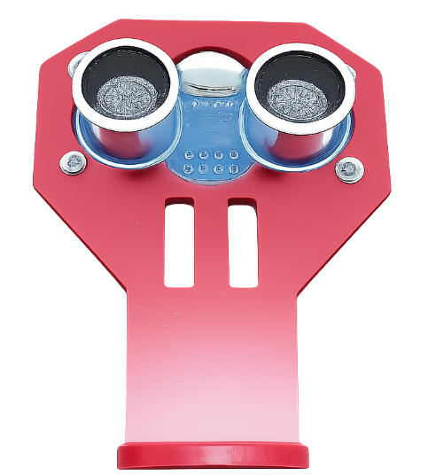
Ultrasonic Obstacle Avoidance
Robot Car-1 (Sensors edition) - Ultrasonic Sensor & Servo Mechanism
Ultrasonic sensor mounted on a servo motor for dynamic environment scanning
Servo enables angular rotation, expanding the sensor’s field of view
Provides real-time distance measurements to detect obstacles
Enhances decision-making for obstacle avoidance
Enables intelligent and responsive navigation
Note: Keep the ultrasonic sensor permanently mounted. Repeated dismantling and re-fixing may cause damage; once mounted, avoid unnecessary handling.

Slide 5
Ultrasonic Obstacle Avoidance
Arduino Component–Pin Mapping Table
Component | Arduino Pin(s) | Function
IR Sensors (Left / LC / RC / Right) | A0, A1, A2, A3 | IR Obstacle detection
Motor Driver (IN1–IN4) | 8, 7, 4, 3 | Direction control
Motor Driver (ENA, ENB) | 6, 5 | Speed control (PWM)
OLED Display (SDA, SCL) | A4 (SDA), A5 (SCL) | Display interface
Ultrasound | 10 (Trig) , 11(Echo) | US Obstacle detection
Motor Driver Pin Configuration
Note:
Downward IR sensors detect lines, floor edges, and pits.
while forward IR sensors detect walls and nearby obstacles.
Use the “Line/Wall Following Switch(2)” to select the mode.
Motor | IN1 | IN2 | PWM (Speed Control)
Left Motor | 7 | 8 | 6
Right Motor | 3 | 4 | 5
IR Sensors Pin Configuration
Sensor | Arduino Pin | Purpose
Left (L) | A0 | Left edge detection
Left-Center (LC) | A1 | Left-center path detection
Right-Center (RC) | A2 | Right-center path detection
Right (R) | A3 | Right edge detection

Slide 6
Ultrasonic Obstacle Avoidance
Schematics :
Ultrasonic Sensor (HC-SR04):
  Function: Measures distance by emitting sound waves and measuring the time taken for the echo to return.
  Range: Typically 2 cm to 400 cm.
Servo Motor:
  Used to rotate the sensor for a wider field of view.
  Provides flexibility in scanning for obstacles.
DC Motors:
  Controls movement direction and speed.
  Capable of forward, backward, left, and right movements.
Arduino Microcontroller:
  Acts as the brain of the robot, processing inputs from sensors and controlling outputs to motors.
Power Supply:
Specifications of batteries used (e.g., 6V to 12V DC).

Slide 7
Ultrasonic Obstacle Avoidance
Distance Measurement Functionality
  Function: Describe the getDistance() method:
  Uses trigger and echo pins to measure distance.
  Formula: distance = duration * 0.034 / 2
  (where duration is the time taken for the echo to return).
GitHub Link:https:
//github.com/info-zas/zas-robotics-car-1- sensors/blob/main/04_BasicFunctionalTests/00_BasicTests/

Slide 8
Ultrasonic Obstacle Avoidance
Algorithm ,Obstacle Detection Logic
Condition | Front Distance | Servo Action | Decision Rule | Robot Action
Path Clear | > 50 cm | Servo at 90° | No obstacle | FORWARD
Obstacle Detected | ≤ 50 cm | Scan 30° → 90° → 150° | Measure left & right | STOP + SCAN
Critical Obstacle | ≤ 25 cm | Scan 30° → 90° → 150° | Immediate danger | BACKUP + SCAN
Right Clear | ≤ 50 cm | After scan | Right > Left AND > 35 cm | TURN RIGHT
Left Clear | ≤ 50 cm | After scan | Left > Right AND > 35 cm | TURN LEFT
Both Blocked | ≤ 50 cm | After scan | Left & Right < 35 cm | BACKUP + LONG TURN
Equal / Uncertain | ≤ 50 cm | After scan | Default behavior | TURN RIGHT (default)
Servo Scan Positions
Direction | Angle | Purpose
Right | 30° | Check right clearance
Center | 90° | Front obstacle detection
Left | 150° | Check left clearance

Slide 9
Ultrasonic Obstacle Avoidance
Algorithm , Distance Thresholds
Parameter | Value | Used For
SAFE_DISTANCE | 50 cm | Trigger obstacle handling
CRITICAL_DISTANCE | 25 cm | Emergency backup
MIN_CLEARANCE | 35 cm | Safe turning decision
MOTOR_SPEED | 100 (PWM) | Normal motion speed
TURN_DELAY | 400 ms | Turn duration
BACKUP_DELAY | 300 ms | Reverse duration

Slide 10
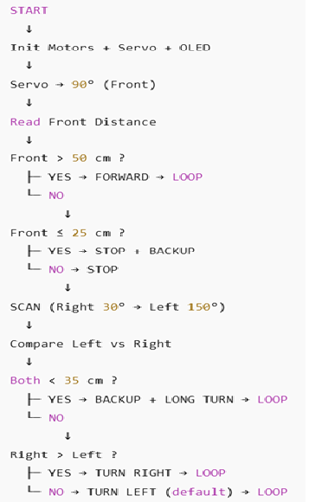
Ultrasonic Obstacle Avoidance
Flowchart ,Obstacle Detection Logic

Slide 11
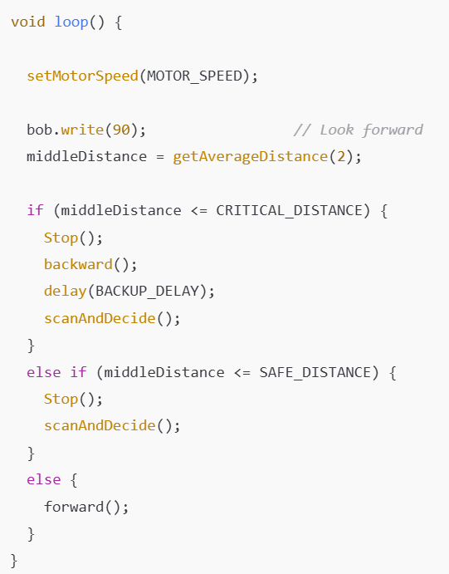
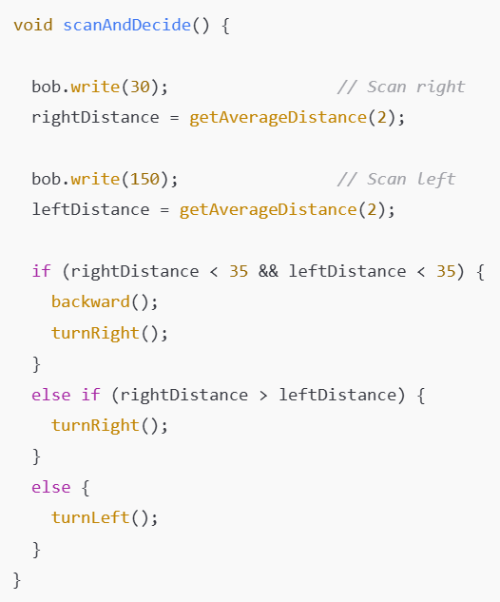
Ultrasonic Obstacle Avoidance
Code Highlight ,Main Control Logic Scanning & Decision Logic

Slide 12
Ultrasonic Obstacle Avoidance
Critical Programming Setup
MANDATORY Switch Settings Before Uploading Code
Before connecting USB and uploading program:
  Motor Driver Standby/On Switch
    ⚠️ MUST BE SET TO: STANDBY
  Why?
    Prevents motors from running during code upload
    Avoids car moving unexpectedly on desk
    Protects USB connection from power surges
Safety first during programming!
  Line/Wall Following Switch
    ⚠️ MUST BE SET TO: WALL FOLLOWING MODE
  Why?
  Pit avoidance uses the same sensor array as line following
  Switch must be in "Line Following" position for downward sensors to work
  Wrong position = sensors won't be read correctly

Slide 13
Ultrasonic Obstacle Avoidance
During Programming (Code Upload):
  Step 1: Connect USB cable to computer
  Step 2: Set Switch “Motor Driver Standby/On Switch” → STANDBY
  Step 3: Set Switch “Line/Wall Following Switch” LINE FOLLOWING
  Step 4: Set Switch “ON/OFF Switch” → OFF ->for batter power
  Step 5: Upload your pit avoidance program
  Step 6: Wait for "Upload Complete" message
  Step 7: Disconnect USB cable
Before Testing (Running the Robot):
  Step 1: Place robot on the ground. No obstacle as this test for basic movements
  Step 2: Verify Switch “Line/Wall Following Switch” -> WALL FOLLOWING
  Step 3: Set Switch “Motor Driver Standby/On Switch” ->activate ( motor driver ON)
  Step 4: Set Switch “ON/OFF Switch” → ON ->for batter power
  Step 5: Press RESET button
  Step 6: Robot car-1 starts pit avoidance program

Slide 14
Safety Guidelines
Avoid Accidents: Conduct tests in a safe, open environment to minimize the risk of collisions and accidents.
Monitor Operations: Always have manual supervision during operation to ensure immediate intervention if necessary.
Slow Speed: Operate the robot at reduced speeds to facilitate learning and prevent accidents, rather than racing.

Slide 15
Common Troubleshooting
Problem: Robot moves in circles
  Check motor polarity (swap IN1/IN2 if needed)
  Calibrate motor speeds (add trim values)
Problem: Motors don't move
  Verify power supply (VM to battery)
  Check motor driver connections
  Test with higher PWM values
Problem: OLED display blank
  Confirm I2C address (0x3C or 0x3D)
  Check SDA/SCL connections

Slide 16
Applications
Line Following Robot
  Uses IR sensors + basic movements
  Adjusts left/right to stay on the line
Obstacle Avoidance Robot
  Ultrasonic sensor detects obstacles
  Moves backward + turns to navigate around
Pit Avoidance Robot
  IR sensor detects edges or pits
  Uses simple avoidance or wall-following style logic
Wall-Following Car
  Follows a wall or boundary using distance sensors
  Continuously corrects path in real time
Autonomous Delivery Robot
  Uses basic movements + higher-level navigation
  Suitable for warehouse or hospital delivery tasks

Slide 17
Q&A
Invite Questions: Encourage the audience to ask questions for further clarification or discussion.

