Slide 1

Robot Car 2 (Wireless Communication Control) (RCC)
(Lesson Ref: RCC12)
RCC12:Hybrid Robot Car Control Using
Voice-Bluetooth-NRF

Slide 2



Robot Car2 - Contents
Bluetooth Connector
Button Control
OLED
Arduino
Uno
Mini
Breadboard
Free Connector
Accelerometer
18650 Battery Holder
Colour Sensor Connector
Joystick
Mode
Button
Gesture Sensor Connector
NRF 24L01
Transmitter
Car 2 Transmitter Module (Front)
Car 2 Transmitter Module (Back)

Slide 3


Robot Car2 - Contents
TB6612 Motor Driver
Castor Wheel
Car2 Receiver Motor Controller Board
18650 Battery Holder
NRF 24L01
Receiver
OLED
Battery Connector
DC Motors
Car 2 Receiver Module (Front)
Car 2 Receiver Module (Back)

Slide 4

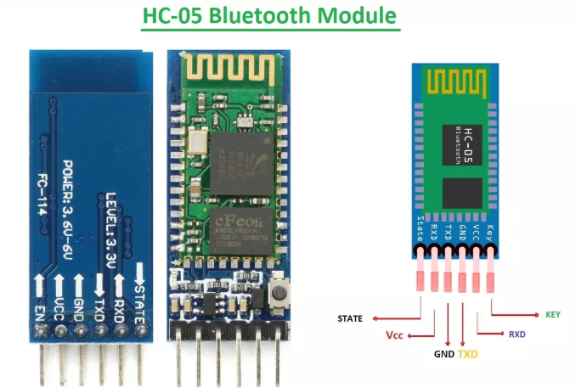
RCC12:Hybrid Robot Car Control Using
Voice-Bluetooth-NRF
Things Needed
Car 2 Transmitter Module
Car 2 Receiver Module

Slide 5
RCC12:Hybrid Robot Car Control Using
Voice-Bluetooth-NRF
Voice => Bluetooth => NRFBluetooth App
↓
HC-05 (Serial)
↓
TX Arduino
↓ (char via NRF24)
NRF24L01
↓
RX Arduino
↓
Motor Driver → Car
NRF =>

Slide 6

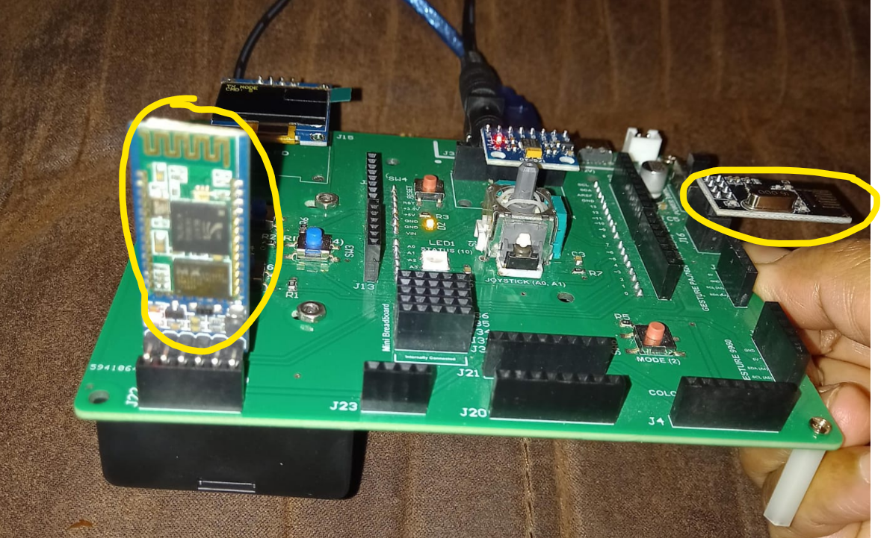
RCC12: Bluetooth Module HC05
Install the App ‘Arduino Bluetooth Control’ from Play Store on your Android Smart Phone.
Remove the HC05 Bluetooth Module from the transmitter module
Upload the code RCC12_Hybrid_Robot_Car_Voice_Bluetooth_NRF_Tx.ino
Re-insert the HC05 Bluetooth Module in the transmitter.
Code for RCC12_Hybrid_Robot_Car_Voice_Bluetooth_NRF_Tx.ino):

Slide 7
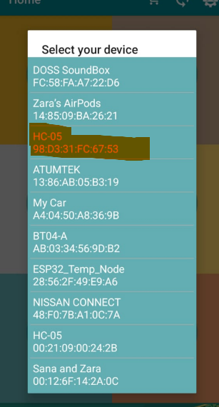
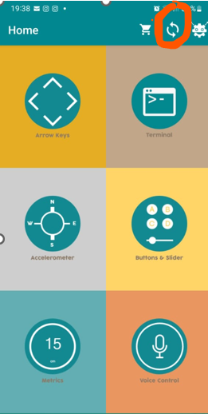
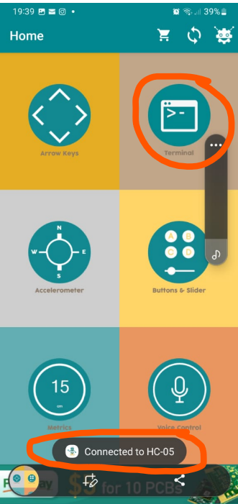
RCC12: Bluetooth APP

Slide 8
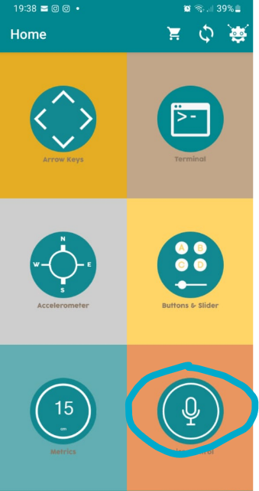
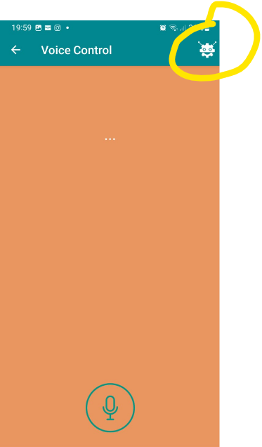
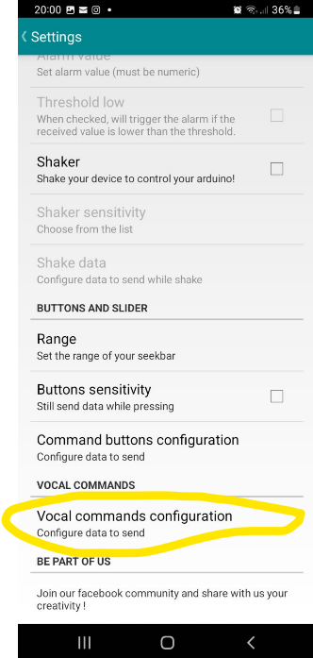
RCC12: Bluetooth APP

Slide 9
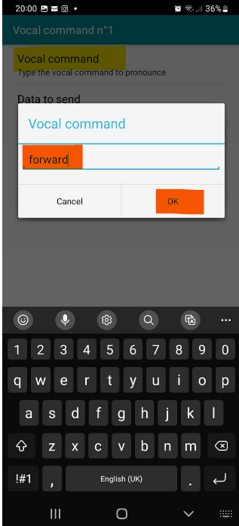
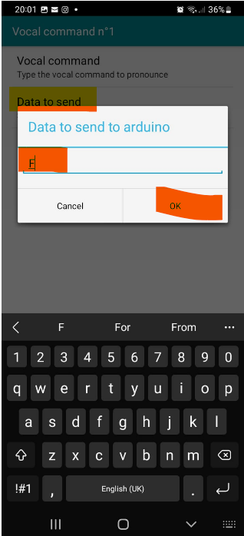
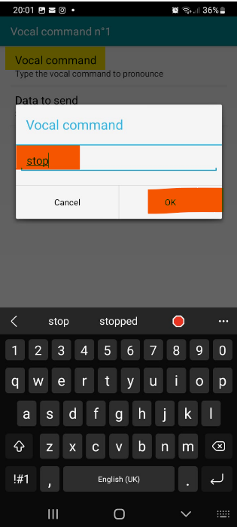
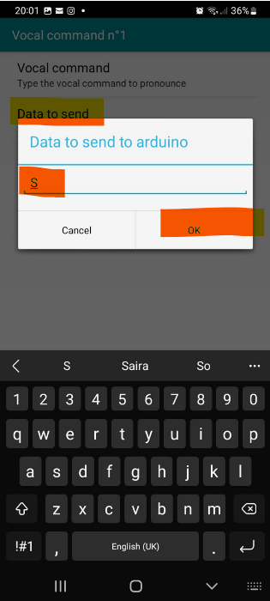
RCC12: Bluetooth APP

Slide 10
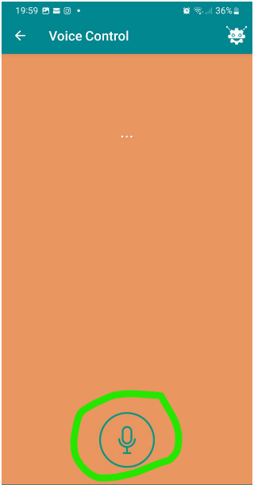
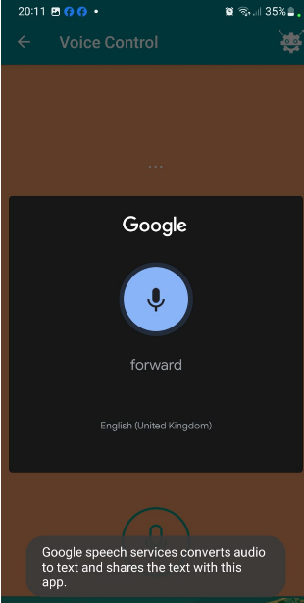
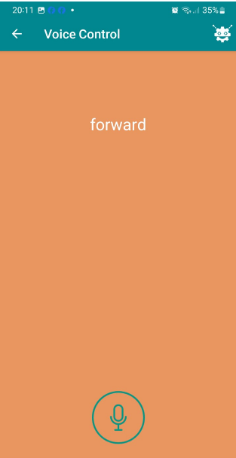
RCC12: Bluetooth APP

Slide 11
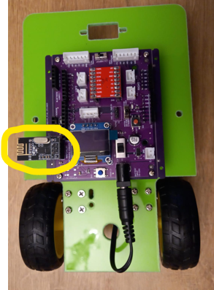
RCC12:Hybrid Robot Car Control Using
Voice-Bluetooth-NRF
Upload the receiver code
RCC12_Hybrid_Robot_Car_Voice_Bluetooth_NRF_Rx.ino in the robot car.
Code for RCC12_Hybrid_Robot_Car_Voice_Bluetooth_NRF_Rx.ino):

Slide 12
RCC12:Hybrid Robot Car Control Using
Voice-Bluetooth-NRF
RCC12_Hybrid_Robot_Car_Voice_Bluetooth_NRF_Rx.ino
RCC12_Hybrid_Robot_Car_Voice_Bluetooth_NRF_Tx.ino
setup()
Init Serial communication (HC-05 Bluetooth @ 9600 baud)
Init OLED display (SSD1306, 128×64, I2C, addr 0x3C)
Init NRF24L01 as TRANSMITTER
  CE=A3, CSN=A2
  Address = "00001", Channel = 108
  PA Level = LOW, TX mode enabled
loop()
Read single-character command from Bluetooth app
Supported commands: F, B, L, R, S
Send command as 1-byte payload via NRF24L01
Display current command on OLED
setup()
Init Serial communication at 9600 baud (HC-05 default)
Configure motor control pins (IN1–IN4, ENA, ENB)
Stop motors at startup
loop()
Check for incoming Bluetooth data via Serial
Read single-character command from mobile app
Decode command and map to motion:
  F → Forward
  B → Backward
  L → Left
  R → Right
  S → Stop
Drive motors using direction pins and PWM speed control

