Slide 1

Robot Car 2 (Wireless Communication Control) (RCC)
(Lesson Ref: RCC01)
RCC01: Robot Car 2 Basic Movements

Slide 2



Robot Car2 - Contents
TB6612 Motor Driver
Castor Wheel
Car2 Receiver Motor Controller Board
18650 Battery Holder
NRF 24L01
Receiver
OLED
Battery Connector
DC Motors
Car 2 Receiver Module (Front)
Car 2 Receiver Module (Back)

Slide 3


Robot Car2 - Contents
Bluetooth Connector
Button Control
OLED
Arduino
Uno
Mini
Breadboard
Free Connector
Accelerometer
18650 Battery Holder
Colour Sensor Connector
Joystick
Mode
Button
Gesture Sensor Connector
NRF 24L01
Transmitter
Car 2 Transmitter Module (Front)
Car 2 Transmitter Module (Back)

Slide 4
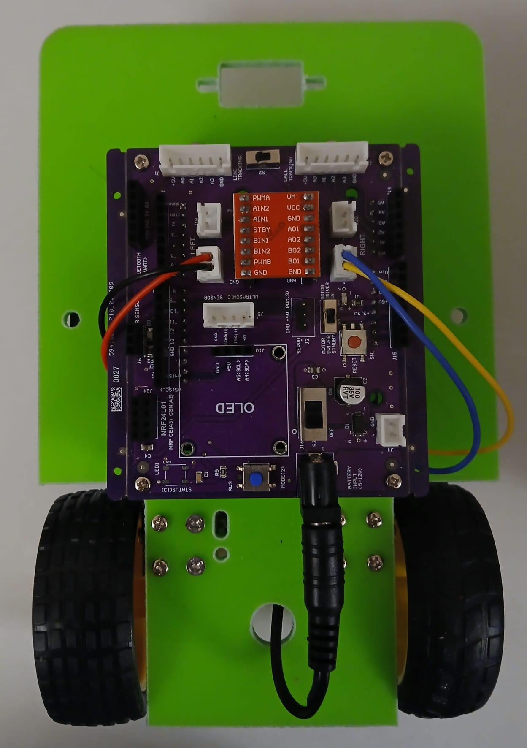

RCC01: Robot Car 2 Basic Movements
Things Needed

Slide 5
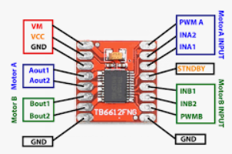
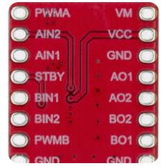
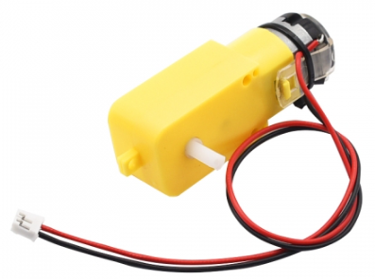
Motor Driver Module
TB 6612 Motor Driver
TT DC Motor Driver
(130 RPM, 6V)
Right Motor
A-IN1 – Arduino Uno 3
A-IN2 – Arduino Uno 4
PWMA – Arduino Uno 5
Left Motor
B-IN1 – Arduino Uno 8
B-IN2 – Arduino Uno 7
PWMB – Arduino Uno 6

Slide 6
RCC01: Robot Car 2 Basic Movements
Robot Car 2 Basic Movements:
Forward
Backward
Left
Right
Stop

Slide 7
RCC01: Robot Car 2 Basic Movements
Car’s FORWARD Direction
It is good practice to follow consistent orientation terminology when navigating the car.
As a guideline, we use the car’s orientation shown in this picture —the car is facing away from you.
Car’s LEFT Direction
Car’s RIGHT Direction
Car’s BACKWARD Direction

Slide 8
RCC01: Robot Car 2 Basic Movements
Movement Command | Left Motor (IN1 / IN2) | Right Motor (IN3 / IN4) | Speed (ENA / ENB) | Description
FORWARD | IN1 = HIGH IN2 = LOW | IN3 = HIGH IN4 = LOW | PWM (0–255) | Both motors rotate forward at the same speed
BACKWARD | IN1 = LOW IN2 = HIGH | IN3 = LOW IN4 = HIGH | PWM (0–255) | Both motors rotate backward at the same speed
TURN LEFT | IN1 = LOW IN2 = HIGH | IN3 = HIGH IN4 = LOW | PWM (0–255) | Left motor backward, right motor forward (pivot turn)
TURN RIGHT | IN1 = HIGH IN2 = LOW | IN3 = LOW IN4 = HIGH | PWM (0–255) | Left motor forward, right motor backward (pivot turn)
STOP | IN1 = LOW IN2 = LOW | IN3 = LOW IN4 = LOW | 0 | Both motors disabled, no movement

Slide 9
Lab 1: Basic Movements
// ============== Pin Definitions ==========
// Left Motor
#define Left1 7
#define Left2 8
#define Left_Speed 6
// Right Motor
#define Right1 3
#define Right2 4
#define Right_Speed 5
Please test each direction in isolation
  Forward
  Backward
  Left
  Right
If incorrect direction, then swap IN1/IN2 pins of the corresponding motor
Expected Output: The car moves in the desired direction

Slide 10
RCC01: Robot Car 2 Basic Movements
Forward
  First check left motor forward code
    if not the correct motor, modify the pin assignments of left and right motors
    If not the correct direction, swap the pin assignments of left motor
    Github Code:
      https://github.com/info-zas/zas-robotics-car-2-communications/blob/main/01_FoundationProjects/RCC01_Robot_Car_Basic_Movements/RCC01_a_Left_Forward_Rx/RCC01_a_Left_Forward_Rx.ino
  Now check the right motor forward code:
    If not the correct direction, swap the pin assignments of right motor
    Github Code:
      https://github.com/info-zas/zas-robotics-car-2-communications/blob/main/01_FoundationProjects/RCC01_Robot_Car_Basic_Movements/RCC01_b_Right_Forward_Rx/RCC01_b_Right_Forward_Rx.ino
Backward
    Add the backward functionality to the code.
    Github Code:
      https://github.com/info-zas/zas-robotics-car-2-communications/blob/main/01_FoundationProjects/RCC01_Robot_Car_Basic_Movements/RCC01_c_Backward_Rx/RCC01_c_Backward_Rx.ino

Slide 11
RCC01: Robot Car 2 Basic Movements
Left
    Now add the left turn code
    Github Code:
      https://github.com/info-zas/zas-robotics-car-2-communications/blob/main/01_FoundationProjects/RCC01_Robot_Car_Basic_Movements/RCC01_d_LeftTurn_Rx/RCC01_d_LeftTurn_Rx.ino
Right
    Now add the right turn code
    Github Code:
      https://github.com/info-zas/zas-robotics-car-2-communications/blob/main/01_FoundationProjects/RCC01_Robot_Car_Basic_Movements/RCC01_e_right_Rx/RCC01_e_right_Rx.ino

Slide 12
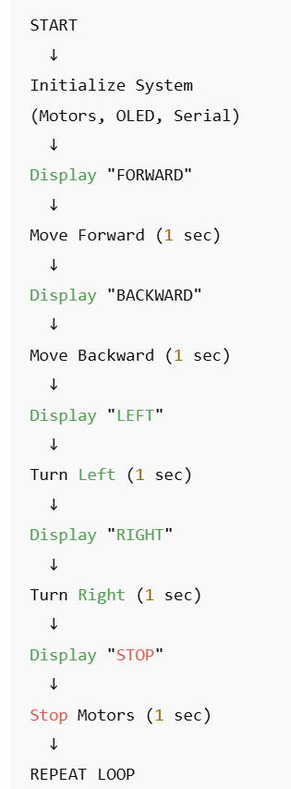
RCC01: Robot Car 2 All Basic Movements
All movements combined
  Github code:
    https://github.com/info-zas/zas-robotics-car-2-communications/blob/main/01_FoundationProjects/RCC01_Robot_Car_Basic_Movements/RCC01_f_All_Basic_Movements_Rx/RCC01_f_All_Basic_Movements_Rx.ino

Slide 13

RCC01: Robot Car 2 All Basic Movements
During Programming (Code Upload):
  Step 1: Connect USB cable to computer
  Step 2: Set Switch “Motor Driver Standby/On Switch” → STANDBY
  Step 3: Set Switch “ON/OFF Switch” → OFF ->for batter power
  Step 4: Upload your pit avoidance program
  Step 5: Wait for "Upload Complete" message
  Step 6: Disconnect USB cable
Before Testing (Running the Robot):
  Step 1: Place robot on the ground. No obstacle as this test for basic movements
  Step 2: Set Switch “Motor Driver Standby/On Switch” ->activate ( motor driver ON)
  Step 3: Set Switch “ON/OFF Switch” → ON ->for batter power
  Step 4: Press RESET button
  Step 5: Robot car-1 starts pit avoidance program
  Note:
    For Basic Movement Line/Wall Following Switch selection is not mandatory

