Slide 1

Robot Car 2 (Wireless Communication Control) (RCC)
(Lesson Ref: RCC07)
RCC07:Robot Car Control Using IR

Slide 2



Robot Car2 - Contents
Bluetooth Connector
Button Control
OLED
Arduino
Uno
Mini
Breadboard
Free Connector
Accelerometer
18650 Battery Holder
Colour Sensor Connector
Joystick
Mode
Button
Gesture Sensor Connector
NRF 24L01
Transmitter
Car 2 Transmitter Module (Front)
Car 2 Transmitter Module (Back)

Slide 3


Robot Car2 - Contents
TB6612 Motor Driver
Castor Wheel
Car2 Receiver Motor Controller Board
18650 Battery Holder
NRF 24L01
Receiver
OLED
Battery Connector
DC Motors
Car 2 Receiver Module (Front)
Car 2 Receiver Module (Back)

Slide 4

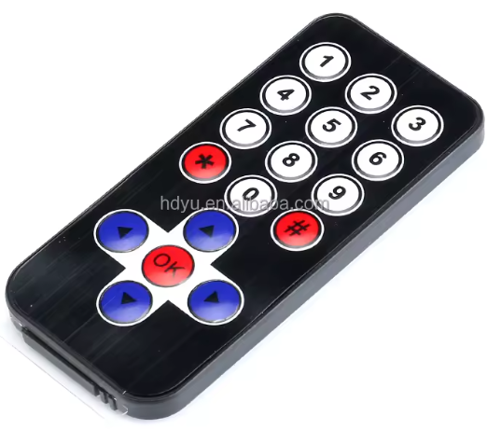
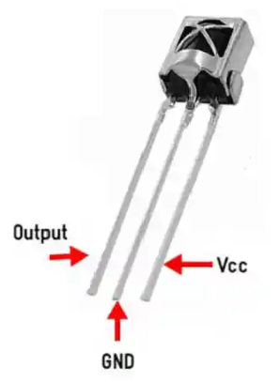
RCC07:Robot Car Control Using IR
Things Needed
Car 2 Receiver Module

Slide 5
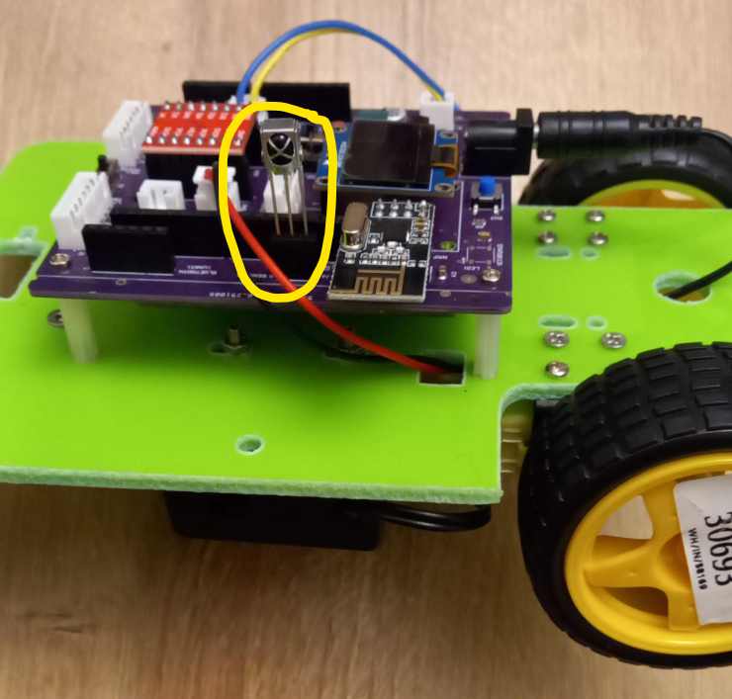
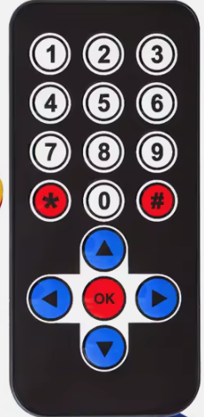
RCC07: IR Tx Codes
Each IR remote has its unique set of code for their keys.
First find the unique code for keys of your IR transmitter remote.
Upload the code (RCC07_a_IR_Remore_Code_Rx.ino ) and get the IR code for each key printed in the serial monitor.
Code for Lesson RCC07 (RCC07_a_IR_Remore_Code_Rx.ino):
https://github.com/info-zas/zas-robotics-car-2-communications/blob/main/01_FoundationProjects/RCC07_Robot_Car_Control_Using_IR/RCC07_a_IR_Remore_Code_Rx/RCC07_a_IR_Remore_Code_Rx.ino

Slide 6
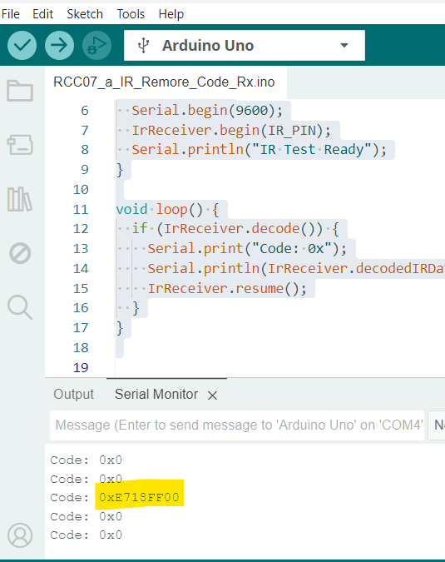
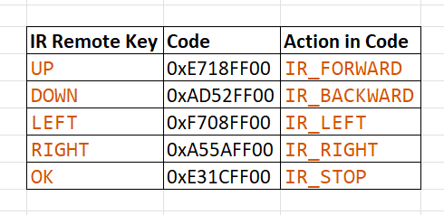
RCC07: IR Tx Codes

Slide 7
RCC07:Robot Car Control Using IR
RC07_b_Robot_Car_Control_Using_IR_Rx.ino
Now that we have the code for the arrow keys of the remote, we can use them in the code to control the car movements.
setup()
Init IR receiver on pin 12
Init motor control pins (Left & Right motors with PWM speed)
Set fixed motor speed using PWM (150)
Init OLED display (SSD1306, I2C, addr 0x3C)
Display startup message “IR READY” on OLED
Stop motors at startup
loop()
Wait for IR signal from remote
Decode received IR raw data
Match IR code to direction:
  FORWARD / BACKWARD / LEFT / RIGHT / STOP
Drive motors based on matched direction
Display current direction text on OLED
Resume IR receiver for next command
Code for Lesson RCC07 (RCC07_b_Robot_Car_Control_Using_IR_Rx.ino):
https://github.com/info-zas/zas-robotics-car-2-communications/blob/main/01_FoundationProjects/RCC07_Robot_Car_Control_Using_IR/RCC07_b_Robot_Car_Control_Using_IR_Rx/RCC07_b_Robot_Car_Control_Using_IR_Rx.ino

