Slide 1

Robot Car 2 (Wireless Communication Control) (RCC)
(Lesson Ref: RCC09)
RCC09:Robot Car Control Using Voice

Slide 2



Robot Car2 - Contents
Bluetooth Connector
Button Control
OLED
Arduino
Uno
Mini
Breadboard
Free Connector
Accelerometer
18650 Battery Holder
Colour Sensor Connector
Joystick
Mode
Button
Gesture Sensor Connector
NRF 24L01
Transmitter
Car 2 Transmitter Module (Front)
Car 2 Transmitter Module (Back)

Slide 3


Robot Car2 - Contents
TB6612 Motor Driver
Castor Wheel
Car2 Receiver Motor Controller Board
18650 Battery Holder
NRF 24L01
Receiver
OLED
Battery Connector
DC Motors
Car 2 Receiver Module (Front)
Car 2 Receiver Module (Back)

Slide 4

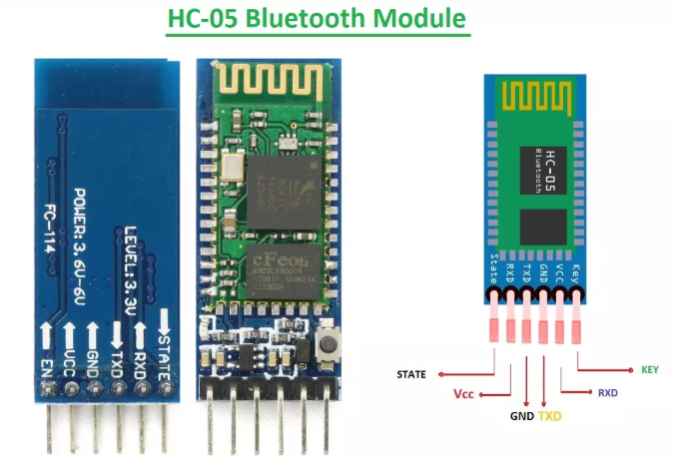
RCC09:Robot Car Control Using Voice
Things Needed
Car 2 Receiver Module

Slide 5

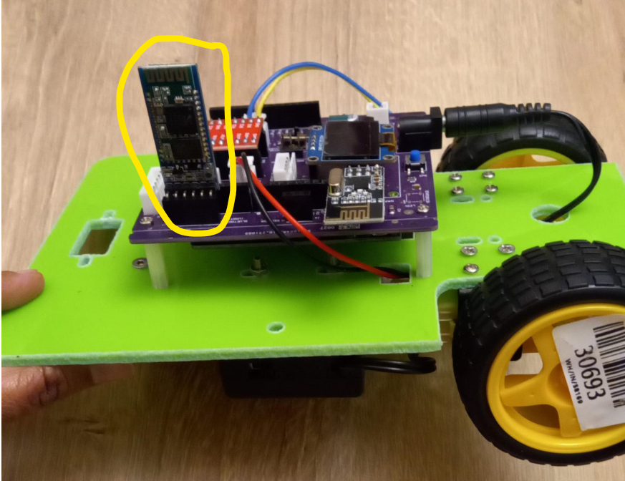
RCC09: Bluetooth Module HC05
Install the App ‘Arduino Bluetooth Control’ from Play Store on your Android Smart Phone.
Remove the HC05 Bluetooth Module from the robot car
Upload the code RCC09_Robot_Car_Control_Using_Voice_Rx.ino
Re-insert the HC05 Bluetooth Module in the car.
Code for RCC09_Robot_Car_Control_Using_Voice_Rx.ino):
https://github.com/info-zas/zas-robotics-car-2-communications/blob/main/01_FoundationProjects/RCC09_Robot_Car_Control_Using_Voice/RCC09_Roboti_Car_Control_Using_Voice_Rx/RCC09_Roboti_Car_Control_Using_Voice_Rx.ino

Slide 6
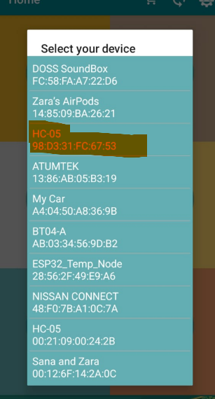
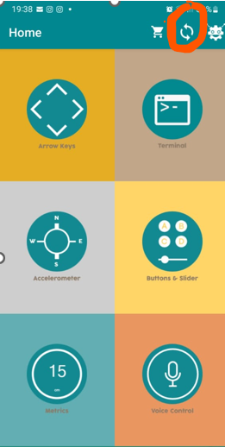
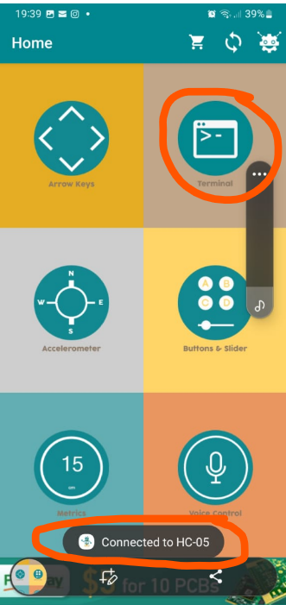
RCC09: Bluetooth APP

Slide 7
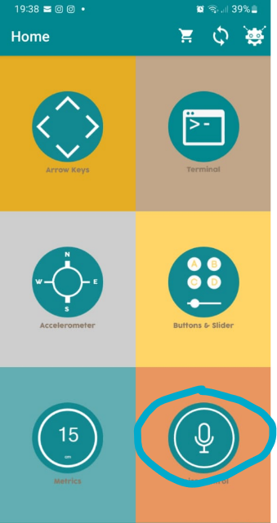
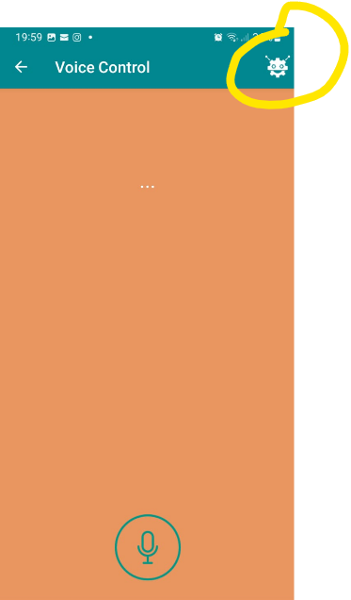
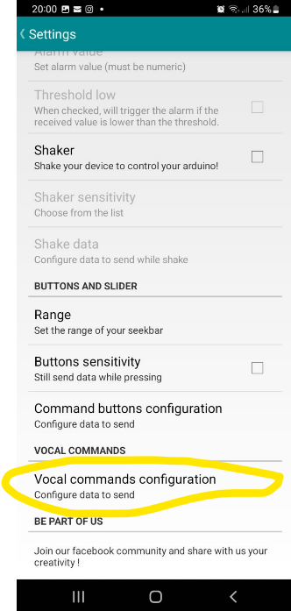
RCC09: Bluetooth APP

Slide 8
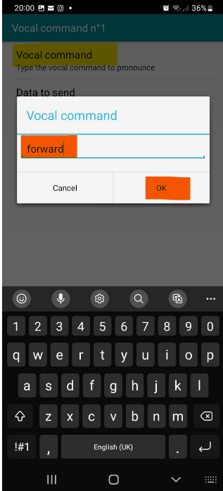
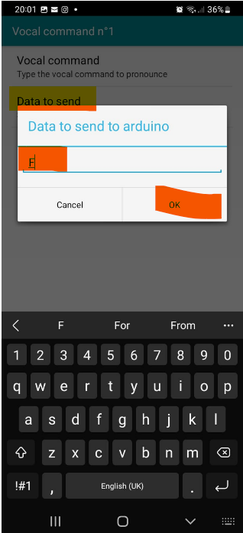
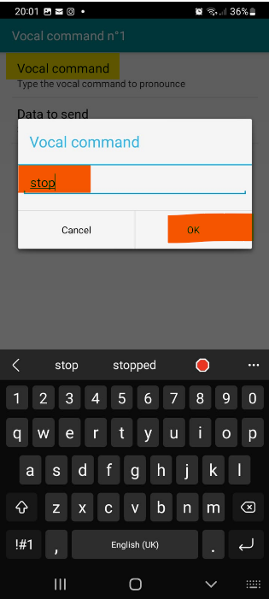
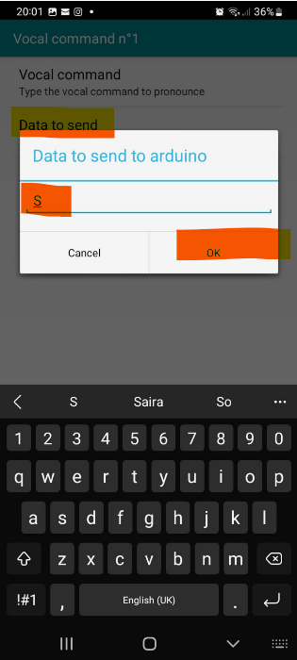
RCC09: Bluetooth APP

Slide 9
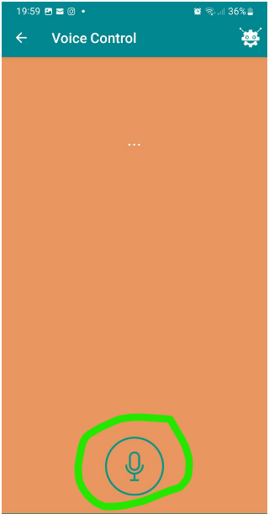
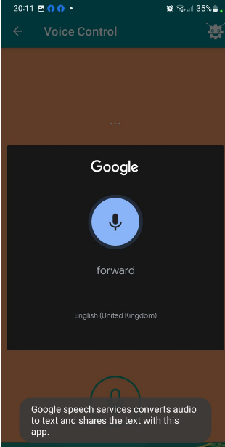
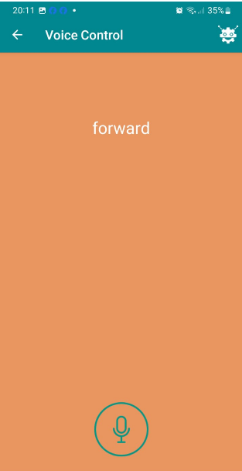
RCC09: Bluetooth APP

Slide 10
RCC09:Robot Car Control Using Voice
RCC09_Robot_Car_Control_Using_Voice_Rx.ino
setup()
Init Serial communication at 9600 baud (HC-05 default)
Configure motor control pins (IN1–IN4, ENA, ENB)
Stop motors at startup
loop()
Check for incoming Bluetooth data via Serial
Read single-character command from mobile app
Decode command and map to motion:
  F → Forward
  B → Backward
  L → Left
  R → Right
  S → Stop
Drive motors using direction pins and PWM speed control
Code for RCC09_Robot_Car_Control_Using_Voice_Rx.ino):
https://github.com/info-zas/zas-robotics-car-2-communications/blob/main/01_FoundationProjects/RCC09_Robot_Car_Control_Using_Voice/RCC09_Roboti_Car_Control_Using_Voice_Rx/RCC09_Roboti_Car_Control_Using_Voice_Rx.ino

