Slide 1

Robot Car 2 (Wireless Communication Control) (RCC)
(Lesson Ref: RCC11)
RCC11:Hybrid Robot Car Control Using IR-NRF

Slide 2



Robot Car2 - Contents
Bluetooth Connector
Button Control
OLED
Arduino
Uno
Mini
Breadboard
Free Connector
Accelerometer
18650 Battery Holder
Colour Sensor Connector
Joystick
Mode
Button
Gesture Sensor Connector
NRF 24L01
Transmitter
Car 2 Transmitter Module (Front)
Car 2 Transmitter Module (Back)

Slide 3


Robot Car2 - Contents
TB6612 Motor Driver
Castor Wheel
Car2 Receiver Motor Controller Board
18650 Battery Holder
NRF 24L01
Receiver
OLED
Battery Connector
DC Motors
Car 2 Receiver Module (Front)
Car 2 Receiver Module (Back)

Slide 4

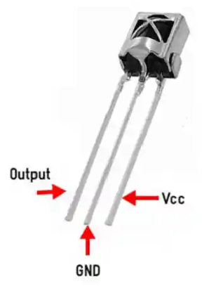

RCC11:Hybrid Robot Car Control Using IR-NRF
Things Needed
Car 2 Transmitter Module
Car 2 Receiver Module

Slide 5
RCC11:Hybrid Robot Car Control Using IR-NRF
IR Remote
↓
IR Receiver (TX Arduino, pin 12)
↓
NRF24L01 (TX)
↓
NRF24L01 (RX)
↓
Motor Driver → Robot Car

Slide 6
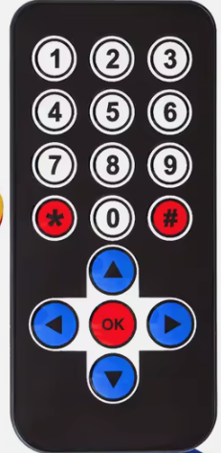
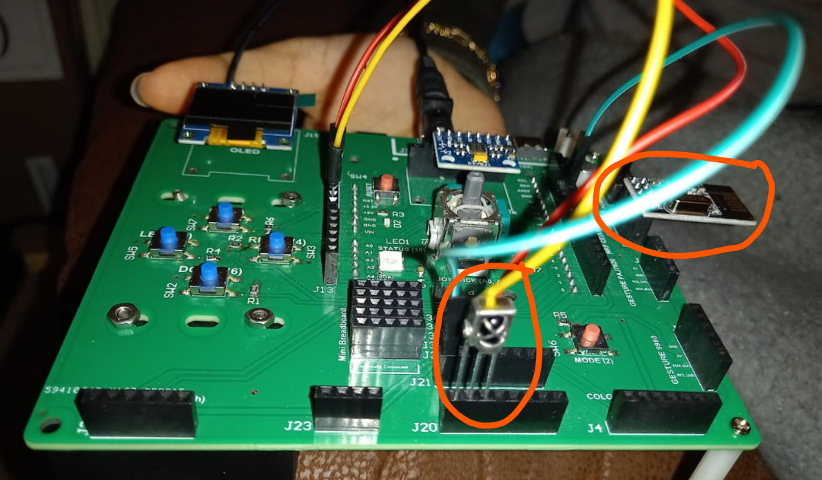
RCC11: IR Tx Codes
Each IR remote has its unique set of code for their keys.
First find the unique code for keys of your IR transmitter remote.
Upload the code (RCC11_a_IR_Remore_Code_Tx.ino ) and get the IR code for each key printed in the serial monitor.
Code for Lesson RCC11 (RCC11_a_IR_Remore_Code_Tx.ino):
https://github.com/info-zas/zas-robotics-car-2-communications/blob/main/01_FoundationProjects/RCC11_Hybrid_Robot_Car_IR_NRF/RCC11_a_IR_Remore_Code_Tx/RCC11_a_IR_Remore_Code_Tx.ino

Slide 7
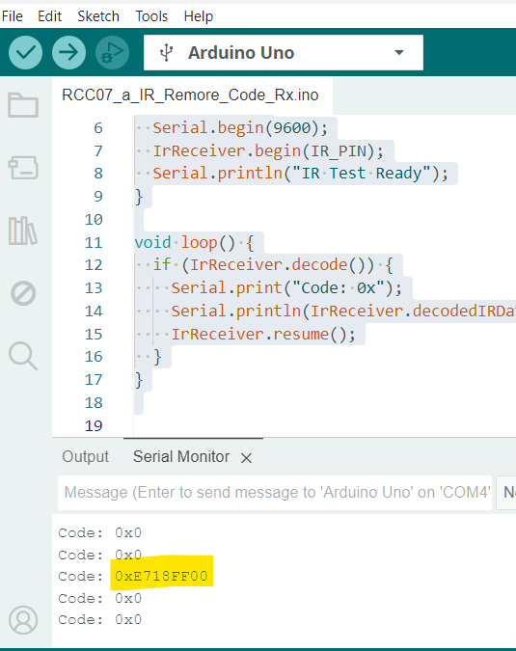
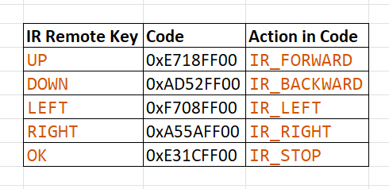
RCC11: IR Tx Codes

Slide 8
RCC11:Hybrid Robot Car Control Using IR-NRF
RCC11_b_Hybrid_Robot_Car_IR_NRF_Tx.ino
setup()
Init IR receiver on pin 12
Init NRF24L01 as TRANSMITTER
  CE = A3, CSN = A2
  Address = "00001", Channel = 108
  PA Level = LOW, TX mode enabled
Start Serial for debugging
loop()
Wait for IR remote input
Decode IR raw data
Map IR codes to commands:
  0xE718FF00 → F (Forward)
  0xAD52FF00 → B (Backward)
  0xF708FF00 → L (Left)
  0xA55AFF00 → R (Right)
  0xE31CFF00 → S (Stop)
Send 1-byte command via NRF24L01
Resume IR receiver for next input
Now that we have the code for the arrow keys of the remote, we can use them in the code the transmitter.
Code for Lesson RCC11 (RCC11_b_Hybrid_Robot_Car_IR_NRF_Tx.ino)
https://github.com/info-zas/zas-robotics-car-2-communications/blob/main/01_FoundationProjects/RCC11_Hybrid_Robot_Car_IR_NRF/RCC11_b_Hybrid_Robot_Car_IR_NRF_Tx/RCC11_b_Hybrid_Robot_Car_IR_NRF_Tx.ino

Slide 9
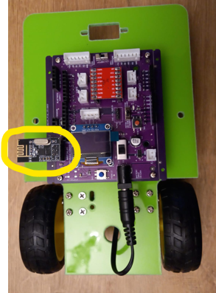
RCC11:Hybrid Robot Car Control Using IR-NRF
Upload the receiver code
RCC11_b_Hybrid_Robot_Car_IR_NRF_Rx.ino in the robot car.
Code for RCC11_b_Hybrid_Robot_Car_IR_NRF_Rx.ino):
https://github.com/info-zas/zas-robotics-car-2-communications/blob/main/01_FoundationProjects/RCC11_Hybrid_Robot_Car_IR_NRF/RCC11_b_Hybrid_Robot_Car_IR_NRF_Rx/RCC11_b_Hybrid_Robot_Car_IR_NRF_Rx.ino

Slide 10
RCC11:Hybrid Robot Car Control Using IR-NRF
RCC11_b_Hybrid_Robot_Car_IR_NRF_Rx.ino
setup()
Configure motor driver pins (IN1–IN4, ENA, ENB)
Stop motors at startup
Init NRF24L01 as RECEIVER
  CE = A3, CSN = A2
  Address = "00001", Channel = 108
  PA Level = LOW, Listening mode enabled
Start Serial for debugging
loop()
Check for incoming NRF24L01 data
Read 1-byte command from transmitter
Decode command and map to motor action:
  F → Forward
  B → Backward
  L → Left
  R → Right
  S / other → Stop
Drive motors using direction pins and PWM speed control

