Slide 1

ZAS Robotic Products
Navigational Robotic Series
Robot Car-3 (Advanced Autonomy)
Car Basic Movements

Slide 2
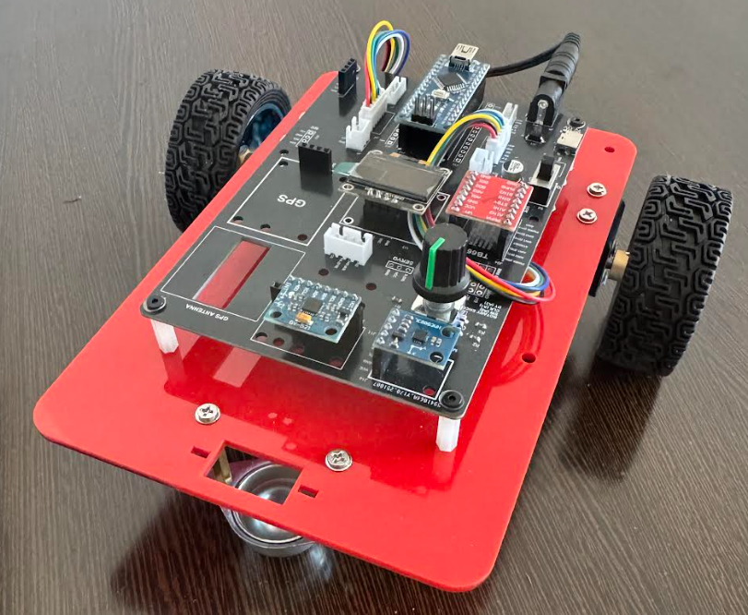
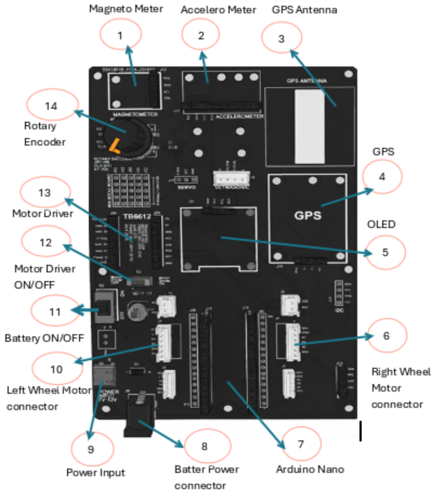
Car Basic Movements
Robot Car-1 - Assembled view and Creative Board component layout

Slide 3
Car Basic Movements
Hardware Architecture
SI No. | Component Name | Description
1 | Magnetometer /Compass | HMC5883L magnetometer sensor used for compass and heading measurement.
2 | Accelerometer | MPU6050 GY-273(IMU) accelerometer sensor used to measure acceleration and tilt.
3 | GPS Antenna | Antenna connection for receiving GPS satellite signals.
4 | GPS Module | NEO-M8N GPS module for position and time data.
5 | OLED Display | OLED display module/connector used for displaying robot status and data.
6 | Right Wheel Motor Connector | Connector for wiring the right wheel DC motor.
7 | Arduino Nano | Microcontroller board acting as the main controller of the robot.
8 | Battery Power Connector | Connector for supplying battery power to the control board.
9 | Power Input | Main power input jack/connector for external power supply.
10 | Left Wheel Motor Connector | Connector for wiring the left wheel DC motor.
11 | Battery ON/OFF Switch | Switch to turn battery power ON or OFF.
12 | Motor Driver ON/OFF Switch | Switch to enable or disable motor driver power.
13 | Motor Driver | TB6612 motor driver module used to drive the DC motors.
14 | Rotary Encoder | Rotary encoder input/device for wheel rotation and position sensing.

Slide 4
Car Basic Movements
Purpose of This Experiment (Car Basic Movements - Mandatory Experiment)
  Initial Motor Verification
  Verify correct motor wiring, polarity, and direction before advanced experiments.
  DC Motor Direction Control
  Understand how motor direction is controlled using an H-Bridge motor driver (TB6612).
  Speed Control using PWM
  Apply PWM signals to regulate motor speed during basic motion testing.
  Robot Motion Validation
  Confirm forward, backward, left, and right movements on the floor using battery power.
Programming Focus
  Basic Arduino Motor Control Code
  Write simple and reliable code to directly control motors.
  Function-Based Movement Logic
  Implement reusable functions for basic car movements.
Key Insight
  Even motors of the same model may rotate differently due to wiring and manufacturing variation.
  Basic movement testing is mandatory before all other robot experiments.

Slide 5
Car Basic Movements
What This Test Confirms
By completing this test, students can verify:
  Correct motor polarity (no reverse movement)
  Proper left and right motor orientation
  Accurate response to PWM speed control
  Safe motor driver operation
Learning Outcome
  Students gain confidence in hardware wiring correctness
  Prevents errors in:
    Line following
    Obstacle avoidance
    Autonomous navigation
Conclusion
  Car Basic Movements is a compulsory foundation experiment that ensures correct motor behavior and reliable hardware setup before progressing to advanced robotics applications.

Slide 6
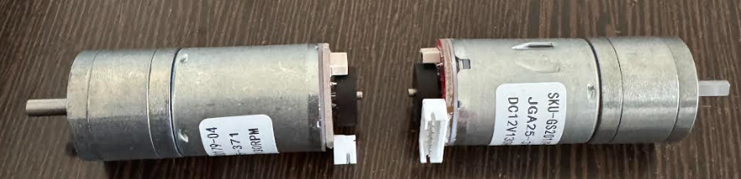
Car Basic Movements
JGA25-371 Motor – Pin Groups, Encoder Details & Comparison
Pin Group | Pin / Wire | Function | Connected To
Motor (Power) | M+ | Motor terminal (+) | TB6612 AO1 / BO1
 | M− | Motor terminal (−) | TB6612 AO2 / BO2
Encoder (Sensor) | VCC | Encoder power supply | Arduino 5V
 | GND | Encoder ground | Arduino GND
 | ENCA_L | Left wheel pulse output | Arduino Pin 2 (Interrupt)
 | ENCB_L | Left wheel direction | Arduino Pin 4
 | ENCA_R | Right wheel pulse output | Arduino Pin 3 (Interrupt)
 | ENCB_R | Right wheel direction | Arduino Pin 5
Motor vs Encoder
Aspect | Motor (via TB6612) | Encoder
Function | Makes wheel rotate | Measures wheel motion
Power/Current | High current | Low-power digital signals
Role | Controls direction & speed | Provides speed, distance & direction
Type | Actuator | Sensor

Slide 7
Car Basic Movements
Technical Comparison of Robot Car-3 Motors With Other Robot Cars
Parameter | JGA25-371 Motor (Silver) | TT Gear Motor (Yellow) | ⭐ JGA25-371 Advantage
Motor Type | DC Geared Motor with Encoder | DC Geared Motor (Basic) | Built-in encoder enables smart control
Construction | Metal body (Aluminum alloy) | Plastic housing | More durable & robust
Operating Voltage | 12V DC | 3V – 6V DC | Higher voltage → higher torque
Rated Speed | 130 RPM @ 12V | 100–200 RPM (varies) | Stable & predictable speed
Encoder | Hall-effect encoder | No encoder | Real-time speed & position feedback
Control Type | Closed-loop (PID possible) | Open-loop | High accuracy motion control
Torque | High (heavy loads) | Moderate (light loads) | Can carry heavier payloads
Durability | High (metal gears) | Moderate | Longer lifespan
Gear Ratio | Precision gear reduction | Standard gear reduction | Smoother motion, less backlash
Noise Level | Quieter | Slightly noisy | Better user experience
Speed Accuracy | ±1 RPM | ±20 RPM | ~20× more accurate

Slide 8
Car Basic Movements
Technical Terms
Term | Sensor / Concept | What It Represents | Role in Robot Navigation
Encoder | Wheel sensor (optical / magnetic) | Counts wheel rotation pulses | Measures wheel rotation, distance, and speed
Quadrature Encoder | Encoder with A & B channels | Phase difference indicates direction | Detects forward / reverse motion
Odometry | Computation method | Estimation of robot position using wheel motion | Short-distance position tracking
RPM | Derived value | Wheel rotations per minute | Used for speed control
Linear Velocity | Derived value | Robot speed in m/s or km/h | Motion estimation
Gyroscope (Gyro) | IMU sensor | Angular velocity (°/s) | Detects turning rate
Accelerometer | IMU sensor | Linear acceleration (m/s²) | Detects motion start, stop, tilt
Magnetometer | IMU sensor | Earth’s magnetic field | Absolute heading reference
Compass | Derived concept | Direction w.r.t. North | Global orientation
IMU | Sensor fusion unit | Gyro + Accel + Magnetometer | Orientation and motion sensing
Heading | Computed angle | Robot orientation angle | Navigation and turning
Drift | Error effect | Accumulated position error | Odometry limitation
GPS | Satellite system | Global position (Lat/Lon) | Absolute outdoor positioning
Sensor Fusion | Algorithmic concept | Combining multiple sensors | Improves accuracy & reliability

Slide 9
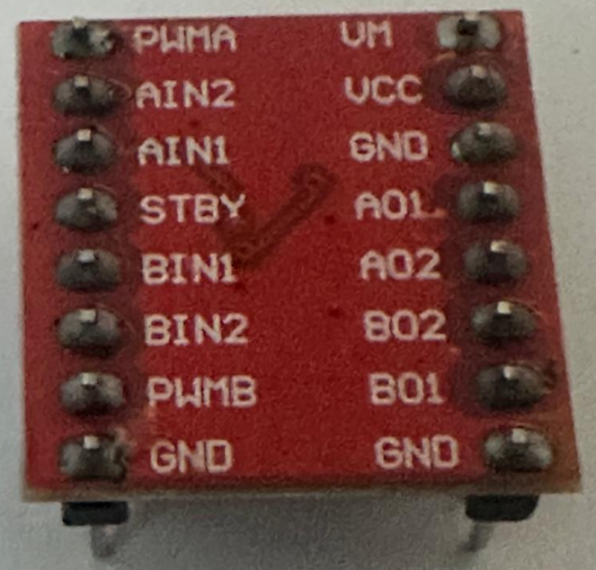
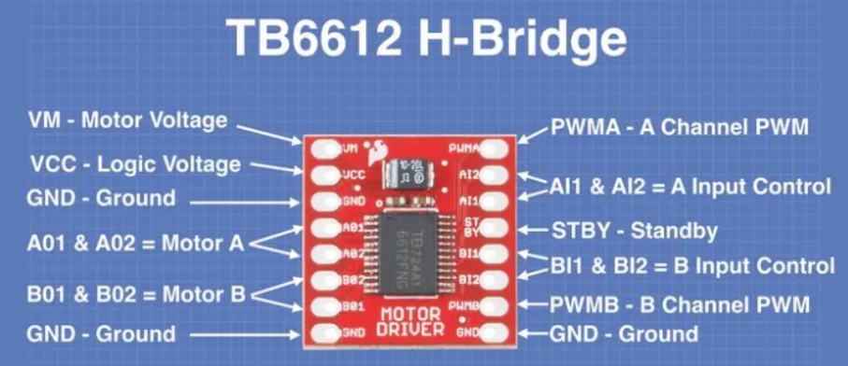
Car Basic Movements
Hardware Architecture
Pin Name | Function | Description | Connected To (in Our Robot)
PWMA(PWM_L) | Speed Control (A) | PWM input for Motor A speed (0-255) | Arduino Pin 6
AIN1 (IN1_L) | Direction (A) Bit 1 | Motor A direction control | Arduino Pin 7
AIN2 (IN2_L) | Direction (A) Bit 2 | Motor A direction control | Arduino Pin 8
PWMB(PWM_R) | Speed Control (B) | PWM input for Motor B speed (0-255) | Arduino Pin 11
BIN1 (IN1_R) | Direction (B) Bit 1 | Motor B direction control | Arduino Pin 12
BIN2(IN2_R) | Direction (B) Bit 2 | Motor B direction control | Arduino Pin 10
STBY | Standby | Enable/Disable driver (HIGH = enabled) | Usually tied to VCC
VM | Motor Power | 7-12V for motors | External battery
VCC | Logic Power | 5V from Arduino | Arduino 5V
GND | Ground | Common ground | Arduino GND
AO1/AO2 | Motor A Outputs | Connect to Motor A terminals | Left Motor
BO1/BO2 | Motor B Outputs | Connect to Motor B terminals | Right Motor
What is TB6612?
TB6612 (TB6612FNG) is a dual H-bridge motor driver
It allows a microcontroller (Arduino) to control two DC motors
Controls direction + speed safely
Back View of Driver

Slide 10
Car Basic Movements
Why TB6612 is Used
  Arduino pins → logic only (low current)
  Motors → high current
  TB6612 safely interfaces logic with power
How it works (clear chain)
  Arduino (decision-maker)
    Sets the logic pins:
      AIN1 / AIN2 → Motor A direction
      BIN1 / BIN2 → Motor B direction
TB6612 (power stage)
  Interprets those logic levels
  Internally switches the H-bridge
  Reverses current on AO1/AO2 or BO1/BO2
Motor
  Spins forward or reverse depending
  on current direction
Direction logic (example: Motor A)
AIN1 | AIN2 | What Arduino commands | What TB6612 does
HIGH | LOW | Forward | AO1=HIGH, AO2=LOW
LOW | HIGH | Reverse | AO1=LOW, AO2=HIGH
LOW | LOW | Brake | Both LOW
HIGH | HIGH | Brake | Both HIGH

Slide 11
Car Basic Movements
Why Choose JGA25-371? (Key Advantages)
1. Encoder Feedback = Smart Control
  Knows exact speed and position
  Detects stalling & wheel slippage
2. Professional-Level Performance
  Used in industry & research
  Repeatable results
  Ideal for robot competitions
3. Advanced Algorithms Possible
  Odometry (distance tracking)
  Path planning
  SLAM
  Autonomous navigation Real-World Analogy (Easy to Understand)
  Enables PID control
4. Educational Value
  Learn control systems (PID)
  Understand feedback mechanisms
  Bridge theory ↔ real-world robotics
Concept | TT Motor | JGA25-371 Motor
Driving a car | Blindfolded | Eyes open
Speed awareness | Guessing | Speedometer
Control method | Open-loop | Closed-loop (auto correction)

Slide 12
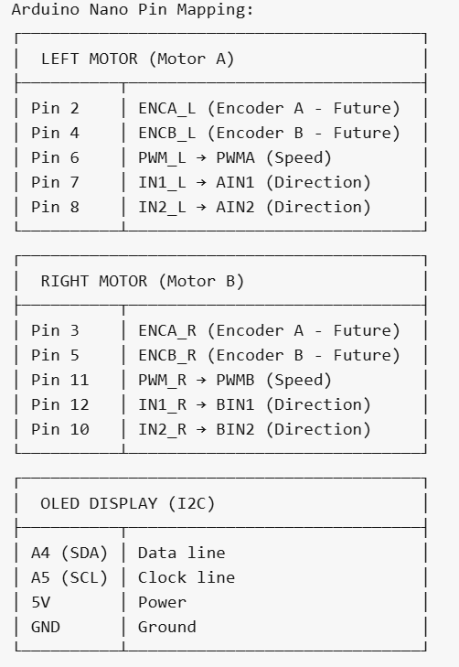
Car Basic Movements
How H-Bridge Controls Motor Direction
Motor Control Truth Table
IN1 | IN2 | Motor Action
HIGH | LOW | ➡️ Forward
LOW | HIGH | ⬅️ Backward
LOW | LOW | 🛑 Stop (Coast)
HIGH | HIGH | 🔒 Brake
How It Works
IN1 = HIGH, IN2 = LOW: Switches S1 & S4 ON → Current flows one way → Motor spins Forward
IN1 = LOW, IN2 = HIGH: Switches S2 & S3 ON → Current flows opposite way → Motor spins Backward
Both LOW: No current → Motor coasts to stop
Both HIGH: Motor terminals shorted → Active brake

Slide 13
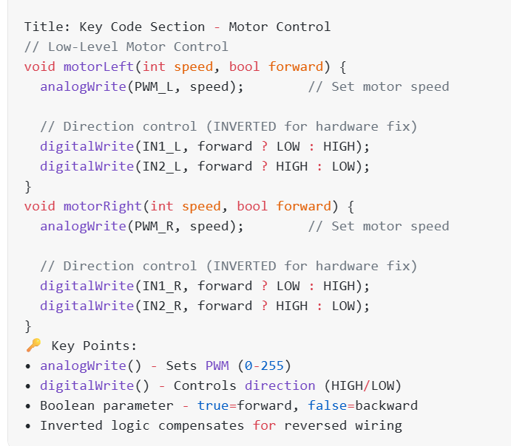
Car Basic Movements
Code Highlights -
Motor Control Functions

Slide 14
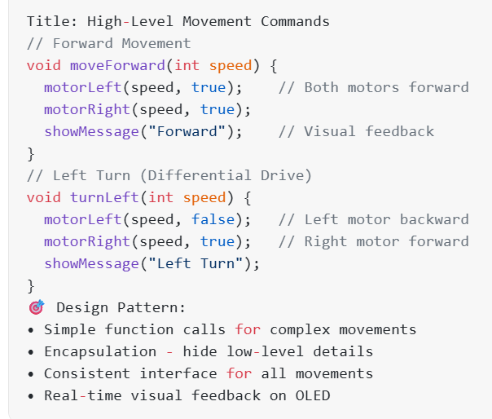
Car Basic Movements
Code Highlights -Movement Functions

Slide 15
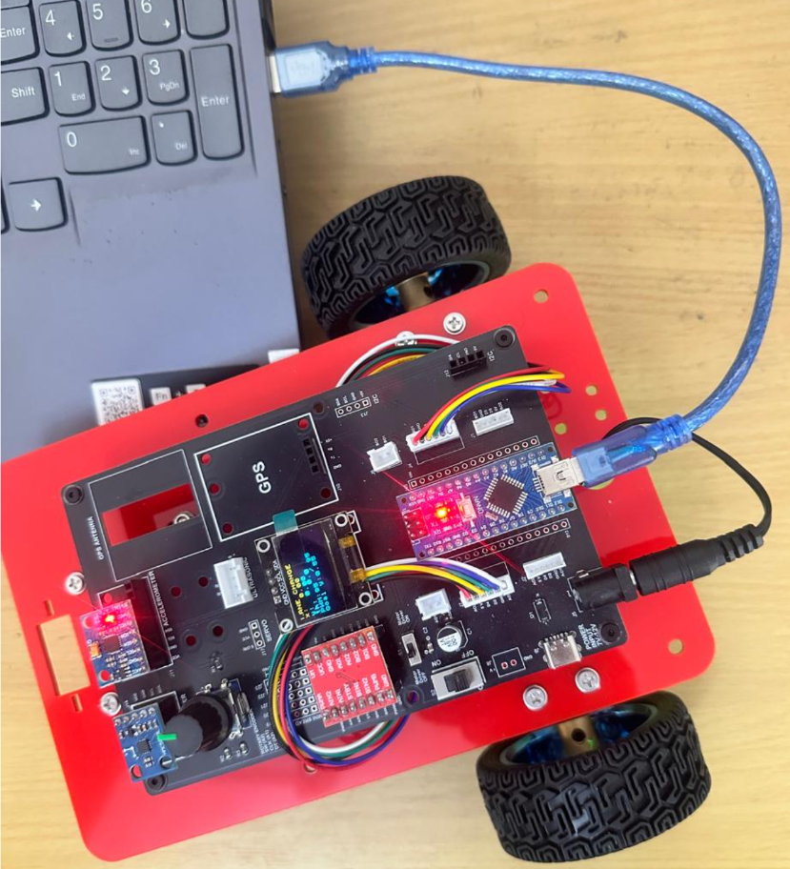
Car Basic Movements
Critical Programming Setup
  MANDATORY Switch Settings Before Uploading Code
  Before connecting USB and uploading program:
    “Motor Driver ON/OFF” Switch
      ⚠️ MUST BE SET TO: OFF
    Why?
      Prevents motors from running during code upload
      Avoids car moving unexpectedly on desk
      Protects USB connection from power surges

Slide 16
Car Basic Movements
During Programming (Code Upload):
  Step 1: Connect USB cable to computer
  Step 2: Set Switch “Motor Driver ON/OFF” → OFF
  Step 3: Set Switch “Battery ON/OFF ” → OFF ->for batter power
  Step 4: Upload your the respective program
  Step 5: Wait for "Upload Complete" message
  Step 6: Disconnect USB cable
Before Testing (Running the Robot):
  Step 1: Place robot on the ground. No obstacle as this test for basic movements
  Step 2: Set Switch “Motor Driver ON/OFF” ->ON ( motor driver ON)
  Step 3: Set Switch “Battery ON/OFF” → ON -> for batter power
  Step 4: Monitor the Robot car-3 Movements & OLED , Monitior the functionality according to the program
https://github.com/info-zas/zas-robotics-car-3-encoders-imu-gps/tree/main/01_FoundationProjects/01_Car-3_Basic_Movements
Lesson Code – GitHub URL:

Slide 17
Q&A
Invite Questions: Encourage the audience to ask questions for further clarification or discussion.

