Slide 1

ZAS Robotic Products
Navigational Robotic Series
Robot Car-3 (Advanced Autonomy)
Encoder Odometry with PI Speed Control
(Closed-Loop Motion Control & Position Estimation)

Slide 2
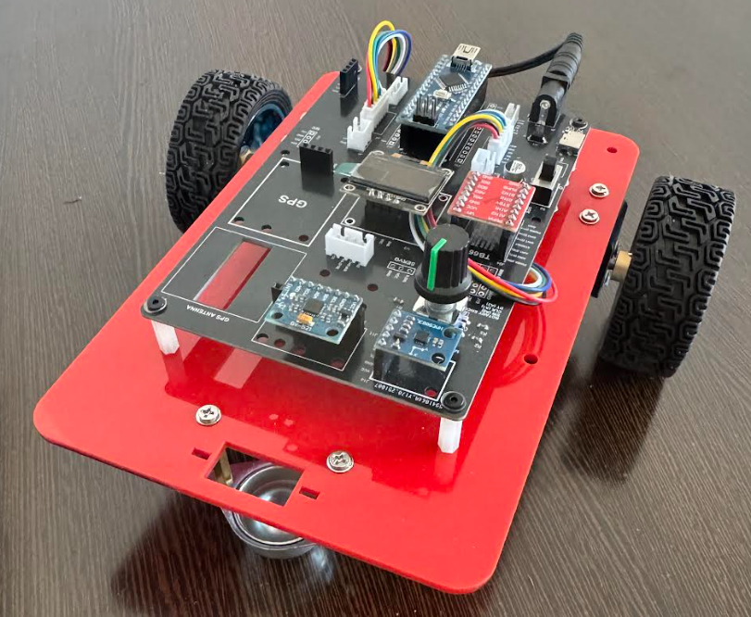
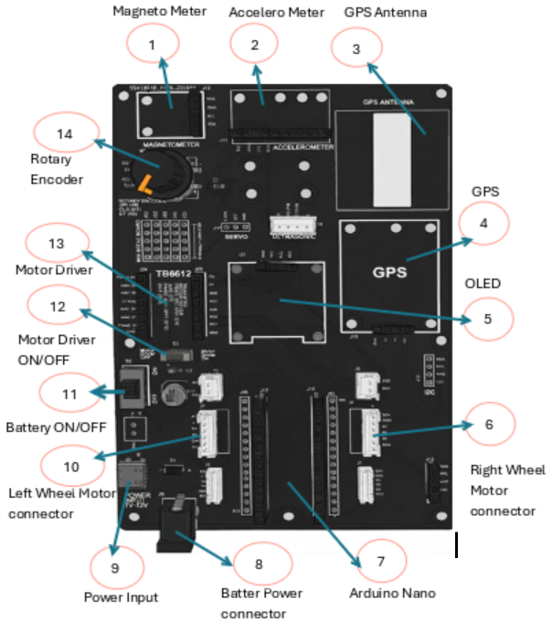
Sine Wave Trajectory Tracking
Robot Car-3 - Assembled view and Creative Board component layout

Slide 3
Encoder Odometry with PI Speed Control
Why Do We Need This Experiment?
Robots can move using:
  Fixed PWM (open loop)
  Simple timing logic
But autonomous robots must:
  Move predictably
  Correct errors automatically
  Estimate where they are while moving
📌 This experiment introduces the minimum building blocks of autonomy.

Slide 4
Encoder Odometry with PI Speed Control
What This Program Demonstrates
High-Level Description
This program makes the robot:
  Drive straight forward
  Maintain constant wheel speed
  Estimate position and orientation
  Stop accurately at 1 meter
All using:
  Encoders
  PI control
  Simple odometry

Slide 5
Encoder Odometry with PI Speed Control
Learning Objectives
After This Experiment, Students Will Be Able To:
  Explain encoder-based speed measurement
  Implement PI speed control
  Synchronize left & right wheel motion
  Estimate robot pose using odometry
  Understand how closed-loop motion improves accuracy

Slide 6
Encoder Odometry with PI Speed Control
Hardware & Sensors Used
System Components
  Differential drive robot
  Left & right DC motors
  Incremental encoders (Channel A)
  Motor driver (TB6612)
  OLED display
📌 No IMU, no GPS — intelligence comes from encoders + math.

Slide 7
Encoder Odometry with PI Speed Control
Role of Encoders
Why Encoders Are Essential
Encoders provide:
  Wheel rotation count (ticks)
  Speed information
  Relative motion between wheels
Encoders enable:
  Speed feedback
  Odometry
  Closed-loop correction
Without encoders, robot motion is uncontrolled.

Slide 8


Encoder Odometry with PI Speed Control
Distance From Encoder Ticks
Basic Measurement
In code:
📌 Converts electrical pulses into real-world distance.

Slide 9
Encoder Odometry with PI Speed Control
What Is Odometry?
Definition
Odometry is the process of estimating a robot’s position using wheel motion.
It estimates:
  x: forward displacement
  y: lateral displacement
  θ: orientation (heading)
Odometry answers:
  “Where am I now, based on how my wheels moved?”

Slide 10


Encoder Odometry with PI Speed Control
Differential Drive Odometry Model
Robot Kinematics
Average motion:
Rotation:
This model is used in most mobile robots.

Slide 11
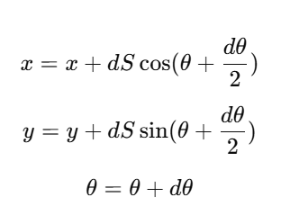
Encoder Odometry with PI Speed Control
Pose Update Equations
Updating Robot Position
Pose is updated continuously while moving.
Why Speed Control Is Needed
Problem With Open-Loop Motion
If motors run without feedback:
  Battery voltage varies
  Motors differ slightly
  Robot drifts or curves
Solution: Closed-loop speed control

Slide 12



Encoder Odometry with PI Speed Control
Speed Measurement
How Speed Is Computed
Encoders act as speed sensors.
PI Control Law
PWM Update Equation
In code:

Slide 13


Encoder Odometry with PI Speed Control
Wheel Speed Synchronization
Why Synchronize Wheels?
Even with PI:
  Left and right motors behave differently
Synchronization logic:
Correct targets:
Keeps robot moving straight.

Slide 14
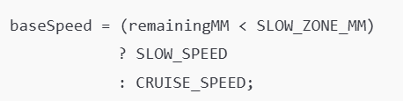
Encoder Odometry with PI Speed Control
Distance-Based Speed Planning
Smart Speed Selection
  Fast when far from target
  Slow near the stop point
Prevents overshoot.

Slide 15
Encoder Odometry with PI Speed Control
Overall Algorithm
Step-by-Step Logic
  Read encoder ticks
  Measure wheel speeds
  Update odometry (x,y,θ)
  Compute remaining distance
  Select target speed
  Synchronize wheels
  Apply PI control
  Update PWM
  Stop at 1 meter

Slide 16
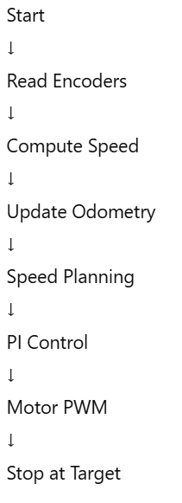
Encoder Odometry with PI Speed Control
Flowchart

Slide 17
Encoder Odometry with PI Speed Control
Test Procedure (Laboratory Method)
Step-by-Step Testing
Hardware Setup
  Flat floor, ≥ 1.5 m space
  Encoder A → D2 (Left), D3 (Right)
  OLED address 0x3C
Safety Test
  Lift robot (wheels free)
  Power ON
  Wheels rotate forward
  OLED distance increases
Ground Test
  Place robot at marked start
  Power ON
  Measure stopping distance
  Observe OLED values

Slide 18
Encoder Odometry with PI Speed Control
Expected Results
What Students Should Observe
Robot moves forward ~1 m
Stops smoothly
x increases
  y≈0
  θ≈0
Left/right speeds close
PWM values slightly different
Small PWM difference = healthy control.

Slide 19
Encoder Odometry with PI Speed Control
Applications
Where This Is Used
  Mobile robot localization
  Autonomous ground vehicles
  Warehouse AGVs
  Robotics research platforms
Same principles scale to industry systems.
FINAL SLIDE — Key Takeaway
Big Picture Message
  Motors create motion
  Encoders create information
  Control creates stability
  Odometry creates awareness
This experiment is the foundation of autonomous navigation.

Slide 20
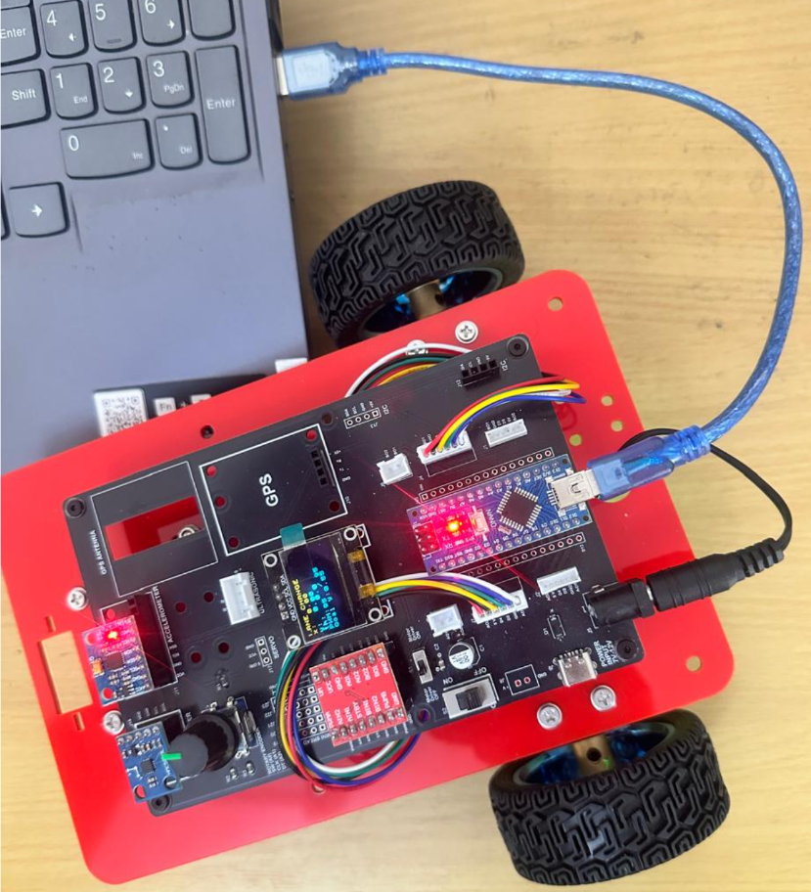
Encoder Odometry with PI Speed Control
Critical Programming Setup
  MANDATORY Switch Settings Before Uploading Code
  Before connecting USB and uploading program:
    “Motor Driver ON/OFF” Switch
      ⚠️ MUST BE SET TO: OFF
    Why?
      Prevents motors from running during code upload
      Avoids car moving unexpectedly on desk
      Protects USB connection from power surges

Slide 21
Encoder Odometry with PI Speed Control
During Programming (Code Upload):
  Step 1: Connect USB cable to computer
  Step 2: Set Switch “Motor Driver ON/OFF” → OFF
  Step 3: Set Switch “Battery ON/OFF ” → OFF ->for batter power
  Step 4: Upload your the respective program
  Step 5: Wait for "Upload Complete" message
  Step 6: Disconnect USB cable
Before Testing (Running the Robot):
  Step 1: Place robot on the ground. No obstacle as this test for basic movements
  Step 2: Set Switch “Motor Driver ON/OFF” ->ON ( motor driver ON)
  Step 3: Set Switch “Battery ON/OFF” → ON -> for batter power
  Step 4: Monitor the Robot car-3 Movements & OLED , Monitior the functionality according to the program
https://github.com/info-zas/zas-robotics-car-3-encoders-imu-gps/tree/main/01_FoundationProjects/10_Car-3_Sine_Trajectory
Lesson Code – GitHub URL:

Slide 22
Q&A
Invite Questions: Encourage the audience to ask questions for further clarification or discussion.

