Slide 1

ZAS Robotic Products
Navigational Robotic Series
Robot Car-3 (Advanced Autonomy)
Gyro-Aided Odometry (Z-axis) with PI Speed Control
(Sensor Fusion for Better Heading Estimation)

Slide 2
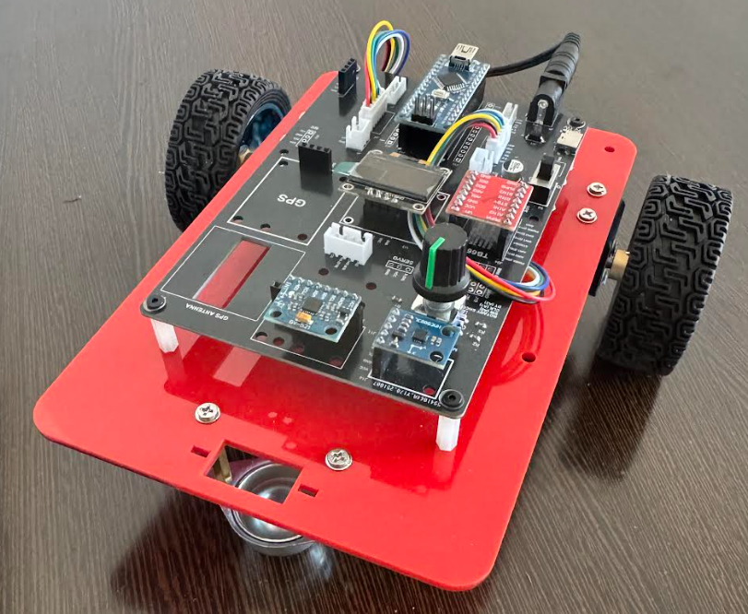
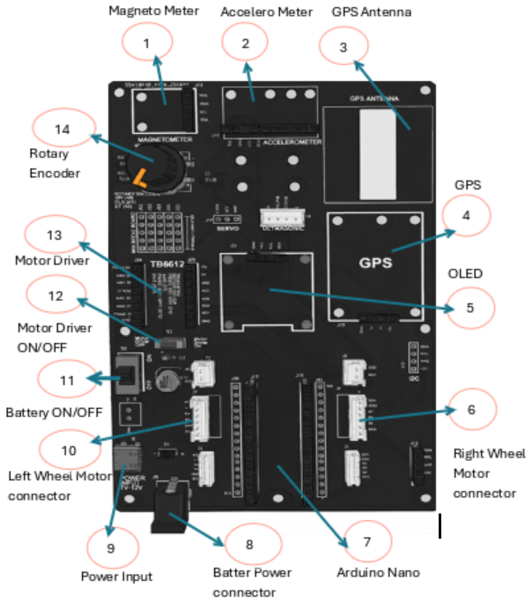
Gyro-Aided Odometry (Z-axis) with PI Speed Control
Robot Car-3 - Assembled view and Creative Board component layout

Slide 3
Gyro-Aided Odometry (Z-axis) with PI Speed Control
Objective of This Program
What is the goal?
  This program makes the robot:
  Drive straight forward ~1 meter
  Maintain controlled wheel speed (PI control)
  Estimate pose (x,y,θ) using odometry
  Improve heading θ using MPU6050 gyro Z-axis
  Display live data on OLED
It answers:
“How can we reduce odometry heading error using a gyroscope?”

Slide 4
Gyro-Aided Odometry (Z-axis) with PI Speed Control
Big Picture: Why This Lesson Exists
Why gyro-aided odometry?
Encoder-only odometry works, but in real robots:
  Wheels slip slightly
  Left/right wheel diameters differ
  Floor friction changes
  Encoder-only heading θ drifts
Gyro measures rotation directly, so we combine:
  Encoders → reliable distance
  Gyro Z → reliable short-term heading rate
This is the entry point to sensor fusion (core autonomy skill)

Slide 5
Gyro-Aided Odometry (Z-axis) with PI Speed Control
Learning Outcomes
After this experiment, students can:
  Explain odometry and robot pose (x,y,θ)
  Compute speed from encoders (ticks/sec)
  Implement PI speed control
  Calibrate and use gyro bias
  Fuse gyro + encoder heading using a complementary blend
  Understand why fusion improves navigation robustness

Slide 6
Gyro-Aided Odometry (Z-axis) with PI Speed Control
System Components
Hardware
  Differential-drive robot
  Wheel encoders (Left/Right)
  TB6612 motor driver
  MPU6050 IMU (gyro + accel)
  OLED (U8X8)
Sensors Used
  Encoders: distance & wheel speed
  Gyro Z: yaw rate (turning rate)

Slide 7
Gyro-Aided Odometry (Z-axis) with PI Speed Control
System Components
Hardware
  Differential-drive robot
  Wheel encoders (Left/Right)
  TB6612 motor driver
  MPU6050 IMU (gyro + accel)
  OLED (U8X8)
Sensors Used
  Encoders: distance & wheel speed
  Gyro Z: yaw rate (turning rate)

Slide 8
Gyro-Aided Odometry (Z-axis) with PI Speed Control
System Components
Hardware
  Differential-drive robot
  Wheel encoders (Left/Right)
  TB6612 motor driver
  MPU6050 IMU (gyro + accel)
  OLED (U8X8)
Sensors Used
  Encoders: distance & wheel speed
  Gyro Z: yaw rate (turning rate)

Slide 9
Gyro-Aided Odometry (Z-axis) with PI Speed Control
Key Terms
Term | Meaning (Simple & Clear)
Tick | Encoder pulse
MM_PER_TICK | Millimeters traveled per encoder tick
Wheelbase | Distance between left and right wheels
Pose | Robot position and orientation → (x, y, θ)
Odometry | Estimating robot pose using wheel encoders
Gyro bias | Non-zero gyro output when robot is stationary
ωz | Angular velocity about Z-axis (rad/s)
Complementary fusion | Weighted blend of two sensor estimates
PI control | Feedback control using proportional + integral
Kp (Proportional gain) | Response to current error
Ki (Integral gain) | Response to accumulated error
Term | Meaning (Simple & Clear)
Error (e) | Difference between setpoint and measurement
PWM | Motor speed control using duty cycle
Duty cycle | Percentage of ON time in PWM signal
Setpoint | Desired target value
Feedback | Measured output returned to controller
Closed-loop control | Control using feedback
Open-loop control | Control without feedback
Yaw (θ) | Rotation about Z-axis (left/right turning)
Heading | Robot’s facing direction in global frame
Bearing | Direction to a target relative to robot

Slide 10
Gyro-Aided Odometry (Z-axis) with PI Speed Control
What is Odometry?
Odometry estimates robot pose from wheel motion:
  x = forward position
  y = sideways position
  θ = heading angle
Odometry answers:
“Where am I based on how my wheels moved?”

Slide 11

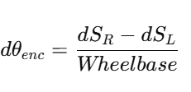

Gyro-Aided Odometry (Z-axis) with PI Speed Control
Encoder Distance Model
    Wheel travel per update:
    In code:
Encoder Heading Model (Wheel-based)
Differential drive heading change:
In code:
Encoder heading is sensitive to slip/mismatch.

Slide 12
Gyro-Aided Odometry (Z-axis) with PI Speed Control
Encoder Distance Model
    Wheel travel per update:
    In code:
Encoder Heading Model (Wheel-based)
Differential drive heading change:
In code:
Encoder heading is sensitive to slip/mismatch.

Slide 13


Gyro-Aided Odometry (Z-axis) with PI Speed Control
Gyroscope Heading Model (Rate-based)
Gyro measures yaw rate ωz (rad/s):
In code:
Gyro measures turning directly, but drifts if biased.

Slide 14


Gyro-Aided Odometry (Z-axis) with PI Speed Control
Gyro Bias Calibration (Why + How)
Why bias calibration?
  Gyro output at rest is not exactly zero:
How it’s done here
  Keep robot still
  Average N samples
  Bias = mean value
In code:
📌 Bias removal is mandatory before using gyro for heading.

Slide 15


Gyro-Aided Odometry (Z-axis) with PI Speed Control
Noise Handling: Deadband
  Small gyro noise is suppressed:
  📌 Prevents tiny noise from integrating into false heading changes.
Sensor Fusion (Complementary Blend)
  We fuse heading increments:
In code:
Interpretation:
  α closer to 1 → trust gyro more (short-term)
  1−α keeps encoder contribution (stability)
This is a simple but powerful fusion approach.

Slide 16
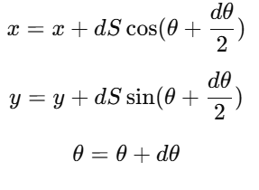
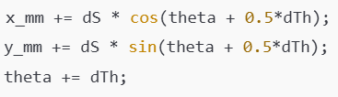
Gyro-Aided Odometry (Z-axis) with PI Speed Control
Pose Update Using Fused Heading
In code:

Slide 17

Gyro-Aided Odometry (Z-axis) with PI Speed Control
Why PI Speed Control Still Matters
Even with good heading estimation, motors must be controlled:
  Battery voltage changes
  Motor friction differs
  Speed measurement:
PI updates PWM to match target speed.

Slide 18


Gyro-Aided Odometry (Z-axis) with PI Speed Control
Wheel Synchronization (Drive Straight)
Speed difference:
Targets corrected:
Keeps robot straight even if motors differ.

Slide 19




Gyro-Aided Odometry (Z-axis) with PI Speed Control
Overall Algorithm (Chronological)
  Initialize OLED, encoders, motor pins
  Initialize MPU6050
  Calibrate gyro bias (robot still)
Every 50 ms:
  Read encoder ticks and compute wheel speed
  Compute encoder-based
  Read gyro Z and compute ​
  Fuse heading increment
  Update odometry pose
  Apply speed planning (cruise/slow zone)
  Sync wheel targets, run PI to compute PWM
  Drive motors and update OLED
Stop at 1 meter (brake + coast)

Slide 20
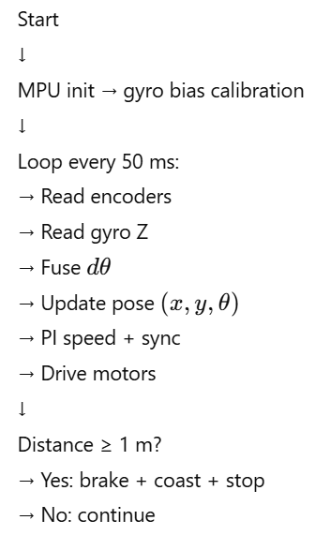
Gyro-Aided Odometry (Z-axis) with PI Speed Control
Flowchart

Slide 21


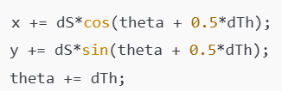
Gyro-Aided Odometry (Z-axis) with PI Speed Control
Code Highlights (Only the Essentials)
1) Gyro bias calibration (still robot)
2) Fusion equation (core autonomy concept)
3) Pose update (odometry)

Slide 22
Gyro-Aided Odometry (Z-axis) with PI Speed Control
Test Procedure (1–2 slides max)
Safety + Ground Test
  Upload code with motor-driver OFF (if switch exists)
  Lift robot (wheels free):
  ensure forward rotation
  OLED updates
  Place on flat floor (≥1.5 m clear)
  Mark start line and stop point
Observe OLED:
  x increases
  y stays near 0
  θ stays near 0°
  L/R speeds close; PWM may differ slightly

Slide 23
Gyro-Aided Odometry (Z-axis) with PI Speed Control
Test Procedure (1–2 slides max)
Safety + Ground Test
  Upload code with motor-driver OFF (if switch exists)
  Lift robot (wheels free):
  ensure forward rotation
  OLED updates
  Place on flat floor (≥1.5 m clear)
  Mark start line and stop point
Observe OLED:
  x increases
  y stays near 0
  θ stays near 0°
  L/R speeds close; PWM may differ slightly

Slide 24
Gyro-Aided Odometry (Z-axis) with PI Speed Control
Expected Results
  Robot travels ~1 m and stops smoothly
  Straighter than open loop
  Heading drift reduced due to gyro fusion
  OLED shows stable pose estimation
Small PWM differences are normal and indicate correction.
Applications
  This method is foundational for:
  Dead-reckoning navigation
  Autonomous indoor robots (no GPS)
  SLAM pre-requisite (needs odometry)
  Sensor fusion pipelines (EKF later)
  Reliable turning and path following

Slide 25
Gyro-Aided Odometry (Z-axis) with PI Speed Control
Key Takeaway
Encoders measure translation
Gyro measures rotation rate
Fusion improves heading estimation
Odometry gives robot awareness
This experiment is the bridge from:
control → estimation → autonomy

Slide 26
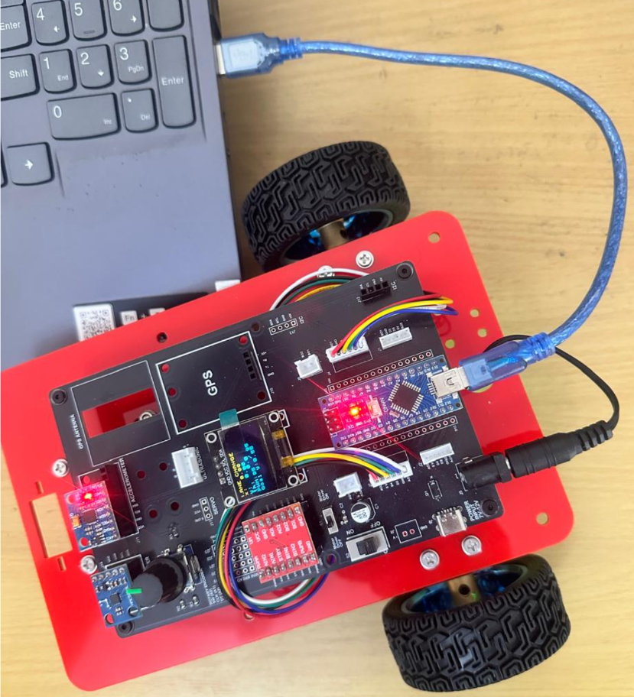
Gyro-Aided Odometry (Z-axis) with PI Speed Control
Critical Programming Setup
  MANDATORY Switch Settings Before Uploading Code
  Before connecting USB and uploading program:
    “Motor Driver ON/OFF” Switch
      ⚠️ MUST BE SET TO: OFF
    Why?
      Prevents motors from running during code upload
      Avoids car moving unexpectedly on desk
      Protects USB connection from power surges

Slide 27
Gyro-Aided Odometry (Z-axis) with PI Speed Control
During Programming (Code Upload):
  Step 1: Connect USB cable to computer
  Step 2: Set Switch “Motor Driver ON/OFF” → OFF
  Step 3: Set Switch “Battery ON/OFF ” → OFF ->for batter power
  Step 4: Upload your the respective program
  Step 5: Wait for "Upload Complete" message
  Step 6: Disconnect USB cable
Before Testing (Running the Robot):
  Step 1: Place robot on the ground. No obstacle as this test for basic movements
  Step 2: Set Switch “Motor Driver ON/OFF” ->ON ( motor driver ON)
  Step 3: Set Switch “Battery ON/OFF” → ON -> for batter power
  Step 4: Monitor the Robot car-3 Movements & OLED , Monitior the functionality according to the program
https://github.com/info-zas/zas-robotics-car-3-encoders-imu-gps/tree/main/01_FoundationProjects/10_Car-3_Sine_Trajectory
Lesson Code – GitHub URL:

Slide 28
Q&A
Invite Questions: Encourage the audience to ask questions for further clarification or discussion.

