Slide 1

ZAS Robotic Products
Navigational Robotic Series
Robot Car-3 (Advanced Autonomy)
Sine Wave Trajectory Tracking
(Using Encoder Odometry & Pure Pursuit Steering)

Slide 2
Sine Wave Trajectory Tracking
Experiment Objective
Objective of This Experiment
  The goal of this experiment is to:
    Make the robot follow a predefined curved path
    Use encoder feedback to estimate robot position
    Continuously adjust steering using control logic
    Demonstrate trajectory tracking, not just motion
This experiment answers:
  “How does a robot follow a path, not just move?”

Slide 3
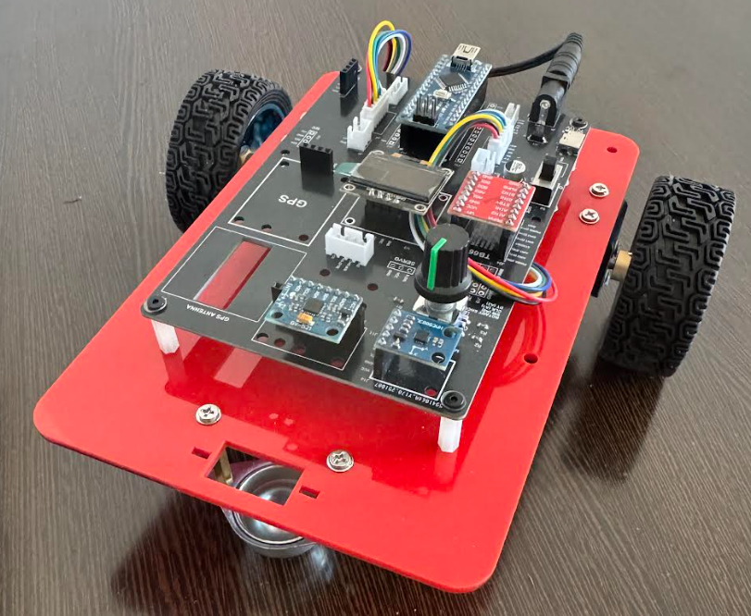
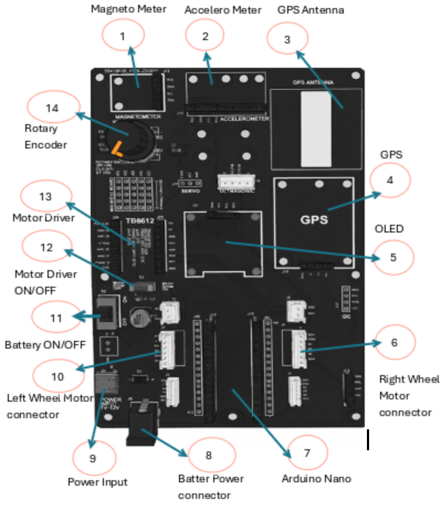
Sine Wave Trajectory Tracking
Robot Car-3 - Assembled view and Creative Board component layout

Slide 4
Sine Wave Trajectory Tracking
Term | Meaning
Tick | One digital pulse generated by the encoder
Encoder (Incremental) | Sensor that outputs ticks proportional to shaft rotation
Encoder PPR | Number of ticks per motor shaft revolution
Gear Ratio | Ratio of motor rotations to one wheel rotation
ΔTicks | Change in encoder ticks between two measurements
dt (Sampling Time) | Time interval between two control updates
Measured Speed | Wheel speed computed as Δticks / dt
Target Speed | Desired wheel speed set by the program
Error | Difference between target speed and measured speed
KP (Proportional Gain) | Gain that reacts to current error
KI (Integral Gain) | Gain that reacts to accumulated error
Integral Term | Sum of error over time (controller memory)
PWM (Pulse Width Modulation) | Method to control motor voltage/speed
Control Loop | Repeating cycle of measure → compute → act
Closed-Loop Control | Control system using feedback from sensors
PI Control | Feedback control using Proportional + Integral terms
Key
Terms

Slide 5
Sine Wave Trajectory Tracking
Prerequisites (What Students Should Know)
Before this experiment, students should understand:
  PWM motor control
  Incremental encoders (ticks)
  Basic trigonometry
  Cartesian coordinates (x,y)
Differential drive concept
This lab builds on earlier straight-line and distance-control experiments.

Slide 6
Sine Wave Trajectory Tracking
Learning Outcomes
After This Experiment, Students Can:
  Understand trajectory tracking
  Use encoders for localization
  Implement pure pursuit control
  Connect math with real robot motion
  Explain how autonomy is built step-by-step

Slide 7
Sine Wave Trajectory Tracking
What Is New in This Experiment
Key Learning Upgrade
Earlier experiments taught:
  Go forward
  Stop at distance
  Turn left / right
This experiment teaches:
  Follow a continuous curve
  Steer smoothly
  Correct motion in real time
This is the entry point to autonomous navigation

Slide 8
Sine Wave Trajectory Tracking
Why This Experiment Matters
Why Trajectory Tracking Is Important
Robots can move straight using simple logic.
But real autonomy requires trajectory tracking:
  Following a planned path
  Adjusting steering continuously
  Estimating position using sensors
  Correcting errors during motion
This experiment teaches the transition:
  From basic motion → to autonomous path-following control

Slide 9

Sine Wave Trajectory Tracking
Path Definition (Mathematical Model)
Reference Path: Sine Wave
The desired path is defined as:
Where:
A = amplitude (sideways swing)
λ = wavelength (distance per cycle)
A sine path is smooth, continuous, and ideal for learning steering control.

Slide 10

Sine Wave Trajectory Tracking
Robot Coordinate System
Robot Pose Definition
The robot state is represented as:
  x: forward position (meters)
  y: sideways position (meters)
  θ: heading angle (radians)
This is called the robot pose:
📌 The robot estimates its pose using encoder odometry

Slide 11
Sine Wave Trajectory Tracking
Encoder Role in This Experiment
Why Encoders Are Critical
  Encoders provide:
    Wheel rotation → distance
    Left vs right difference → turning
    Continuous feedback
  Encoders enable:
    Position estimation
    Heading estimation
    Closed-loop motion
Without encoders, the robot is blind

Slide 12


Sine Wave Trajectory Tracking
Distance From Encoder Ticks
Distance Calculation Formula
In code:
Converts raw pulses into real-world motion.

Slide 13
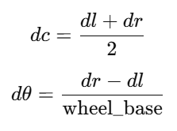

Sine Wave Trajectory Tracking
Odometry Update Equations
Pose Update Model
Pose update:
This is classical differential drive odometry

Slide 14
Sine Wave Trajectory Tracking
Steering Problem
The Core Question
At every moment, the robot must decide:
  How much should I turn?
  Left or right?
  How strongly?
This is solved using Pure Pursuit Control
Pure Pursuit Concept (Intuition)
    Pure Pursuit Explained Simply
      Look ahead a short distance on the path
      Aim the robot toward that point
      Continuously repeat
📌 Like a human walking while looking a few steps ahead.

Slide 15
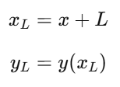
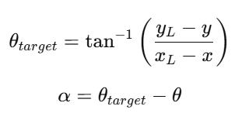
Sine Wave Trajectory Tracking
Lookahead Point
Lookahead Geometry
Where:
    L = lookahead distance
The lookahead smooths steering and prevents oscillation.
Heading Error
  Steering Error Calculation
📌 This error drives steering correction.

Slide 16
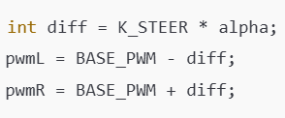
Sine Wave Trajectory Tracking
From Error to Motor Control
Differential PWM Steering
Larger error → stronger turn
Smaller error → gentle correction
📌 This is continuous steering control.

Slide 17
Sine Wave Trajectory Tracking
Algorithm (Step-by-Step)
Overall Algorithm
  Read encoder ticks
  Update odometry (x,y,θ)
  Compute reference path value
  Find lookahead target
  Compute heading error
  Adjust PWM differentially
  Repeat until target distance

Slide 18
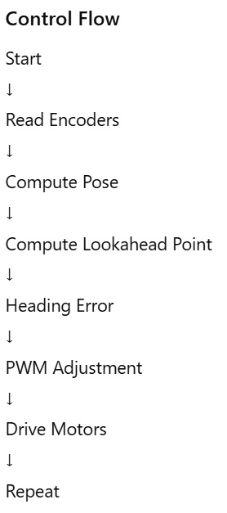
Sine Wave Trajectory Tracking
Flowchart

Slide 19
Sine Wave Trajectory Tracking
Code Highlights
Key Sections to Study
  Encoder interrupts
  Odometry update function
  Sine reference function
  Pure pursuit steering logic
  PWM saturation
Students should trace data flow, not memorize code.

Slide 20
Sine Wave Trajectory Tracking
Applications
Where This Is Used
  Lane keeping in autonomous cars
  AGV navigation in factories
  Delivery robots
  Mobile robot research
  Robotics competitions
Same principles scale to high-end robots.

Slide 21
Sine Wave Trajectory Tracking
Key Takeaway
Big Picture Message
  Straight motion is a skill
  Path tracking is autonomy
  Encoders turn motion into information
  Control turns information into intelligence
This experiment is the bridge from motion to navigation

Slide 22
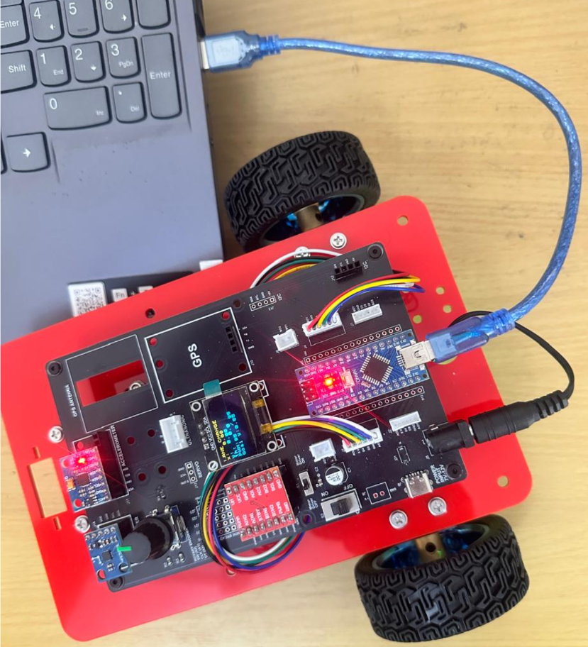
Sine Wave Trajectory Tracking
Critical Programming Setup
  MANDATORY Switch Settings Before Uploading Code
  Before connecting USB and uploading program:
    “Motor Driver ON/OFF” Switch
      ⚠️ MUST BE SET TO: OFF
    Why?
      Prevents motors from running during code upload
      Avoids car moving unexpectedly on desk
      Protects USB connection from power surges

Slide 23
Sine Wave Trajectory Tracking
During Programming (Code Upload):
  Step 1: Connect USB cable to computer
  Step 2: Set Switch “Motor Driver ON/OFF” → OFF
  Step 3: Set Switch “Battery ON/OFF ” → OFF ->for batter power
  Step 4: Upload your the respective program
  Step 5: Wait for "Upload Complete" message
  Step 6: Disconnect USB cable
Before Testing (Running the Robot):
  Step 1: Place robot on the ground. No obstacle as this test for basic movements
  Step 2: Set Switch “Motor Driver ON/OFF” ->ON ( motor driver ON)
  Step 3: Set Switch “Battery ON/OFF” → ON -> for batter power
  Step 4: Monitor the Robot car-3 Movements & OLED , Monitior the functionality according to the program
https://github.com/info-zas/zas-robotics-car-3-encoders-imu-gps/tree/main/01_FoundationProjects/10_Car-3_Sine_Trajectory
Lesson Code – GitHub URL:

Slide 24
Q&A
Invite Questions: Encourage the audience to ask questions for further clarification or discussion.

