Slide 1

ZAS Robotic Products
Navigational Robotic Series
Robot Car-3 (Advanced Autonomy)
MPU6050 Gyroscope Calibration & Bias Estimation

Slide 2
MPU6050 Gyroscope Calibration & Bias Estimation
The Real Robotics Problem (Very Important)
What goes wrong in robots without calibration?
  Wrong heading
  Bad odometry
  Drift in navigation
  Poor path following
  Example :
  Even when robot is standing still: GyroZ = +0.5°/s (bias)
  After 60 seconds : Error = 0.5 × 60 = 30°
  Robot thinks it turned 30 degrees, even though it did not move.
Root cause:
  Gyroscope outputs non-zero angular velocity at rest
  This experiment solves that.
  Hence Z-axis calibration is essential

Slide 3
MPU6050 Gyroscope Calibration & Bias Estimation
Where This Fits in IMU Learning (Big Picture)
An IMU (Inertial Measurement Unit) is a sensor module that measures an object’s motion and orientation by sensing acceleration and angular velocity along multiple axes.
  IMU(Inertial Measurement Unit) Learning Path (For Students)
    Understand IMU sensors (Accel, Gyro, Mag)
    Identify sensor errors
    Perform calibration
    Apply correction
    Use data in control & navigation

Slide 4
MPU6050 Gyroscope Calibration & Bias Estimation
Learning Outcomes
  Why gyroscope calibration is required
  How sensor bias affects robots
  Practical IMU handling
  Role of averaging in noise reduction
  Industry-standard calibration workflow

Slide 5
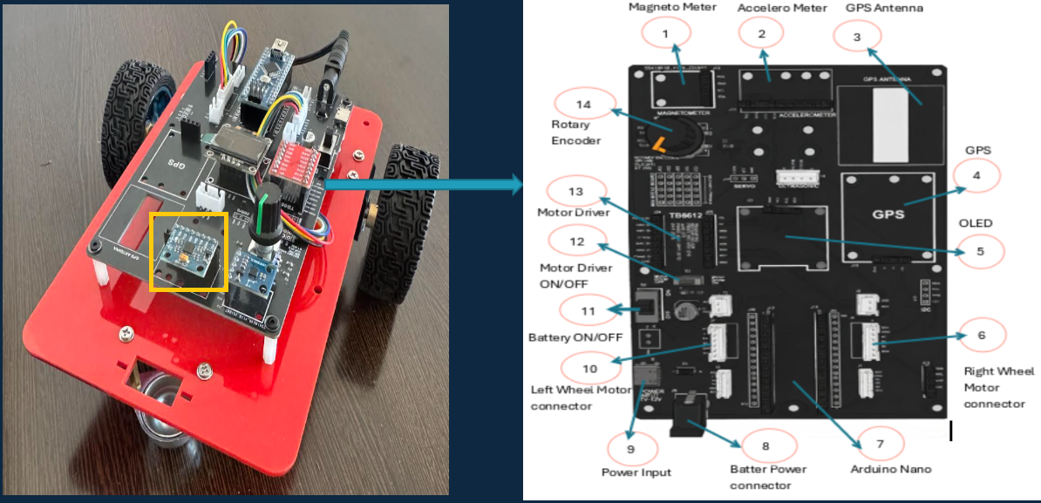
MPU6050 Gyroscope Calibration & Bias Estimation
    Car-3 – MPU6050

Slide 6
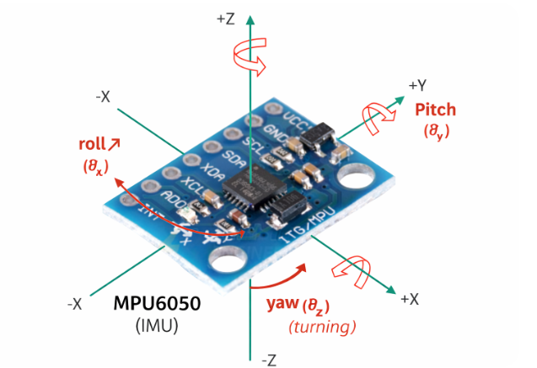
MPU6050 Gyroscope Calibration & Bias Estimation
MPU6050 : MPU6050 is an IMU because it combines an accelerometer and a gyroscope to measure linear motion and rotational motion in 3D space.
Sensor | Measures | Units
Accelerometer | Linear acceleration | m/s² or g
Gyroscope | Angular velocity | rad/s, deg/s
It Communicates via I²C
Widely used in:
  Mobile robots
  Drones
  Self-balancing systems
Important:
Gyroscope measures rotation rate, not angle.
DOF: It means one independent way something can move (or) be measured

Slide 7
MPU6050 Gyroscope Calibration & Bias Estimation
Gyroscope :A gyroscope is a sensor that measures angular velocity—how fast an object rotates around an axis.
since ground robots mainly turn in the horizontal plane, they rotate about the Z-axis—making accurate Z-axis calibration critical for correct heading.
Why Ground Robots Rotate Around Z-Axis
✔ Ground robots move on a flat surface (X–Y plane)
✔ Turning left/right changes direction (Yaw)
✔ Axis perpendicular to ground is Z-axis
✔ Therefore robot rotates around Z-axis
✔ Gyro Z (ωz) measures turning rate
Axis | Rotation
X | Roll rate
Y | Pitch rate
Z | Yaw rate (turning)
Example:
Robot turns left → ωz ≠ 0
Robot stands still → ωz ≈ 0

Slide 8


MPU6050 Gyroscope Calibration & Bias Estimation
Why a Gyroscope Measures Rotation, Not Angle
A gyroscope measures angular velocity (rate of rotation), not angle, because its MEMS structure senses Coriolis force produced only when the sensor is rotating.
Angle Relationship (Formula)
or in discrete form:
Angle is obtained by integrating angular velocity over time.

Slide 9
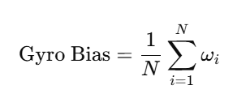
MPU6050 Gyroscope Calibration & Bias Estimation
Calibration Method Used
Averaging
  Keep robot completely still
  Take many gyro samples
  Average the readings
  Average value = bias
Random noise averages out
Bias remains
Where:
N = number of samples
ωi​ = gyro Z-axis reading

Slide 10



MPU6050 Gyroscope Calibration & Bias Estimation
Sampling Parameters
In This Program
1000 samples
~2 seconds total
Stable and noise-reduced average
Higher N → better accuracy (up to a limit)
MPU6050 Output Units
Library provides: rad/s (radians per second)
Conversion Used
Both units are displayed for clarity

Slide 11
MPU6050 Gyroscope Calibration & Bias Estimation
Algorithm (Step-by-Step)
MPU6050 Gyro Calibration Algorithm
  Initialize OLED and MPU6050
  Set gyro range and filter
  Ask user to keep robot still
  Read gyro Z-axis repeatedly
  Accumulate readings
  Compute average (bias)
  Display bias on OLED
  Stop program

Slide 12
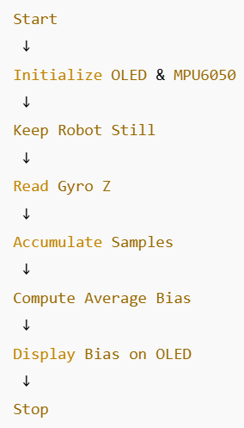
MPU6050 Gyroscope Calibration & Bias Estimation
Flowchart

Slide 13



MPU6050 Gyroscope Calibration & Bias Estimation
Code Highlights:
Sensor Setup:
  Lower range → higher resolution
  Filter reduces noise during calibration
Bias Accumulation:
  Raw gyro data is accumulated
  No correction applied yet
Bias Computation:
  This value represents gyro drift

Slide 14
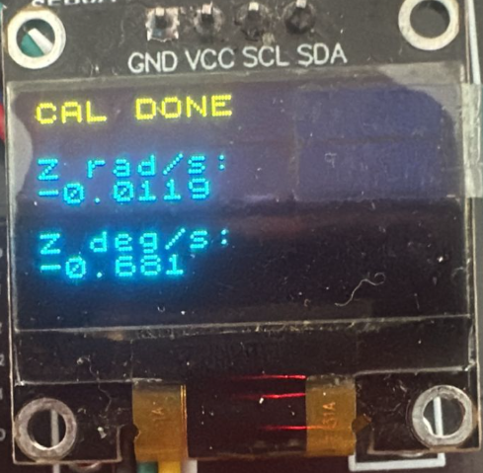
MPU6050 Gyroscope Calibration & Bias Estimation
OLED Display Role
Why OLED is Used
  Immediate visual feedback
  No need for Serial Monitor
  Useful in field calibration
  Displayed:
  Sample count
  Bias in rad/s
  Bias in deg/s

Slide 15
MPU6050 Gyroscope Calibration & Bias Estimation
Robotics Applications
Where This Calibration Helps
  Odometry correction
  Heading estimation
  Sensor fusion (IMU + Encoder)
  Line following + turning
  Autonomous navigation

Slide 16
MPU6050 Gyroscope Calibration & Bias Estimation
Critical Programming Setup
  MANDATORY Switch Settings Before Uploading Code
  Before connecting USB and uploading program:
    “Motor Driver ON/OFF” Switch
      ⚠️ MUST BE SET TO: OFF
    Why?
      Prevents motors from running during code upload
      Avoids car moving unexpectedly on desk
      Protects USB connection from power surges

Slide 17
MPU6050 Gyroscope Calibration & Bias Estimation
During Programming (Code Upload):
  Step 1: Connect USB cable to computer
  Step 2: Set Switch “Motor Driver ON/OFF” → OFF
  Step 3: Set Switch “Battery ON/OFF ” → OFF ->for batter power
  Step 4: Upload your the respective program
  Step 5: Wait for "Upload Complete" message
  Step 6: Disconnect USB cable
Before Testing (Running the Robot):
  Step 1: Place robot on the ground. No obstacle as this test for basic movements
  Step 2: Set Switch “Motor Driver ON/OFF” ->ON ( motor driver ON)
  Step 3: Set Switch “Battery ON/OFF” → ON -> for batter power
  Step 4: Monitor the Robot car-3 Movements & OLED , Monitior the functionality according to the program

Slide 18
Q&A
Invite Questions: Encourage the audience to ask questions for further clarification or discussion.

