Slide 1

ZAS Robotic Products
Navigational Robotic Series
Robot Car-3 (Advanced Autonomy)
Encoder-Based Constant Speed Control using PI

Slide 2
Encoder-Based Constant Speed Control using PI
Objective of this Program
  Maintain constant wheel speed
  Automatically compensate for:
    Battery voltage drop
    Load variation
    Surface friction
  Stop accurately at 1 meter
This program answers a new question:
“How fast am I moving right now?”

Slide 3
Encoder-Based Constant Speed Control using PI
Learning Outcomes
  Encoder-based speed measurement
  Difference between distance and speed control
  Closed-loop control concepts
  Meaning of KP and KI
  Why feedback is essential in robotics

Slide 4
Encoder-Based Constant Speed Control using PI
Term | Meaning
Tick | One digital pulse generated by the encoder
Encoder (Incremental) | Sensor that outputs ticks proportional to shaft rotation
Encoder PPR | Number of ticks per motor shaft revolution
Gear Ratio | Ratio of motor rotations to one wheel rotation
ΔTicks | Change in encoder ticks between two measurements
dt (Sampling Time) | Time interval between two control updates
Measured Speed | Wheel speed computed as Δticks / dt
Target Speed | Desired wheel speed set by the program
Error | Difference between target speed and measured speed
KP (Proportional Gain) | Gain that reacts to current error
KI (Integral Gain) | Gain that reacts to accumulated error
Integral Term | Sum of error over time (controller memory)
PWM (Pulse Width Modulation) | Method to control motor voltage/speed
Control Loop | Repeating cycle of measure → compute → act
Closed-Loop Control | Control system using feedback from sensors
PI Control | Feedback control using Proportional + Integral terms
Key
Terms

Slide 5
Encoder-Based Constant Speed Control using PI
Prerequisite Knowledge
This program builds on previous learning.
Reused Concepts
  Encoder hardware
  Encoder ticks
  Distance calculation
  Motor direction logic
  PWM motor control
New Learning Introduced Here:
  Speed measurement + feedback control (PI)

Slide 6
Encoder-Based Constant Speed Control using PI
Encoder Output (Foundation Reminder)
Incremental Encoder
  Encoder generates digital pulses
  Each pulse is called a tick
Tick
  One pulse generated by the encoder when the motor shaft rotates
Encoder provides ticks only
  No speed
  No distance
  (All intelligence comes from calculations)

Slide 7


Encoder-Based Constant Speed Control using PI
Speed Measurement (Key Upgrade)
What Changes from Distance_1M program?
Instead of total ticks, we now use change in ticks over time.
Speed Formula
In Code
Note: Indirectly the Encoder now acts as a SPEED sensor

Slide 8

Encoder-Based Constant Speed Control using PI
Encoder now acts as a SPEED sensor
Meaning
  Speed is measured every 50 ms
  PWM is updated every 50 ms
Why this matters
Stable control systems require fixed timing

Slide 9

Encoder-Based Constant Speed Control using PI
Target Speed Definition
Target Speed
Desired wheel speed set by the programmer
Speed is defined in encoder units, not RPM
This keeps control independent of motor specs

Slide 10




Encoder-Based Constant Speed Control using PI
Key Control Terms (Defined Once)
Measured Speed
Actual wheel speed calculated from encoder ticks
Error
Difference between desired speed and measured speed
Error = 0 → perfect speed
dt (Sampling Time)
Time between two control updates

Slide 11
Encoder-Based Constant Speed Control using PI
What is PI Control?
PI = Proportional + Integral
PI control is a feedback control method that adjusts motor PWM based on speed error.
Used in:
  Industrial drives
  Mobile robots
  Drones
  Autonomous vehicles

Slide 12

Encoder-Based Constant Speed Control using PI
Proportional Term (P)
KP — Proportional Gain
Determines how strongly the controller reacts to current error
KP = 0.8;
Higher KP → faster response
Too high KP → oscillation

Slide 13


Encoder-Based Constant Speed Control using PI
Integral Term (I)
KI — Integral Gain
Corrects accumulated past error
KI = 0.25;
Integral Term (Memory)
Integral removes long-term speed drift

Slide 14
Encoder-Based Constant Speed Control using PI
PI Control Law (Core Formula)
PWM Update Equation
pwmL += KP * errL + KI * intL;
pwmR += KP * errR + KI * intR;
Role of Distance (Clarified Clearly)
Distance is still calculated:
But distance is now used for:
Entering slow-down zone
Deciding when to stop
  Distance does NOT control speed
  PI controller controls speed

Slide 15
Encoder-Based Distance Measurement & Straight Motion
PI Control Law (Core Formula)
PWM Update Equation
pwmL += KP * errL + KI * intL;
pwmR += KP * errR + KI * intR;
Role of Distance (Clarified Clearly)
Distance is still calculated:
But distance is now used for:
Entering slow-down zone
Deciding when to stop
  Distance does NOT control speed
  PI controller controls speed

Slide 16
Encoder-Based Distance Measurement & Straight Motion
Algorithm (Step-by-Step)
  Reset encoder counts
  Every 50 ms:
  Measure encoder tick change
  Compute wheel speed
  Calculate speed error
  Apply PI control
  Update PWM
  Check remaining distance
  Brake and coast at target

Slide 17
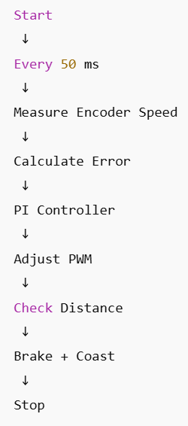
Encoder-Based Constant Speed Control using PI
Flowchart

Slide 18



Encoder-Based Constant Speed Control using PI
Code Highlights
Speed Calculation
PI Controller
Smooth Stop

Slide 19



Encoder-Based Constant Speed Control using PI
Distance Calculation (Core Formula)
Step-1: Wheel Circumference
Program : WHEEL_CIRC_MM = 3.1416 * WHEEL_DIAMETER_MM;
Step-2: Ticks per Wheel Revolution
TICKS_PER_WHEEL_REV = ENCODER_PPR * GEAR_RATIO;
Step-3: Distance per Tick
MM_PER_TICK = WHEEL_CIRC_MM / TICKS_PER_WHEEL_REV;
Distance Traveled
distanceMM = avgTicks * MM_PER_TICK;

Slide 20
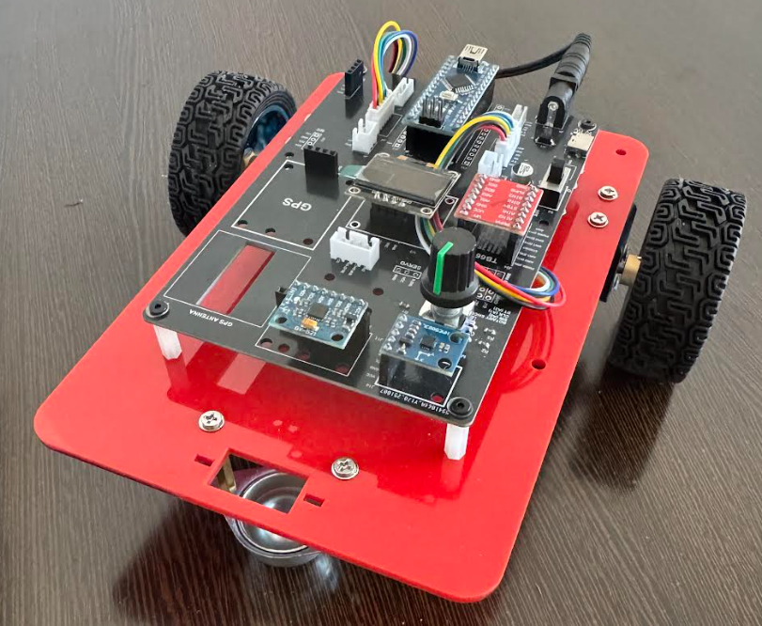
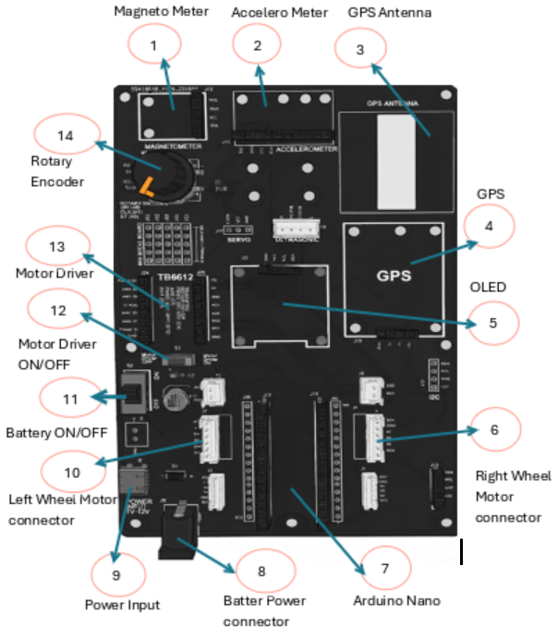
Encoder-Based Constant Speed Control using PI
Robot Car-3 - Assembled view and Creative Board component layout

Slide 21
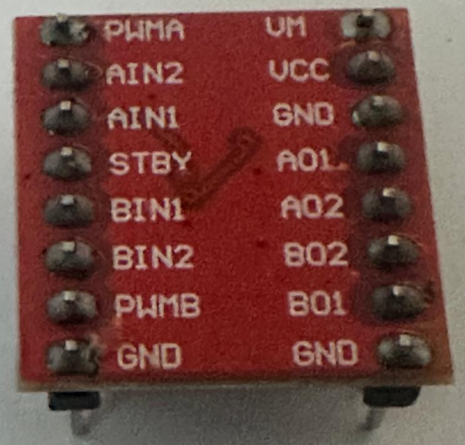
Encoder-Based Constant Speed Control using PI
Hardware Architecture
Pin Name | Function | Description | Connected To (in Our Robot)
PWMA(PWM_L) | Speed Control (A) | PWM input for Motor A speed (0-255) | Arduino Pin 6
AIN1 (IN1_L) | Direction (A) Bit 1 | Motor A direction control | Arduino Pin 7
AIN2 (IN2_L) | Direction (A) Bit 2 | Motor A direction control | Arduino Pin 8
PWMB(PWM_R) | Speed Control (B) | PWM input for Motor B speed (0-255) | Arduino Pin 11
BIN1 (IN1_R) | Direction (B) Bit 1 | Motor B direction control | Arduino Pin 12
BIN2(IN2_R) | Direction (B) Bit 2 | Motor B direction control | Arduino Pin 10
STBY | Standby | Enable/Disable driver (HIGH = enabled) | Usually tied to VCC
VM | Motor Power | 7-12V for motors | External battery
VCC | Logic Power | 5V from Arduino | Arduino 5V
GND | Ground | Common ground | Arduino GND
AO1/AO2 | Motor A Outputs | Connect to Motor A terminals | Left Motor
BO1/BO2 | Motor B Outputs | Connect to Motor B terminals | Right Motor
TB6612 Pin configuration With Arduino

Slide 22
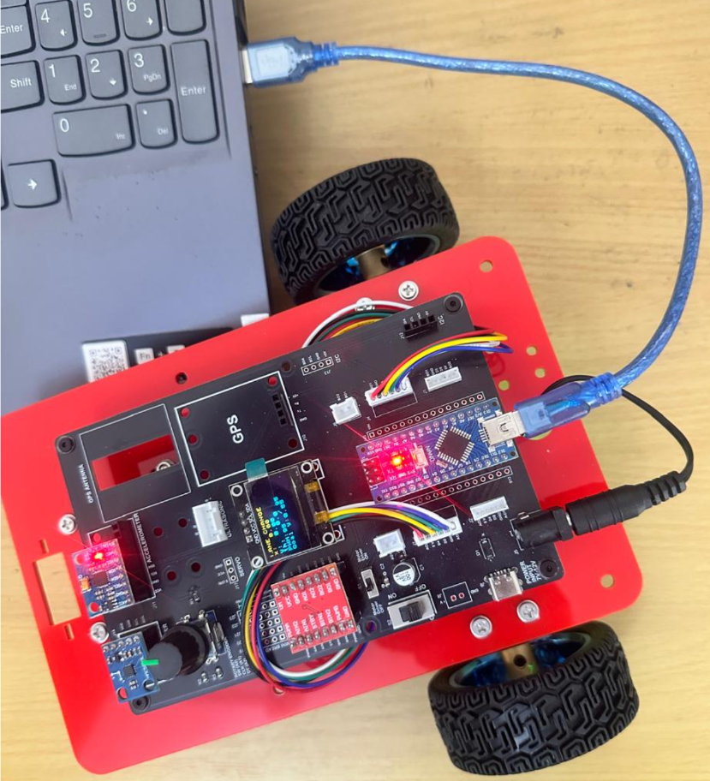
Encoder-Based Constant Speed Control using PI
Critical Programming Setup
  MANDATORY Switch Settings Before Uploading Code
  Before connecting USB and uploading program:
    “Motor Driver ON/OFF” Switch
      ⚠️ MUST BE SET TO: OFF
    Why?
      Prevents motors from running during code upload
      Avoids car moving unexpectedly on desk
      Protects USB connection from power surges

Slide 23
Encoder-Based Constant Speed Control using PI
During Programming (Code Upload):
  Step 1: Connect USB cable to computer
  Step 2: Set Switch “Motor Driver ON/OFF” → OFF
  Step 3: Set Switch “Battery ON/OFF ” → OFF ->for batter power
  Step 4: Upload your the respective program
  Step 5: Wait for "Upload Complete" message
  Step 6: Disconnect USB cable
Before Testing (Running the Robot):
  Step 1: Place robot on the ground. No obstacle as this test for basic movements
  Step 2: Set Switch “Motor Driver ON/OFF” ->ON ( motor driver ON)
  Step 3: Set Switch “Battery ON/OFF” → ON -> for batter power
  Step 4: Monitor the Robot car-3 Movements & OLED , Monitior the functionality according to the program
https://github.com/info-zas/zas-robotics-car-3-encoders-imu-gps/tree/main/01_FoundationProjects/04_Car-3_Constant_Speed_1M
Lesson Code – GitHub URL:

Slide 24
Q&A
Invite Questions: Encourage the audience to ask questions for further clarification or discussion.

