Slide 1

ZAS Robotic Products
Navigational Robotic Series
Robot Car-3 (Advanced Autonomy)
MPU6050 Accelerometer Calibration
Course Context: Robotics / Embedded Systems / Sensors & Actuators

Slide 2
MPU6050 Accelerometer Calibration
Why This Experiment Is Important
Modern robots rely on IMU sensors for:
  Orientation (roll & pitch)
  Balance
  Navigation
  Sensor fusion
Raw accelerometer data is not accurate
✔ Calibration is mandatory before using IMU data
This experiment converts raw sensor data into physically correct data

Slide 3
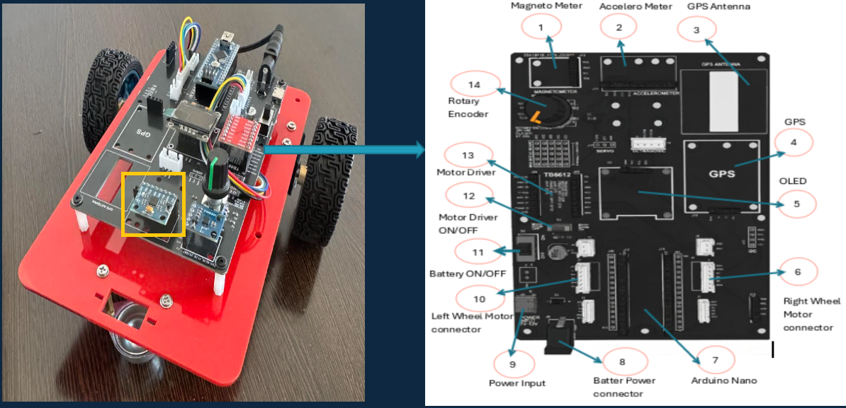
MPU6050 Accelerometer Calibration
    Car-3 – MPU6050

Slide 4
MPU6050 Accelerometer Calibration
What Problem Are We Solving?
Real Sensor Issues
  Manufacturing bias
  Scale error
  Axis misalignment
Consequences if ignored
  Wrong tilt angles
  Unstable control
  Incorrect fusion with gyroscope
Calibration corrects bias and scale errors

Slide 5
MPU6050 Accelerometer Calibration
Learning Outcomes
After this lab, students will be able to:
  Explain what an accelerometer measures
  Use gravity as a calibration reference
  Perform 6-pose calibration correctly
  Compute offset and scale
  Implement calibration in embedded code
  Validate sensor correctness using plots

Slide 6
MPU6050 Accelerometer Calibration
An accelerometer measures specific force (force per unit mass).
When the robot is stationary, the only force acting on it is gravity.
Gravity magnitude ≈ 1 g (9.81 m/s²), which is constant and always present.
IMPORTANT:
The accelerometer does NOT distinguish between motion force and gravity — it only senses total force.
Because gravity always points downward, it provides a natural reference direction.
Using gravity, an accelerometer can directly estimate:
– Roll
– Pitch
Yaw cannot be determined because gravity has no left/right direction.

Slide 7
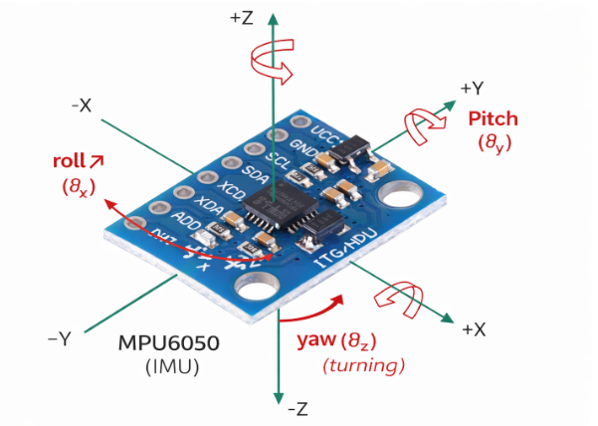
MPU6050 Accelerometer Calibration
Understanding +1g and −1g (Key Concept)
  +1 g → gravity acts along the sensor axis direction
  −1 g → gravity acts opposite to the sensor axis direction
  0 g → axis is perpendicular to gravity
📌 Sign depends on sensor axis direction
Why 6-Pose Calibration?
Each accelerometer axis must experience:
+1 g
−1 g
There are 3 axes → 3 × 2 = 6 poses
📌 This allows accurate estimation of:
Offset (bias)
Scale (gain)

Slide 8
MPU6050 Accelerometer Calibration
Two-Phase Calibration Strategy (Very Important)
This program runs in two clear phases:
PHASE-1: Data Collection
  Rotate robot into 6 poses
  Record min/max values
  No calibration applied yet
PHASE-2: Calibration Application
  Paste measured values into code
  Apply offset and scale
  Verify ±1g behavior
Only one line changes in code

Slide 9
MPU6050 Accelerometer Calibration
Program Control
  COLLECT_MIN_MAX = true → Phase-1: Collect Min/Max
  COLLECT_MIN_MAX = false → Phase-2: Apply Calibration
Note: Avoids comment/uncomment mistakes; student-safe
PHASE-1: Data Collection (6-Pose Method)
  Robot powered ON, completely still
  Carefully rotate sensor
  +X/−X → xMax/xMin | +Y/−Y → yMax/yMin | +Z/−Z → zMax/zMin
  Hold each pose 2–3 seconds

Slide 10
MPU6050 Accelerometer Calibration
Program Control
PHASE-1 Algorithm
  Init MPU6050 → Read accel → Convert to g
  Continuously update min/max → Display live values
  Calibration Mathematics
  Offset = (max + min) / 2
  Scale = 2 / (max − min)
PHASE-2: Apply Calibration
  A_cal = scale × (A_raw − offset)
Expected:
  Vertical axis → ±1 g
  Horizontal axis → ≈ 0 g

Slide 11

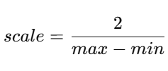
MPU6050 Accelerometer Calibration
PHASE-1 Output (What Students Record)
Students must note:
  xMax, xMin
  yMax, yMin
  zMax, zMin
These values represent real sensor behavior, not ideal physics
Offset (Bias Correction)
Scale (Gain Correction)
These formulas convert raw data into physical values

Slide 12
MPU6050 Accelerometer Calibration
PHASE-2 Objective (Apply Calibration)
Goal of Phase-2
  Correct raw accelerometer data
  Validate ±1g physics
  Prepare data for roll/pitch computation
No rotation needed in this phase
PHASE-2 Algorithm
  Read raw accelerometer data
  Subtract offset
  Multiply by scale
  Output calibrated values
  Compare with ±1g reference

Slide 13

MPU6050 Accelerometer Calibration
PHASE-2 Calibration Formula
Expected behavior:
Axis vertical → ±1 g
Axis horizontal → ≈ 0 g
Validation Using Serial Plotter
Program outputs:
  Ax, Ay, Az
  UL = +1
  LL = −1
Correct calibration shows:
  Signals centered between +1 and −1
  Minimal offset drift

Slide 14
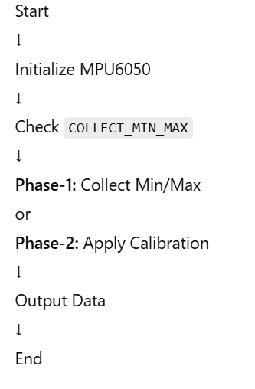
MPU6050 Accelerometer Calibration
Complete Program Flowchart

Slide 15
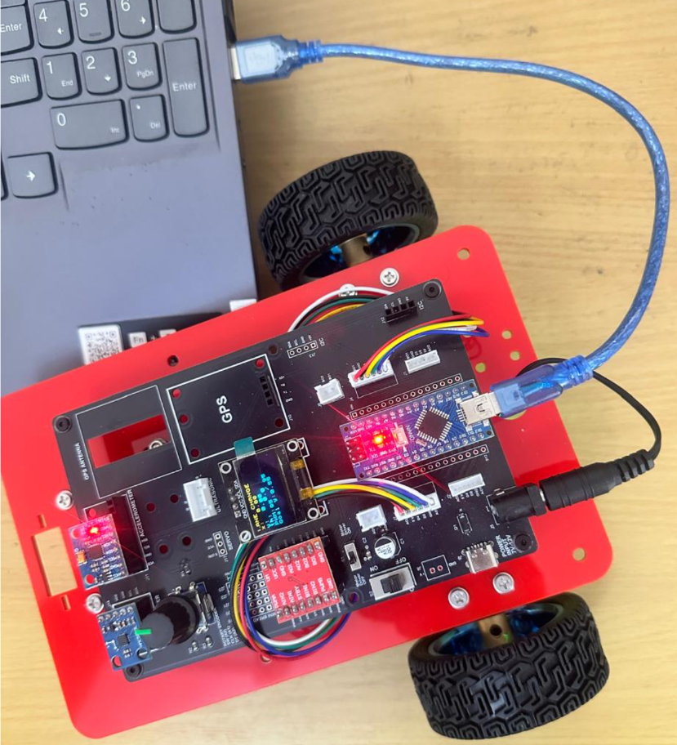
MPU6050 Accelerometer Calibration
Critical Programming Setup
  MANDATORY Switch Settings Before Uploading Code
  Before connecting USB and uploading program:
    “Motor Driver ON/OFF” Switch
      ⚠️ MUST BE SET TO: OFF
    Why?
      Prevents motors from running during code upload
      Avoids car moving unexpectedly on desk
      Protects USB connection from power surges

Slide 16
MPU6050 Accelerometer Calibration
During Programming (Code Upload):
  Step 1: Connect USB cable to computer
  Step 2: Set Switch “Motor Driver ON/OFF” → OFF
  Step 3: Set Switch “Battery ON/OFF ” → OFF ->for batter power
  Step 4: Upload your the respective program
  Step 5: Wait for "Upload Complete" message
  Step 6: Disconnect USB cable
Before Testing (Running the Robot):
  Step 1: Place robot on the ground. No obstacle as this test for basic movements
  Step 2: Set Switch “Motor Driver ON/OFF” ->ON ( motor driver ON)
  Step 3: Set Switch “Battery ON/OFF” → ON -> for batter power
  Step 4: Monitor the Robot car-3 Movements & OLED , Monitior the functionality according to the program
https://github.com/info-zas/zas-robotics-car-3-encoders-imu-gps/tree/main/01_FoundationProjects/09_Car-3_MPU6050_Accelerometer_Caliberation
Lesson Code – GitHub URL:

Slide 17
Q&A
Invite Questions: Encourage the audience to ask questions for further clarification or discussion.

