Slide 1

Communication Kit (Kit 3)
Communication Foundation Lessons (CFL)
(Lesson Ref: CFL02)
CFL11: Half-Duplex Sensor (DHT11 and MQ135) Data Transmission Using LoRa

Slide 2


Communication Kit : Contents
Communication Kit Components
Communication Creative Board

Slide 3
Kit 3 Communication Creative Board - Features
LoRa Module I/F
NRF24L01 Module I/F
ESP32
OLED I/F
RFID I/F
Mini
Breadboard
SD Card Module I/F
Power
Connector
Rotary Encoder
ON/OFF Switch
Input DC Jack
Free Connectors

Slide 4
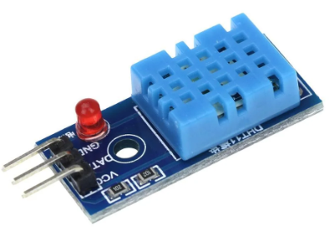
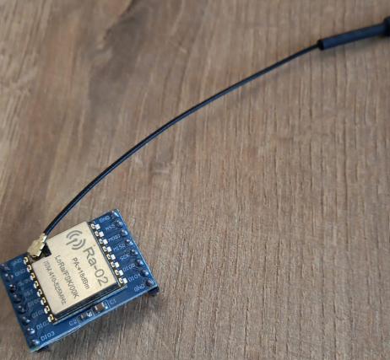

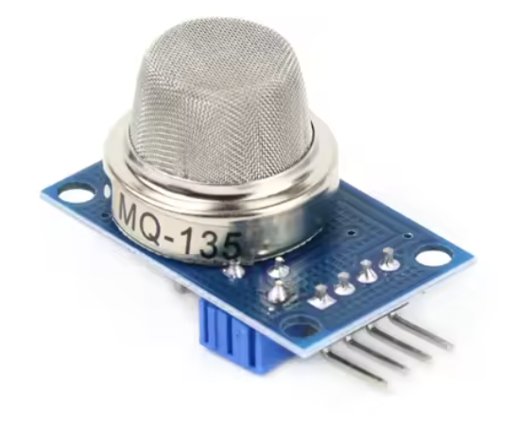

CFL11: Half-Duplex Data Transmission Using LoRa Using Button, Pot, Buzzer
Things Needed
LoRa B:
LoRa A:
4

Slide 5
CFL11: Half-Duplex Data Transmission Using LoRa Using Button, Pot, Buzzer
setup()
• Initialize Serial monitor
• Initialize OLED display and show startup text
• Configure LED, buzzer, button, and potentiometer pins
• Initialize LoRa module at 433 MHz
• Display “LoRa ready” on OLED
loop()
• Check button press (with debounce)
• If button pressed → read potentiometer and send LoRa message
• Check for incoming LoRa packets
• If message received → display it on OLED and activate LED + buzzer alert
sendMessage()
• Read potentiometer value
• Create message (“POT:value”)
• Transmit message using LoRa
• Show sent message on OLED
displayMessage(msg)
• Print received message to Serial
• Show received message on OLED
notifyUser()
• Blink LED and buzz buzzer briefly to signal new message
setup()
• Initialize Serial communication
• Initialize OLED and show startup text
• Configure LED, buzzer, button (pull-up), and potentiometer pins
• Initialize LoRa module at 433 MHz using custom SPI pins
• Display “LoRa ready” on OLED
loop()
• Read button state and apply debounce
• If button is pressed → read potentiometer value and send LoRa message
• Check for incoming LoRa packets
• If a message is received → show it on OLED and trigger LED + buzzer alert
sendMessage()
• Read potentiometer value
• Create message “POT:value”
• Send message via LoRa
• Display sent message on OLED
displayMessage(msg)
• Print message to Serial
• Show received message on OLED
notifyUser()
• Flash LED and buzzer briefly to indicate new message

Slide 6
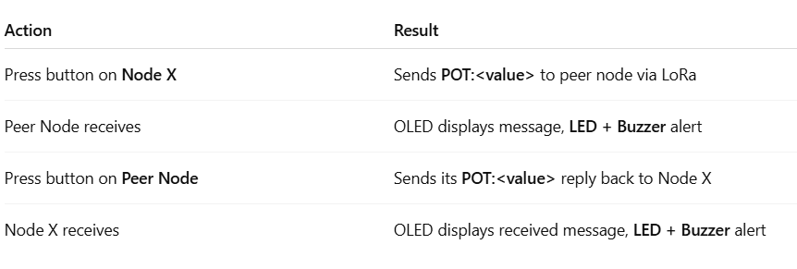
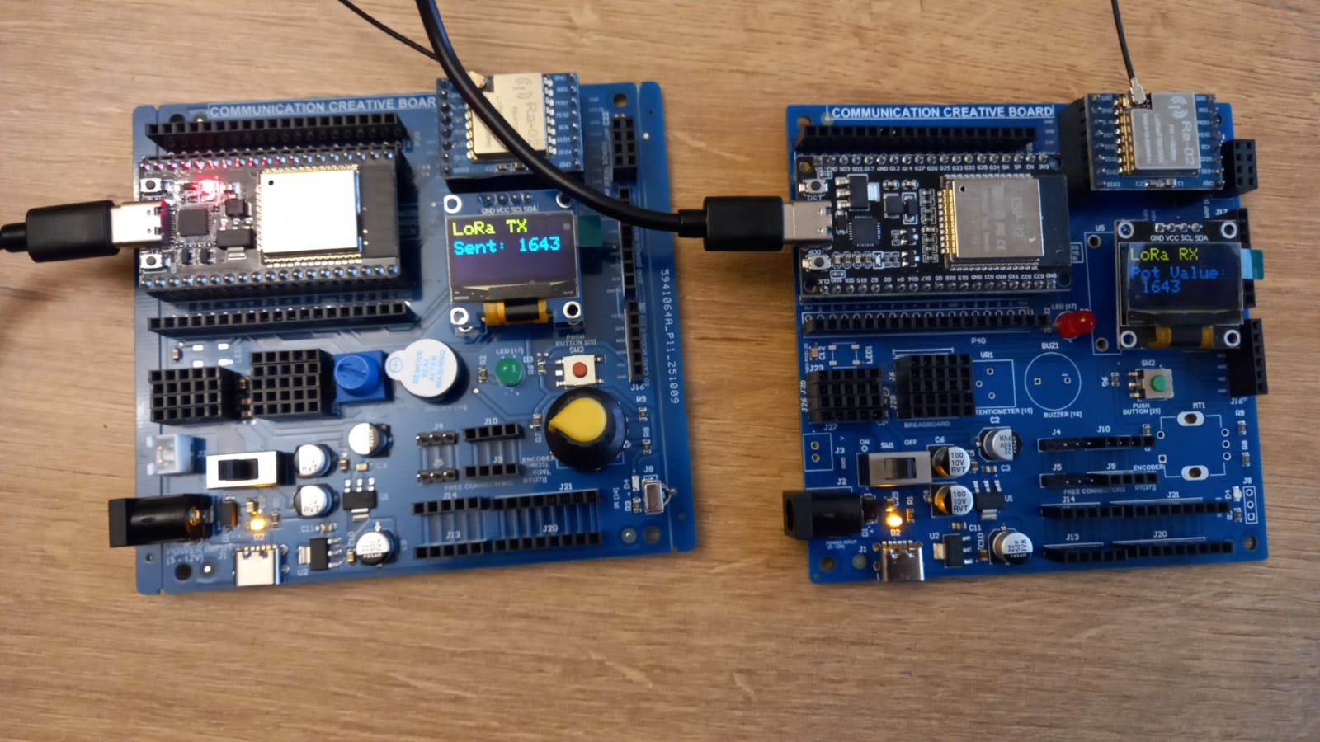
CFL11: Half-Duplex Data Transmission Using LoRa Using Button, Pot, Buzzer
Code for Lesson CFL10 (CFL11_Half_Duplex_LoRa_DHT_Pollution_ESP32_A.ino)
(CFL11_Half_Duplex_LoRa_DHT_Pollution_ESP32_B.ino)
https://github.com/info-zas/zas-robotics-communications/blob/main/01_FoundationProjects/CFL11_Half_Duplex_Sensor_DHT11_MQ135_Wireless_LoRa/CFL11_LoRa_Half_Dulex_Button_Pot_Tx/CFL11_LoRa_Half_Dulex_Button_Pot_Tx.ino
https://github.com/info-zas/zas-robotics-communications/blob/main/01_FoundationProjects/CFL11_Half_Duplex_Sensor_DHT11_MQ135_Wireless_LoRa/CFL11_LoRa_Half_Dulex_Button_Pot_Rx/CFL11_LoRa_Half_Dulex_Button_Pot_Rx.ino

Slide 7
CFL11: Half-Duplex Sensor (DHT11 and MQ135) Data Transmission Using LoRa
setup()
• Start Serial communication
• Configure button, LED, and buzzer pins
• Initialize OLED and display “Node A: TX”
• Initialize DHT11 and MQ135 sensors
• Initialize LoRa module with custom SPI pins
• Display “LoRa OK” on OLED
loop()
• Check button press with debounce
• If button is pressed → read sensors and send LoRa message
• Continuously listen for LoRa replies from Node B
• If a reply is received → display it on OLED and alert user (LED + buzzer)
sendSensorData()
• Read temperature (DHT11), humidity, and air quality (MQ135)
• Format message: “Temp:X Hum:Y MQ135:Z”
• Send message via LoRa
• Show sent message on OLED
displayReceived(msg)
• Print received reply to Serial
• Display reply on OLED
alertUser()
• Flash LED and buzzer briefly to indicate message received
setup()
• Start Serial communication
• Configure potentiometer, button, LED, and buzzer pins
• Initialize OLED and display “Node B: RX”
• Initialize LoRa module at 433 MHz with custom SPI pins
• Display “LoRa OK” on OLED
loop()
• Continuously listen for LoRa packets from Node A
• When a packet arrives:
- Read message
- Display it on OLED
- Alert user using LED + buzzer
• Check button press with debounce
• If button is pressed → read potentiometer and send reply back to Node A
displayIncoming(msg)
• Print received message to Serial
• Show “Data from Node A” and the message on OLED
sendPotValue()
• Read analogue potentiometer value
• Format reply message “Pot:<value>”
• Transmit reply via LoRa
• Display sent message on OLED
alertUser()
• Flash LED and buzzer briefly when a new message arrives

Slide 8
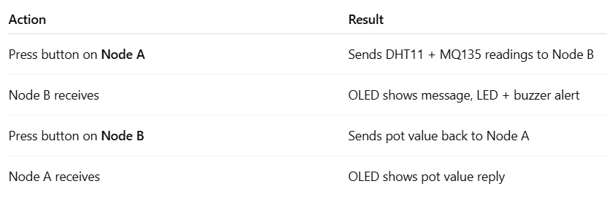
CFL11: Half-Duplex Sensor (DHT11 and MQ135) Data Transmission Using LoRa

Slide 9
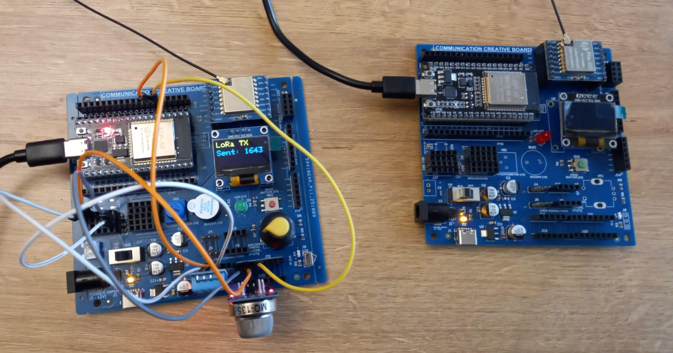
  CFL11: Half-Duplex Sensor (DHT11 and MQ135) Data Transmission Using LoRa
DHT11 | ESP32 Pin
VCC | 5V
GND | GND
Data | 32
MQ-135 | ESP32 Pin
VCC | 3.3V
GND | GND
A0 | 35
Code for Lesson CFL11 (CFL11_LoRa_Half_Dulex_DHT11_MQ135_Rx.ino)
(CFL11_LoRa_Half_Dulex_DHT11_MQ135_Tx.ino)
https://github.com/info-zas/zas-robotics-communications/blob/main/01_FoundationProjects/CFL11_Half_Duplex_Sensor_DHT11_MQ135_Wireless_LoRa/CFL11_LoRa_Half_Dulex_DHT11_MQ135_Tx/CFL11_LoRa_Half_Dulex_DHT11_MQ135_Tx.ino
https://github.com/info-zas/zas-robotics-communications/blob/main/01_FoundationProjects/CFL11_Half_Duplex_Sensor_DHT11_MQ135_Wireless_LoRa/CFL11_LoRa_Half_Dulex_DHT11_MQ135_Rx/CFL11_LoRa_Half_Dulex_DHT11_MQ135_Rx.ino

