Slide 1

Communication Kit (Kit 3)
Communication Foundation Lessons (CFL)
(Lesson Ref: CFL02)
CFL12: Infra Red (IR) Communication

Slide 2


Communication Kit : Contents
Communication Kit Components
Communication Creative Board

Slide 3
Kit 3 Communication Creative Board - Features
LoRa Module I/F
NRF24L01 Module I/F
ESP32
OLED I/F
RFID I/F
Mini
Breadboard
SD Card Module I/F
Power
Connector
Rotary Encoder
ON/OFF Switch
Input DC Jack
Free Connectors

Slide 4
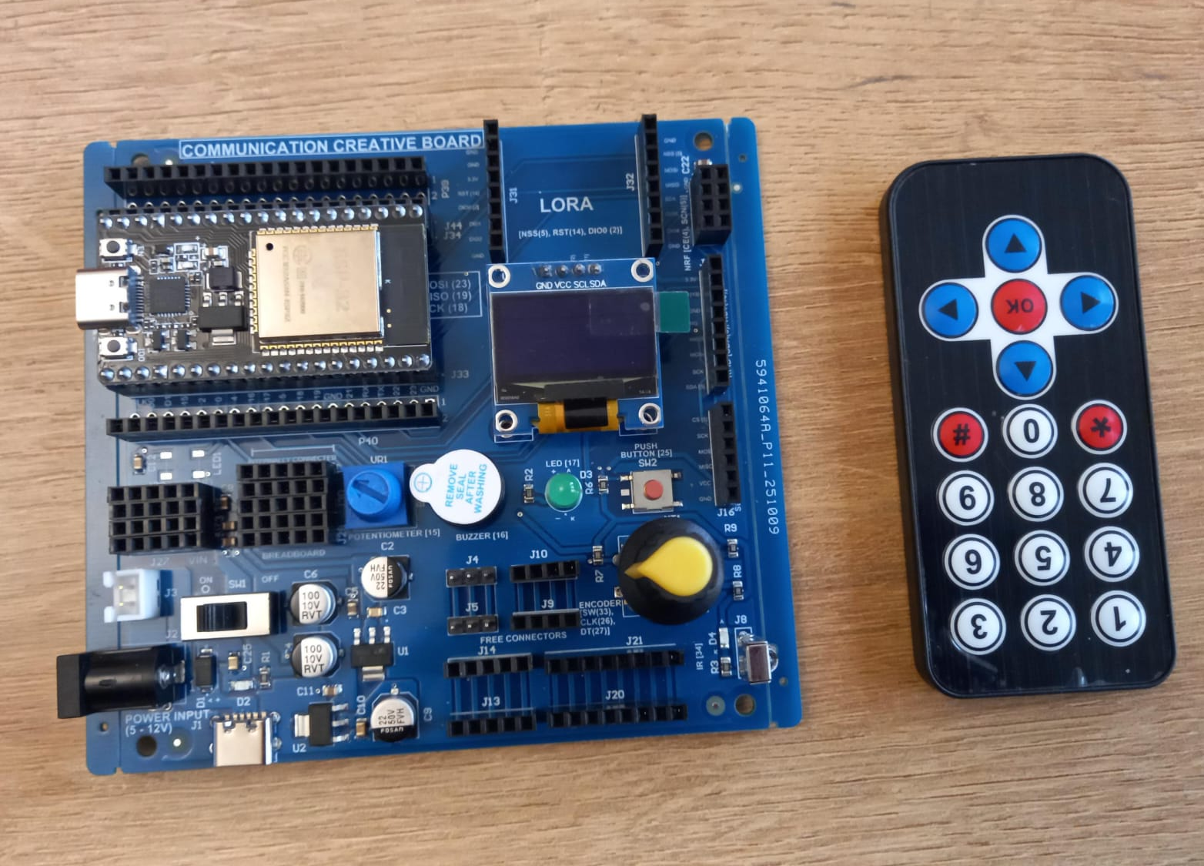

CFL12: Infra Red (IR) Communication
Things Needed
4

Slide 5
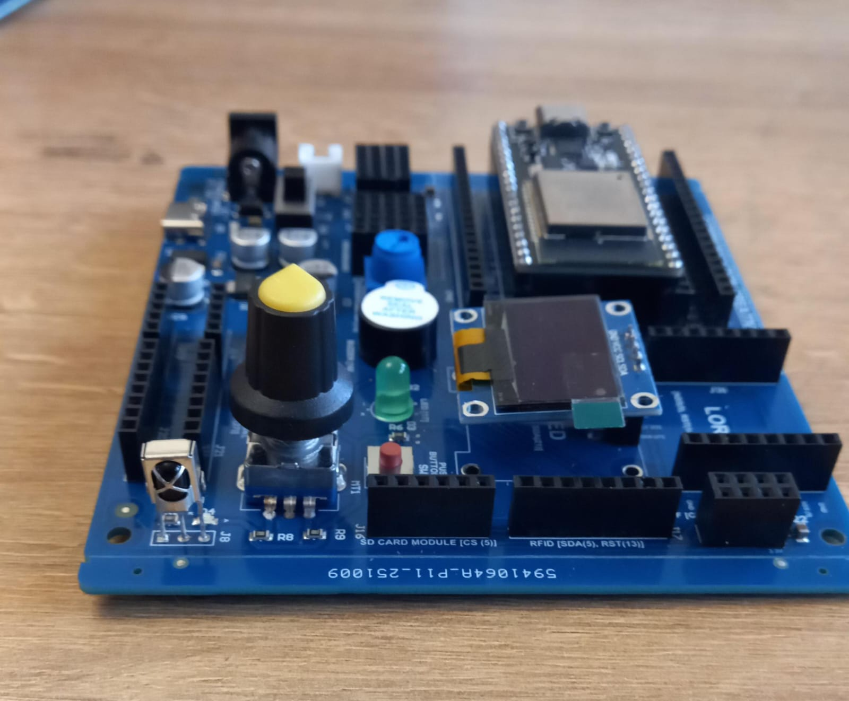
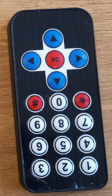
CFL12: Infra Red (IR) Communication
IR Transmitter
IR Receiver

Slide 6
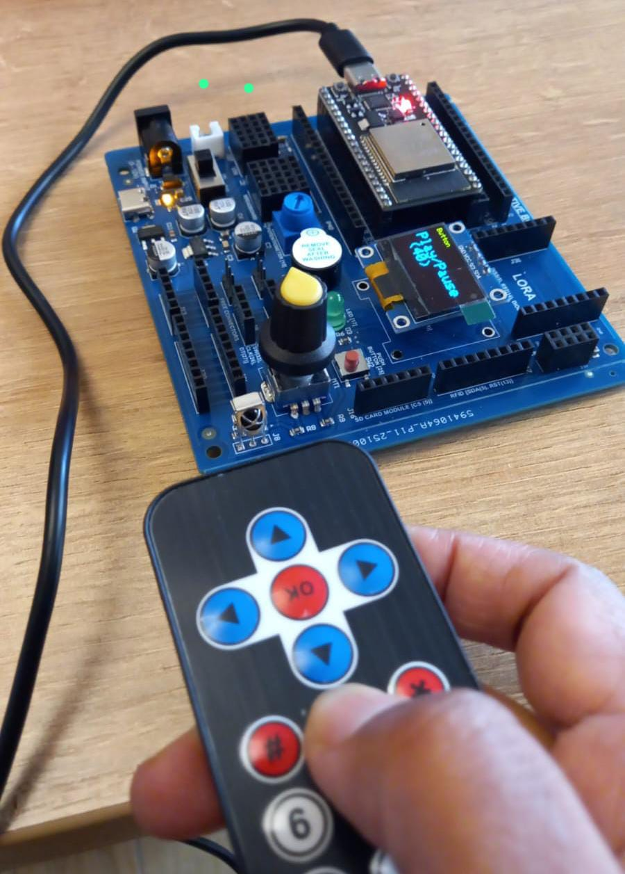
  CFL12: Infra Red (IR) Communication
setup()
• Start Serial communication
• Initialize IR receiver on pin 34
• Initialize OLED display (128x64)
• Show “Waiting for IR input” on OLED
loop()
• Check if an IR signal is received
• Read the IR command byte
• Print IR code in HEX on Serial Monitor
• Match command to a button label (e.g., Power, Up, Down, Play)
• Display the button name and code on OLED
• Resume IR receiver to accept the next signal
Code for Lesson CFL12
(CFL12_IR_Remote_OLED.ino)
https://github.com/info-zas/zas-robotics-communications/blob/main/01_FoundationProjects/CFL12_IR_Communication/CFL12_IR_Remote_OLED/CFL12_IR_Remote_OLED.ino
• Clear OLED
• Display a label (e.g., “Button”)
• Display the decoded button name and HEX code in large text

