Slide 1

Communication Kit (Kit 3)
Communication Foundation Lessons (CFL)
(Lesson Ref: CFL02)
CFL13: Hybrid Relay (IR-NRF) Communication

Slide 2


Communication Kit : Contents
Communication Kit Components
Communication Creative Board

Slide 3
Kit 3 Communication Creative Board - Features
LoRa Module I/F
NRF24L01 Module I/F
ESP32
OLED I/F
RFID I/F
Mini
Breadboard
SD Card Module I/F
Power
Connector
Rotary Encoder
ON/OFF Switch
Input DC Jack
Free Connectors

Slide 4
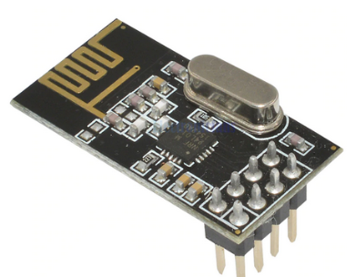

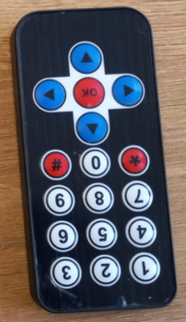

CFL13: Hybrid Relay (IR-NRF) Communication
Things Needed
4

Slide 5
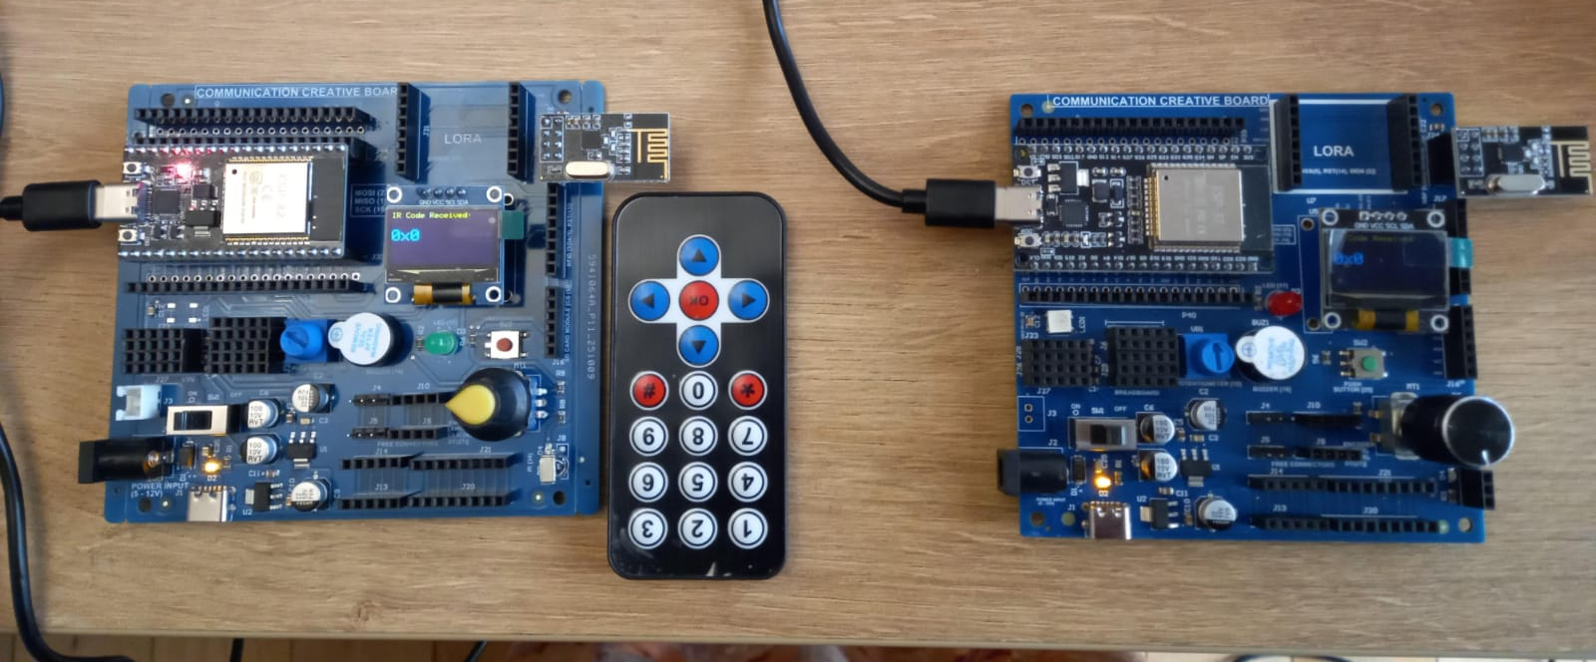
CFL13: Hybrid Relay (IR-NRF) Communication

Slide 6
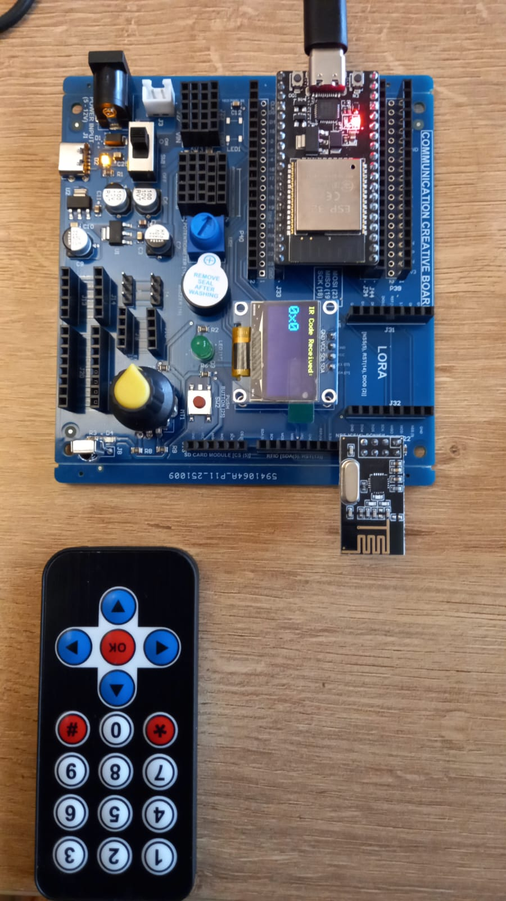
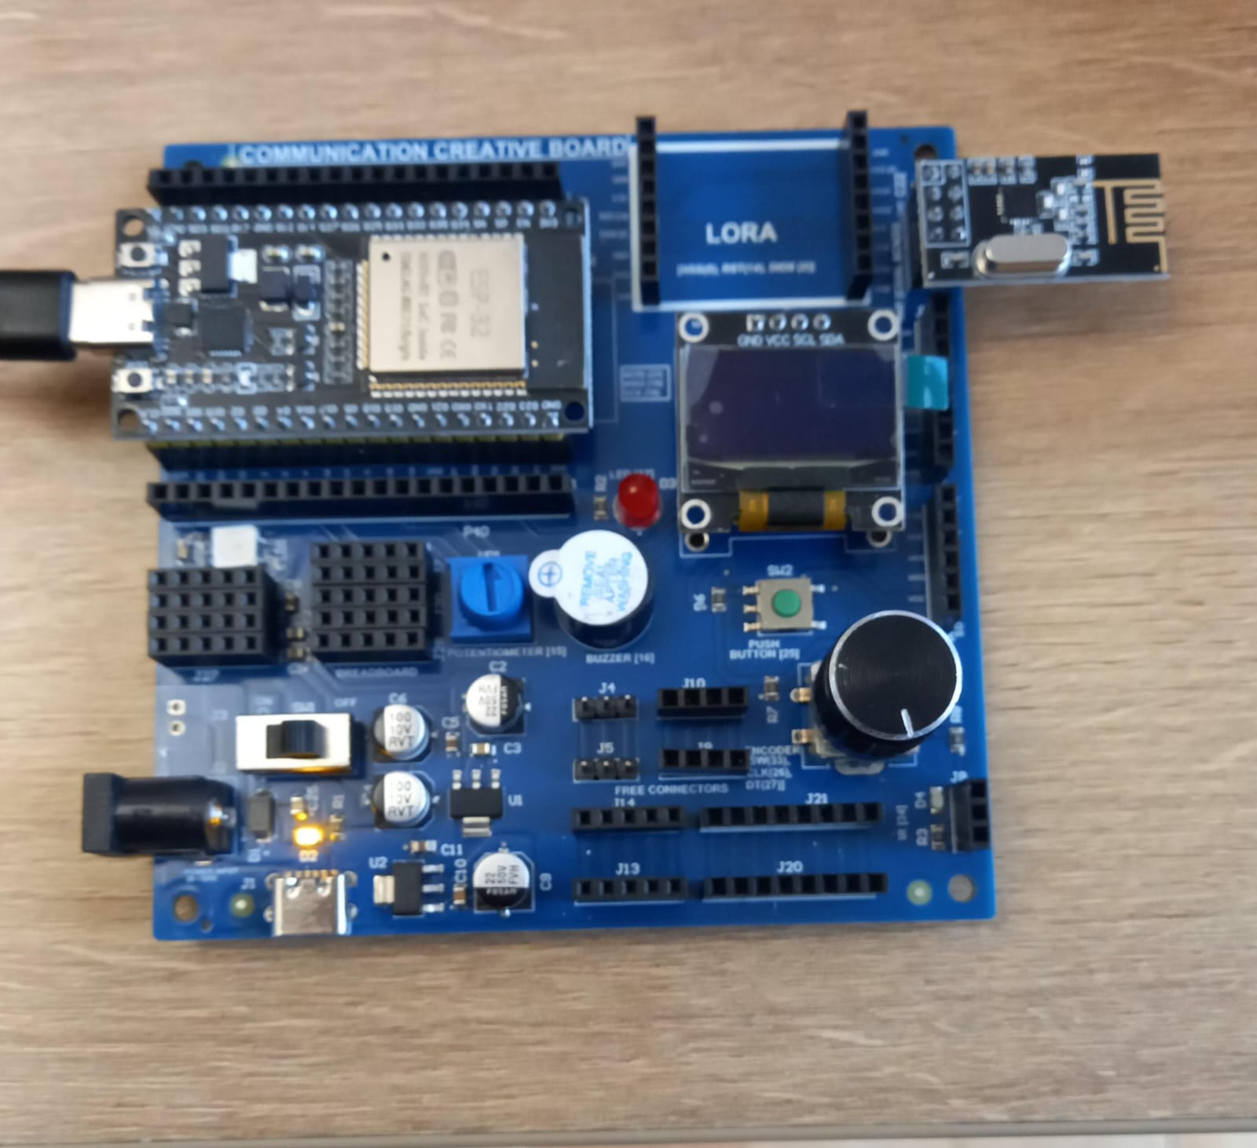
CFL13: Hybrid Relay (IR-NRF) Communication

Slide 7
  CFL13: Hybrid Relay (IR-NRF) Communication
Receiver
Transmitter
setup()
• Start Serial communication
• Initialize OLED display and show “nRF24 Receiver”
• Initialize nRF24L01 radio:
- Set power level, channel, data rate
- Open reading pipe with the same address as sender
- Start listening mode
setup()
• Initialize Serial communication
• Initialize OLED display and show “IR + nRF Sender”
• Start IR receiver on pin 34
• Configure nRF24L01 radio:
- Set power level, channel, data rate
- Open writing pipe
- Set radio to transmit mode
loop()
• Check if a wireless packet is available
• Read the received IR code (1 byte)
• Print the HEX value on Serial Monitor
• Display the IR code in large text on the OLED screen
loop()
• Check if an IR signal is received
• Read the IR command byte (0–255)
• Print IR code in HEX on Serial Monitor
• Display IR code on OLED
• Transmit the IR code via nRF24L01
• Resume IR receiver for next command
Code for Lesson CFL13 (CFL13_Hybrid_Communication_IR_NRF_Tx.ino)
(CFL13_Hybrid_Communication_IR_NRF_Rx.ino)
https://github.com/info-zas/zas-robotics-communications/blob/main/01_FoundationProjects/CFL13_Hybrid_Communication_IR_NRF/CFL13_Hybrid_Communication_IR_NRF_Tx/CFL13_Hybrid_Communication_IR_NRF_Tx.ino
https://github.com/info-zas/zas-robotics-communications/blob/main/01_FoundationProjects/CFL13_Hybrid_Communication_IR_NRF/CFL13_Hybrid_Communication_IR_NRF_Rx/CFL13_Hybrid_Communication_IR_NRF_Rx.ino

