Slide 1

Communication Kit (Kit 3)
Communication Foundation Lessons (CFL)
(Lesson Ref: CFL02)
CFL14: Hybrid Relay (LoRa-IoT) Communication

Slide 2


Communication Kit : Contents
Communication Kit Components
Communication Creative Board

Slide 3
Kit 3 Communication Creative Board - Features
LoRa Module I/F
NRF24L01 Module I/F
ESP32
OLED I/F
RFID I/F
Mini
Breadboard
SD Card Module I/F
Power
Connector
Rotary Encoder
ON/OFF Switch
Input DC Jack
Free Connectors

Slide 4
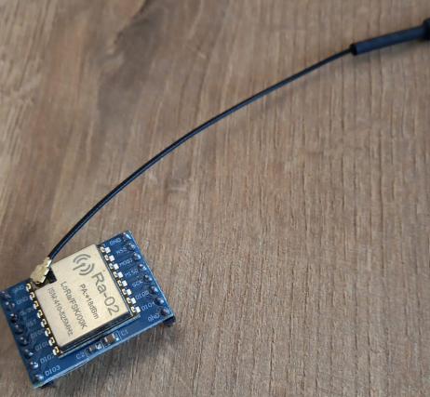

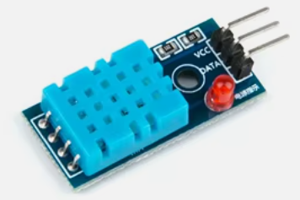

CFL14: Hybrid Relay (LoRa-IoT) Communication
Things Needed
LoRa Receiver:
LoRa Transmitter:
4

Slide 5
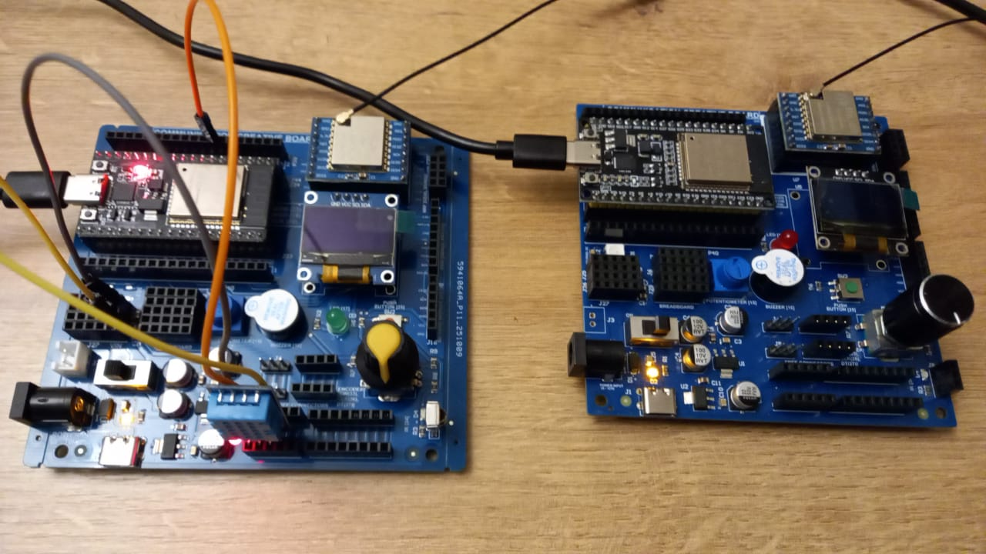
CFL14: Hybrid Relay (LoRa-IoT) Communication
DHT11 | ESP32 Pin
VCC | 5V
GND | GND
Data | 33

Slide 6
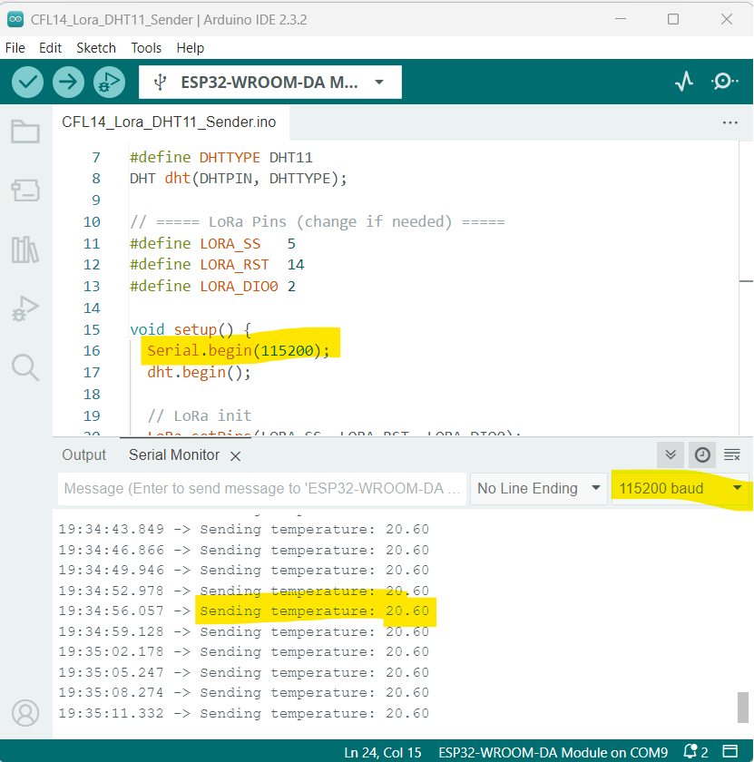
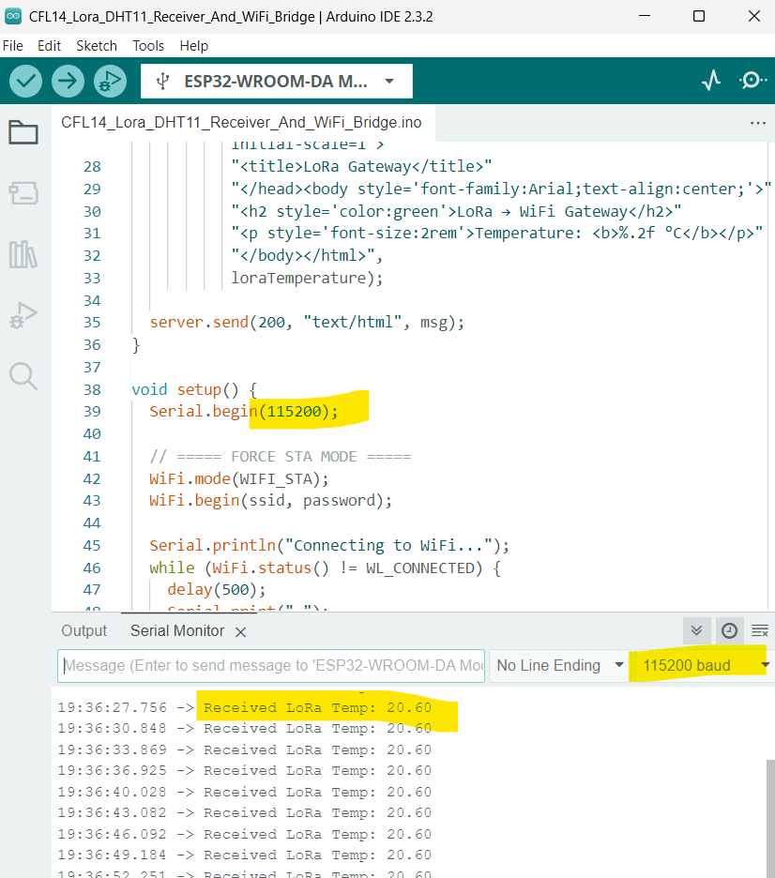
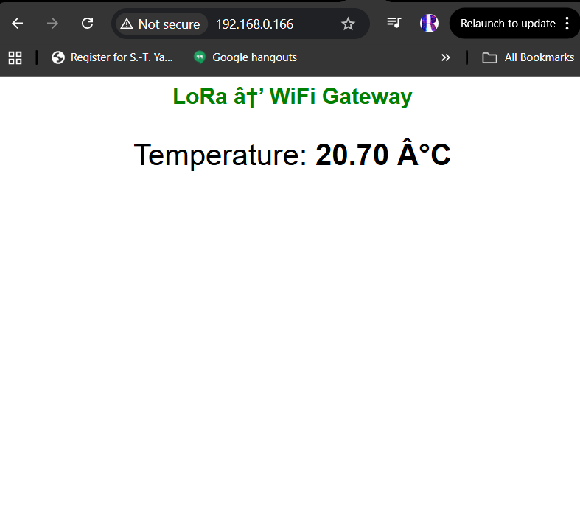
CFL14: Hybrid Relay (LoRa-IoT) Communication
LoRa
WiFi

Slide 7
CFL14: Hybrid Relay (LoRa-IoT) Communication
LoRa Temperature Sender (DHT11 → LoRa TX)
LoRa Temperature Receiver + WiFi Web Dashboard
setup()
• Start Serial communication
• Initialize DHT11 temperature sensor
• Configure LoRa pins and start LoRa at 433 MHz
• Print “LoRa Sender Ready”
setup()
• Connect ESP32 to WiFi network (STA mode)
• Start an HTTP server on port 80
• Create webpage handler to display LoRa temperature
• Initialize LoRa receiver at 433 MHz
• Print IP address and "LoRa Receiver Ready"
loop()
• Read temperature from DHT11
• If sensor read fails → print error and retry
• Print temperature value to Serial Monitor
• Send the temperature value as a LoRa packet
• Wait 3 seconds before sending the next reading
loop()
• Handle incoming web browser requests
• Check for LoRa packets
• If a LoRa packet arrives:
- Read the temperature string
- Convert to float and store in loraTemperature
- Print value on Serial Monitor
• Small delay to allow WiFi tasks to run properly
Code for Lesson CFL14 (CFL14_Lora_DHT11_Sender.ino)
(CFL14_Lora_DHT11_Receiver_And_WiFi_Bridge.ino)
https://github.com/info-zas/zas-robotics-communications/blob/main/01_FoundationProjects/CFL14_Hybrid_IoT_LoRa_To_LoRa_WiFi/CFL14_Lora_DHT11_Sender/CFL14_Lora_DHT11_Sender.ino
https://github.com/info-zas/zas-robotics-communications/blob/main/01_FoundationProjects/CFL14_Hybrid_IoT_LoRa_To_LoRa_WiFi/CFL14_Lora_DHT11_Receiver_And_WiFi_Bridge/CFL14_Lora_DHT11_Receiver_And_WiFi_Bridge.ino

