Slide 1

Communication Kit (Kit 3)
Communication Foundation Lessons (CFL)
(Lesson Ref: CFL02)
CFL03: RFID - Reading & Access Control System Using MFRC522

Slide 2


Communication Kit : Contents
Communication Kit Components
Communication Creative Board

Slide 3
Kit 3 Communication Creative Board - Features
LoRa Module I/F
NRF24L01 Module I/F
ESP32
OLED I/F
RFID I/F
Mini
Breadboard
SD Card Module I/F
Power
Connector
Rotary Encoder
ON/OFF Switch
Input DC Jack
Free Connectors

Slide 4


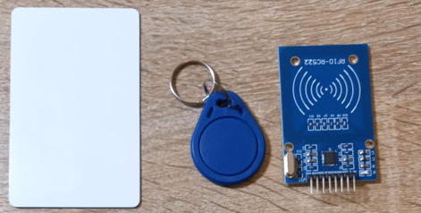







CFL03 : RFID - Reading & Access Control System Using MFRC522
Things Needed

Slide 5
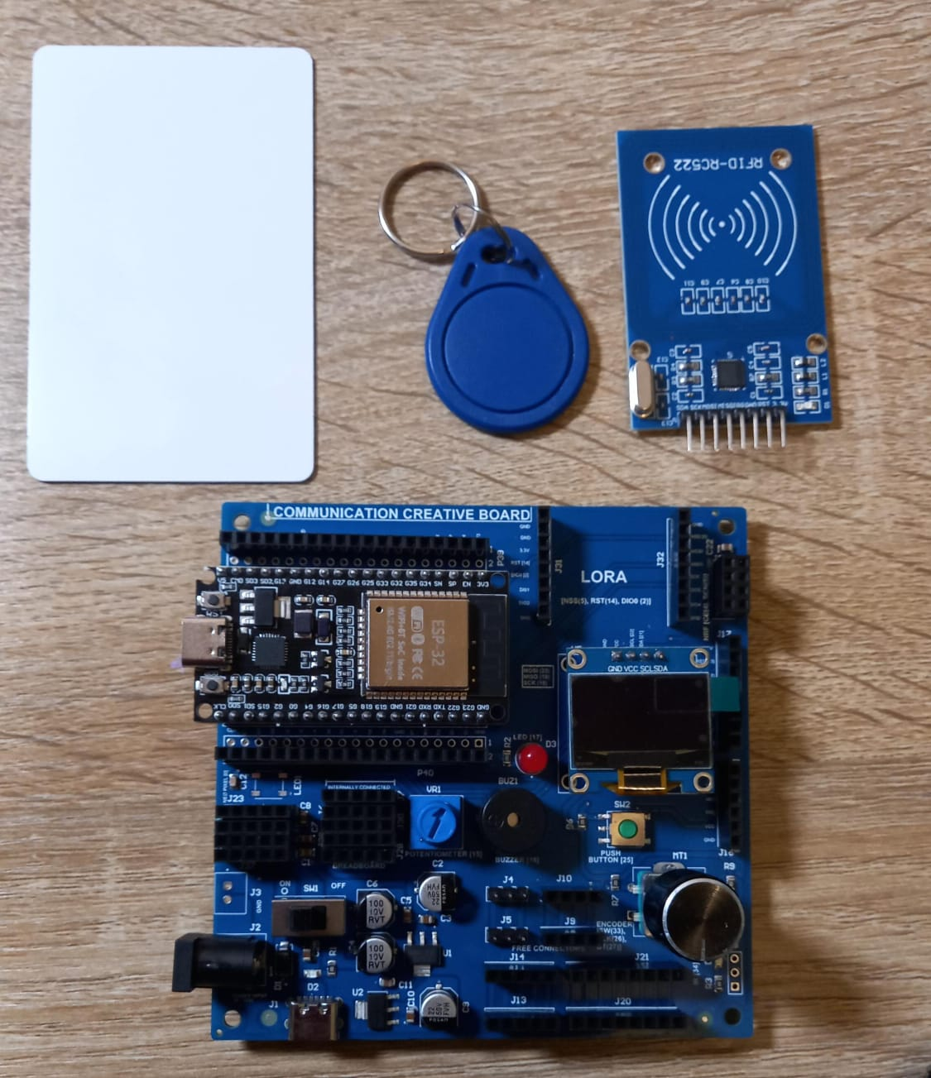
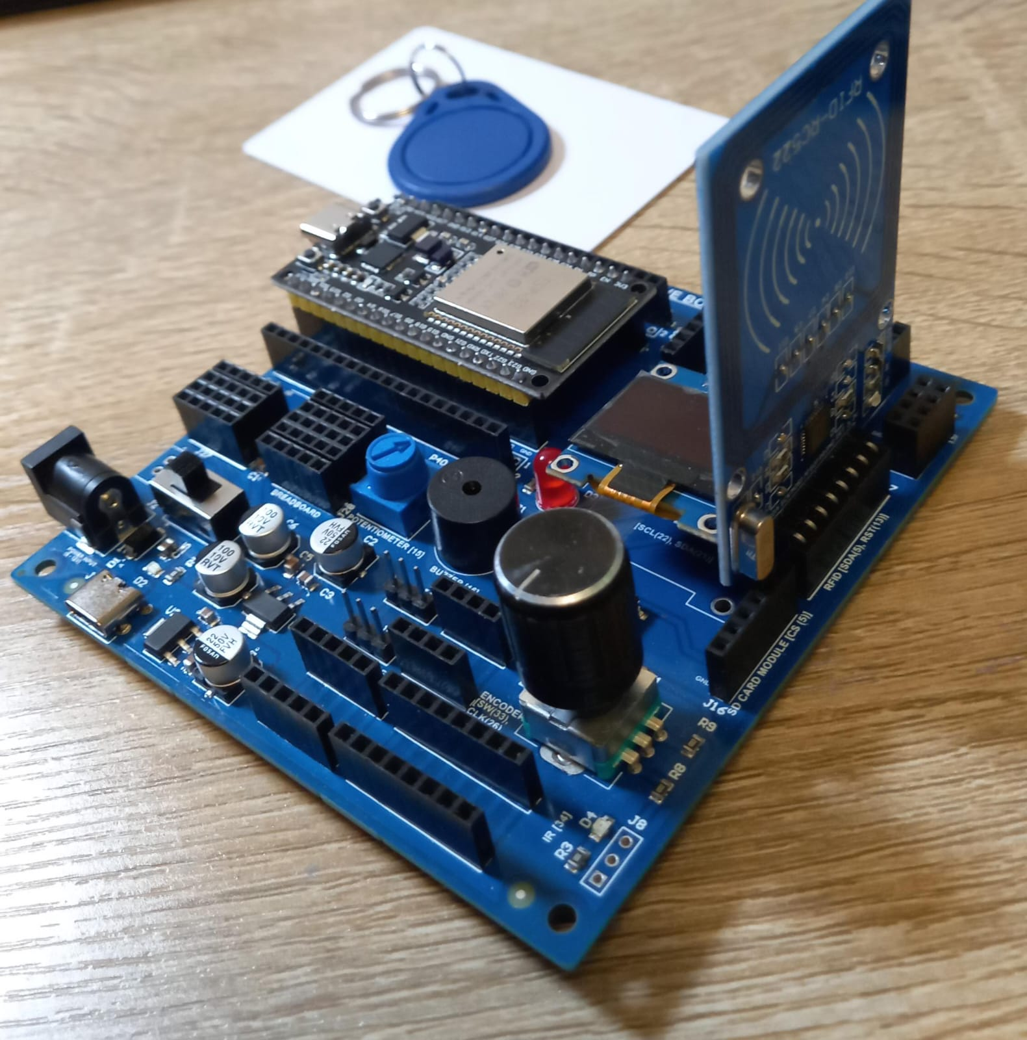
CFL03 : RFID - Reading

Slide 6
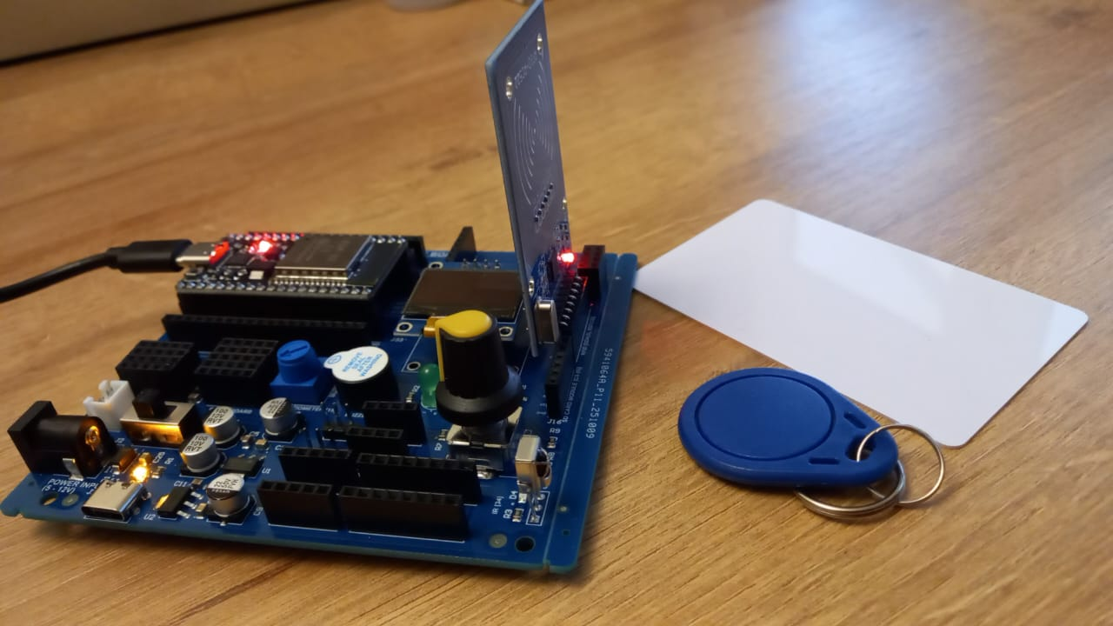
CFL03 : RFID Tag Reading
Code Explanation (RFID UID Reader)
setup()
Start Serial monitor
Initialize OLED, show “RFID Ready”
Initialize RFID reader (MFRC522)
Display “Scan card…” message in Serial
loop()
Check if a new card is present
Read card’s UID bytes
Convert UID to HEX string
Print UID in Serial
Display UID on OLED
Title: “RFID UID”
UID printed below
Small delay before next scan
Code for Lesson CFL03 (CFL03_RFID_Card_Info.ino):
Github Code Link:
(1) https://github.com/info-zas/Training/tree/main/GPREC/03_Communications/01_Code/01_Comm_Kit_RFIDCardInfo

Slide 7
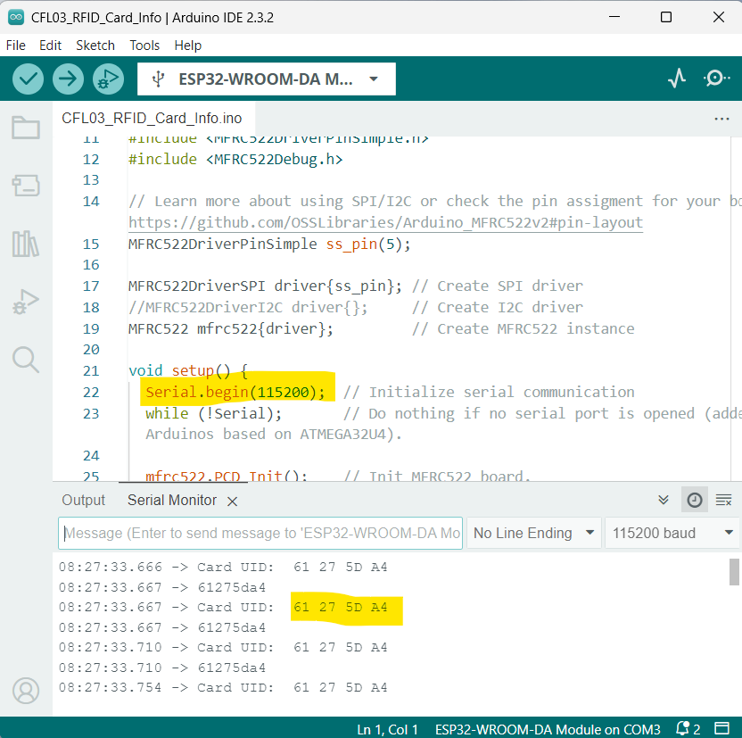
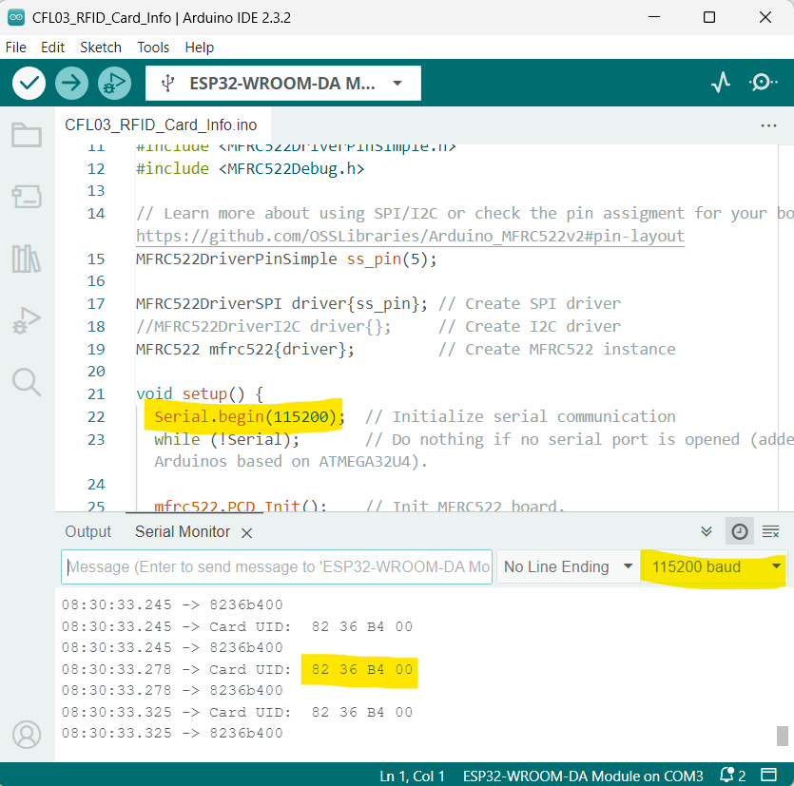
CFL03 : RFID Tag Reading
With RFID Card (Proximity Card or RFID Smart Card)
With Blue Key Fob

Slide 8
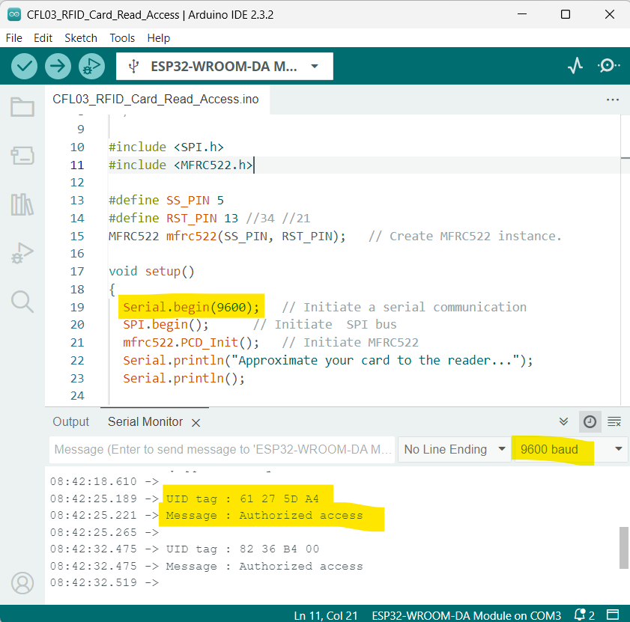
CFL03 : RFID - Access Control System
setup()
• Start Serial communication
• Initialise SPI bus
• Initialise RFID reader (MFRC522)
• Display “Scan card…” message in Serial
loop()
• Check if a new RFID card is present
• Read the card’s UID
• Convert UID bytes to HEX string
• Print UID to Serial Monitor
• Compare UID with authorised IDs
• Display “Authorized access” or “Access denied” in Serial
• Wait for 3 seconds before next scan
Code for Lesson CFL03 (CFL03_RFID_Card_Read_Access.ino):

Slide 9
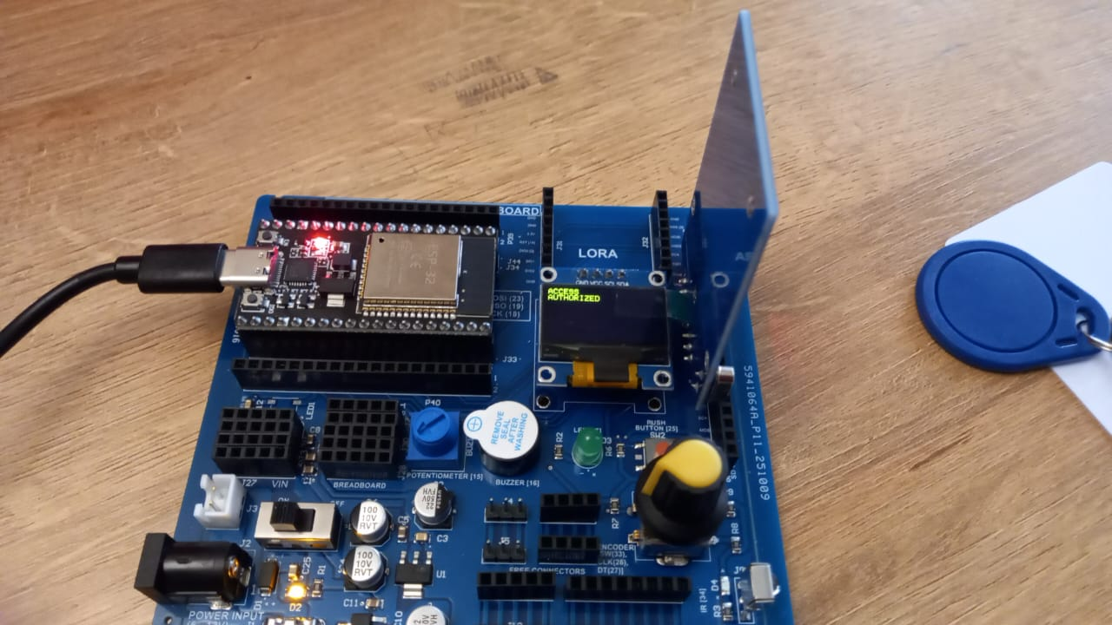
CFL03 : RFID - Access Control System -OLED
setup()
• Start Serial communication
• Initialise I2C and OLED display
• Show “RFID Ready” on OLED
• Initialise SPI bus
• Initialise RFID reader (MFRC522)
loop()
• Check if a new RFID card is present
• Read the card’s UID bytes
• Convert UID to HEX string
• Compare UID with authorised IDs
• Display “ACCESS AUTHORIZED” or “ACCESS DENIED” on OLED
• Print access result to Serial Monitor
• Wait for 3 seconds
• Display “Scan Card…” on OLED
Code for Lesson CFL03 (CFL03_RFID_Card_Read_Access_OLED.ino):

