Slide 1

Communication Kit (Kit 3)
Communication Foundation Lessons (CFL)
(Lesson Ref: CFL02)
CFL05:WiFi Client (HTTP)-Server(ESP32) Sensor Network

Slide 2


Communication Kit : Contents
Communication Kit Components
Communication Creative Board

Slide 3
Kit 3 Communication Creative Board - Features
LoRa Module I/F
NRF24L01 Module I/F
ESP32
OLED I/F
RFID I/F
Mini
Breadboard
SD Card Module I/F
Power
Connector
Rotary Encoder
ON/OFF Switch
Input DC Jack
Free Connectors

Slide 4


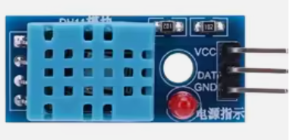
CFL05 : WiFi Client (HTTP)-Server(ESP32) Sensor Network
Things Needed

Slide 5
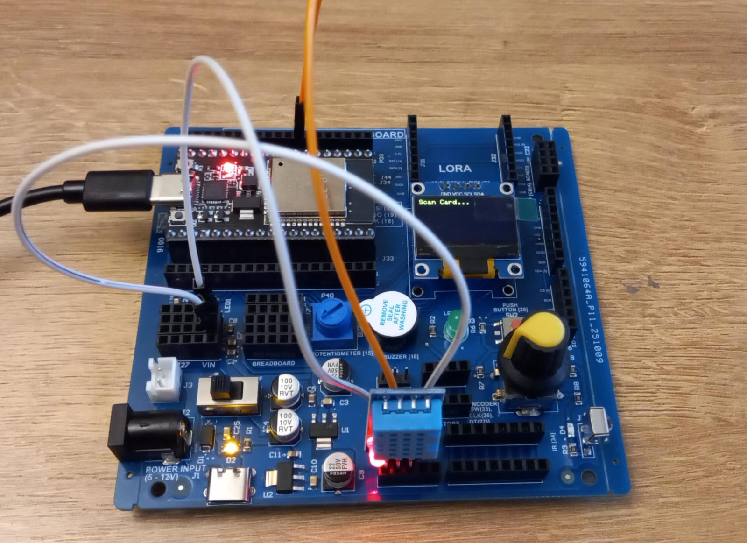
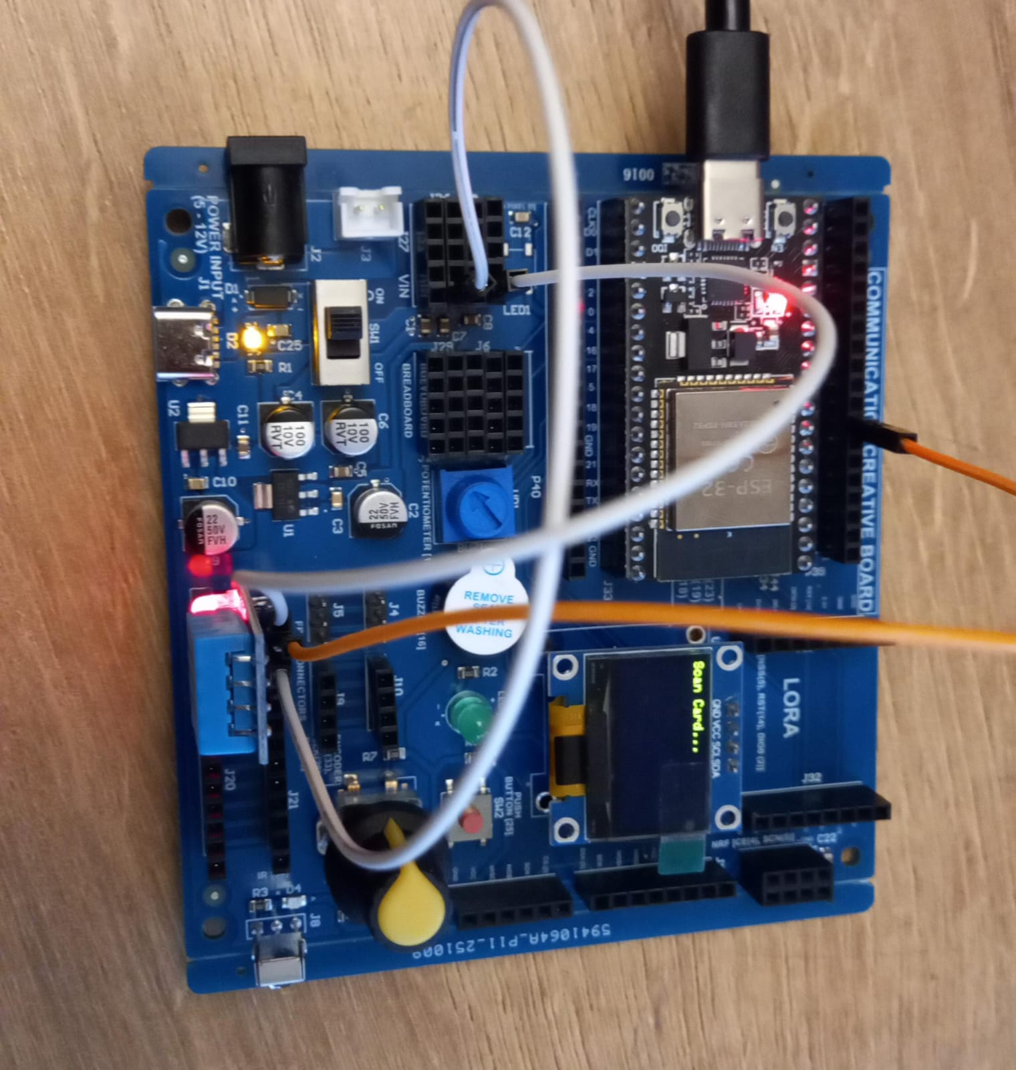
CFL05 : WiFi Client (HTTP)-Server(ESP32) Sensor (DHT11) Network
DHT11 | ESP32 Pin
VCC | 5V
GND | GND
Data | 33

Slide 6
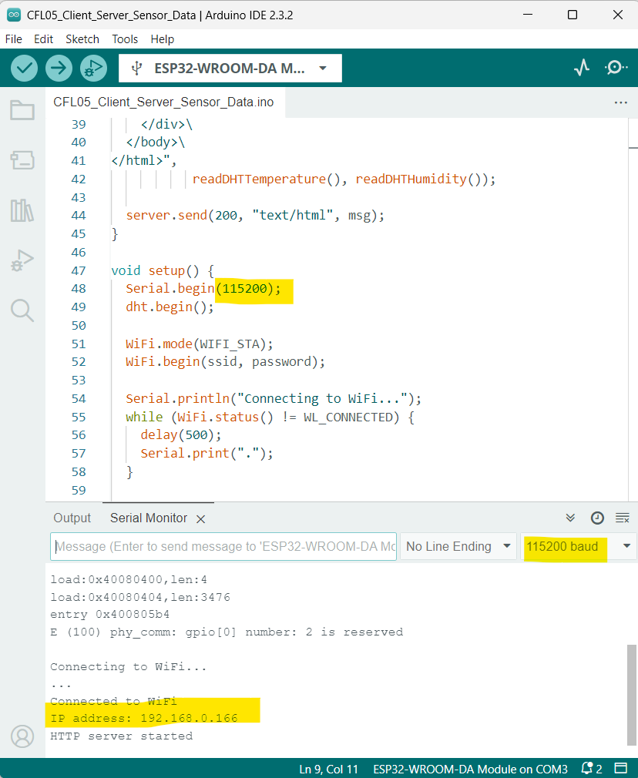
CFL05 : WiFi Client (HTTP)-Server(ESP32) Sensor (DHT11) Network
Code for Lesson CFL05 (CFL05_Client_Server_Sensor_Data.ino):

Slide 7
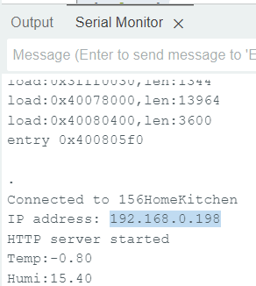
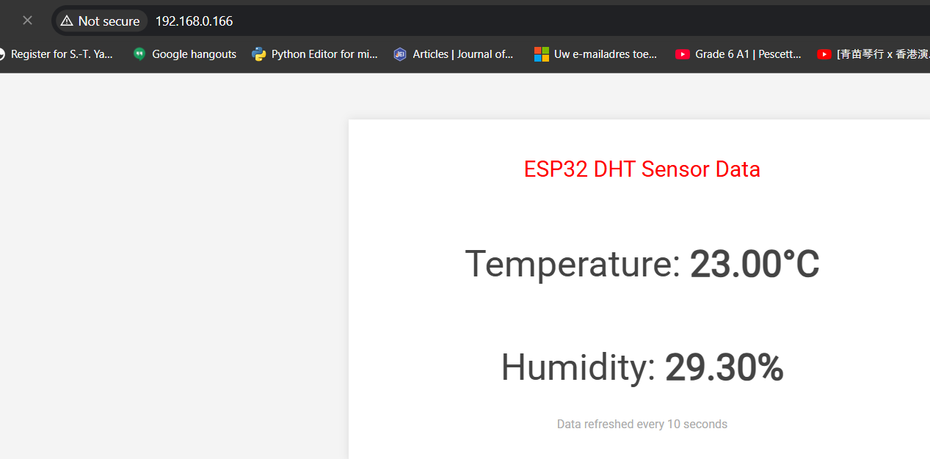
CFL05 : WiFi Client (HTTP)-Server(ESP32) Sensor (DHT11) Network
Once you upload the code, press EN button on ESP32 and select the baudrate to 115200 and copy the IP address from serial monitor as below. Copy the IP address in the browser.

