Slide 1

Communication Kit (Kit 3)
Communication Foundation Lessons (CFL)
(Lesson Ref: CFL02)
CFL06: Push Sensor Data to a Web Page

Slide 2


Communication Kit : Contents
Communication Kit Components
Communication Creative Board

Slide 3
Kit 3 Communication Creative Board - Features
LoRa Module I/F
NRF24L01 Module I/F
ESP32
OLED I/F
RFID I/F
Mini
Breadboard
SD Card Module I/F
Power
Connector
Rotary Encoder
ON/OFF Switch
Input DC Jack
Free Connectors

Slide 4


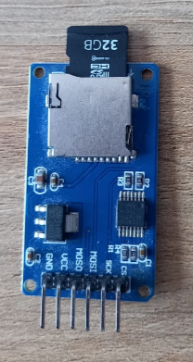
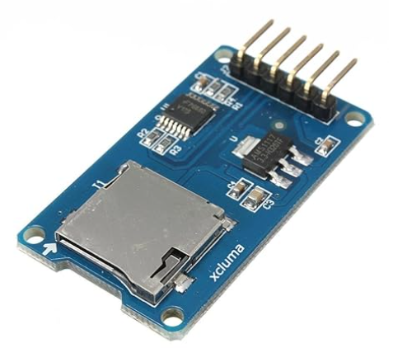
CFL04 : Sensor (DHT11) Data Logging Using SD Card Module
Things Needed

Slide 5
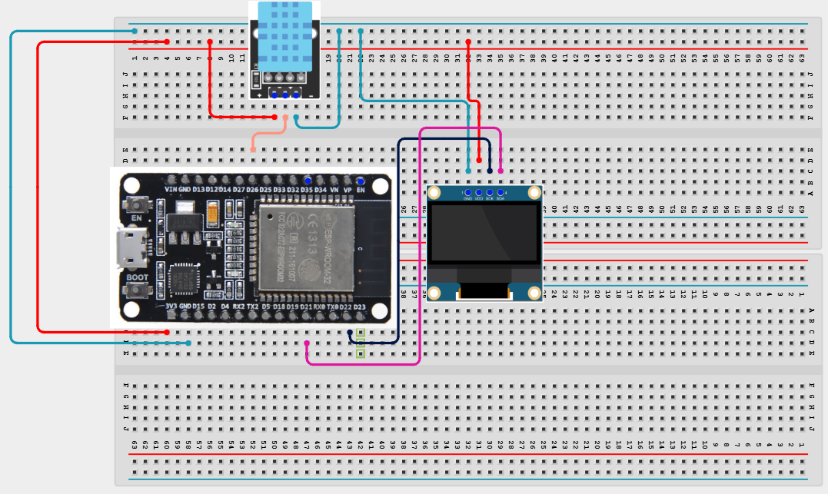
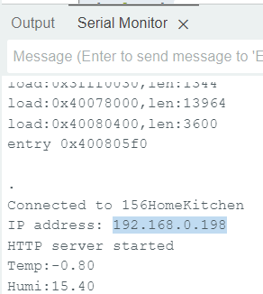
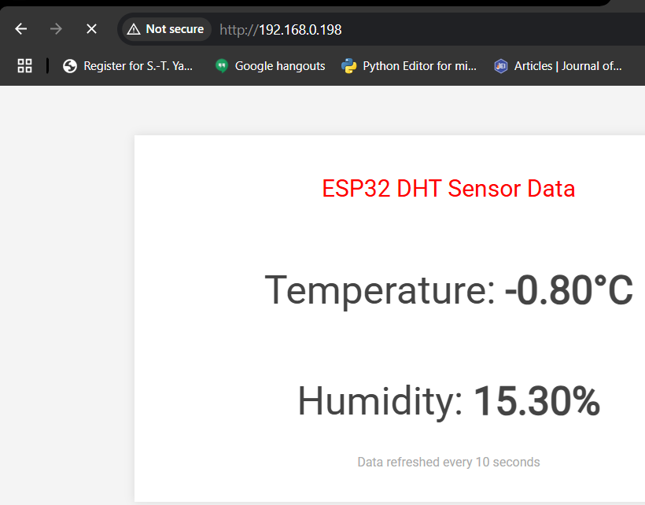
ESP32_DHT11_Webpage
#include <WiFi.h>
#include <WebServer.h>
#include <DHT.h>
const char *ssid = "156HomeKitchen";
const char *password = "Hitchin786&";
WebServer server(80);
DHT dht(26, DHT11);
void handleRoot() {
char msg[2000];
snprintf(msg, 2000,
"<html>\
<head>\
<meta http-equiv='refresh' content='10'/>\
<meta name='viewport' content='width=device-width, initial-scale=1'>\
<link href='https://fonts.googleapis.com/css2?family=Roboto:wght@100;400&display=swap' rel='stylesheet'>\
<title>ESP32 DHT Server</title>\
<style>\
body { font-family: 'Roboto', sans-serif; background-color: #f4f4f4; color: #444; margin: 0; padding: 0; }\
.container { max-width: 600px; margin: 50px auto; padding: 20px; text-align: center; background-color: white; box-shadow: 0 0 10px rgba(0, 0, 0, 0.1); }\
h2 { font-weight: 400; }\
.reading { font-size: 2.5rem; margin: 20px 0; }\
.units { font-size: 1.5rem; color: #888; }\
.sensor-icon { font-size: 4rem; color: #1a8cff; margin-bottom: 10px; }\
.footer { margin-top: 30px; font-size: 0.8rem; color: #aaa; }\
</style>\
</head>\
<body>\
<div class='container'>\
<h2 style='color:red'>ESP32 DHT Sensor Data</h2>\
<p class='sensor-icon'><i class='fas fa-thermometer-half'></i></p>\
<p class='reading'>Temperature: <strong>%.2f&deg;C</strong></p>\
<p class='sensor-icon'><i class='fas fa-tint'></i></p>\
<p class='reading'>Humidity: <strong>%.2f%%</strong></p>\
<p class='footer'>Data refreshed every 10 seconds</p>\
</div>\
</body>\
</html>",
readDHTTemperature(), readDHTHumidity()
);
server.send(200, "text/html", msg);
}
void setup(void) {
Serial.begin(115200);
dht.begin();
WiFi.mode(WIFI_STA);
WiFi.begin(ssid, password);
Serial.println("");
// Wait for connection
while (WiFi.status() != WL_CONNECTED) {
delay(500);
Serial.print(".");
}
Serial.println("");
Serial.print("Connected to ");
Serial.println(ssid);
Serial.print("IP address: ");
Serial.println(WiFi.localIP());
server.on("/", handleRoot);
server.begin();
Serial.println("HTTP server started");
}
void loop(void) {
server.handleClient();
delay(2000); // Allow the CPU to switch to other tasks
}
float readDHTTemperature() {
float t = dht.readTemperature();
if (isnan(t)) {
Serial.println("Failed to read from DHT sensor!");
return -1;
} else {
Serial.print("Temp:");
Serial.println(t);
return t;
}
}
float readDHTHumidity() {
float h = dht.readHumidity();
if (isnan(h)) {
Serial.println("Failed to read from DHT sensor!");
return -1;
} else {
Serial.print("Humi:");
Serial.println(h);
return h;
}
}
Once you upload the code, press EN button on ESP32 and select the baudrate to 115200 and copy the IP address from serial monitor as below. Copy the IP address in the browser.

