Slide 1

Communication Kit (Kit 3)
Communication Foundation Lessons (CFL)
(Lesson Ref: CFL02)
CFL08: Simplex Wireless Communication Using NRF24L01

Slide 2


Communication Kit : Contents
Communication Kit Components
Communication Creative Board

Slide 3
Kit 3 Communication Creative Board - Features
LoRa Module I/F
NRF24L01 Module I/F
ESP32
OLED I/F
RFID I/F
Mini
Breadboard
SD Card Module I/F
Power
Connector
Rotary Encoder
ON/OFF Switch
Input DC Jack
Free Connectors

Slide 4


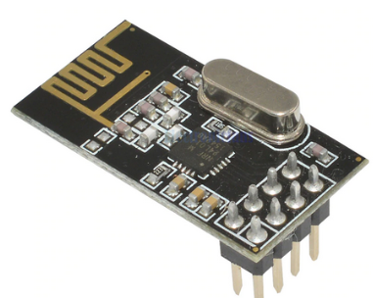
CFL08 : Simplex Wireless Communication Using NRF24L01
Things Needed

Slide 5

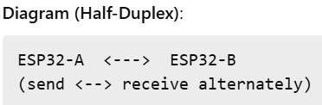
CFL09 : What is Simplex and Duplex Communication?
Communication in electronics can be:
  Simplex: One-way
    Definition: Data flows in only one direction
    Example:
    ESP32-A sends sensor data
    ESP32-B only receives
    Real-world analogy: TV broadcast
  Duplex: Two-way (Half or Full)
    Definition: Data flows in both directions
    Types:
    Half-Duplex: One direction at a time (walkie-talkie)
    Full-Duplex: Both directions at the same time (phone call)
  In Microcontrollers: Usually implement Half-Duplex

Slide 6
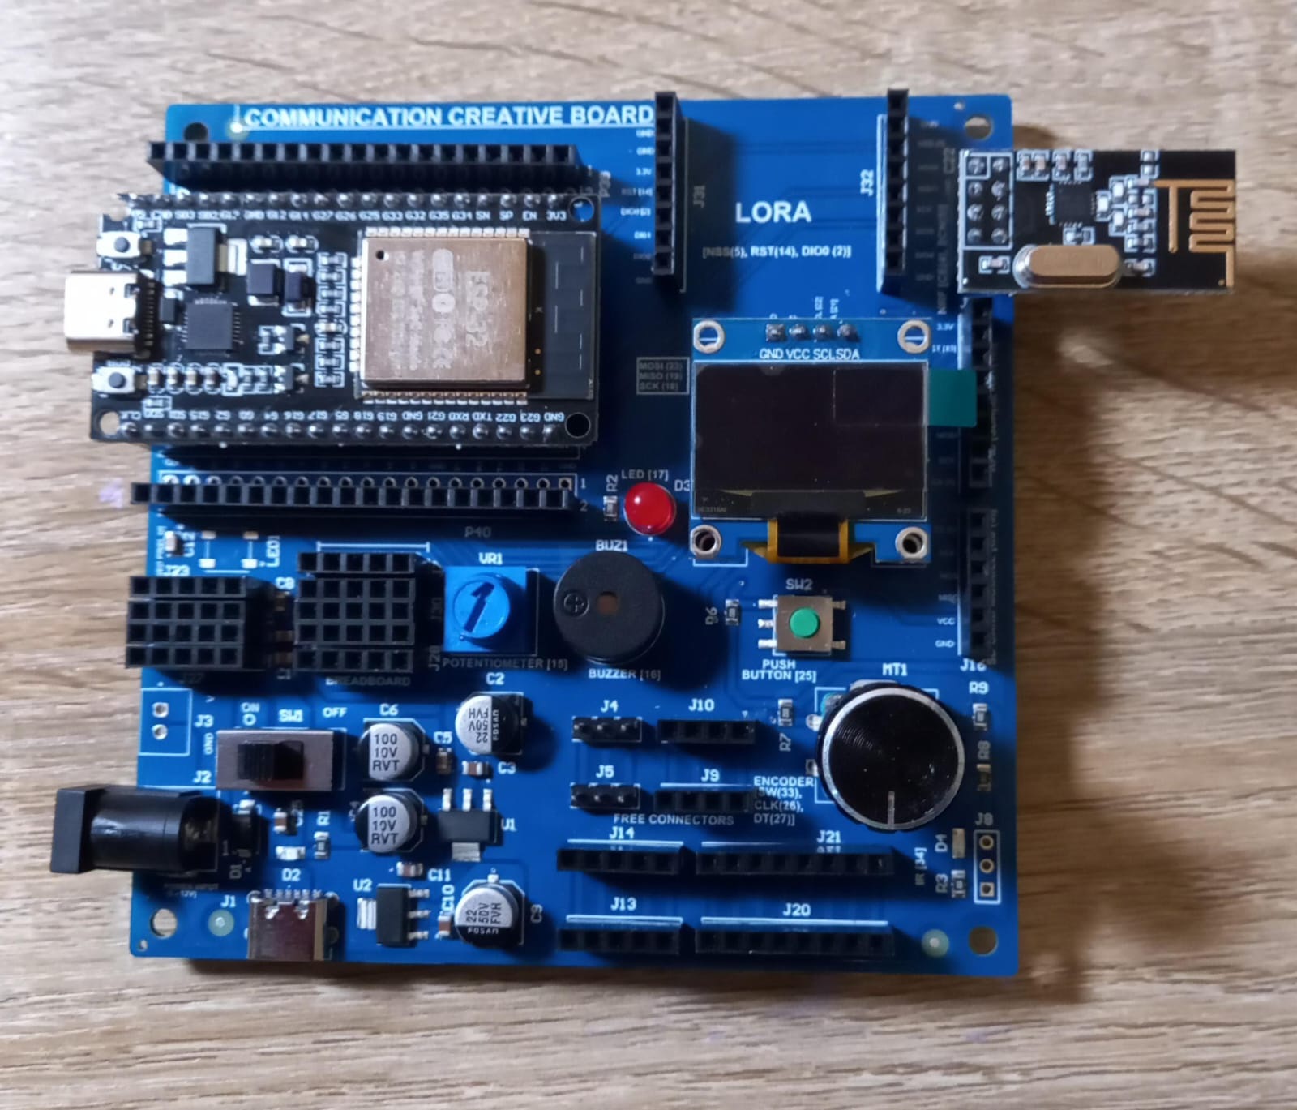
  CFL08: Simplex Wireless Communication Using NRF24L01
NRF Transmitter/Sender
NRF Receiver

Slide 7
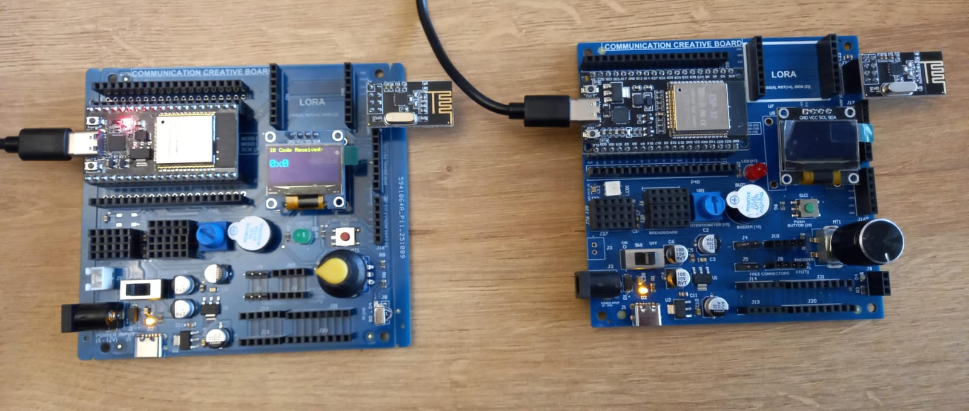
CFL08: Simplex Wireless Communication Using NRF24L01

Slide 8
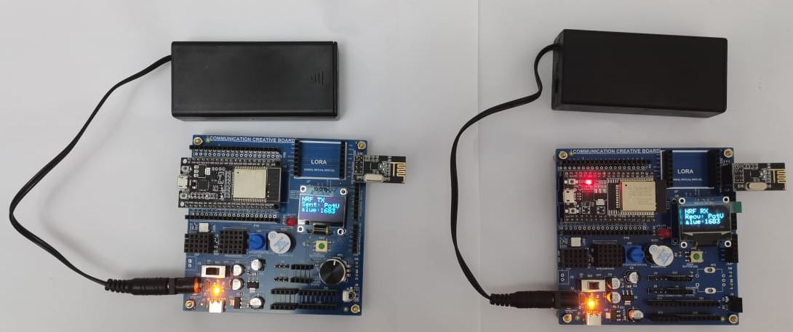
  CFL08: Simplex Wireless Communication Using NRF24L01
NRF24L01 – Transmitter & Receiver Workflow
1. Setup Transmitter & Receiver
Configure ESP32 + NRF24L01 on SPI pins
Connect OLED display for feedback
Set matching radio address for TX/RX
2. NRF24 Communication Workflow
Transmitter Side (TX)
ESP32 reads potentiometer value
Formats message as: "PotValue:XXXX"
Sends packet using NRF24L01 @ 2.4 GHz (32-byte payload)
OLED shows: “Sent: XXXX”
Uses SPI pins (CE, CSN, SCK, MOSI, MISO)
NRF24 Wireless Link
Short-range, high-speed 2.4 GHz radio link
Ideal for robot-to-robot, remote sensors, wireless controllers
Low power, reliable packet system with auto-acknowledge
Supports multiple nodes via unique radio addresses
Receiver Side (RX)
ESP32 detects packets using radio.available()
Reads data with radio.read()
Extracts potentiometer value from received message
OLED displays: “Recv: XXXX”
Github Link for Code:
(1). https://github.com/info-zas/Training/tree/main/GPREC/03_Communications/01_Code/03_Comm_Kit_NRF24L01_Transmitter_Encoder_Value
(2). https://github.com/info-zas/Training/tree/main/GPREC/03_Communications/01_Code/04_Comm_Kit_NRF24L01_Receiver_Encoder_Value

