Slide 1

Communication Kit (Kit 3)
Communication Foundation Lessons (CFL)
(Lesson Ref: CFL02)
CFL10: Simplex Wireless Communication Using LoRa

Slide 2


Communication Kit : Contents
Communication Kit Components
Communication Creative Board

Slide 3
Kit 3 Communication Creative Board - Features
LoRa Module I/F
NRF24L01 Module I/F
ESP32
OLED I/F
RFID I/F
Mini
Breadboard
SD Card Module I/F
Power
Connector
Rotary Encoder
ON/OFF Switch
Input DC Jack
Free Connectors

Slide 4
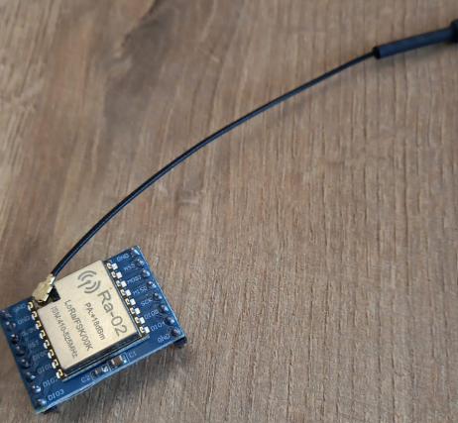


CFL10 : Simplex Wireless Communication Using LoRa
Things Needed
LoRa Receiver:
LoRa Transmitter:
4

Slide 5
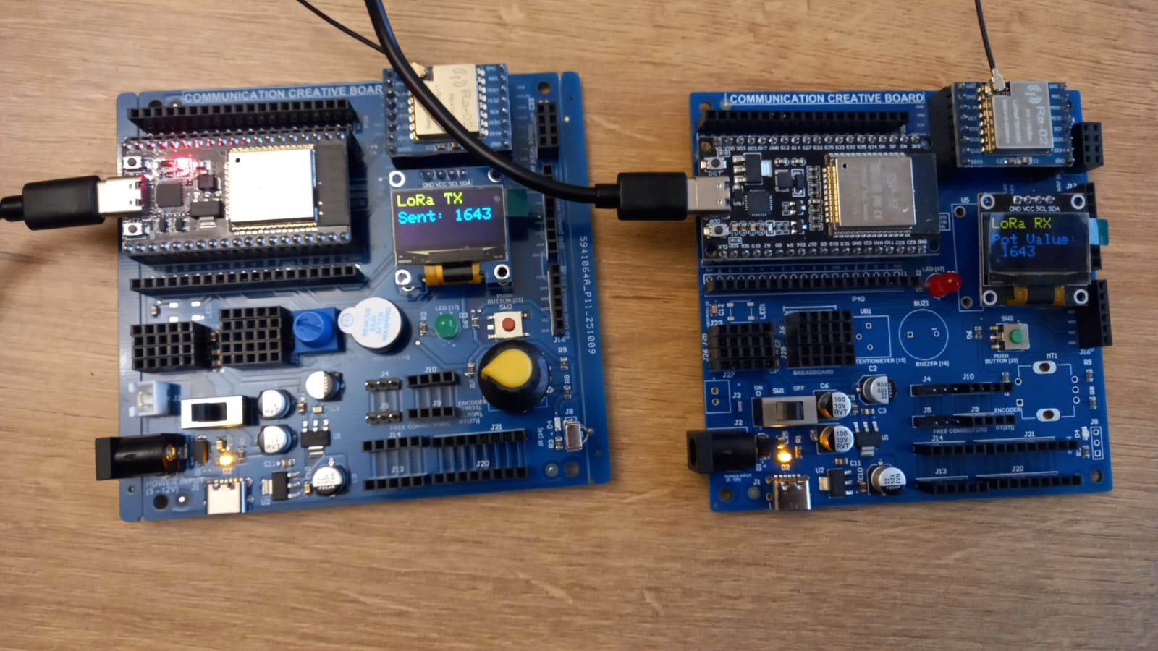
  CFL10 : Simplex Wireless Communication Using LoRa

Slide 6
CFL10 : Simplex Wireless Communication Using LoRa
LoRa Transmitter:
LoRa Receiver:
setup()
• Start Serial communication
• Configure potentiometer pin as INPUT
• Initialise OLED display
• Show “LoRa TX Starting…” on OLED
• Reset and initialise LoRa module (SX1278)
• Set LoRa frequency to 433 MHz
• Display “LoRa Ready” on OLED
loop()
• Read potentiometer analogue value
• Create message containing pot value
• Send message using LoRa packet
• Print sent data to Serial Monitor
• Display transmitted value on OLED
• Wait for 2 seconds before next transmission
setup()
• Start Serial communication
• Initialise OLED display
• Show “LoRa RX Starting…” on OLED
• Reset and initialise LoRa module (SX1278)
• Set LoRa frequency to 433 MHz
• Display “LoRa Ready” on OLED
loop()
• Check if a LoRa packet is received
• Read incoming LoRa message
• Print received data to Serial Monitor
• Extract potentiometer value from message
• Display received pot value on OLED
Code for Lesson CFL10 (CFL10_Simplex_Wireless_LoRa_Receiver.ino)
(CFL10_Simplex_Wireless_LoRa_Transmitter.ino)

Slide 7
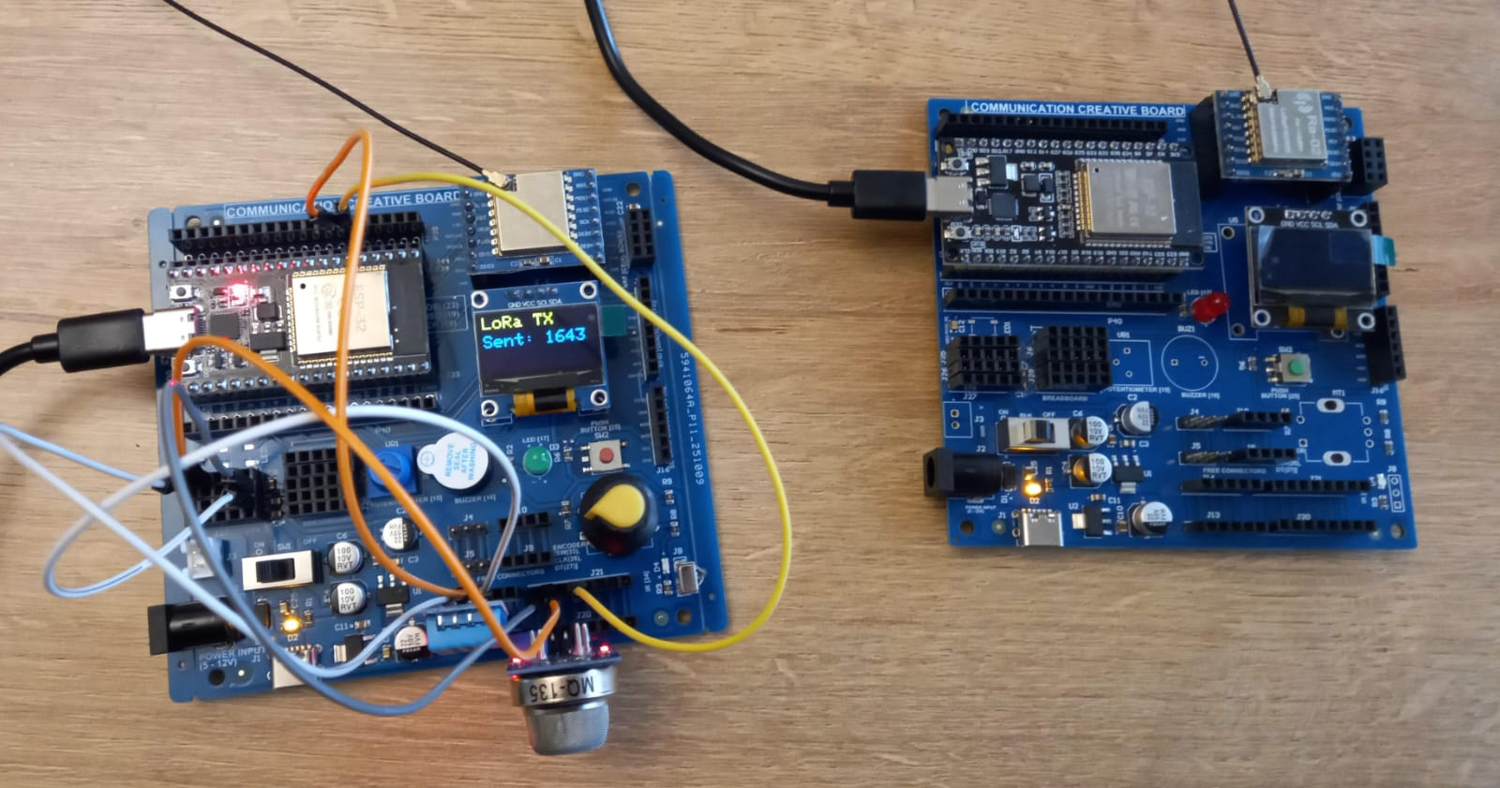
CFL10 : Simplex Wireless Sensor Data (DHT11 and MQ-135) Communication Using LoRa
DHT11 | ESP32 Pin
VCC | 5V
GND | GND
Data | 32
MQ-135 | ESP32 Pin
VCC | 3.3V
GND | GND
A0 | 35
Code for Lesson CFL10 (CFL10_Simplex_LoRa_DHT_Pollution_Rx.ino)
(CFL10_Simplex_LoRa_DHT_Pollution_Tx.ino)

