Slide 1

Communication Kit (Kit 3)
Communication Foundation Lessons (CFL)
(Lesson Ref: CFL02)
CFL15: ESP32 As Access Point

Slide 2


Communication Kit : Contents
Communication Kit Components
Communication Creative Board

Slide 3
Kit 3 Communication Creative Board - Features
LoRa Module I/F
NRF24L01 Module I/F
ESP32
OLED I/F
RFID I/F
Mini
Breadboard
SD Card Module I/F
Power
Connector
Rotary Encoder
ON/OFF Switch
Input DC Jack
Free Connectors

Slide 4

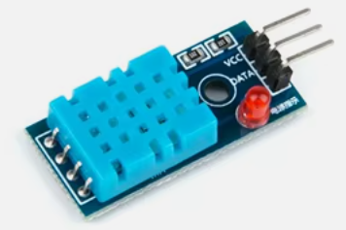

CFL15: ESP32 As Access Point
Things Needed
4

Slide 5
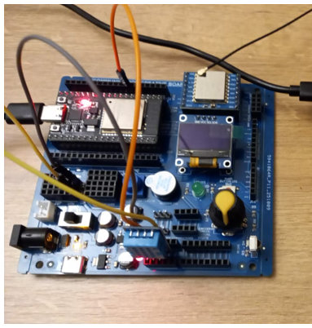
CFL15: ESP32 As Access Point
DHT11 | ESP32 Pin
VCC | 5V
GND | GND
Data | 33

Slide 6
CFL15: ESP32 As Access Point
ESP32 Agriculture Field Monitor (Access Point + Web Dashboard)
setup()
• Initialize Serial monitor
• Start DHT11 sensor
• Configure ESP32 as a WiFi Access Point (AP)
- SSID: "Agri_Field_Node"
- Password: "farm12345"
• Print AP IP address (usually 192.168.4.1)
• Start an HTTP server on port 80
• Register handler for "/" to show the sensor dashboard
loop()
• Handle incoming web browser requests
• Every 3 seconds:
- Read temperature and humidity from DHT11
- Print values to Serial Monitor
- Report error if sensor read fails

Slide 7
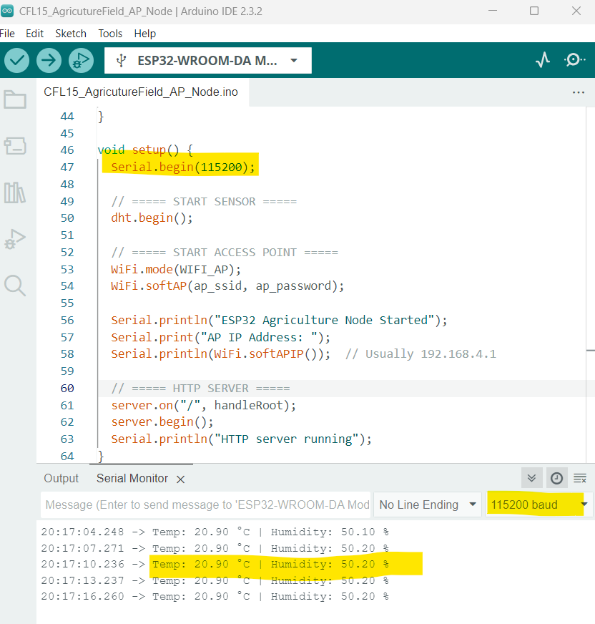
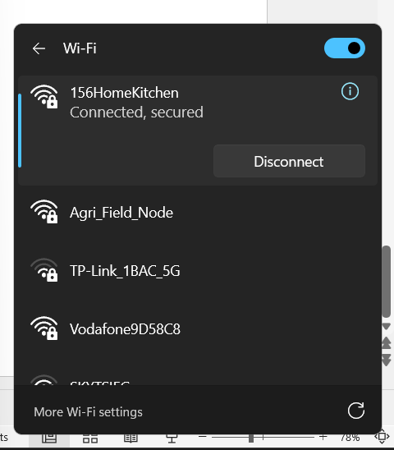
CFL15: ESP32 As Access Point
Code for Lesson CFL15 (CFL15_AgricutureField_AP_Node.ino)

Slide 8
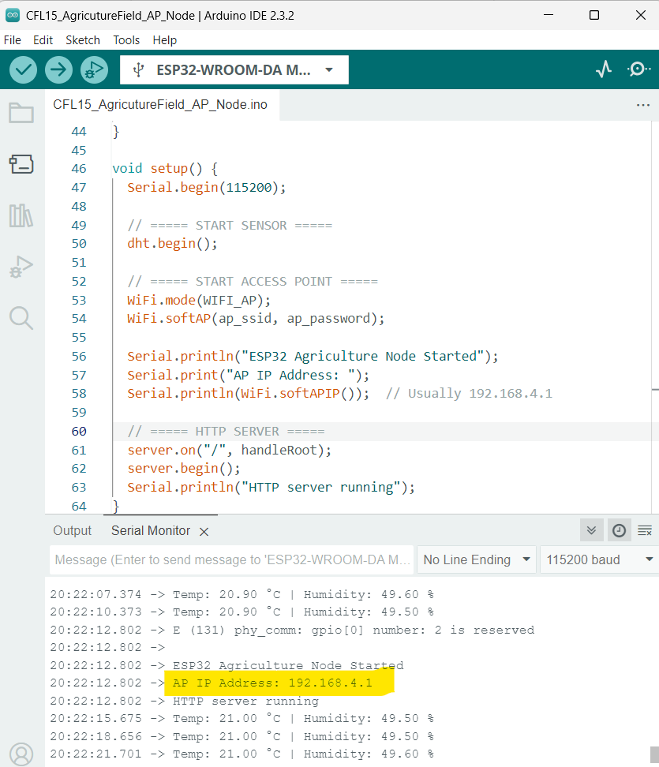
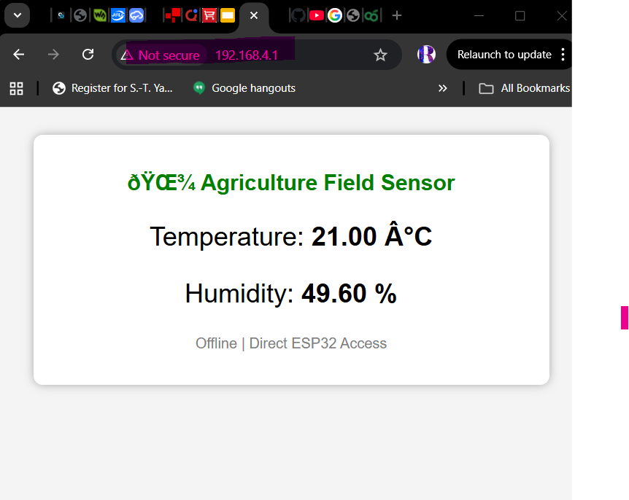
CFL15: ESP32 As Access Point

