Slide 1

Motion Kit (Kit 2)
Motion Foundation Lessons (MFL)
(Lesson Ref: MFL01)
MFL01: Servo Motor Control with Potentiometer

Slide 2


Motion Kit : Contents
Motion Kit Components
Motion Creative Board

Slide 3
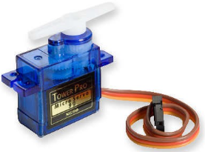
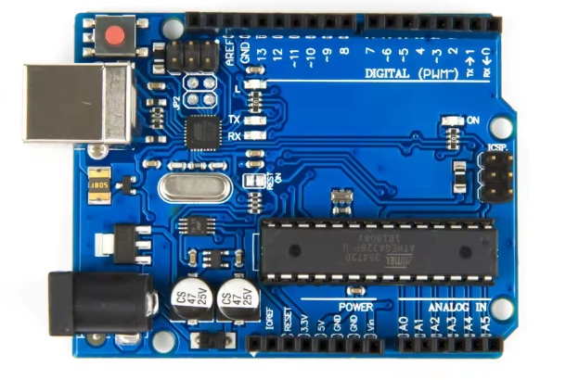
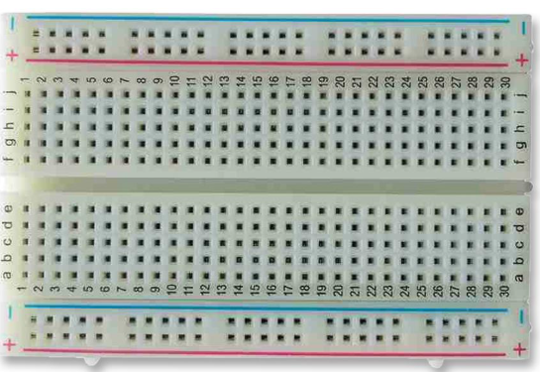
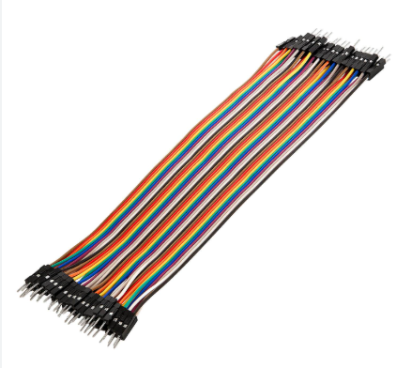
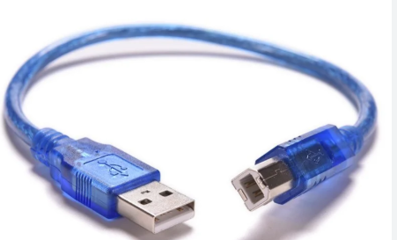
MFL01 : Servo Motor Control
Things Needed

Slide 4
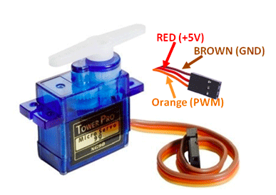
MFL01 : Servo Motor Control
Servo Motor

Slide 5
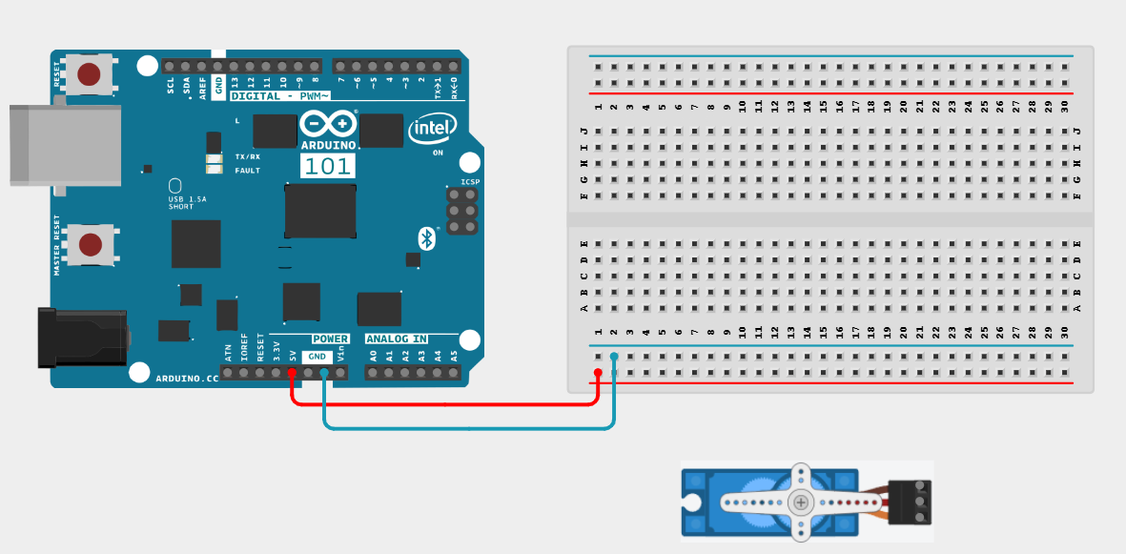
MFL01 : Servo Motor Control
Connections:
Arduino Pin | Breadboard
GND (Brown Wire) | Blueline
5V (Red Wire) | Redline

Slide 6
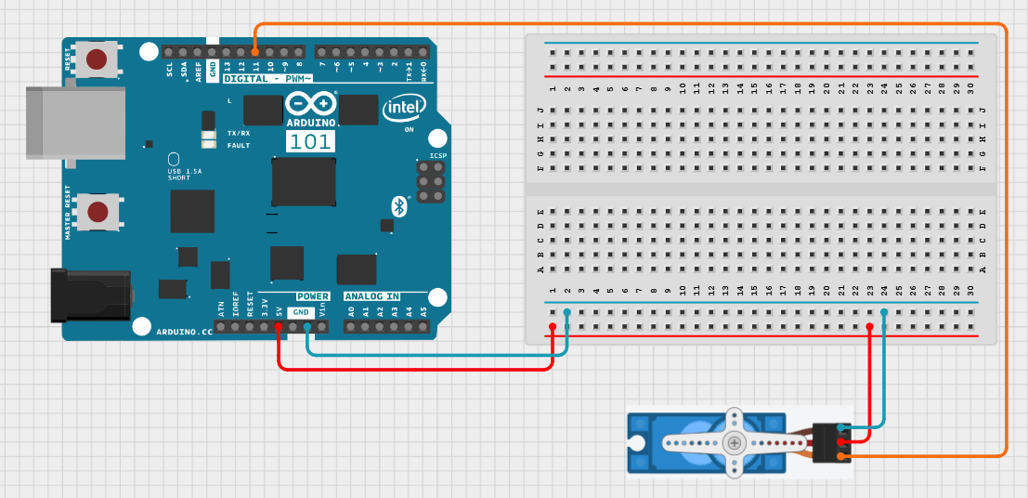
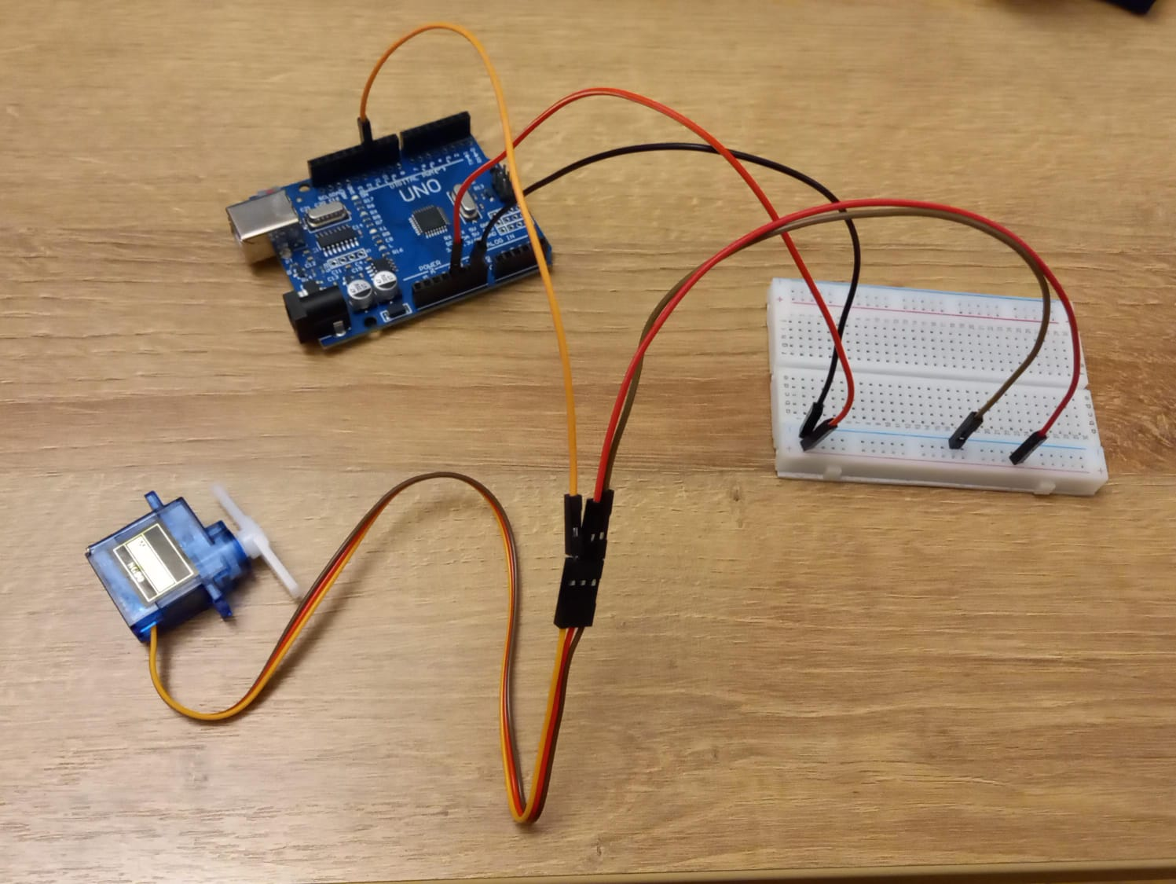
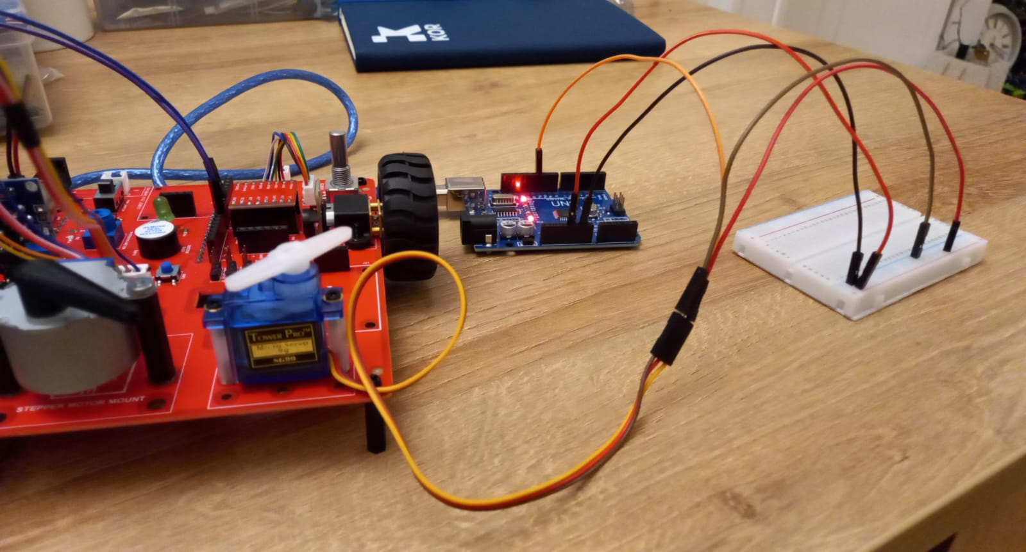
MFL01 : Servo Motor Control
Connections:
Servo Pin | Arduino Pin
PWM (Orange Wire) | 11
GND (Brown Wire) | GND (Breadboard)
5V (Red Wire) | 5V (Breadboard)

Slide 7
MFL01 : Servo Motor Control
Include servo library
setup()
• attach servo to pin 11
loop()
• Move the servo from 0 to 180 degrees in the steps of 10 degrees
• Move the servo back from 180 to 0 degrees in the steps of 10 degrees
Code for Lesson MFL01 (MFL01_Servo.ino):
https://github.com/info-zas/zas-robotics-motion/tree/main/01_FoundationProjects/MFL01_Servo_Control/MFL01_Servo

Slide 8
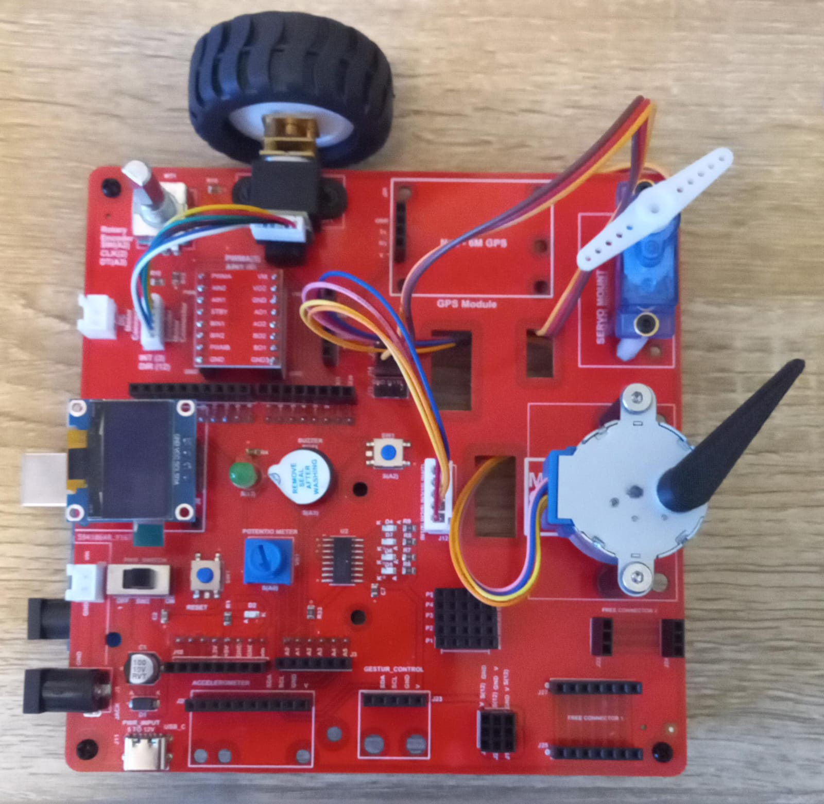
MFL01 : Servo Motor Control
Connect the Servo to Connector J14 in Motion Creative Board
Execute the same code in the Motion Creative Board
Code for Lesson MFL01 (MFL01_Servo.ino):
https://github.com/info-zas/zas-robotics-motion/tree/main/01_FoundationProjects/MFL01_Servo_Control/MFL01_Servo

Slide 9
MFL01 : Servo Motor Control With Potentiometer
Execute the code to control the servo motor with
potentiometer
Include Servo library
setup()
Attach servo motor to pin 11
loop()
Read potentiometer value from analog pin A0
Convert potentiometer value (0–1023) to servo angle (0–180 degrees)
Move the servo to the calculated angle
Repeat continuously as the potentiometer is rotated
Code for Lesson MFL01 (MFL01_Servo_Pot.ino):
https://github.com/info-zas/zas-robotics-motion/tree/main/01_FoundationProjects/MFL01_Servo_Control/MFL01_Servo_Pot

Slide 10
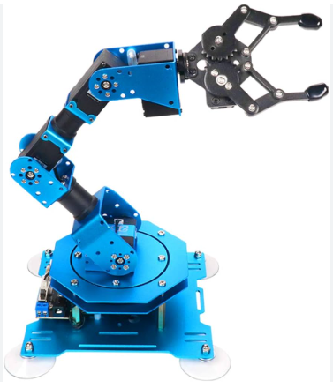
Applications of Servo Motors
Applications of Servo Motors
Robotics: Robot arms, pick-and-place systems
Industrial Automation: CNC machines, conveyor control
Electronics Projects: Arduino-based motion control
Automotive Systems: Power steering, headlamp positioning
Medical Equipment: Surgical robots, prosthetic limbs
Consumer Products: Remote-controlled toys, drones
Servo motors are used wherever precise position and motion control is required.

