Slide 1
Motion Kit (Kit 2)
Motion Foundation Lessons (MFL)
(Lesson Ref: MFL02)
MFL02: DC Motor Direction Control Using TB6612

Slide 2



Motion Kit : Contents
Motion Kit Components
Motion Creative Board

Slide 3
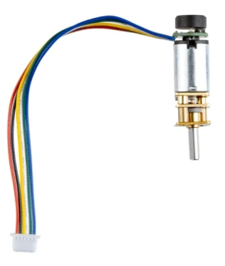
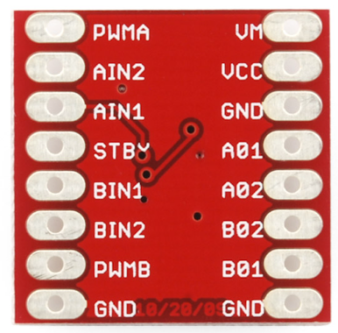
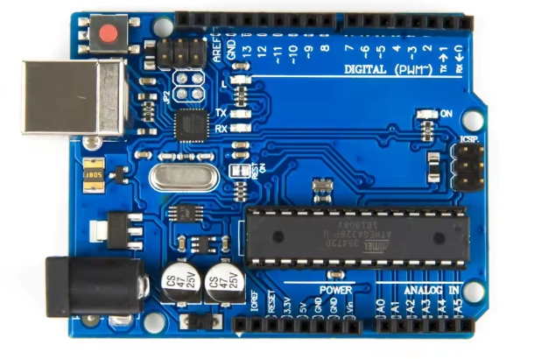
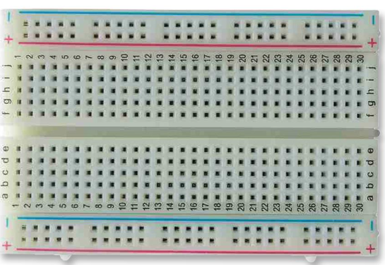
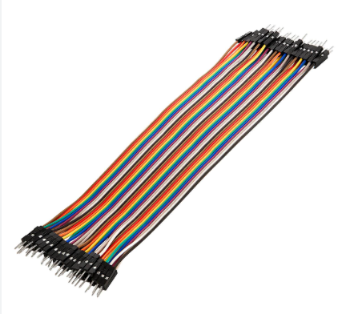
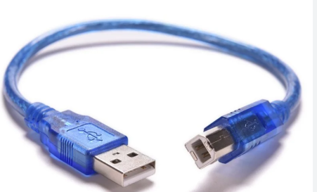
MFL02 : Direction Control DC Motor with TB6612 Motor Driver
Things Needed

Slide 4
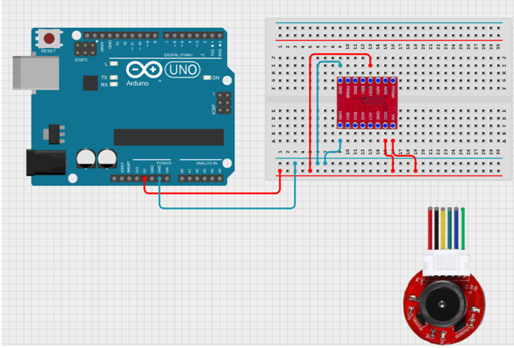

MFL02 : Direction Control DC Motor with TB6612 Motor Driver
Connections:
Power and Ground connections

Slide 5
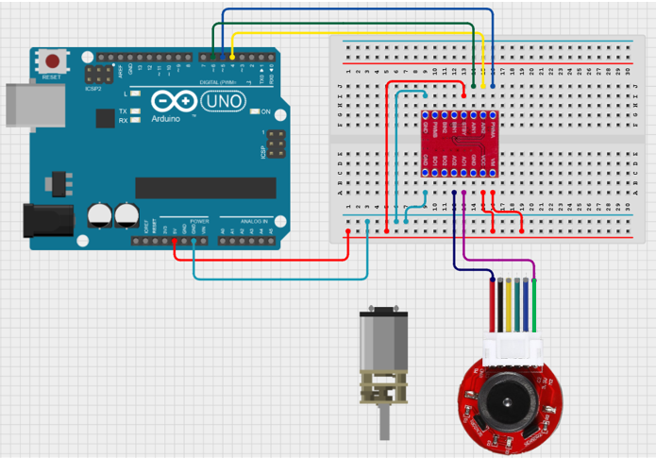
MFL02 : Direction Control DC Motor with TB6612 Motor Driver
Connections:
DC Motor connections as below
TB6612 Pins | Arduino UNO Pins
PWMA | 5
AIN2 | 4
AIN1 | 6
TB6612 Pins | DC Motor
AO1 | DC Motor
AO2 | DC Motor

Slide 6
MFL02 : Direction Control DC Motor with TB6612 Motor Driver
setup()
• Set motor driver pins as OUTPUT
(PWM pin, Direction pin 1, Direction pin 2)
loop()
• Set motor speed (0–255)
• Run motor forward for 1 second
• Run motor backward for 1 second
forward()
• Set direction pins for forward motion
backward()
• Set direction pins for reverse motion
Code for Lesson MFL02 (MFL02_DC_Motor_Direction_Control.ino):
https://github.com/info-zas/zas-robotics-motion/tree/main/01_FoundationProjects/MFL02_DC_Motor_Direction_Control/MFL02_DC_Motor_Direction_Control

Slide 7
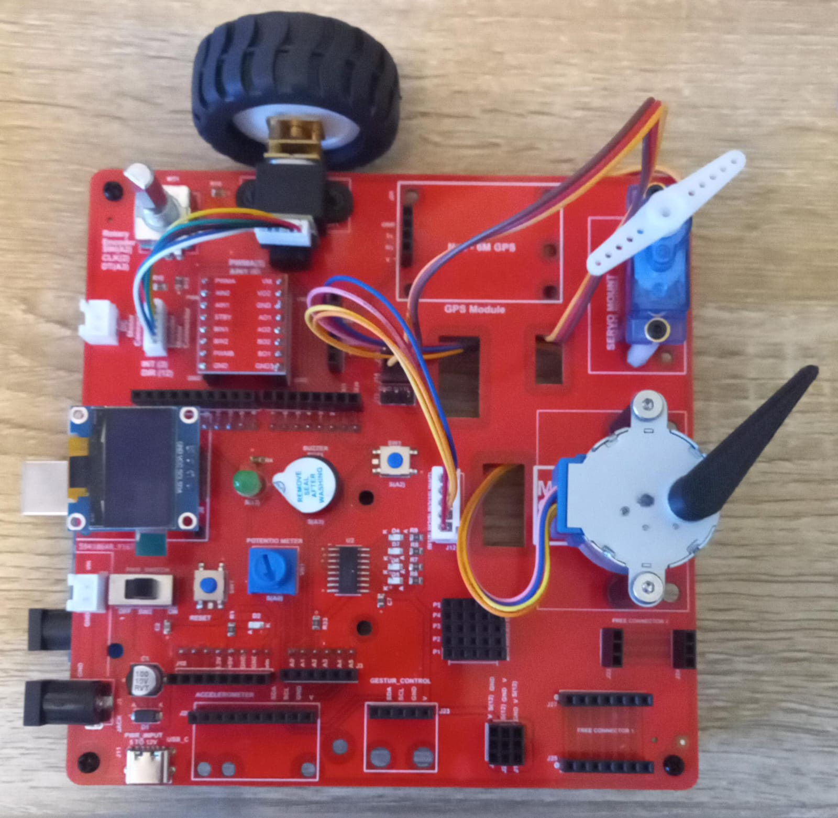
MFL02 : Direction Control DC Motor with TB6612 Motor Driver
Execute the same code in the motion creative board
setup()
• Set motor driver pins as OUTPUT
(PWM pin, Direction pin 1, Direction pin 2)
loop()
• Set motor speed (0–255)
• Run motor forward for 1 second
• Run motor backward for 1 second
forward()
• Set direction pins for forward motion
backward()
• Set direction pins for reverse motion
Code for Lesson MFL02 (MFL02_DC_Motor_Direction_Control.ino):
https://github.com/info-zas/zas-robotics-motion/tree/main/01_FoundationProjects/MFL02_DC_Motor_Direction_Control/MFL02_DC_Motor_Direction_Control

Slide 8
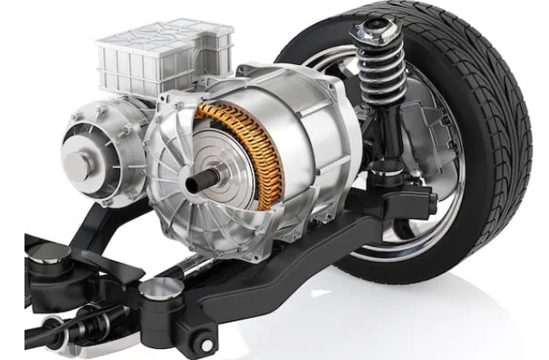
Applications of DC Motors
Applications of DC Motors
Electric vehicles and battery-powered vehicles
Fans, blowers, and cooling systems
Conveyor belts and material handling systems
Toys and small household appliances
Pumps and compressors
Robotics and simple motion control systems
DC motors are widely used for applications requiring continuous rotation and speed control.

