Slide 1
Motion Kit (Kit 2)
Motion Foundation Lessons (MFL)
(Lesson Ref: MFL03)
MFL03: DC Motor Speed Control Using TB6612

Slide 2



Motion Kit : Contents
Motion Kit Components
Motion Creative Board

Slide 3
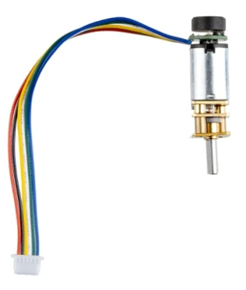
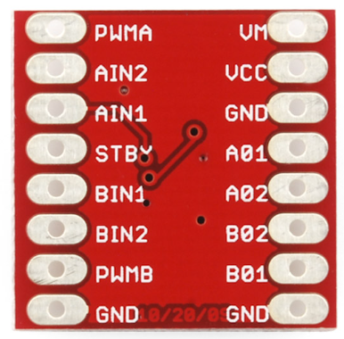
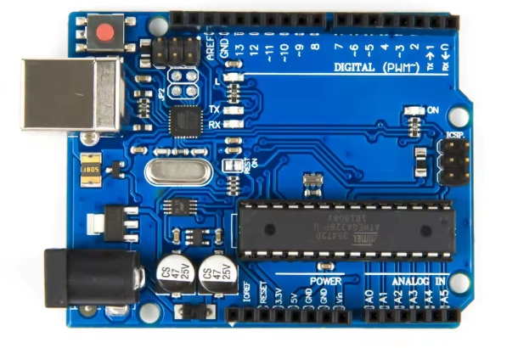
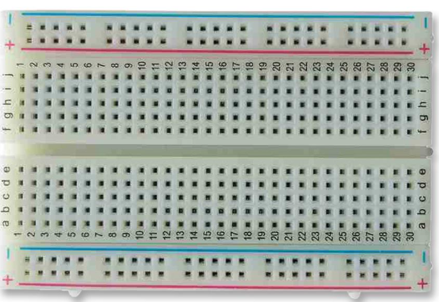
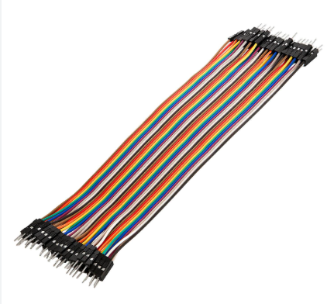
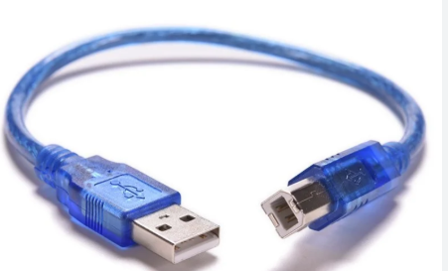
MFL03 : Speed Control DC Motor with TB6612 Motor Driver
Things Needed

Slide 4
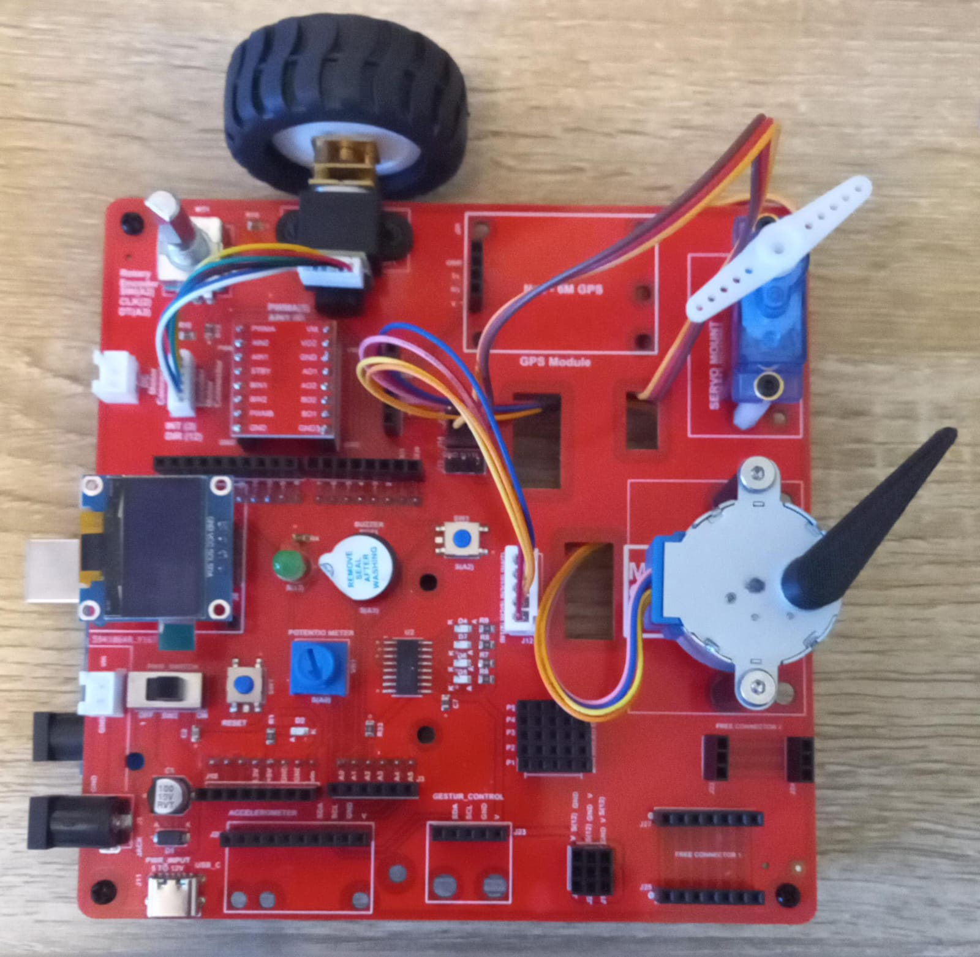
MFL03 : Speed Control DC Motor with TB6612 Motor Driver
Execute the code in the motion
creative board
setup()
• Set motor driver pins as OUTPUT
(PWM pin, Direction pin 1, Direction pin 2)
loop()
• Set motor speed (0–255)
• Run motor forward for 1 second
• Run motor backward for 1 second
forward()
• Set direction pins for forward motion
backward()
• Set direction pins for reverse motion
Code for Lesson MFL03 (MFL03_DC_Motor_Speed_Control.ino):
https://github.com/info-zas/zas-robotics-motion/tree/main/01_FoundationProjects/MFL03_DC_Motor_Speed_Control/MFL03_DC_Motor_Speed_Control

Slide 5
MFL03 : Speed Control DC Motor with TB6612 Motor Driver
void setup() {
pinMode(5, OUTPUT); // PWM speed control
pinMode(6, OUTPUT); // Direction pin 1
pinMode(4, OUTPUT); // Direction pin 2
}
void loop() {
analogWrite(5, 255); // Speed (0–255), adjust as needed
forward();
delay(1000);
backward();
delay(1000);
}
// Function to move motor forward
void forward() {
digitalWrite(6, HIGH); // Forward direction
digitalWrite(4, LOW);
}
// Function to move motor backward
void backward() {
digitalWrite(6, LOW); // Reverse direction
digitalWrite(4, HIGH);
}
Execute the code in the motion creative board
Change the value between 0 to 255 to observe the speed changes of DC motor
0,1,3,15,31,63,127,255
Code for Lesson MFL03 (MFL03_DC_Motor_Speed_Control.ino):
https://github.com/info-zas/zas-robotics-motion/tree/main/01_FoundationProjects/MFL03_DC_Motor_Speed_Control/MFL03_DC_Motor_Speed_Control

Slide 6
MFL03: Display Speed and Direction of DC Motor in OLED
Include required libraries
OLED display libraries
setup()
Set motor speed pin as OUTPUT (PWM)
Set motor direction pins as OUTPUT
Initialize OLED display
loop()
Set motor speed using PWM
Rotate motor in forward direction
Display motor direction and speed on OLED
Rotate motor in backward direction
Update motor direction and speed on OLED
Repeat continuously
Code for Lesson MFL03 (MFL03_DC_Motor_Speed_Control_OLED.ino):
https://github.com/info-zas/zas-robotics-motion/tree/main/01_FoundationProjects/MFL03_DC_Motor_Speed_Control/MFL03_DC_Motor_Speed_Control_OLED

