Slide 1

Motion Kit (Kit 2)
Motion Foundation Lessons (MFL)
(Lesson Ref: MFL04)
MFL04: Stepper Motor Control with ULN2003

Slide 2


Motion Kit : Contents
Motion Kit Components
Motion Creative Board

Slide 3
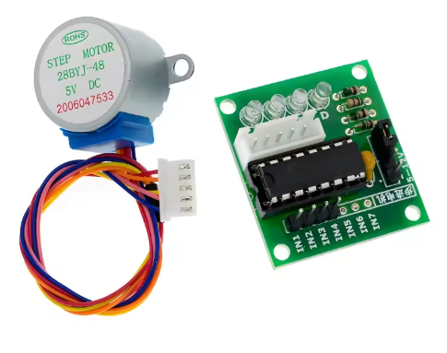
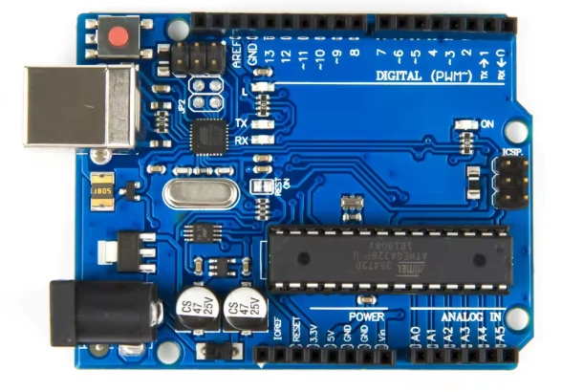
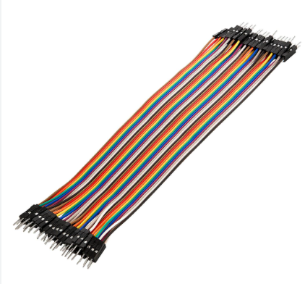
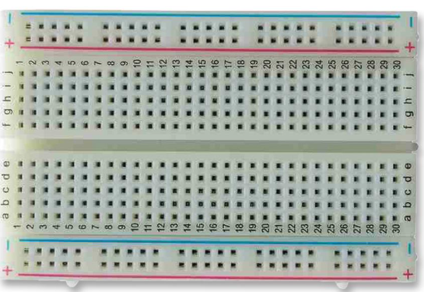
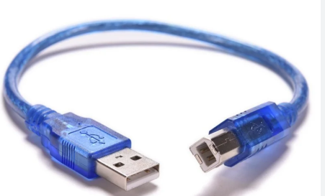
MFL04 : Stepper Motor Control with ULN2003
Things Needed
Stepper Motor
28BYJ-48-5V
Stepper Motor Driver Board ULN2003

Slide 4
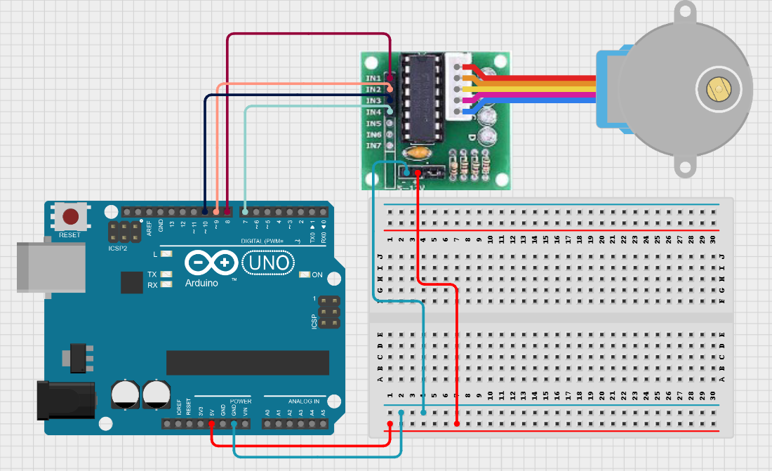
MFL04 : Stepper Motor Control with ULN2003
ULN2003 Stepper Motor Pins | Arduino UNO Pins
AIN1 | 8
AIN2 | 9
AIN3 | 10
AIN4 | 7

Slide 5
MFL04 : Stepper Motor Control with ULN2003
Code for Lesson MFL04 (MFL04_Stepper_Motor_Control.ino):
https://github.com/info-zas/zas-robotics-motion/tree/main/01_FoundationProjects/MFL04_Stepper_Motor_Control/MFL04_Stepper_Motor_Control
setup()
• Set stepper motor speed (RPM)
• Start serial communication
• Print "Stepper Motor Test Start" to serial monitor
loop()
• Print "Clockwise rotation"
• Rotate stepper motor one full turn clockwise
• Wait for 1 second
• Print "Counterclockwise rotation"
• Rotate stepper motor one full turn
counterclockwise
• Wait for 1 second

Slide 6
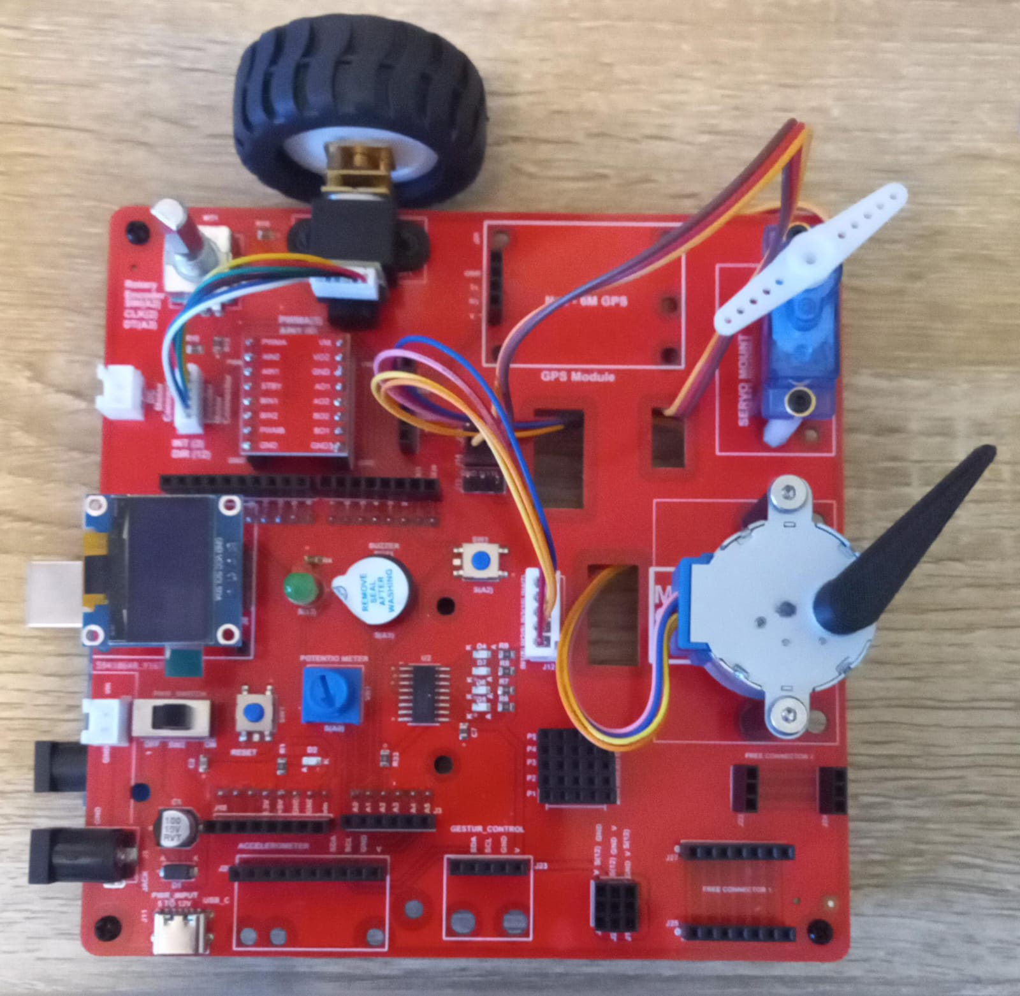
MFL04 : Stepper Motor Control with ULN2003
Execute the same code in the motion creative board
Code for Lesson MFL04 (MFL04_Stepper_Motor_Control.ino):
https://github.com/info-zas/zas-robotics-motion/tree/main/01_FoundationProjects/MFL04_Stepper_Motor_Control/MFL04_Stepper_Motor_Control

