Slide 1
Motion Kit (Kit 2)
Motion Foundation Lessons (MFL)
(Lesson Ref: MFL05)
MFL05: Accelerometer MPU6050

Slide 2



Motion Kit : Contents
Motion Kit Components
Motion Creative Board

Slide 3
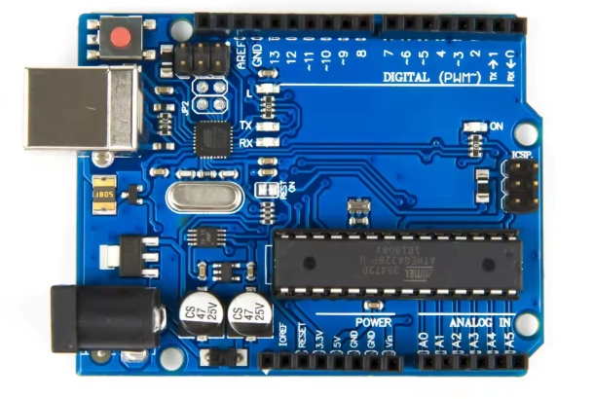
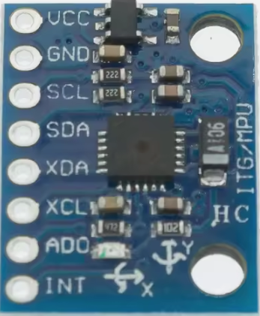
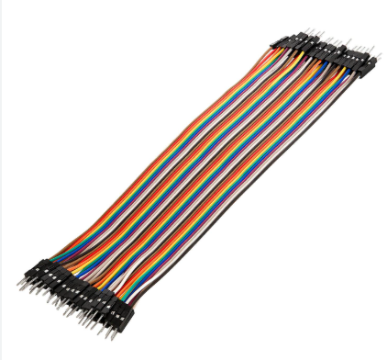
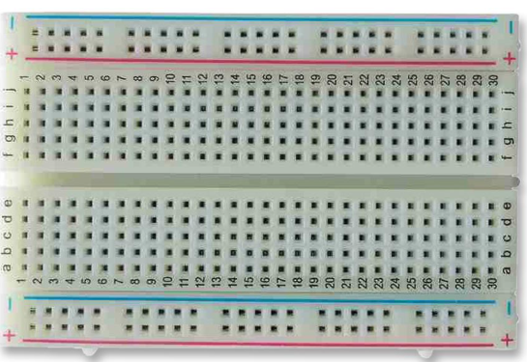
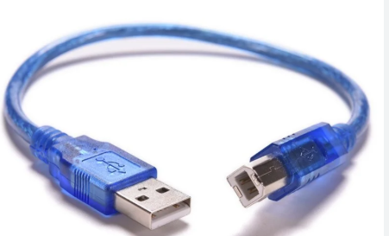
MFL05 : Accelerometer MPU6050
Things Needed

Slide 4
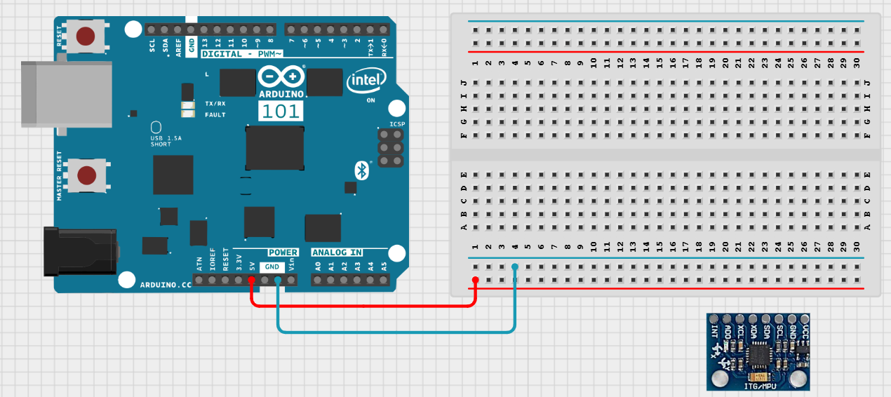
MFL05 : Accelerometer MPU6050
Connections:
Arduino Pin | Breadboard
GND (Brown Wire) | Blueline
5V (Red Wire) | Redline

Slide 5
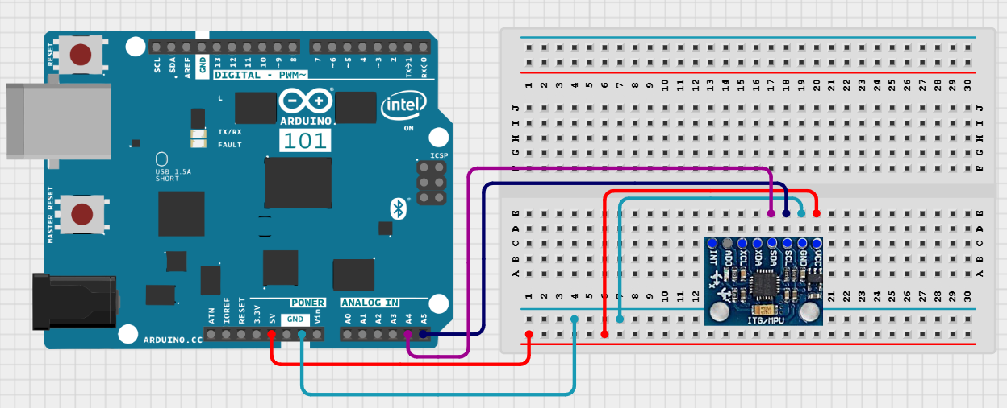
MFL05 : Accelerometer MPU6050
Connections:
MPU6050 | Arduino Pin
VCC | 5V
GND | GND
SCL | A5
SDA | A4

Slide 6
MFL05 : Accelerometer MPU6050
Code for Lesson MFL05 (MFL05_Accelerometer_MPU6050.ino):
Include libraries
setup()
Start serial communication
Start I2C communication
Initialize MPU6050 sensor
Check sensor connection
loop()
Read acceleration values (AX, AY, AZ)
Print values on Serial Monitor
Repeat continuously
https://github.com/info-zas/zas-robotics-motion/tree/main/01_FoundationProjects/MFL05_Accelerometer/MFL05_Accelerometer_MPU6050

Slide 7
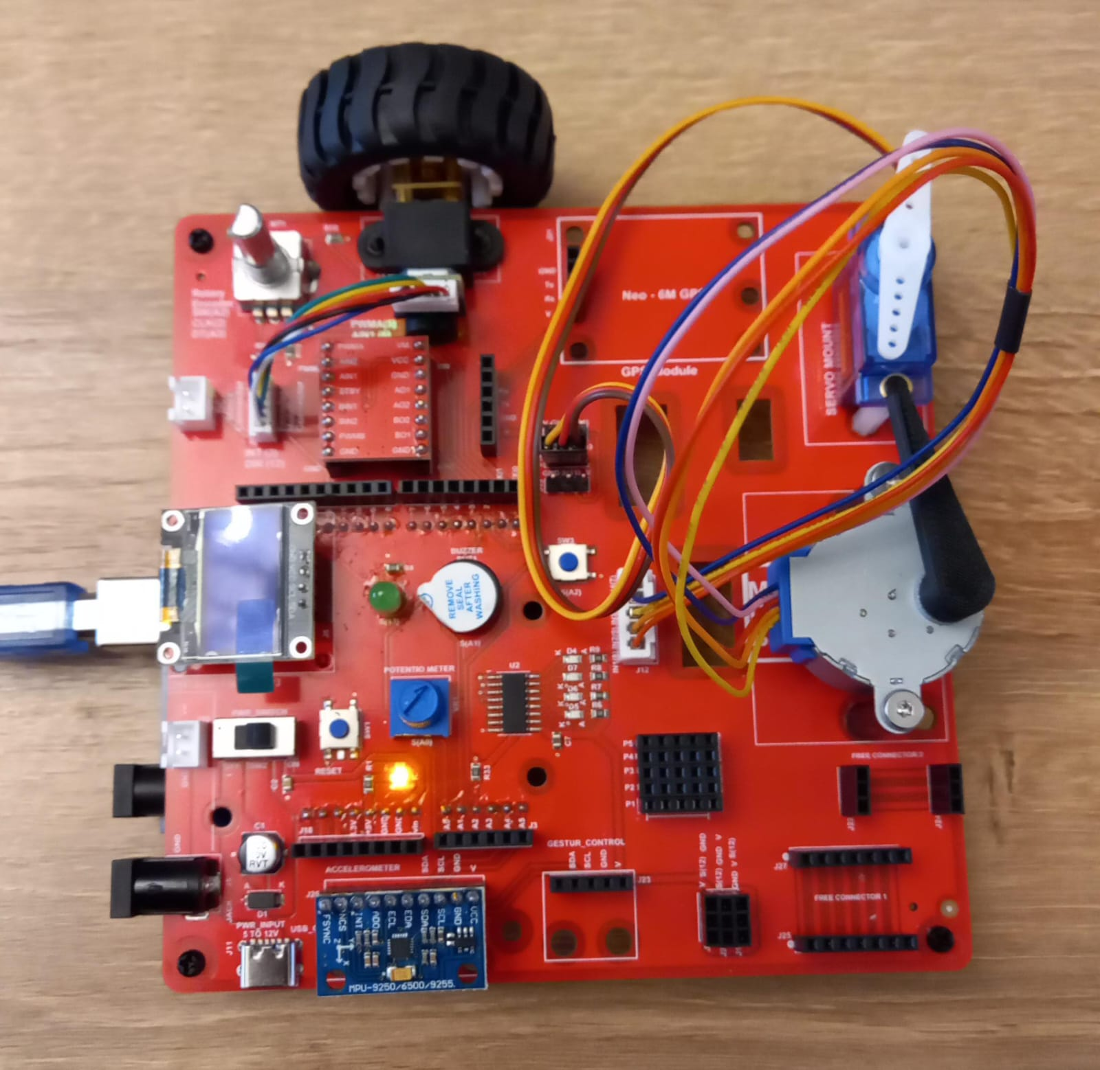
MFL05 : Accelerometer MPU6050
Execute the same code in the motion creative board
Code for Lesson MFL05 (MFL05_Accelerometer_MPU6050.ino):
https://github.com/info-zas/zas-robotics-motion/tree/main/01_FoundationProjects/MFL05_Accelerometer/MFL05_Accelerometer_MPU6050

Slide 8
MFL05: Accelerometer MPU6050
Include libraries
setup()
Start serial communication
Start I2C communication
Initialize MPU6050 sensor
Initialise OLED
Check sensor connection
loop()
Read acceleration values (AX, AY, AZ)
Print values on Serial Monitor and OLED
Repeat continuously
Code for Lesson MFL05 (MFL05_Accelerometer_MPU6050_OLED.ino):
https://github.com/info-zas/zas-robotics-motion/tree/main/01_FoundationProjects/MFL05_Accelerometer/MFL05_Accelerometer_MPU6050_OLED

