Slide 1
Motion Kit (Kit 2)
Motion Foundation Lessons (MFL)
(Lesson Ref: MFL06)
MFL06: Stepper Motor Control with Accelerometer MPU6050

Slide 2



Motion Kit : Contents
Motion Kit Components
Motion Creative Board

Slide 3
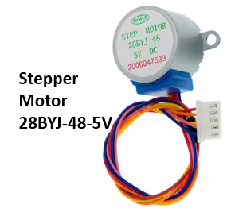
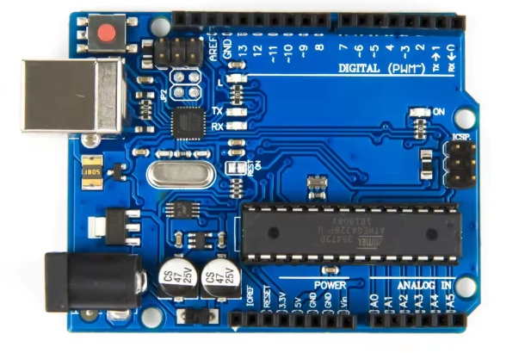
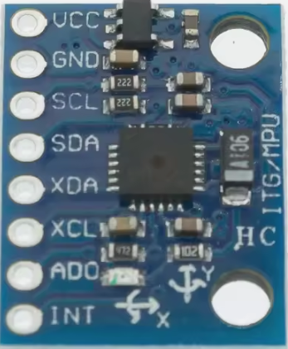
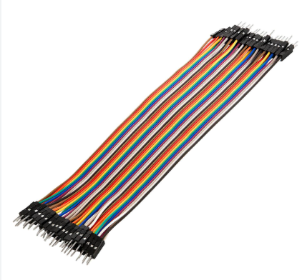
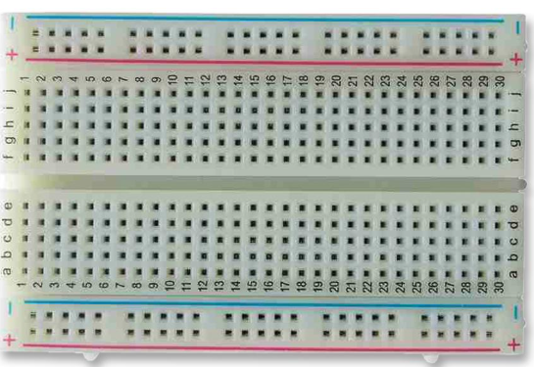
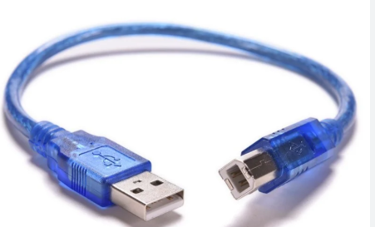
MFL06 : Stepper Motor Control with Accelerometer MPU6050
Things Needed

Slide 4
MFL06 : Stepper Motor Control with Accelerometer MPU6050
Include required libraries
Wire library for I2C communication
MPU6050 sensor library
Stepper motor library
setup()
Initialize serial communication
Initialize I2C communication
Initialize MPU6050 sensor
Set stepper motor speed
loop()
Read accelerometer X-axis value from MPU6050
Rotate stepper motor clockwise when X value is positive
Rotate stepper motor anticlockwise when X value is negative
Stop motor when the sensor is in neutral position
Repeat continuously
Code for Lesson MFL06 (MFL06_Stepper_Accelerometer.ino):
https://github.com/info-zas/zas-robotics-motion/tree/main/01_FoundationProjects/MFL06_Stepper_Accelerometer/MFL06_Stepper_Accelerometer

Slide 5
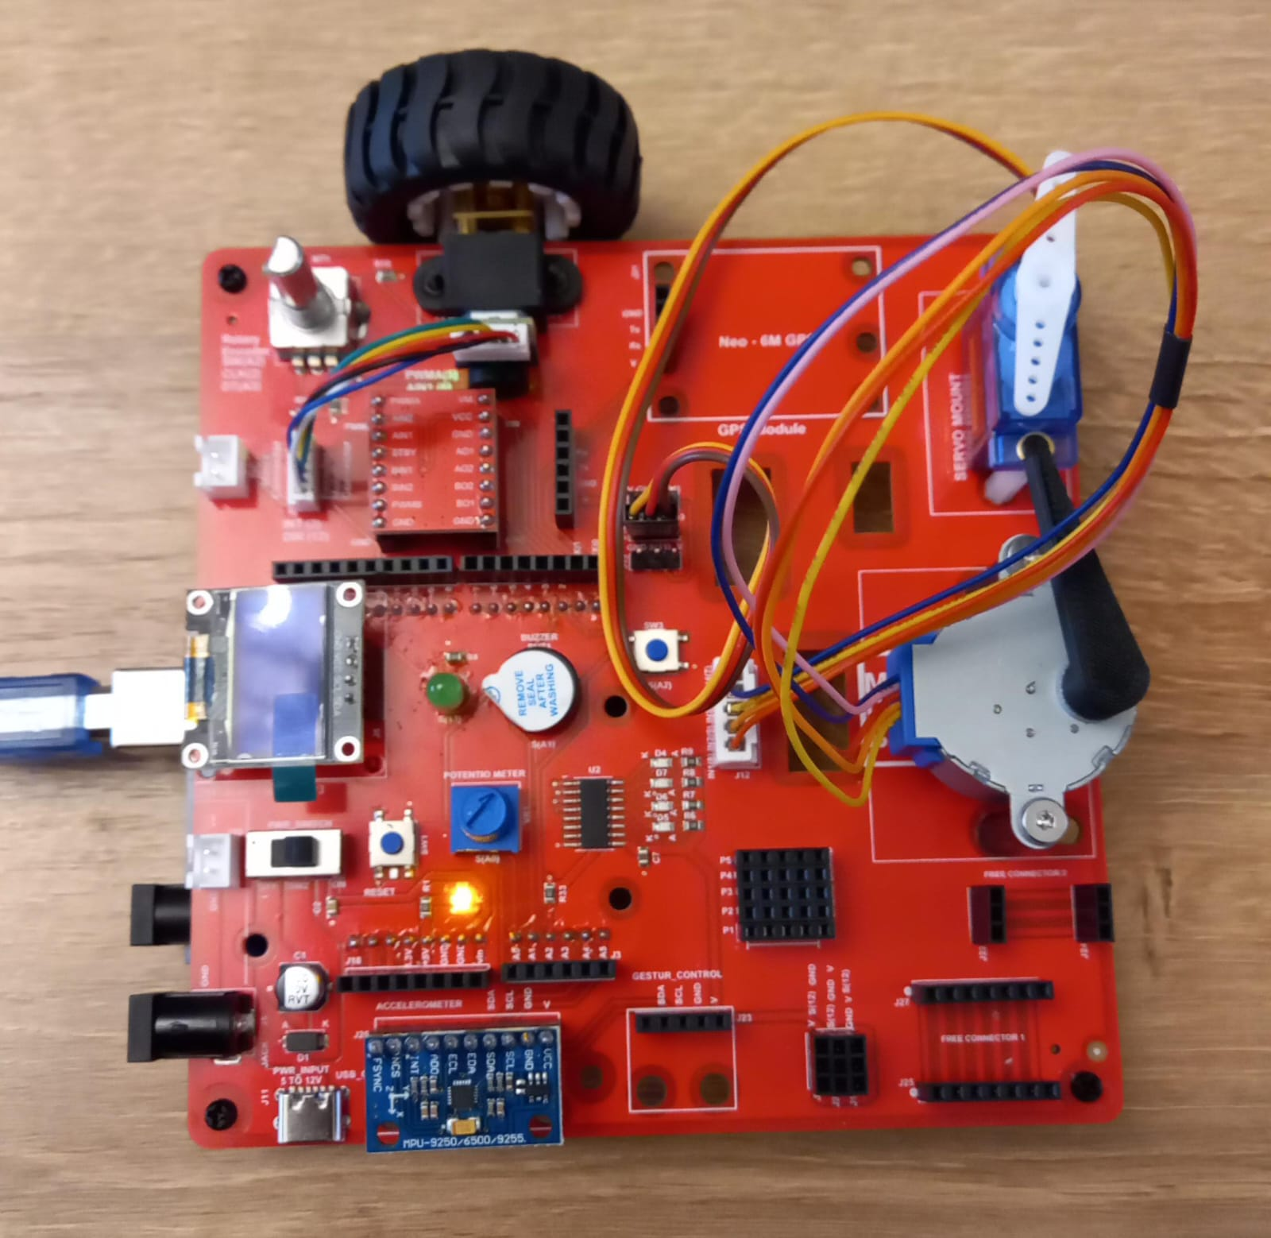
MFL06 : Stepper Motor Control with Accelerometer MPU6050
Execute the same code in the motion creative board
Code for Lesson MFL06 (MFL06_Stepper_Accelerometer.ino):
https://github.com/info-zas/zas-robotics-motion/tree/main/01_FoundationProjects/MFL06_Stepper_Accelerometer/MFL06_Stepper_Accelerometer

