Slide 1
Motion Kit (Kit 2)
Motion Foundation Lessons (MFL)
(Lesson Ref: MFL07)
MFL07: Rotary Encoder

Slide 2



Motion Kit : Contents
Motion Kit Components
Motion Creative Board

Slide 3
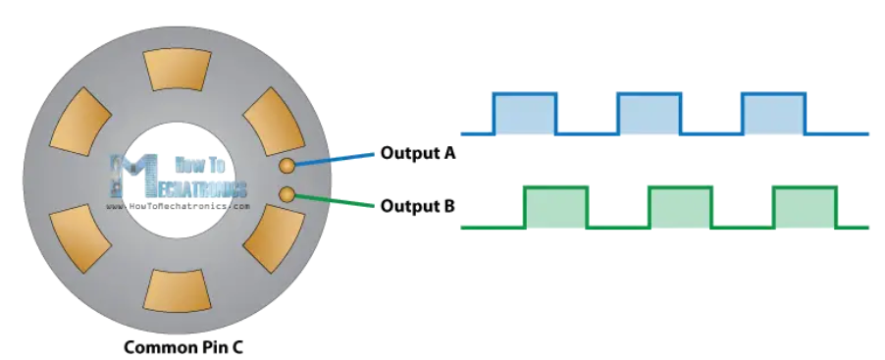
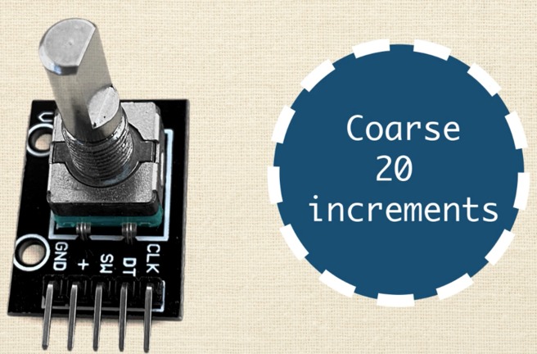
MFL07 : Rotary Encoder
https://www.youtube.com/watch?v=v4BbSzJ-hz4

Slide 4
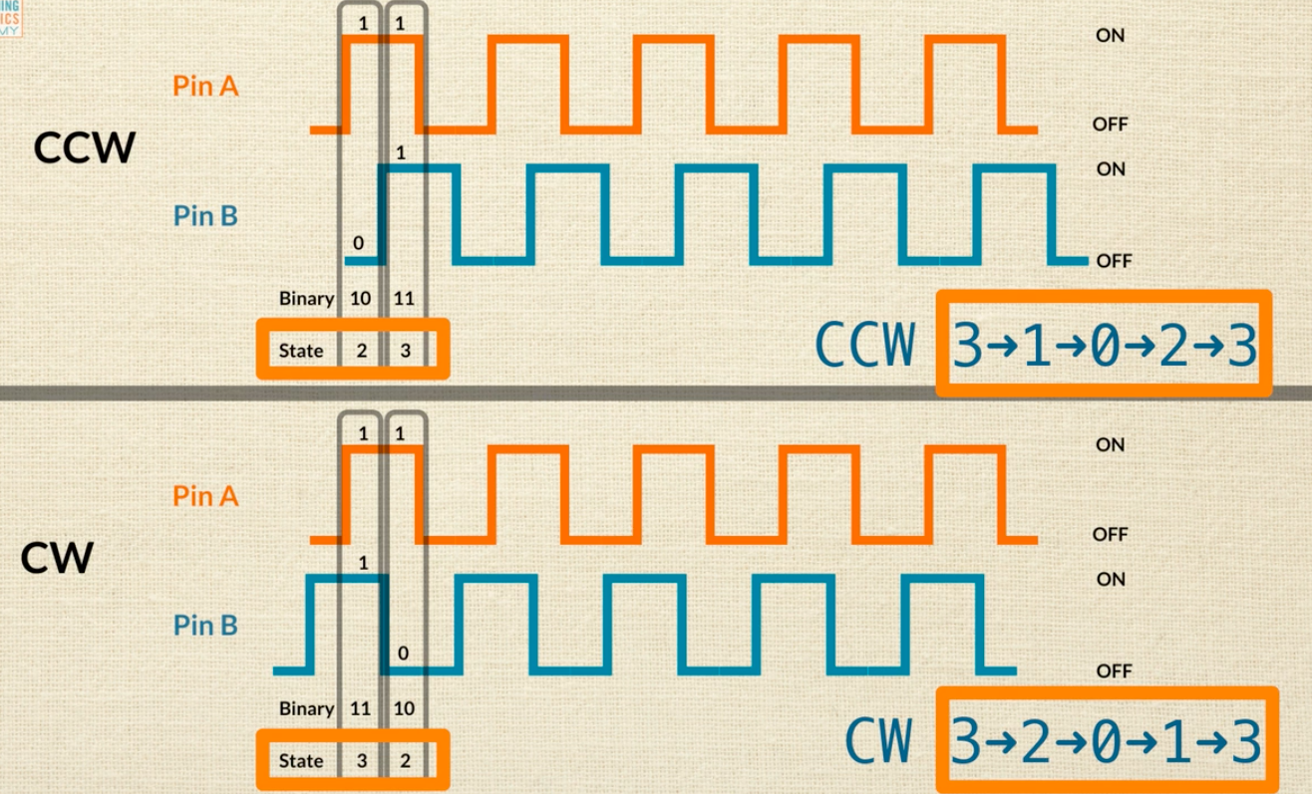
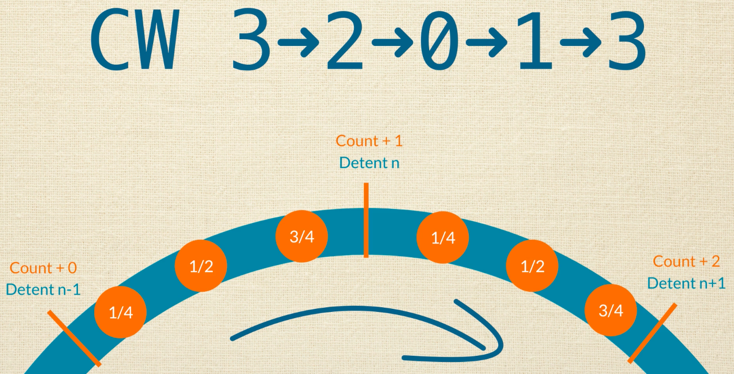
MFL07 : Rotary Encoder

Slide 5
MFL07 : Rotary Encoder - Basic Mode
Code for Lesson MFL07 (MFL07_Rotary_Encoder_Basic.ino):
Define pin names
Assign CLK, DT, and SW pins of the rotary encoder to Arduino pins
setup()
Set CLK and DT pins as input
Set SW pin as input with internal pull-up resistor
Initialize serial communication
loop()
Read the state of CLK, DT, and SW pins
Display the pin states on the Serial Monitor
Update readings continuously
https://github.com/info-zas/zas-robotics-motion/tree/main/01_FoundationProjects/MFL07_Rotary_Encoder/MFL07_Rotary_Encoder_Basic

Slide 6
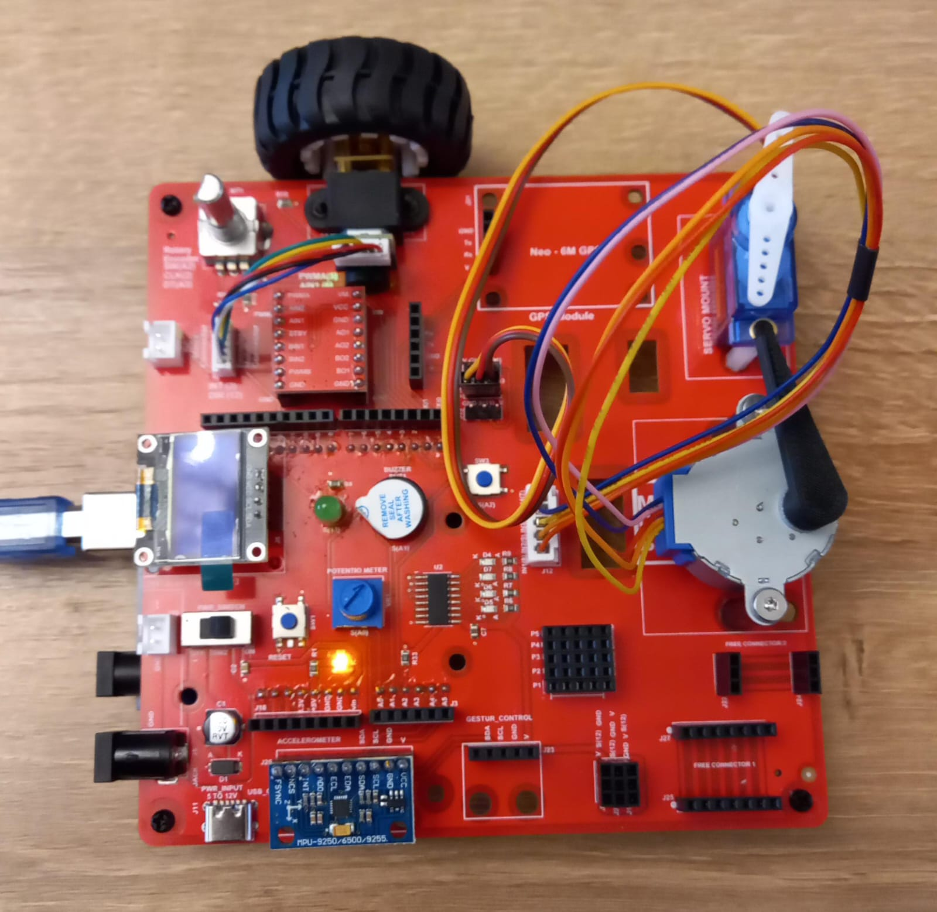
MFL07 : Rotary Encoder - Basic Mode
Execute the code in the motion creative board
Code for Lesson MFL07 (MFL07_Rotary_Encoder_Basic.ino):
https://github.com/info-zas/zas-robotics-motion/tree/main/01_FoundationProjects/MFL07_Rotary_Encoder/MFL07_Rotary_Encoder_Basic

Slide 7
MFL07 : Rotary Encoder – Rotation Direction
Execute the code in the motion creative board
Code for Lesson MFL07 (MFL07_Rotary_Encoder_Rotation_Direction.ino):
Define pin names
Assign CLK, DT, and SW pins of the rotary encoder
setup()
Set encoder pins as input
Enable pull-up resistor for switch pin
Initialize serial communication
Read initial CLK state
loop()
Monitor CLK pin for change
Read DT pin to determine rotation direction
Increase counter for clockwise rotation
Decrease counter for anticlockwise rotation
Display direction and position on Serial Monitor
https://github.com/info-zas/zas-robotics-motion/tree/main/01_FoundationProjects/MFL07_Rotary_Encoder/MFL07_Rotary_Encoder_Rotation_Direction

