Slide 1
Motion Kit (Kit 2)
Motion Foundation Lessons (MFL)
(Lesson Ref: MFL08)
MFL08: Servo Motor Control with Rotary Encoder

Slide 2



Motion Kit : Contents
Motion Kit Components
Motion Creative Board

Slide 3
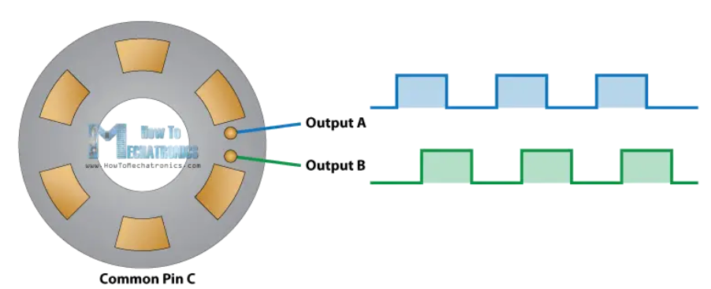
MFL08 : Servo Motor Control with Rotary Encoder
https://www.youtube.com/watch?v=v4BbSzJ-hz4

Slide 4
MFL08 : Servo Motor Control with Rotary Encoder
Include required libraries
Servo library
Define pin connections
CLK → pin 2
DT → pin A3
SW → pin A2
Servo signal → pin 11
setup()
Set encoder pins as input
Enable pull-up for switch pin
Initialize serial communication
Attach servo motor to pin 11
Set initial servo position
loop()
Detect rotary encoder movement
Rotate servo clockwise or anticlockwise based on encoder direction
Increase or decrease servo angle in steps
Limit servo angle between 0 and 180 degrees
Display encoder position and servo angle on Serial Monitor
Repeat continuously
Code for Lesson MFL08 (MFL08_Servo_Control_Rotary_Encoder.ino):
https://github.com/info-zas/zas-robotics-motion/tree/main/01_FoundationProjects/MFL08_Servo_Control_Rotary_Encoder/MFL08_Servo_Control_Rotary_Encoder

Slide 5
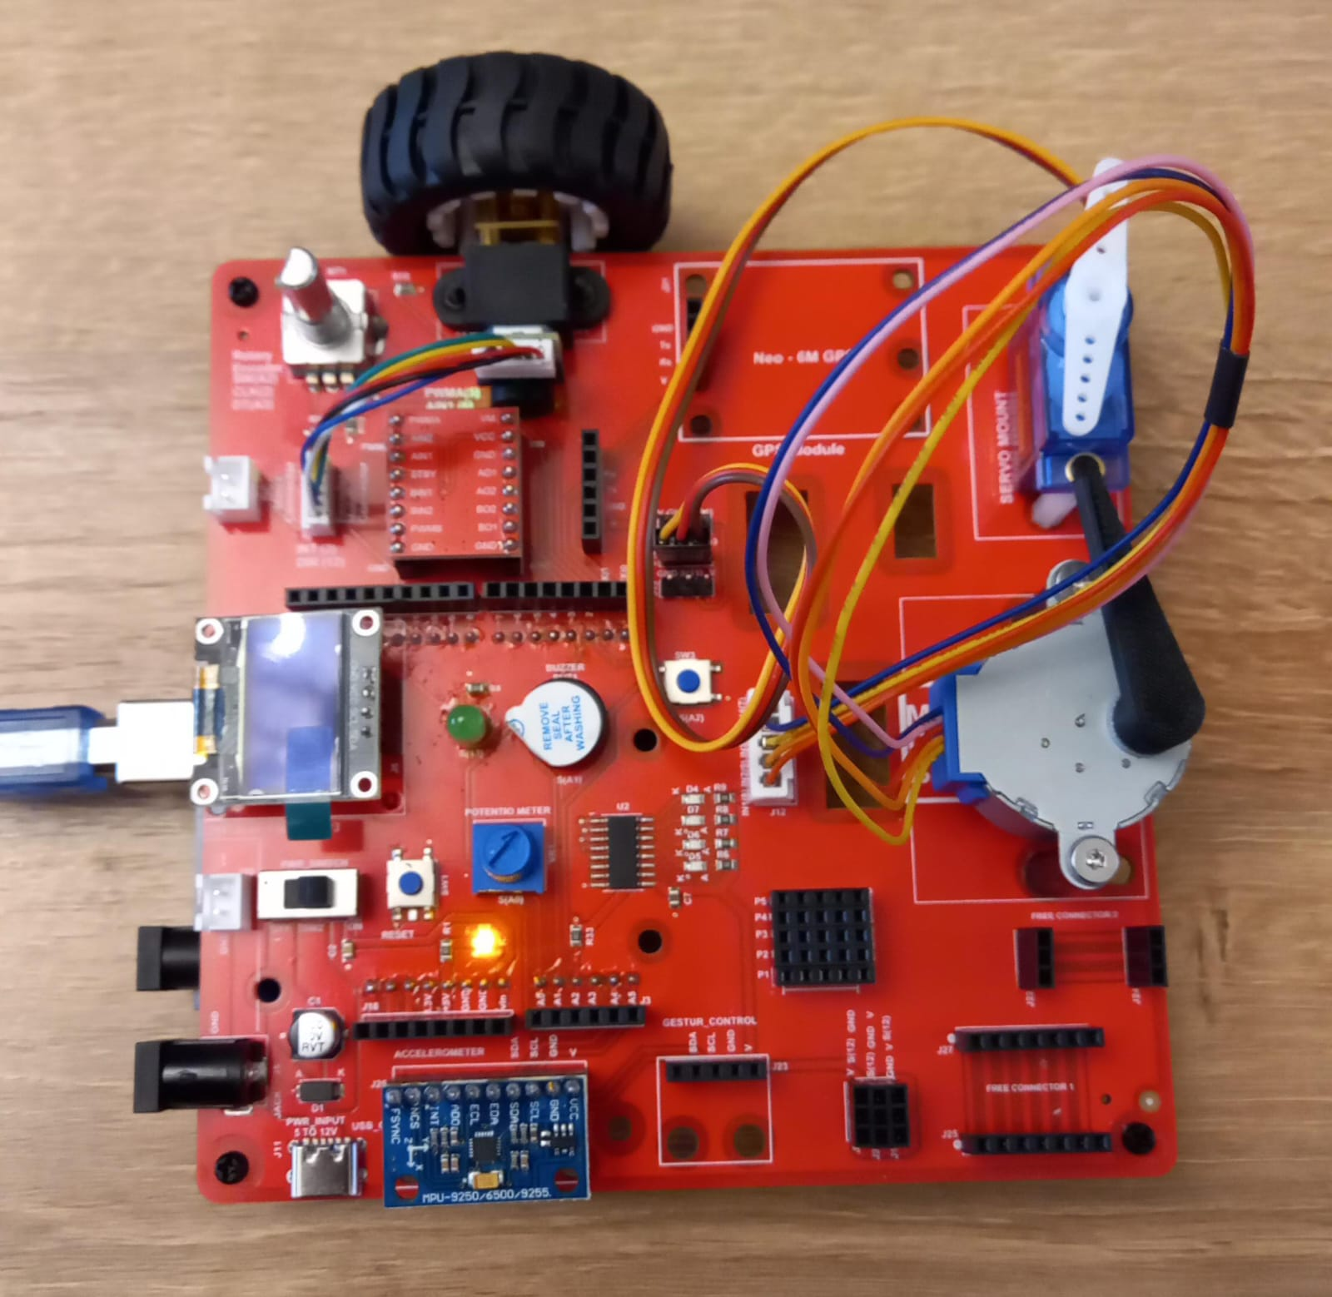
MFL08 : Servo Motor Control with Rotary Encoder
Execute the code in the motion creative board
Code for Lesson MFL08 (MFL08_Servo_Control_Rotary_Encoder.ino):
https://github.com/info-zas/zas-robotics-motion/tree/main/01_FoundationProjects/MFL08_Servo_Control_Rotary_Encoder/MFL08_Servo_Control_Rotary_Encoder

