Slide 1
Motion Kit (Kit 2)
Motion Foundation Lessons (MFL)
(Lesson Ref: MFL09)
MFL09: Encoder Motor Control with TB6612

Slide 2



Motion Kit : Contents
Motion Kit Components
Motion Creative Board

Slide 3
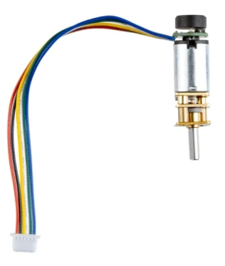
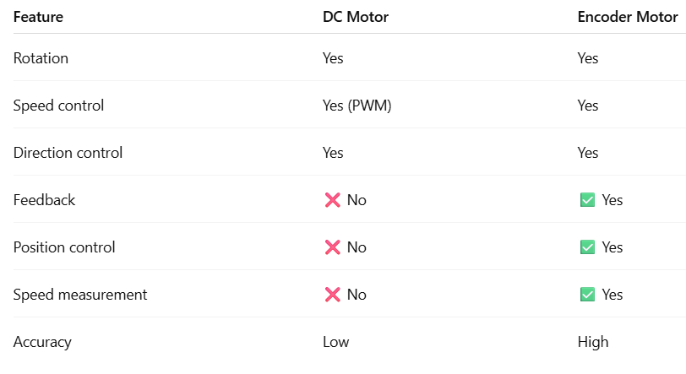
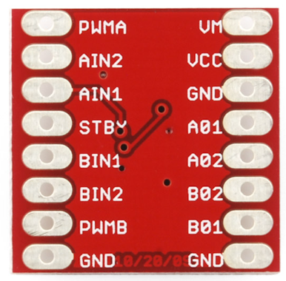
MFL09 : Encoder Motor Control with TB6612
TB6612, same motor driver as DC motor
DC motor → no feedback
Encoder motor → live pulses + direction

Slide 4
MFL09 : Encoder Motor Control with TB6612
Include required libraries
Wire library
OLED display libraries
Define pin connections
TB6612 motor driver pins (PWMA, AIN1, AIN2)
OLED I2C pins
setup()
Set motor control pins as output
Initialize serial communication
Initialize OLED display
Set initial motor direction and speed
loop()
Rotate DC motor clockwise
Display motor direction and speed on OLED
Display same information on Serial Monitor
Change motor direction after a fixed delay
Repeat continuously
Control the encoder motor direction and speed same as DC motor with TB6612
Code for Lesson MFL09 (MFL09_Encoder_Motor_Control.ino):
https://github.com/info-zas/zas-robotics-motion/tree/main/01_FoundationProjects/MFL09_Encoder_Motor_Control/MFL09_Encoder_Motor_Control

Slide 5
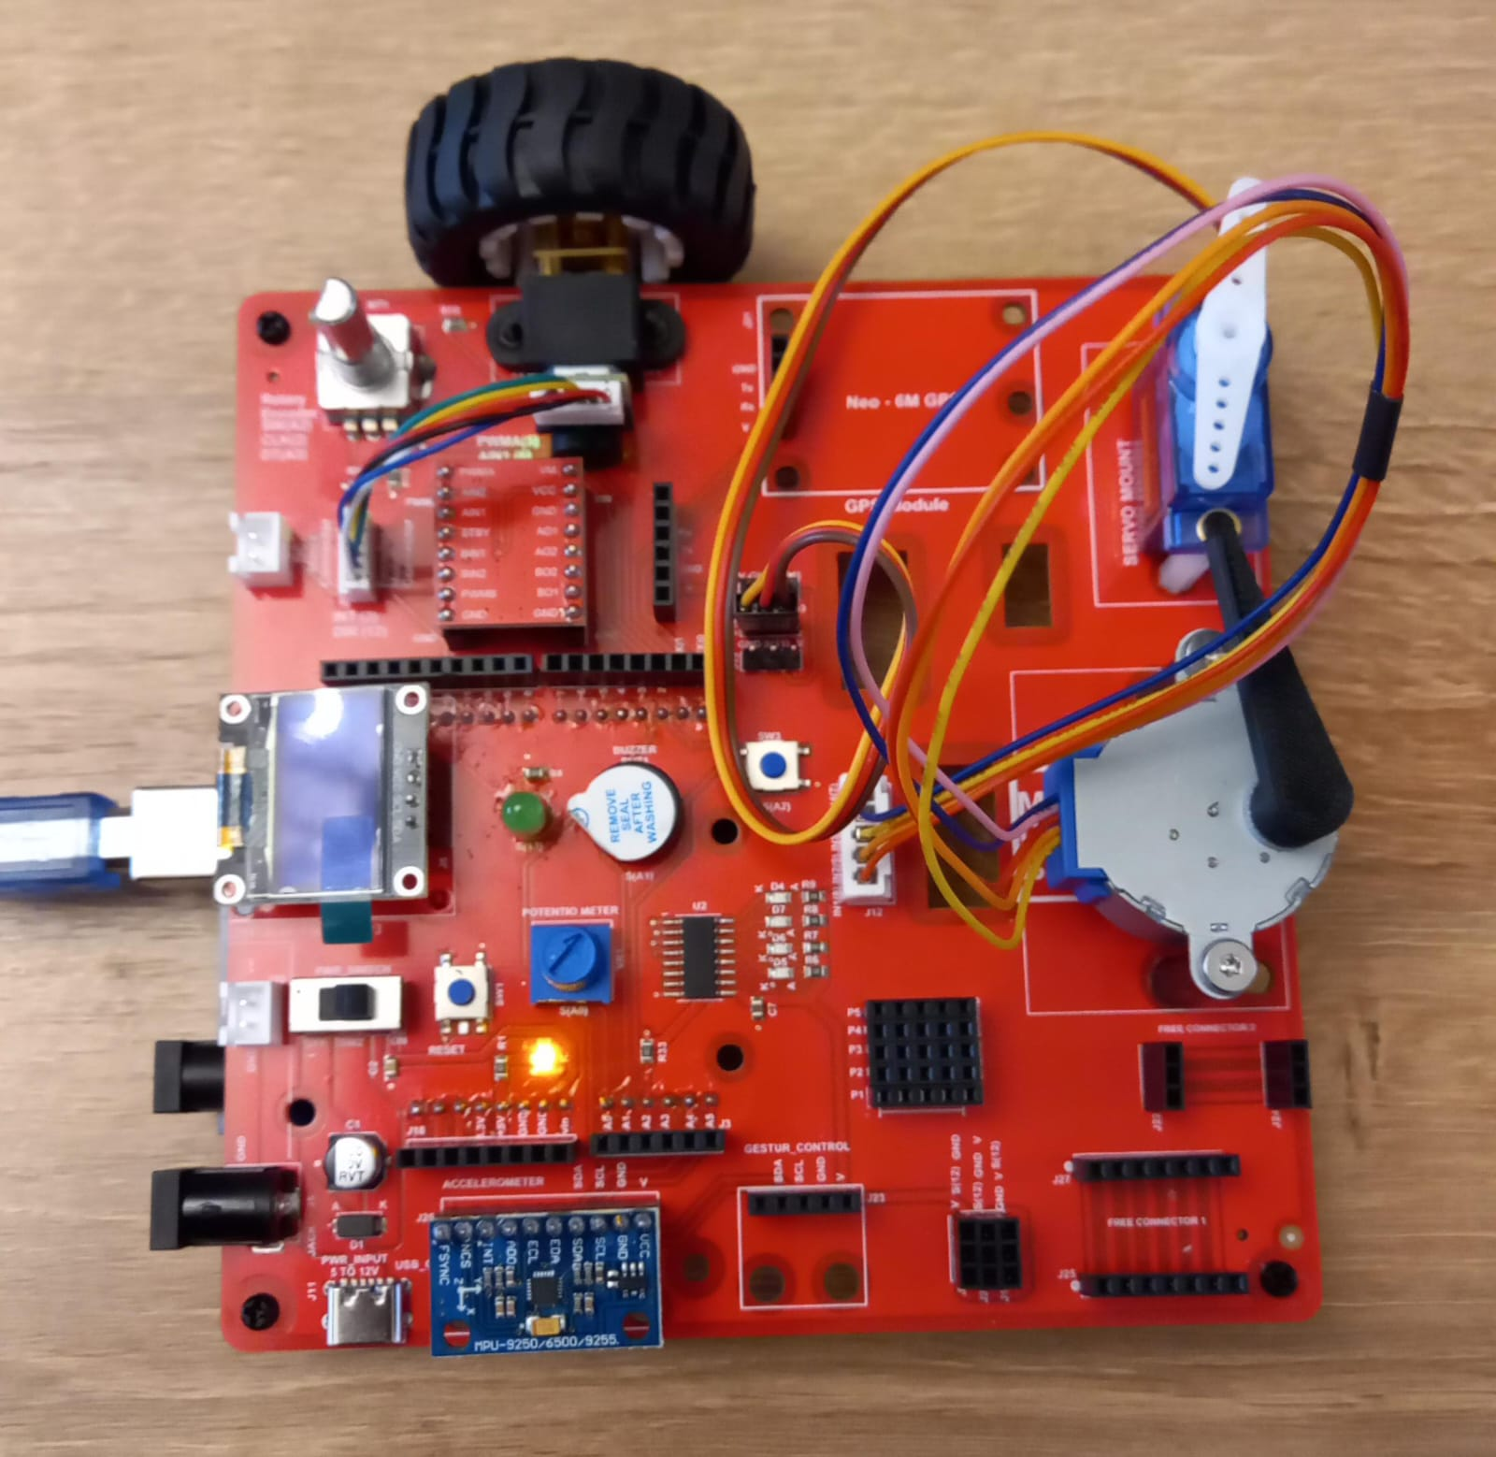
MFL09 : Encoder Motor Control with TB6612
Execute the code in the motion creative board
Code for Lesson MFL09 (MFL09_Encoder_Motor_Control.ino):
https://github.com/info-zas/zas-robotics-motion/tree/main/01_FoundationProjects/MFL09_Encoder_Motor_Control/MFL09_Encoder_Motor_Control

Slide 6
MFL09 : Encoder Motor Control with Hand
The INT, DIR pin is an OUTPUT from the encoder
Encoder motors provide feedback, unlike normal DC motors.
INT (Interrupt / Pulse Pin):
Generates pulses when the motor shaft rotates
Each pulse represents a small movement (tick)
Used to measure speed, distance, and position
DIR (Direction Pin):
Indicates the direction of motor rotation
HIGH → Clockwise (CW)
LOW → Anti-clockwise (CCW)
How they work together:
INT tells how much the motor moved
DIR tells which direction the motor moved
Remove TB6612 from the creativity board
Control the encoder motor direction and speed with hand
Check the DIRECTION and TICKS in the serial monitor
Code for Lesson MFL09 (MFL09_Encoder_Motor_Control_by_Hand.ino):
https://github.com/info-zas/zas-robotics-motion/tree/main/01_FoundationProjects/MFL09_Encoder_Motor_Control/MFL09_Encoder_Motor_Control_by_Hand

