Slide 1
Motion Kit (Kit 2)
Motion Foundation Lessons (MFL)
(Lesson Ref: MFL10)
MFL10: Target Ticks and RPM Calculator of Encoder Motors

Slide 2



Motion Kit : Contents
Motion Kit Components
Motion Creative Board

Slide 3
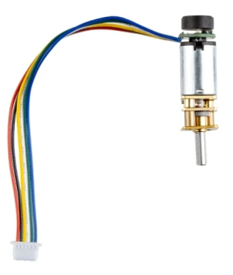
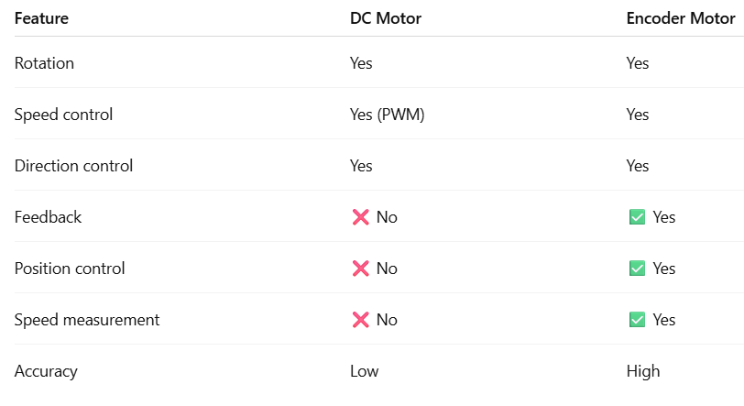
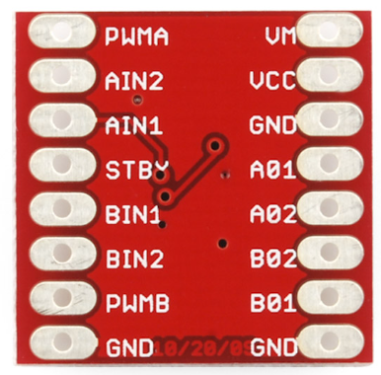
MFL10 : Target Ticks with Encoder Motor
TB6612, same motor driver as DC motor
DC motor → no feedback
Encoder motor → live pulses + direction

Slide 4
MFL10 : Target Ticks with Encoder Motor
“Encoders turn motion into data, and data into control.”
Include required libraries
Wire library
OLED display libraries
setup()
Initialize encoder pins
Initialize motor driver pins
Initialize Serial and OLED display
Start motor in clockwise direction
Attach interrupt for encoder pulses
loop()
Read and display current encoder position
Compare position with target value
Stop motor when target is reached
Display position and target on OLED
Repeat until motor stops
Interrupt routine
Update net position using DIR pin
Code for Lesson MFL10 (MFL10_Enocder_Motor_Target_Ticks.ino):
https://github.com/info-zas/zas-robotics-motion/tree/main/01_FoundationProjects/MFL10_Enocder_Motor_Target_Ticks/MFL10_Enocder_Motor_Target_Ticks

Slide 5
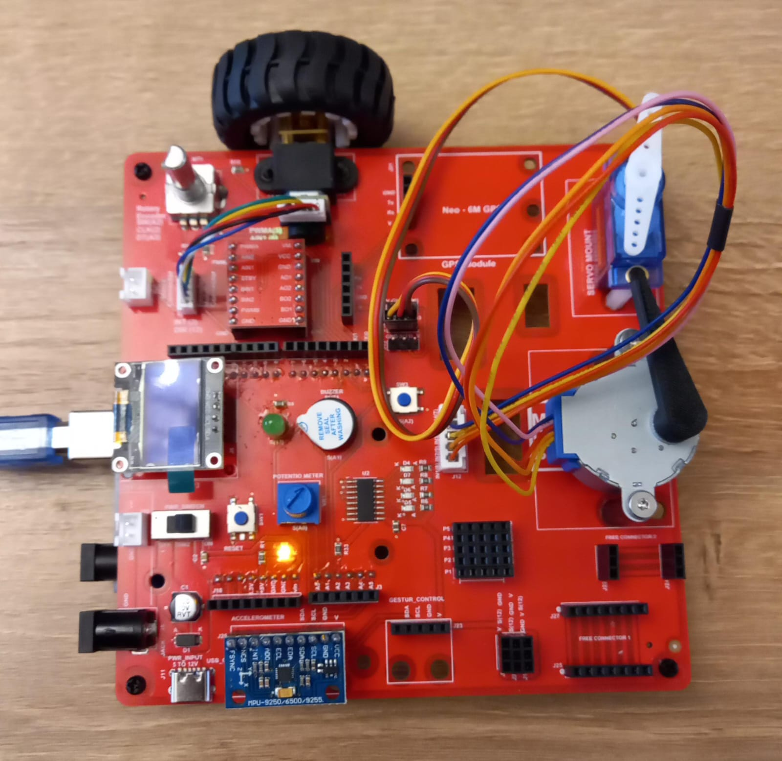
MFL10 : Target Ticks with Encoder Motor
Execute the code in the motion creative board
Code for Lesson MFL10 (MFL10_Enocder_Motor_Target_Ticks.ino):
https://github.com/info-zas/zas-robotics-motion/tree/main/01_FoundationProjects/MFL10_Enocder_Motor_Target_Ticks/MFL10_Enocder_Motor_Target_Ticks

Slide 6
MFL10 : Encoder Motor (RPM) Speed Measurement
PPR (Pulses Per Revolution) of N20 motor in the kit is 7
RPM = (Pulses per second × 60) ÷ Pulses per revolution
Encoder Speed Measurement (RPM) with OLED
setup()
Initialize encoder pins
Initialize Serial communication
Initialize OLED display
Attach interrupt to encoder INT pin
loop()
Count encoder pulses for 1 second
Calculate RPM
Display RPM and direction on Serial Monitor
Display RPM and direction on OLED
Repeat continuously
interrupt routine
Increment pulse count on every encoder pulse
Code for Lesson MFL10 (MFL10_Enocder_Motor_RPM.ino):
https://github.com/info-zas/zas-robotics-motion/tree/main/01_FoundationProjects/MFL10_Enocder_Motor_Target_Ticks/MFL10_Enocder_Motor_RPM

