Slide 1
Motion Kit (Kit 2)
Motion Foundation Lessons (MFL)
(Lesson Ref: MFL11)
MFL11: Encoder Motor Control with PID

Slide 2



Motion Kit : Contents
Motion Kit Components
Motion Creative Board

Slide 3
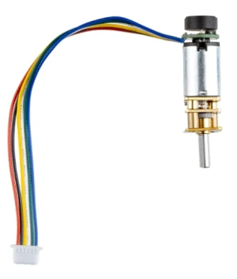
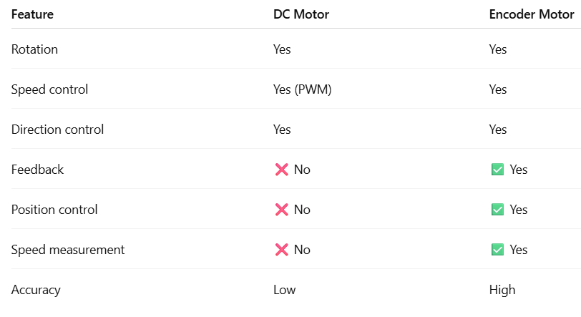
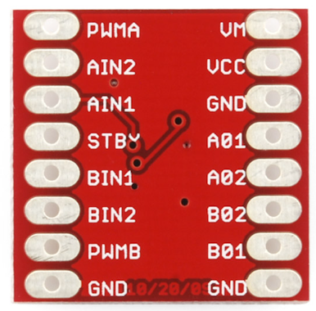
MFL11 : Encoder Motor Control with PID
TB6612, same motor driver as DC motor
DC motor → no feedback
Encoder motor → live pulses + direction

Slide 4
MFL11 : Encoder Motor Control with PID
“Encoders turn motion into data, and data into control.”
Feedback System
A feedback system measures motor output and uses it to correct the motor
In encoder motors:
Encoder measures speed / position
Controller compares actual value with desired value
Motor driver adjusts power automatically
Example: Encoder measures RPM → Arduino adjusts PWM → speed stays constant

Slide 5
MFL11 : Encoder Motor Control with PID
PID Controller
PID is a control method used in closed-loop systems.
P – Proportional
Reacts to current error
If speed is low → increase PWM
I – Integral
Corrects accumulated error over time
Removes long-term speed offset
D – Derivative
Predicts future error
Reduces overshoot and oscillations
Encoder provides feedback, PID decides how strongly to correct the motor.

Slide 6
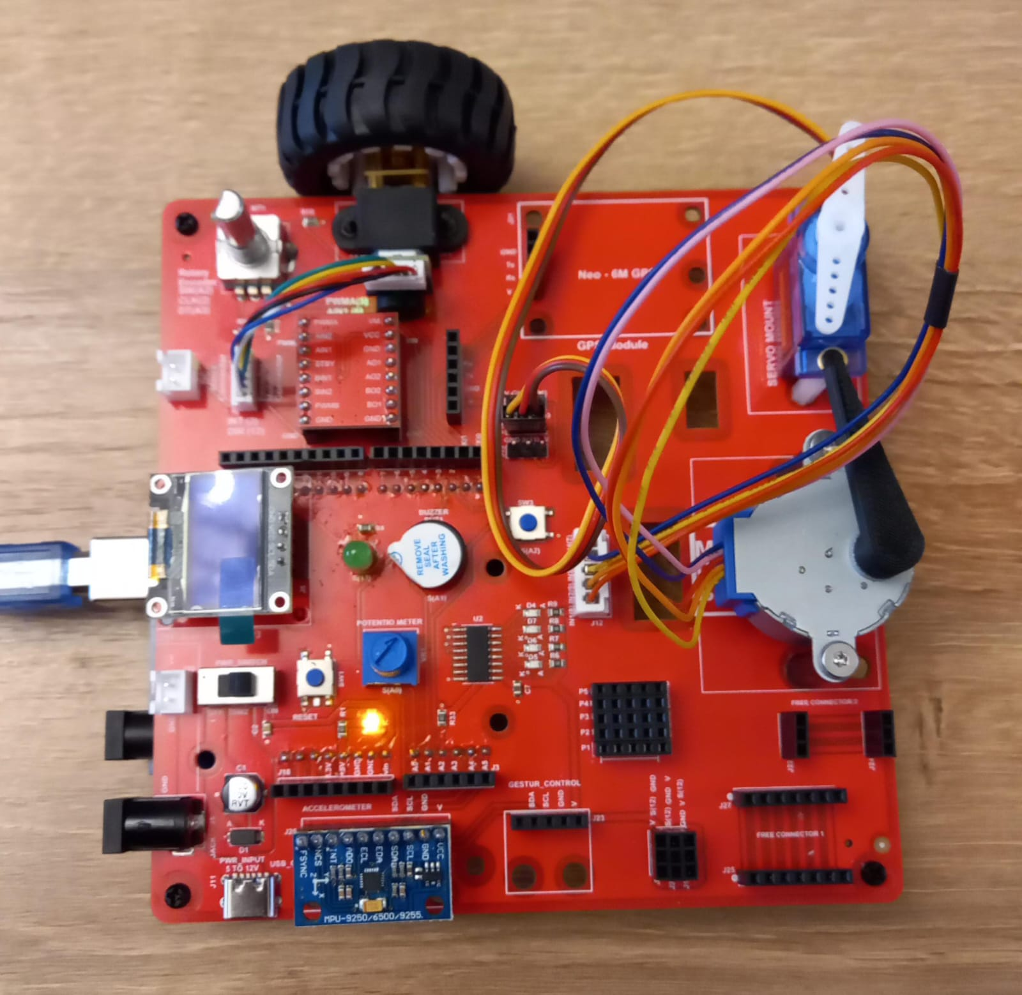
MFL11 : Encoder Motor Control with PID
Execute the code (MFL11.ino) in the motion creative board
setup()
• Set motor driver pins (PWM, AIN1, AIN2) as OUTPUT
• Set ENCA pin as INPUT_PULLUP
• Attach interrupt to ENCA (RISING) to track encoder ticks
• Initialize OLED display at address 0x3C
• Display "PID Start" message on OLED
loop()
• Safely copy encoderTicks using noInterrupts()
• Calculate error = targetTicks – ticks
• If error is within tolerance:
- Stop motor (PWM = 0, AIN1 & AIN2 LOW)
• Else:
- Compute PID terms: proportional, integral, derivative
- Calculate output speed (PWM), constrain between minPWM and maxPWM
- Set direction (CW), apply PWM to motor
- Update previousError and lastTime
• Clear OLED
• Display ticks and error value
• Wait 100 ms
readEncoder()
• Increment encoderTicks every time ENCA rises
https://github.com/info-zas/zas-robotics-motion/tree/main/01_FoundationProjects/MFL11_Encoder_Motor_PID/MFL11_Encoder_Motor_PID

