Slide 1

Motion Kit (Kit 2)
Motion Foundation Lessons (MFL)
(Lesson Ref: MFL12)
MFL12: NeoPixel Strip Control with Rotary Encoder

Slide 2


Motion Kit : Contents
Motion Kit Components
Motion Creative Board

Slide 3
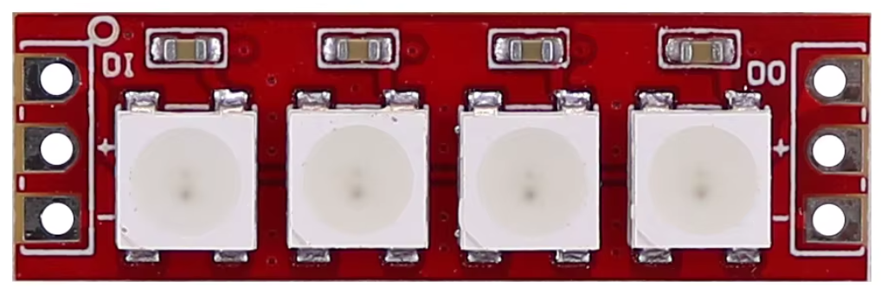
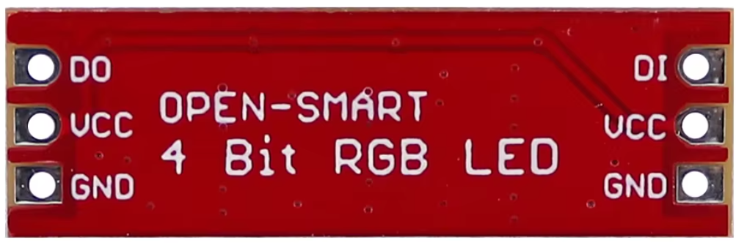
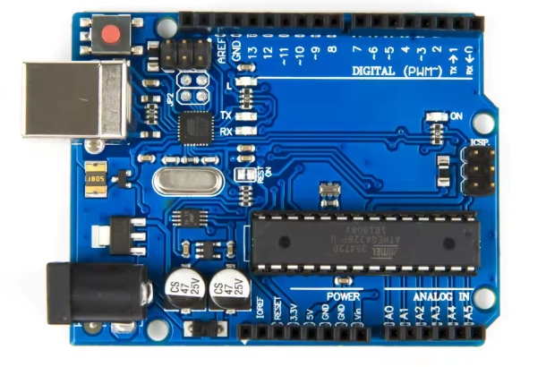
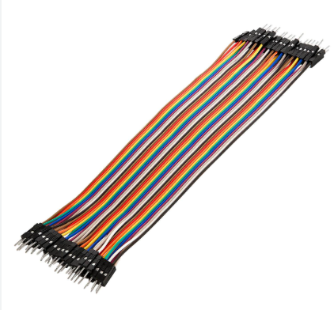
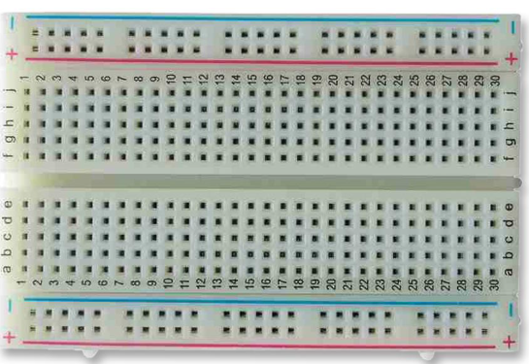
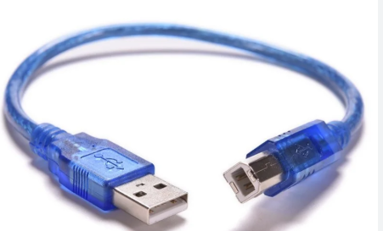
MFL12 : NeoPixel Strip
Things Needed

Slide 4
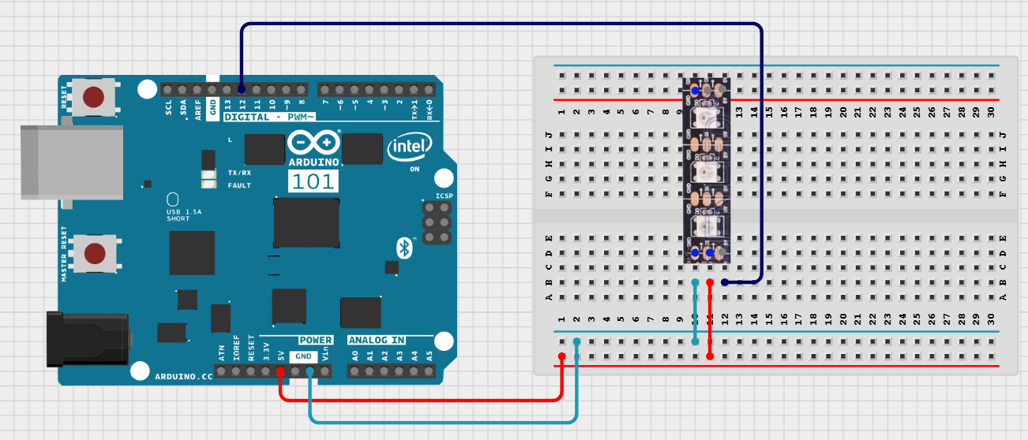
MFL12 : NeoPixel Strip
NeoPixel Strip | Arduino Pin
VCC | 5V
GND | GND
DI | 12

Slide 5
MFL12 : NeoPixel Strip
Code for MFL12 (MFL12_NeoPixel.ino)
https://github.com/info-zas/zas-robotics-motion/tree/main/01_FoundationProjects/MFL12_NeoPixel_Servo_Encoder/MFL12_NeoPixel
Include required library
Adafruit NeoPixel library
Define parameters
Set NeoPixel data pin
Set number of LEDs
setup()
Initialize NeoPixel strip
Set LED brightness
loop()
Turn ON all LEDs in the strip
Set all LEDs to cyan color
Update LEDs continuously

Slide 6
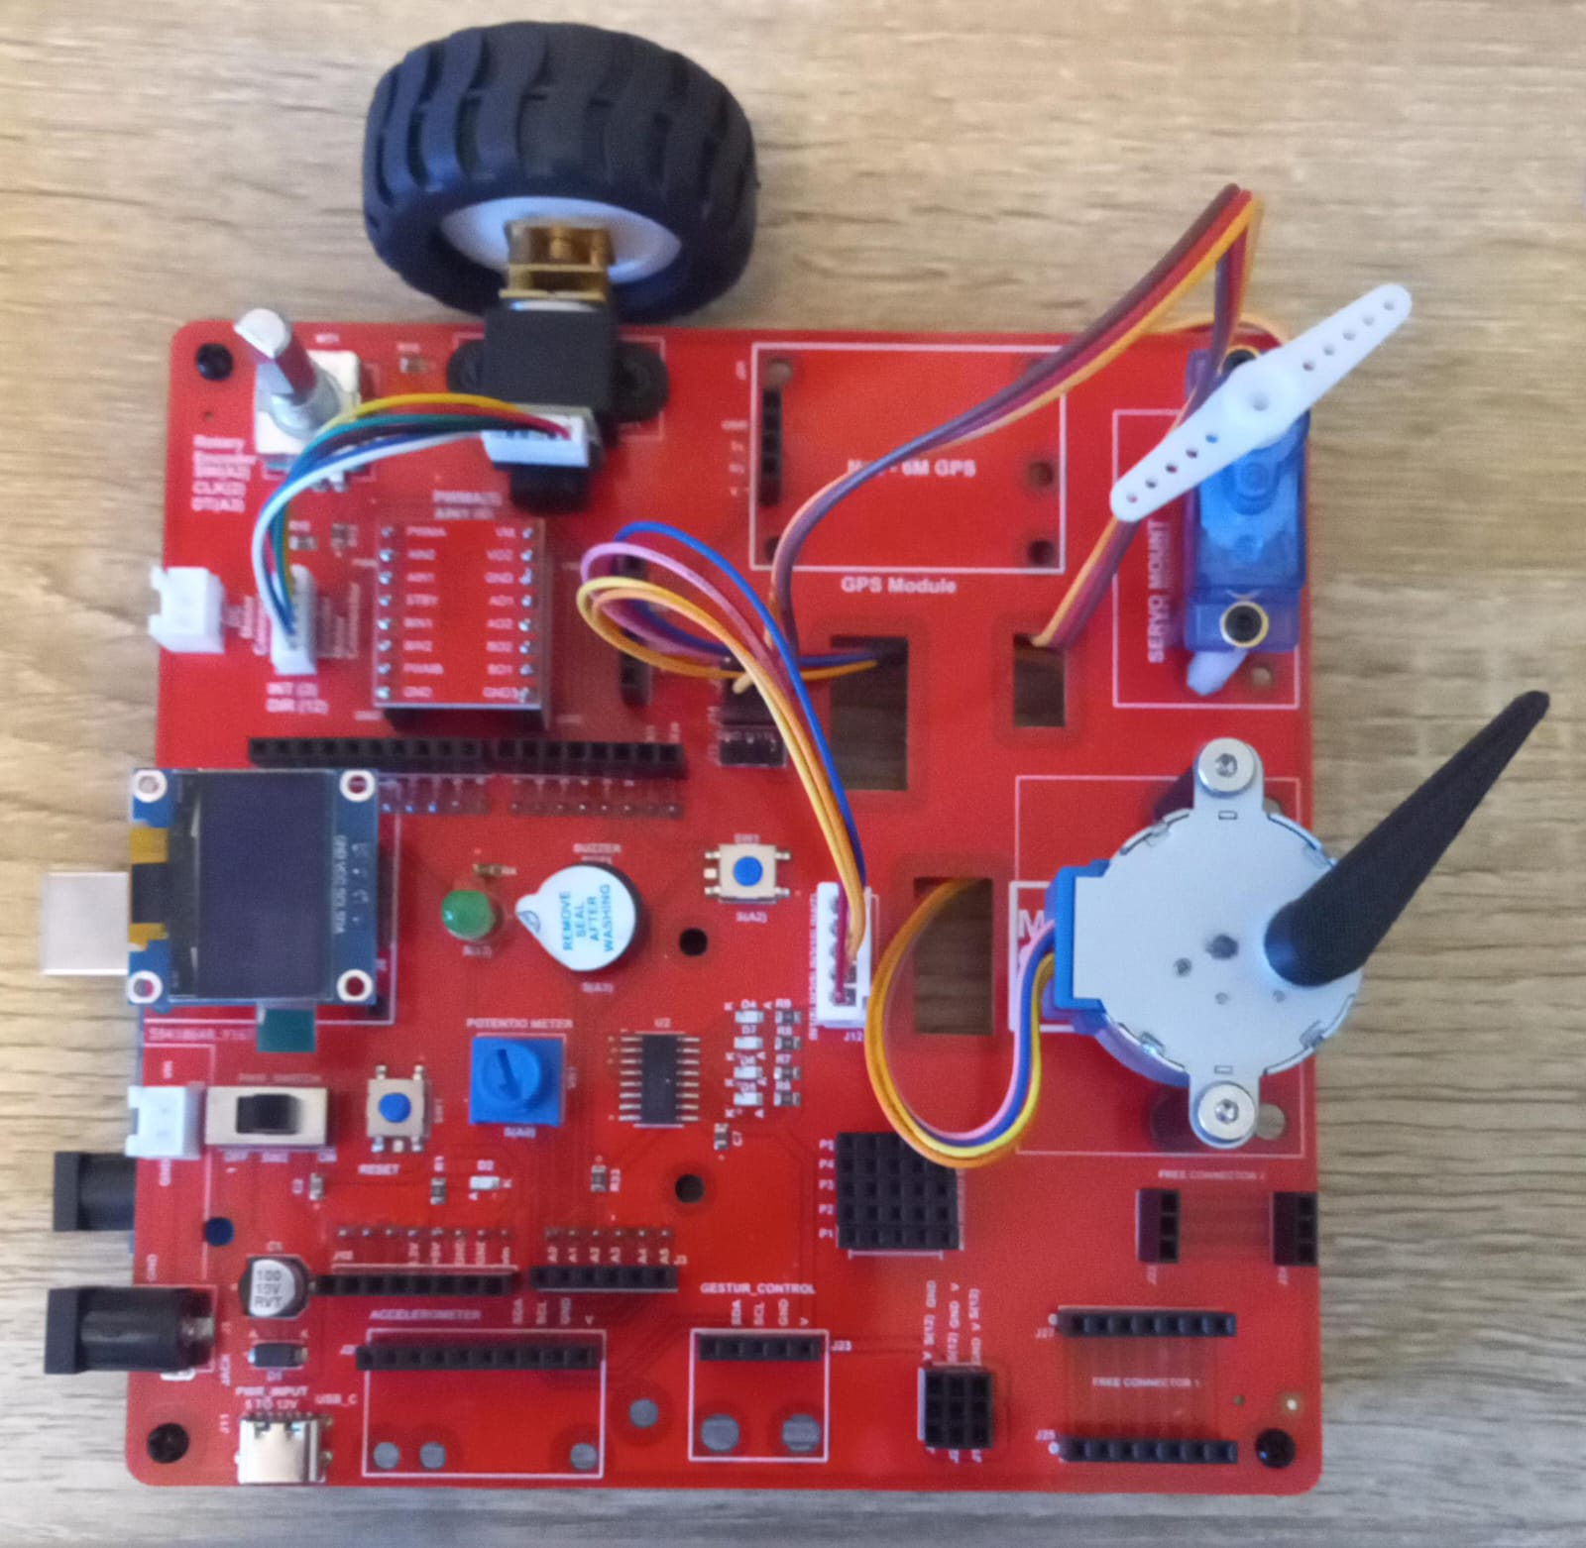
MFL12 : NeoPixel Strip
Execute the same code in the motion creative board
Place the NeoPixel strip in J15.
Code for MFL12 (MFL12_NeoPixel.ino)
https://github.com/info-zas/zas-robotics-motion/tree/main/01_FoundationProjects/MFL12_NeoPixel_Servo_Encoder/MFL12_NeoPixel

Slide 7
MFL12 : NeoPixel Strip Control with Rotary Encoder
Place the NeoPixel strip in J15.
Include required library
Adafruit NeoPixel library
Define pin connections
NeoPixel data pin
Rotary encoder CLK and DT pins
setup()
Initialize NeoPixel strip
Set brightness
Read initial encoder state
loop()
Detect rotary encoder rotation
Change color index based on direction
Update NeoPixel strip color
Repeat continuously
Code for MFL13 (MFL12_NeoPixel_Servo_Encoder.ino):
https://github.com/info-zas/zas-robotics-motion/tree/main/01_FoundationProjects/MFL12_NeoPixel_Servo_Encoder/MFL12_NeoPixel_Servo_Encoder

Slide 8
MFL12_a : NeoPixel Strip Control with Rotary Encoder
Execute the code (MFL12_a.ino) in the motion creative board
Place the NeoPixel strip in J15.
Code for MFL13 (MFL12_a.ino):
https://github.com/info-zas/zas-robotics-motion/blob/main/01_FoundationProjects/MFL12/MFL12_a/MFL12_a.ino

