Slide 1

Motion Kit (Kit 2)
Motion Foundation Lessons (MFL)
(Lesson Ref: MFL13)
MFL13: Introduction to Neo-6M GPS Module

Slide 2


Motion Kit : Contents
Motion Kit Components
Motion Creative Board

Slide 3
MFL13 : NeoPixel Strip Control with Rotary Encoder
Place the NeoPixel strip in J15.
Include required library
Adafruit NeoPixel library
Define pin connections
NeoPixel data pin
Rotary encoder CLK and DT pins
setup()
Initialize NeoPixel strip
Set brightness
Read initial encoder state
loop()
Detect rotary encoder rotation
Change color index based on direction
Update NeoPixel strip color
Repeat continuously

Slide 4
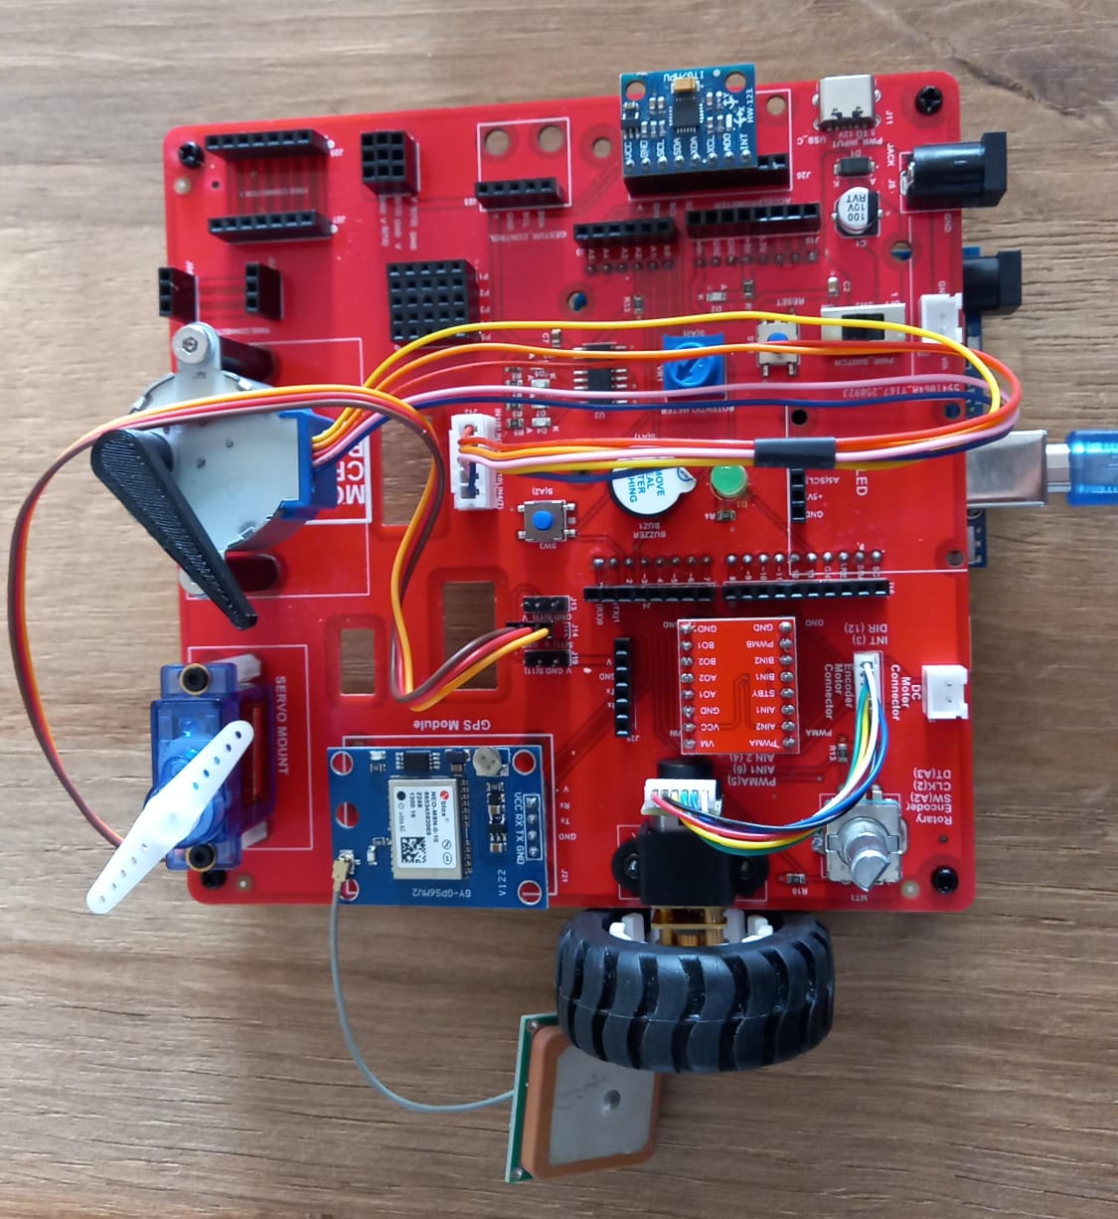
MFL13 : Introduction to Neo-6M GPS
Execute the code (MFL13.ino) in the motion creative board
Place Neo-6M GPS Module in J21.
Note: Make sure the module is not plugged while uploading the code
Code for MFL13 (MFL13_GPS_Module.ino):
https://github.com/info-zas/zas-robotics-motion/tree/main/01_FoundationProjects/MFL13_GPS_Module/MFL13_GPS_Module

