Slide 1

Motion Kit (Kit 2)
Motion Foundation Lessons (MFL)
(Lesson Ref: MFL15)
MFL15: Mini Project: Smart Fan

Slide 2


Motion Kit : Contents
Motion Kit Components
Motion Creative Board

Slide 3
MFL15 : Smart Fan
Include required libraries
Wire, Adafruit GFX, Adafruit SSD1306
Define pin connections
DC motor driver pins (AIN1, AIN2, PWMA)
Ultrasonic trigger and echo pins
MQ135 air quality sensor pin
setup()
Configure motor and sensor pins
Initialize Serial and OLED display
Show startup message
loop()
Read distance and air quality
Control motor based on priority logic
– High pollution → motor CCW
– Obstacle detected → motor CW
– Otherwise → motor stop
Display sensor values on OLED
Repeat continuously
Functions
getDistance(): measure distance using ultrasonic sensor
cw(), ccw(), stopMotor(): control DC motor direction and speed
Place Ultrasonic Sensor Module in J25.
Place MQ-135 Air Quality Sensor in the
Mini Breadboard.
Ultrasonic Sensor Pins | Arduino UNO Pins
VCC | 5V
Trig | 7
Echo | 10
GND | GND
MQ-135 Sensor Pins | Arduino UNO Pins
VCC | 3.3V
A0 | A1
GND | GND
Code for MFL15 (MFL15.ino)

Slide 4
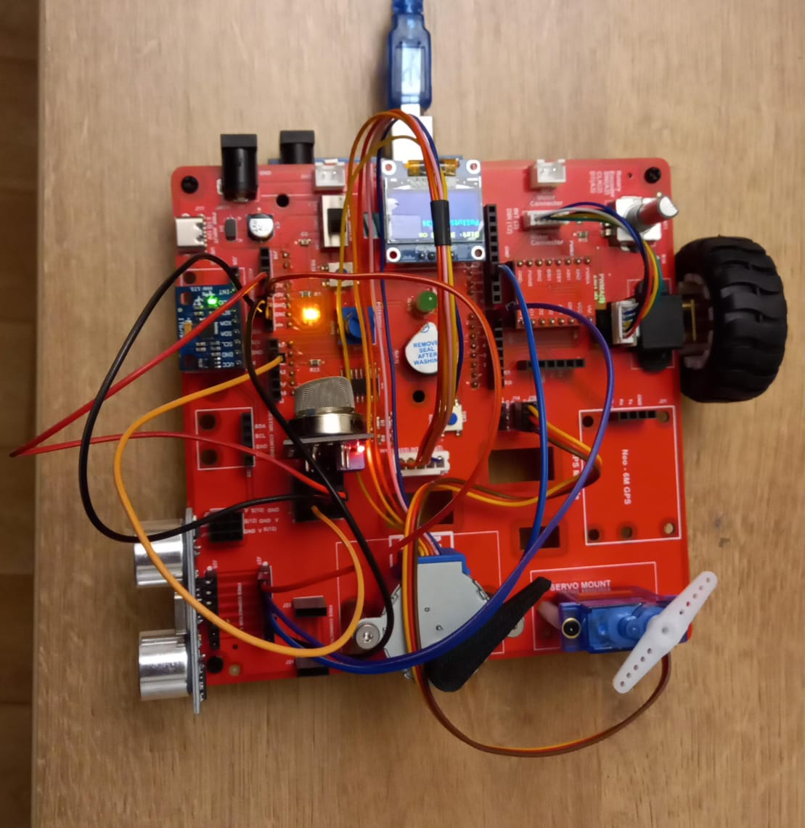
MFL15 : Smart Fan
Execute the code in the motion creative board
Ultrasonic Sensor Pins | Arduino UNO Pins
VCC | 5V
Trig | 7
Echo | 10
GND | GND
MQ-135 Sensor Pins | Arduino UNO Pins
VCC | 3.3V
A0 | A1
GND | GND
Code for MFL15 (MFL15_Smart_Fan.ino):
https://github.com/info-zas/zas-robotics-motion/tree/main/01_FoundationProjects/MFL15_Smart_Fan/MFL15_Smart_Fan

Slide 5
MFL15 : Smart Fan with NeoPixel Strip
Add NeoPixel strip in J15. (In addition to Ultrasonic Sensor and Air Quality Sensor)
Code for MFL15_a (MFL15_Smart_Fan_NeoPixel.ino):
https://github.com/info-zas/zas-robotics-motion/tree/main/01_FoundationProjects/MFL15_Smart_Fan/MFL15_Smart_Fan_NeoPixel

