Slide 1

Motion Kit (Kit 2)
Motion Foundation Lessons (MFL)
(Lesson Ref: MFL14)
MFL14: Free Connector and Mini Bread Board Usage (Ultrasonic and Pollution Sensor)

Slide 2


Motion Kit : Contents
Motion Kit Components
Motion Creative Board

Slide 3
MFL14 : Free Connector: Ultrasonic Sensor
Include required libraries
Wire, Adafruit GFX, Adafruit SSD1306
Define pin connections
Ultrasonic trigger pin
Ultrasonic echo pin
setup()
Configure ultrasonic pins
Initialize Serial
Initialize OLED display
loop()
Measure distance
Display distance on OLED
Print distance to Serial
Repeat continuously
getDistance()
Trigger ultrasonic sensor
Read echo duration
Convert to distance (cm)
Return value
Place Ultrasonic Sensor Module in J25.
Code for MFL14 (MFL14.ino):

Slide 4
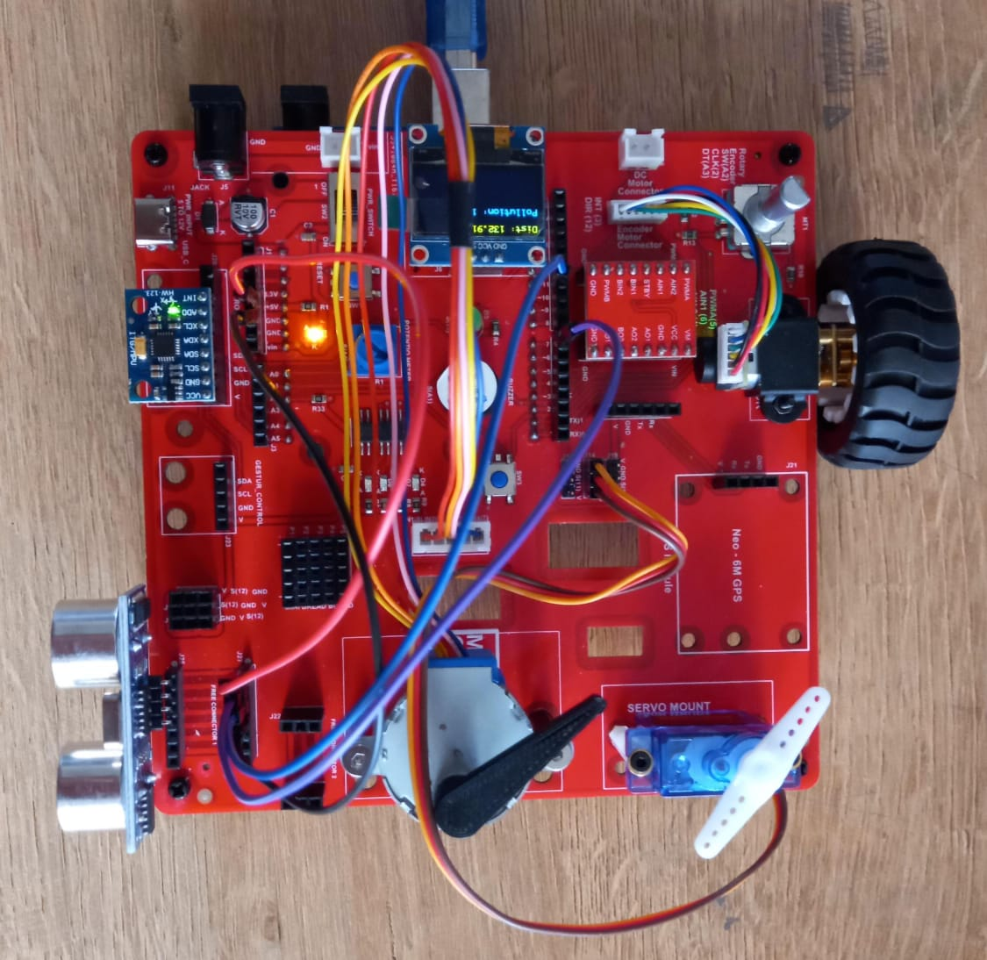
MFL14 : Free Connector: Ultrasonic Sensor
Execute the code (MFL14.ino) in the motion creative board
Ultrasonic Sensor Pins | Arduino UNO Pins
VCC | 5V
Trig | 7
Echo | 11
GND | GND
Code for MFL14 (MFL14.ino):
https://github.com/info-zas/zas-robotics-motion/blob/main/01_FoundationProjects/MFL14/MFL14/MFL14.ino

Slide 5
MFL14_a : Mini Breadboard: MQ-135 Sensor
Include required libraries
Wire, Adafruit GFX, Adafruit SSD1306
Define pin connections
Ultrasonic trigger and echo pins
MQ135 air quality sensor pin
setup()
Configure sensor pins
Initialize Serial communication
Initialize OLED display
loop()
Read distance from ultrasonic sensor
Read air quality value from MQ135
Print sensor values to Serial Monitor
Display distance and pollution values on OLED
Repeat continuously
getDistance()
Trigger ultrasonic sensor
Measure echo duration
Convert duration to distance (cm)
Return distance value
Place MQ-135 Air Quality Sensor in the Mini Breadboard.

Slide 6
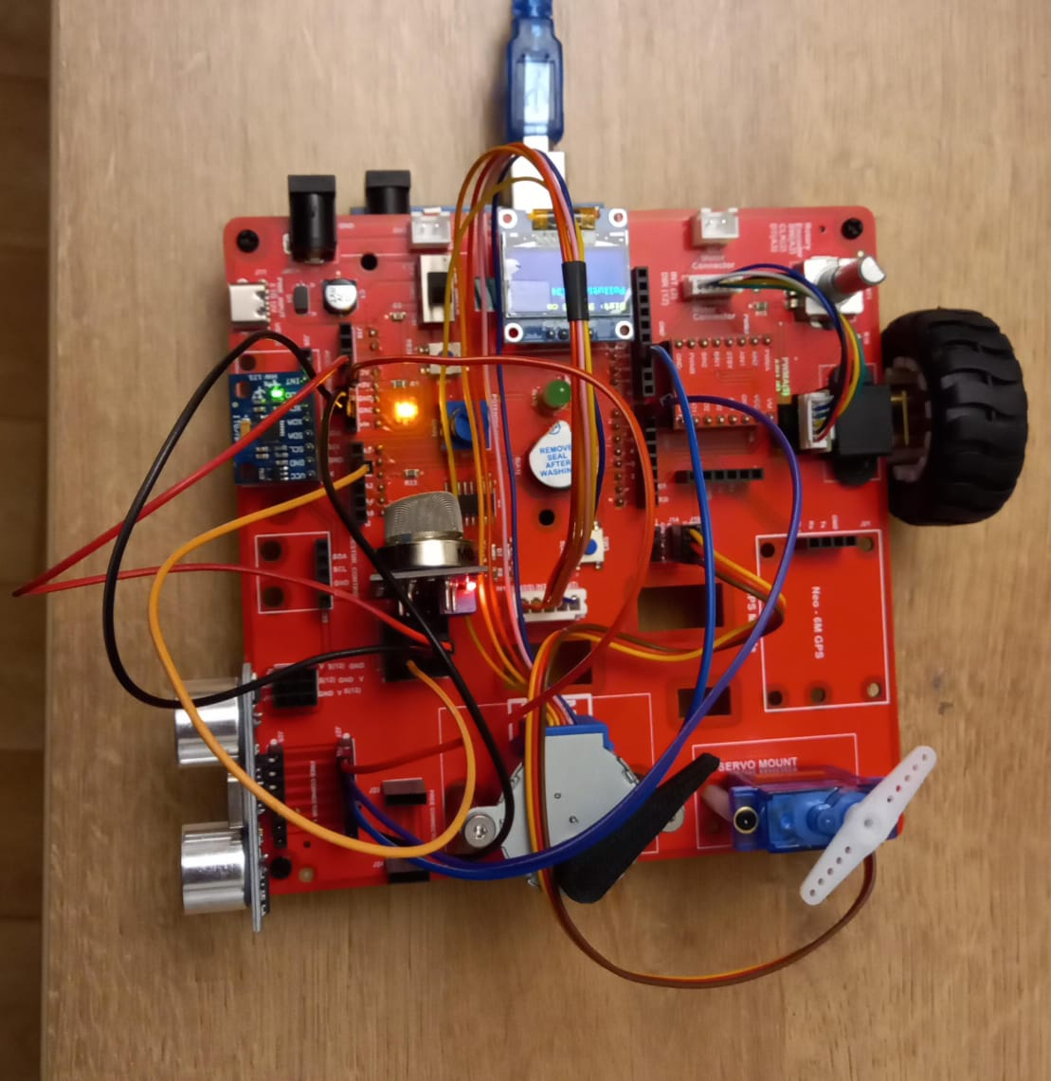
MFL14_a : Mini Breadboard: MQ-135 Sensor
Execute the code (MFL14.ino) in the motion creative board
MQ-135 Sensor Pins | Arduino UNO Pins
VCC | 3.3V
A0 | A1
GND | GND
Code for MFL14_a (MFL14_a.ino):
https://github.com/info-zas/zas-robotics-motion/blob/main/01_FoundationProjects/MFL14/MFL14_a/MFL14_a.ino

