Slide 1

Sensor Kit (Kit 1)
ZAS Robotics Training

Slide 2



Sensor Kit - Contents
Sensor Kit Components
Sensor Creative Board

Slide 3



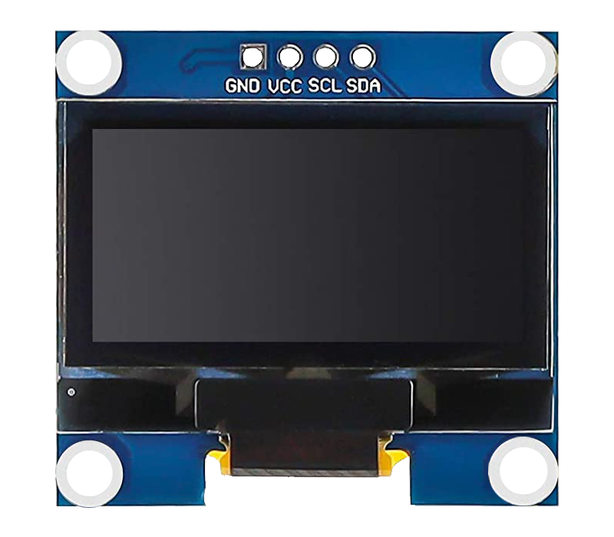

SFL10: OLED DISPLAY
Things Needed

Slide 4
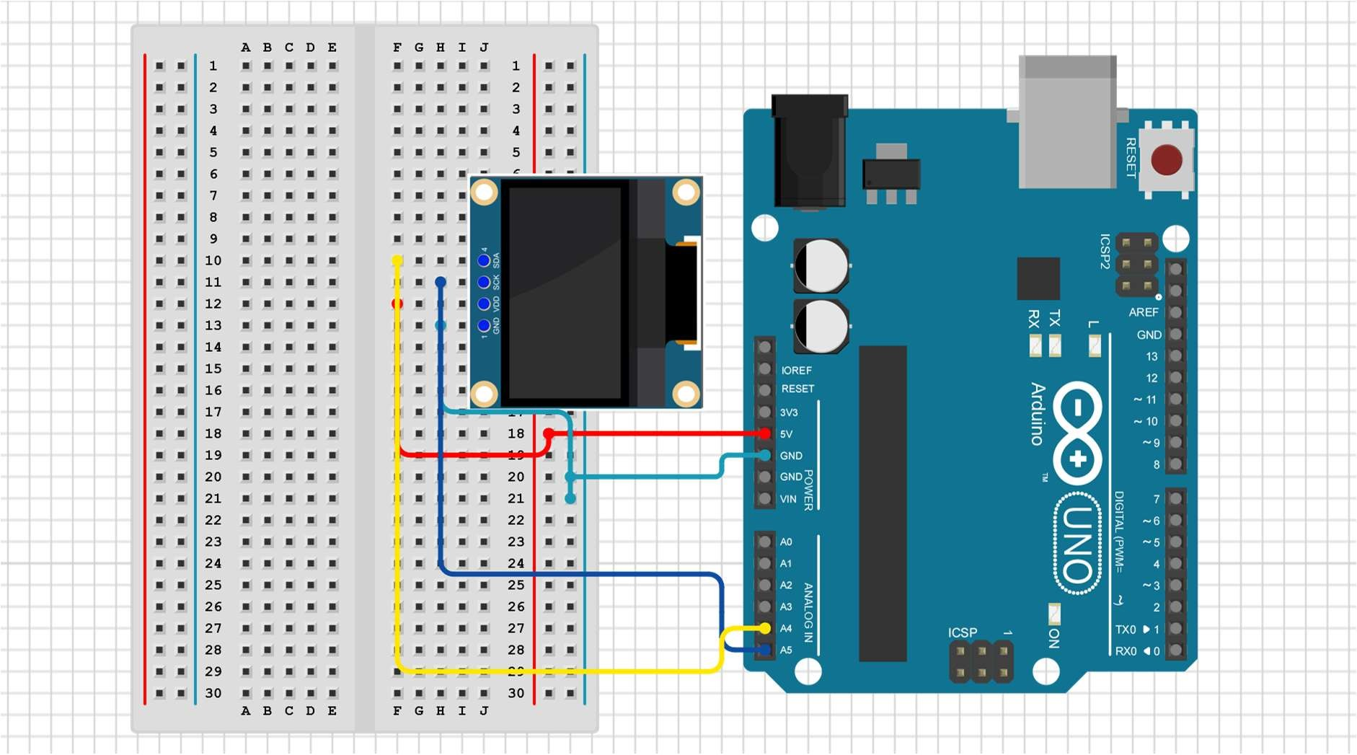
SFL10: OLED DISPLAY
Connections:
Arduino pin | breadboard
GND | GND(light blue)
5V | VCC(red)
A4 | SDA(yellow)
A5 | SCL(blue)

Slide 5
SFL10: OLED DISPLAY
Define OLED library
Setup()
SDA to analog A4 pin
SCL to analog A5 pin
Loop()
Print hello!
Code for Lesson SFL10:

Slide 6
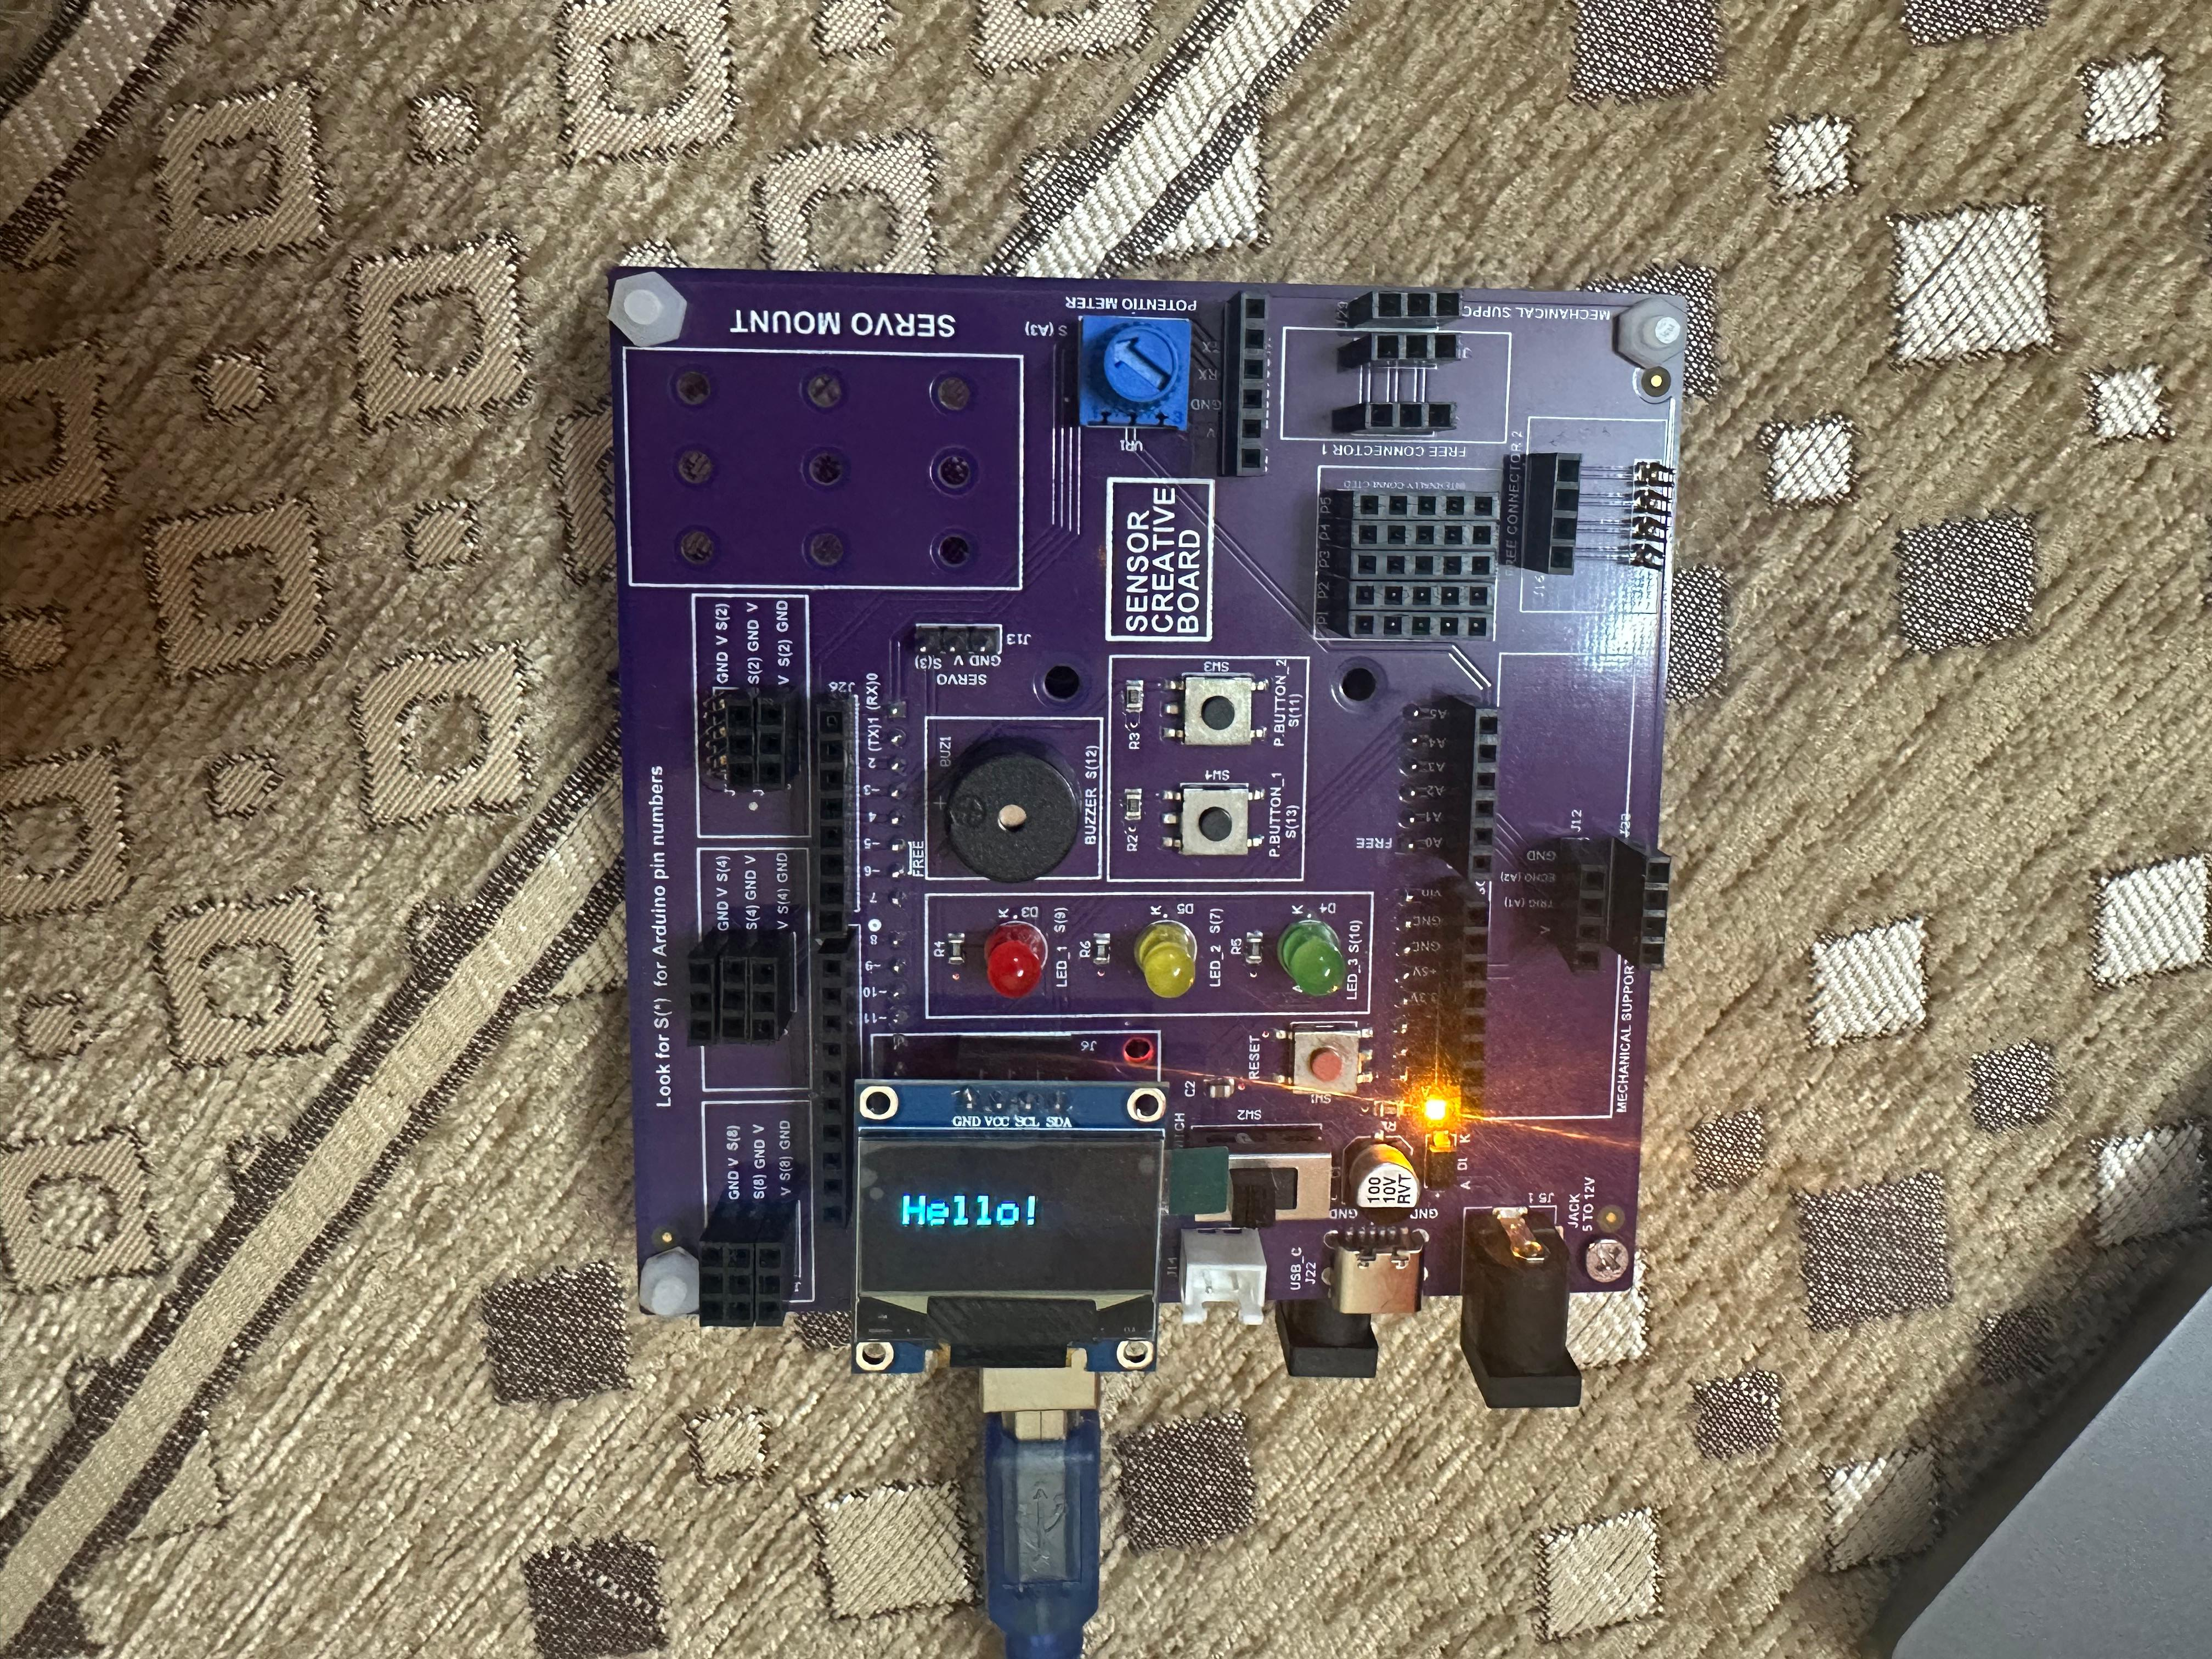
SFL10: OLED DISPLAY

